Slide 1
Embedding length
Token id：0
Vector 0
Token id：1
Vector 1
Dictionary size
.
.
.
Token id：d
Vector d

Slide 2
Embedding length
Vector 0
1
Vector 1
12
0
Input length
Dictionary size
.
.
.
d
5
Vector d
Token id

Slide 3
Embedding length
1
Vector 0
12
Word Embedding
Vector 1
0
Input length
Vector d
Input length
d
Vector d
5
Vector d
Token id

Slide 4
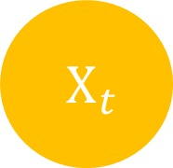


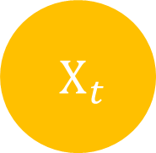
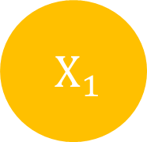

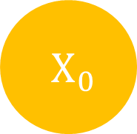

$H_{t}$
$H_{0}$
$H_{1}$
$H_{t}$
$X_{t}$
$X_{0}$
$X_{1}$
$X_{t}$

Slide 5
Output
Encoders
Decoders
Positional Encoding
Positional Encoding
Embedding
Embedding
Input
Target

Slide 6
Encoder
Decoder
Encoder
Decoder
Encoder
Decoder

