Slide 1






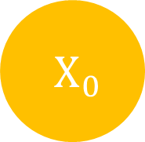

$H_{t}$
$H_{0}$
$H_{1}$
$H_{t}$
$X_{t}$
$X_{0}$
$X_{1}$
$X_{t}$

Slide 2
Output
Encoders
Decoders
Positional Encoding
Positional Encoding
Embedding
Embedding
Input
Target

Slide 3
Encoder
Decoder
Encoder
Decoder
Encoder
Decoder

