Slide 1
Dictionary size
1
Vector[i]=1 if i==1 else 0
12
One Hot Encoding
Vector[i]=1 if i==12 else 0
0
Input length
Vector[i]=1 if i==0 else 0
Input length
d
Vector[i]=1 if i==d else 0
5
Vector[i]=1 if i==5 else 0
Symbol id

Slide 2
Embedding length
Symbol id：0
Vector 0
Symbol id：1
Vector 1
.
.
.
Dictionary size
Symbol id：d
Vector d

Slide 3
Embedding length
1
Vector 0
12
Vector 1
0
Input length
.
.
.
Dictionary size
d
5
Symbol id
Vector d

Slide 4
Embedding length
1
Vector 1
12
Word Embedding
Vector 12
0
Input length
Vector 0
Input length
d
Vector d
5
Vector 5
Symbol id

Slide 5
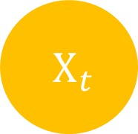


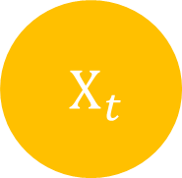
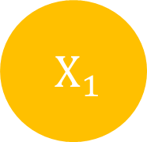
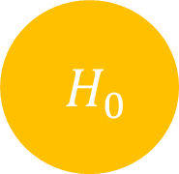
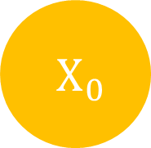

$H_{t}$
$H_{0}$
$H_{1}$
$H_{t}$
$X_{t}$
$X_{0}$
$X_{1}$
$X_{t}$

Slide 6
Input length
Input
Target length
Output
Target
Target length

Slide 7
Input
Output
Target
Target’
Target length
+1

Slide 8
Output
Linear
& Sotfmax
Encoders
Decoders
Positional Encoding
Positional Encoding
Embedding
Embedding
Input
Target

Slide 9
Output
Linear
& Sotfmax
Encoders
Decoders
Positional Encoding
Positional Encoding
Embedding
Embedding
Input
Target

Slide 10
Output
Linear
& Sotfmax
Encoders
Decoders
Positional Encoding
Positional Encoding
Embedding
Embedding
Input
Target

Slide 11
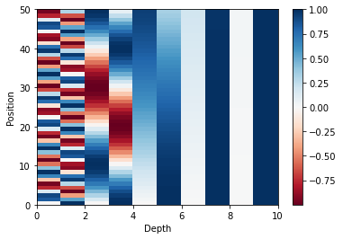
Position
Depth

Slide 12
Output
Linear
& Sotfmax
Encoders
Decoders
Positional Encoding
Positional Encoding
Embedding
Embedding
Input
Target

Slide 13
Encoder
Decoder
Encoder
Decoder
Encoder
Decoder

Slide 14
Output
Linear
& Sotfmax
Encoders
Decoders
Positional Encoding
Positional Encoding
Embedding
Embedding
Input
Target

Slide 15
In
Out
LayerNorm
V
K
Q
Mutil Head Attention
+
+
Feed Forward
LayerNorm

Slide 16
Output
Linear
& Sotfmax
Encoders
Decoders
Positional Encoding
Positional Encoding
Embedding
Embedding
Input
Target

Slide 17
In
Out
LayerNorm
V
K
Q
Masked Mutil Head Attention
+
Feed Forward
+
LayerNorm
LayerNorm
+
Q
Mutil Head Attention
Encoder
K
V

Slide 18
Output
Linear
& Sotfmax
Encoders
Decoders
Positional Encoding
Positional Encoding
Embedding
Embedding
Input
Target

Slide 19


Scaled
Dot-Product Attention
$V_{input}=K_{input}$
Linear
V
Linear
K
$Q_{input}$
Linear
Q

Slide 20
Embedding length
depth
Symbol length
Linear
Symbol length

Slide 21


K depth
K depth
K length
Q length
$×$
$=$
Q length
K length
Q
K
QK

Slide 22





K length
K length
Q length
Q length
$$=$$
$$($$
$$)$$
$$Softmax$$
$\frac{ }{\sqrt{K depth} }$
Attention
Weight

Slide 23


-1e30
Q length
Q length
Q length
$+$
$=$
Q length
Q length
Q length
QK
Masking
QK
Masking

Slide 24


K length
V depth
V depth
Q length
$×$
$=$
K length
Q length
Attention
Weight
V

Slide 25

Embedding length
Multi-Head Attention Output
Q length
V depth $×$ Head number
Q length
Linear

Slide 26
Scaled Dot-Product Attention
Scaled Dot-Product Attention
Scaled Dot-Product Attention
Linear
Linear
Linear
Linear
Linear
Linear
Linear
Linear
Linear
V
K
Q

