Slide 1
Dictionary size
1
Vector[i]=1 if i==1 else 0
12
One Hot Encoding
Vector[i]=1 if i==12 else 0
0
Input length
Vector[i]=1 if i==0 else 0
Input length
d
Vector[i]=1 if i==d else 0
5
Vector[i]=1 if i==5 else 0
Symbol id

Slide 2
Embedding length
Symbol id：0
Vector 0
Symbol id：1
Vector 1
.
.
.
Dictionary size
Symbol id：d
Vector d

Slide 3
Embedding length
1
Vector 0
12
Vector 1
0
Input length
.
.
.
Dictionary size
d
5
Symbol id
Vector d

Slide 4
Embedding length
1
Vector 1
12
Word Embedding
Vector 12
0
Input length
Vector 0
Input length
d
Vector d
5
Vector 5
Symbol id

Slide 5
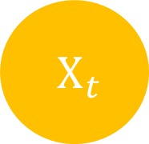

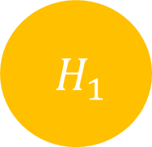
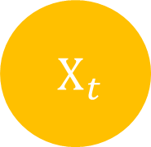
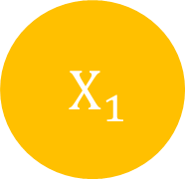
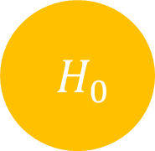
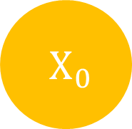

$H_{t}$
$H_{0}$
$H_{1}$
$H_{t}$
$X_{t}$
$X_{0}$
$X_{1}$
$X_{t}$

Slide 6
Input length
Input
Target length
Output
Target
Target length

Slide 7
Input
Output
Target
Target’
Target length
+1

Slide 8
Output
Linear
& Sotfmax
Encoders
Decoders
Positional Encoding
Positional Encoding
Embedding
Embedding
Input
Target

Slide 9
Output
Linear
& Sotfmax
Encoders
Decoders
Positional Encoding
Positional Encoding
Embedding
Embedding
Input
Target

Slide 10
Output
Linear
& Sotfmax
Encoders
Decoders
Positional Encoding
Positional Encoding
Embedding
Embedding
Input
Target

Slide 11
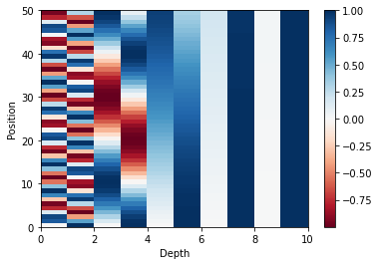
Position
Depth

Slide 12
Output
Linear
& Sotfmax
Encoders
Decoders
Positional Encoding
Positional Encoding
Embedding
Embedding
Input
Target

Slide 13
Encoder
Decoder
Encoder
Decoder
Encoder
Decoder

Slide 14
Encoder
Decoder
Encoder
Decoder
Encoder
Decoder

Slide 15
In
Out
LayerNorm
V
K
Q
Mutil Head Attention
+
+
Feed Forward
LayerNorm

Slide 16
Encoder
Decoder
Encoder
Decoder
Encoder
Decoder

Slide 17
In
Out
LayerNorm
V
K
Q
Masked Mutil Head Attention
+
Feed Forward
+
LayerNorm
LayerNorm
+
Q
Mutil Head Attention
Encoder
K
V

Slide 18
Output
Linear
& Sotfmax
Encoders
Decoders
Positional Encoding
Positional Encoding
Embedding
Embedding
Input
Target

Slide 19


Scaled
Dot-Product Attention
$V_{input}=K_{input}$
Linear
V
Linear
K
$Q_{input}$
Linear
Q

Slide 20
Embedding length
depth
Symbol length
Linear
Symbol length

Slide 21


K depth
K depth
K length
Q length
$×$
$=$
Q length
K length
Q
K
QK

Slide 22





K length
K length
Q length
Q length
$$=$$
$$($$
$$)$$
$$Softmax$$
$\frac{ }{\sqrt{K depth} }$
Attention
Weight

Slide 23


-1e30
Q length
Q length
Q length
$+$
$=$
Q length
Q length
Q length
QK
Masking
QK
Masking

Slide 24


K length
V depth
V depth
Q length
$×$
$=$
K length
Q length
Attention
Weight
V

Slide 25

Embedding length
Multi-Head Attention Output
Q length
V depth $×$ Head number
Q length
Linear

Slide 26
Scaled Dot-Product Attention
Scaled Dot-Product Attention
Scaled Dot-Product Attention
Linear
Linear
Linear
Linear
Linear
Linear
Linear
Linear
Linear
V
K
Q

