Slide 1
Dictionary size
1
Vector[i]=1 if i==1 else 0
12
One Hot Encoding
Vector[i]=1 if i==12 else 0
0
Input length
Vector[i]=1 if i==0 else 0
Input length
d
Vector[i]=1 if i==d else 0
5
Vector[i]=1 if i==5 else 0
Symbol id

Slide 2
Embedding length
Symbol id：0
Vector 0
Symbol id：1
Vector 1
Dictionary size
.
.
.
Symbol id：d
Vector d

Slide 3
Embedding length
Vector 0
1
Vector 1
12
0
Input length
Dictionary size
.
.
.
d
5
Vector d
Symbol id

Slide 4
Embedding length
1
Vector 1
12
Word Embedding
Vector 12
0
Input length
Vector 0
Input length
d
Vector d
5
Vector 5
Symbol id

Slide 5
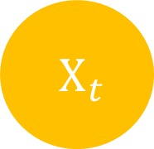


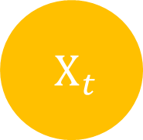
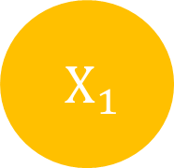
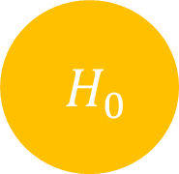
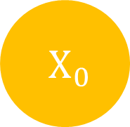

$H_{t}$
$H_{0}$
$H_{1}$
$H_{t}$
$X_{t}$
$X_{0}$
$X_{1}$
$X_{t}$

Slide 6
Input length
Input
Target length
Output
Target
Target length

Slide 7
Input
Output
Target
Target’
Target length
+1

Slide 8
Output
Encoders
Decoders
Positional Encoding
Positional Encoding
Embedding
Embedding
Input
Target

Slide 9
Output
Encoders
Decoders
Positional Encoding
Positional Encoding
Embedding
Embedding
Input
Target

Slide 10
Output
Encoders
Decoders
Positional Encoding
Positional Encoding
Embedding
Embedding
Input
Target

Slide 11
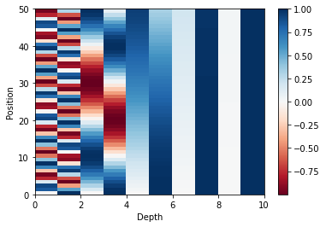
Position
Depth

Slide 12
Output
Encoders
Decoders
Positional Encoding
Positional Encoding
Embedding
Embedding
Input
Target

Slide 13
Encoder
Decoder
Encoder
Decoder
Encoder
Decoder

Slide 14
Encoder
Decoder
Encoder
Decoder
Encoder
Decoder

Slide 15
Output
Encoders
Decoders
Positional Encoding
Positional Encoding
Embedding
Embedding
Input
Target

Slide 16
Output
Encoders
Decoders
Positional Encoding
Positional Encoding
Embedding
Embedding
Input
Target

Slide 17


Scaled
Dot-Product Attention
$V_{input}=K_{input}$
Linear
V
Linear
K
$Q_{input}$
Linear
Q

Slide 18
Embedding length
depth
Symbol length
Linear
Symbol length

Slide 19


K depth
K length
K depth
$×$
$=$
Q length
Q length
K length
Q
K
QK

Slide 20





K length
K length
Q length
Q length
$$=$$
$$($$
$$)$$
$$Softmax$$
$\frac{ }{\sqrt{K depth} }$
Attention
Weight

Slide 21


-1e30
Q length
Q length
Q length
$+$
$=$
Q length
Q length
Q length
Masking
QK
QK
Masking

Slide 22


K length
V depth
V depth
Q length
$×$
$=$
K length
Q length
Attention
Weight
V

Slide 23

Embedding length
Multi-Head Attention Output
Q length
V depth $×$ Head number
Q length
Linear

Slide 24
Scaled Dot-Product Attention
Scaled Dot-Product Attention
Scaled Dot-Product Attention
Linear
Linear
Linear
Linear
Linear
Linear
Linear
Linear
Linear
V
K
Q

