Slide 1
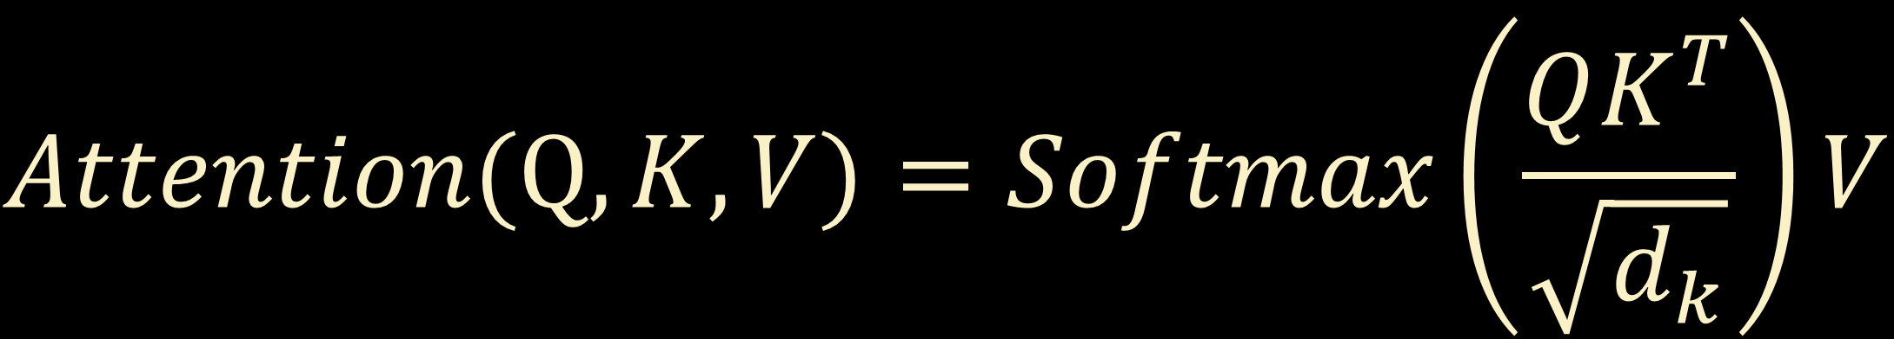
$$Attention(Q,K,V)=Softmax\left(\frac{QK^{T}}{\sqrt{d_{k}}}\right)V$$

Slide 2
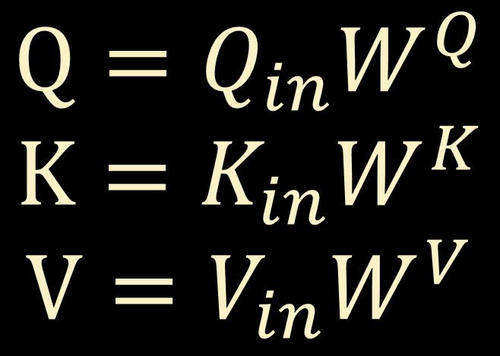
$$Q=Q_{in}W^{Q}$$
$$K=K_{in}W^{K}$$
$$V=V_{in}W^{V}$$

