Slide 1
Dictionary size
1
[0, 1, 0, 0, 0, 0, 0, 0,...]
7
One Hot Encoding
[0, 0, 0, 0, 0, 0, 0, 1,...]
0
Input length
[1, 0, 0, 0, 0, 0, 0, 0,...]
Input length
3
[0, 0, 0, 1, 0, 0, 0, 0,...]
5
[0, 0, 0, 0, 0, 1, 0, 0,...]
Symbol id

Slide 2
Embedding length
Symbol id：0
Vector 0
Symbol id：1
Vector 1
.
.
.
Dictionary size
Symbol id：d
Vector d

Slide 3
Embedding length
1
Vector 0
12
Vector 1
0
Input length
.
.
.
Dictionary size
d
5
Symbol id
Vector d

Slide 4
Embedding length
1
Vector 1
12
Word Embedding
Vector 12
0
Input length
Vector 0
Input length
d
Vector d
5
Vector 5
Symbol id

Slide 5
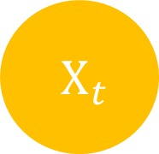


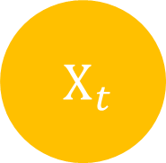
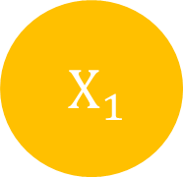
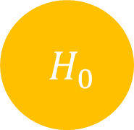
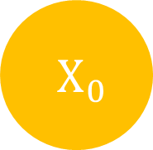

$H_{t}$
$H_{0}$
$H_{1}$
$H_{t}$
$X_{t}$
$X_{0}$
$X_{1}$
$X_{t}$

Slide 6
Input length
Input
Target length
Output
Target
Target length

Slide 7
Input
Output
Target
Target’
Target length
+1

Slide 8


Embedding length
Embedding length
注意力
Attention
就是
is
你
all
Q length
K length
所
you
需要
need
的
$$V_{input}、K_{input}$$
$$Q_{input}$$

Slide 9
Output
Linear
& Sotfmax
Encoders
Decoders
Positional Encoding
Positional Encoding
Embedding
Embedding
Input
Target

Slide 10
Output
Linear
& Sotfmax
Encoders
Decoders
Positional Encoding
Positional Encoding
Embedding
Embedding
Input
Target

Slide 11
Output
Linear
& Sotfmax
Encoders
Decoders
Positional Encoding
Positional Encoding
Embedding
Embedding
Input
Target

Slide 12
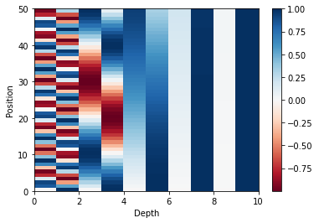
Position
Depth

Slide 13
Output
Linear
& Sotfmax
Encoders
Decoders
Positional Encoding
Positional Encoding
Embedding
Embedding
Input
Target

Slide 14
Encoder
Decoder
Encoder
Decoder
Encoder
Decoder

Slide 15
Encoder
Decoder
Encoder
Decoder
Encoder
Decoder

Slide 16
In
Out
LayerNorm
V_{in}
K_{in}
Q_{in}
Multi Head Attention
+
+
Feed Forward
LayerNorm

Slide 17
In
Out
LayerNorm
V_{in}
K_{in}
Q_{in}
Multi Head Attention
+
+
Feed Forward
LayerNorm

Slide 18
Out
Linear
Concat
Scaled Dot-Product Attention
Vin
Scaled Dot-Product Attention
Linear
V
Scaled Dot-Product Attention
Linear
V
Linear
V
Kin
Linear
K
Linear
K
Linear
K
Linear
Q
Qin
Linear
Q
Linear
Q

Slide 19
Embedding length
depth
Symbol length
Linear
Symbol length

Slide 20


K depth
K depth
Input length
Input length
$×$
$=$
Input length
Input length
Q
T
QK
K

Slide 21





Input length
Input length
Input length
Input length
$$=$$
$$($$
$$)$$
$$Softmax$$
$\frac{ }{\sqrt{K depth} }$
Attention
Weight

Slide 22


Input length
V depth
V depth
Input length
$×$
$=$
Input length
Input length
Attention
Weight
V

Slide 23

Embedding length
Multi-Head Attention Output
Input length
V depth $×$ Head number
Input length
Linear

Slide 24
In
Out
LayerNorm
V_{in}
K_{in}
Q_{in}
Multi Head Attention
+
+
Feed Forward
LayerNorm

Slide 25
Encoder
Decoder
Encoder
Decoder
Encoder
Decoder

Slide 26
In
Out
LayerNorm
V_{in}
K_{in}
Q_{in}
Masked Multi Head Attention
+
Feed Forward
+
LayerNorm
LayerNorm
+
Q_{in}
Multi Head Attention
Encoder
K_{in}
V_{in}

Slide 27
In
Out
LayerNorm
V_{in}
K_{in}
Q_{in}
Masked Multi Head Attention
+
Feed Forward
+
LayerNorm
LayerNorm
+
Q_{in}
Multi Head Attention
Encoder
K_{in}
V_{in}

Slide 28
In
Out
LayerNorm
V_{in}
K_{in}
Q_{in}
Masked Multi Head Attention
+
Feed Forward
+
LayerNorm
LayerNorm
+
Q_{in}
Multi Head Attention
Encoder
K_{in}
V_{in}

Slide 29


-1e30
Target length
Target length
Target length
Target length
$+$
Target length
$=$
Target length
QK
Masking
QK
Masking

Slide 30
Target length
Target length
Target length
$$=$$
Target length
$$($$
$$)$$
$$Softmax$$
$\frac{ }{\sqrt{K depth} }$
Attention
Weight

Slide 31


K depth
K depth
Input length
Target length
$×$
Target length
$=$
Input length
Q
T
QK
K

Slide 32
Input length
Input length
Target length
Target length
$$=$$
$$($$
$$)$$
$$Softmax$$
$\frac{ }{\sqrt{K depth} }$
Attention
Weight

Slide 33


Input length
V depth
V depth
Target length
Input length
Target length
$×$
$=$
Attention
Weight
V

Slide 34
Embedding length
Multi-Head Attention Output
Target length
V depth $×$ Head number
Target length
Linear

Slide 35
Output
Linear
& Sotfmax
Encoders
Decoders
Positional Encoding
Positional Encoding
Embedding
Embedding
Input
Target

Slide 36
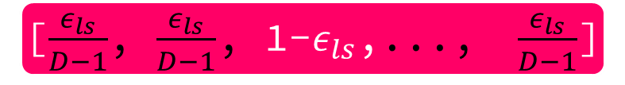
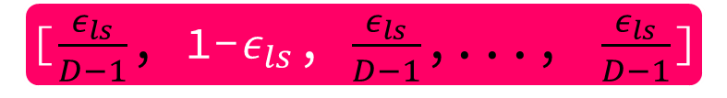
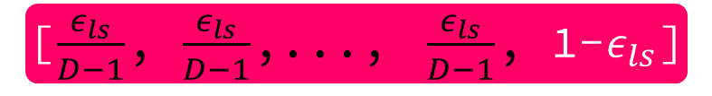
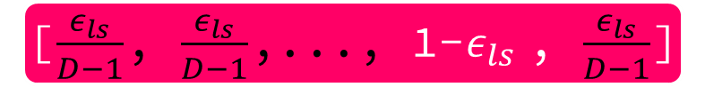
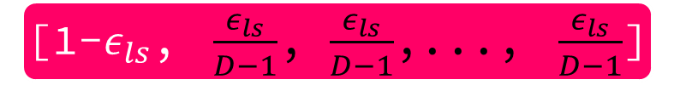
Dictionary size = D
Dictionary size = D
[0, 1, 0,..., 0]
[$\frac{ε_{ls}}{D−1}$, 1-$ε_{ls}$, $\frac{ε_{ls}}{D−1}$,..., $\frac{ε_{ls}}{D−1}$]
[0, 0, 1,..., 0]
Label Smoothing
[$\frac{ε_{ls}}{D−1}$, $\frac{ε_{ls}}{D−1}$, 1-$ε_{ls}$,..., $\frac{ε_{ls}}{D−1}$]
[1, 0, 0,..., 0]
[1-$ε_{ls}$, $\frac{ε_{ls}}{D−1}$, $\frac{ε_{ls}}{D−1}$,..., $\frac{ε_{ls}}{D−1}$]
[0, 0,..., 1, 0]
[$\frac{ε_{ls}}{D−1}$, $\frac{ε_{ls}}{D−1}$,..., 1-$ε_{ls}$ , $\frac{ε_{ls}}{D−1}$]
[0, 0,..., 0, 1]
[$\frac{ε_{ls}}{D−1}$, $\frac{ε_{ls}}{D−1}$,..., $\frac{ε_{ls}}{D−1}$, 1-$ε_{ls}$]

Slide 37
 | N | d_{model} | d_{ff} | h | d_{k} | d_{v} | P_{drop} | ϵ_{ls} | train steps | PPL (dev) | BLEU (dev) | params$×$10⁶
base | 6 | 512 | 2048 | 8 | 64 | 64 | 0.1 | 0.1 | 100K | 4.92 | 25.8 | 65

Slide 38
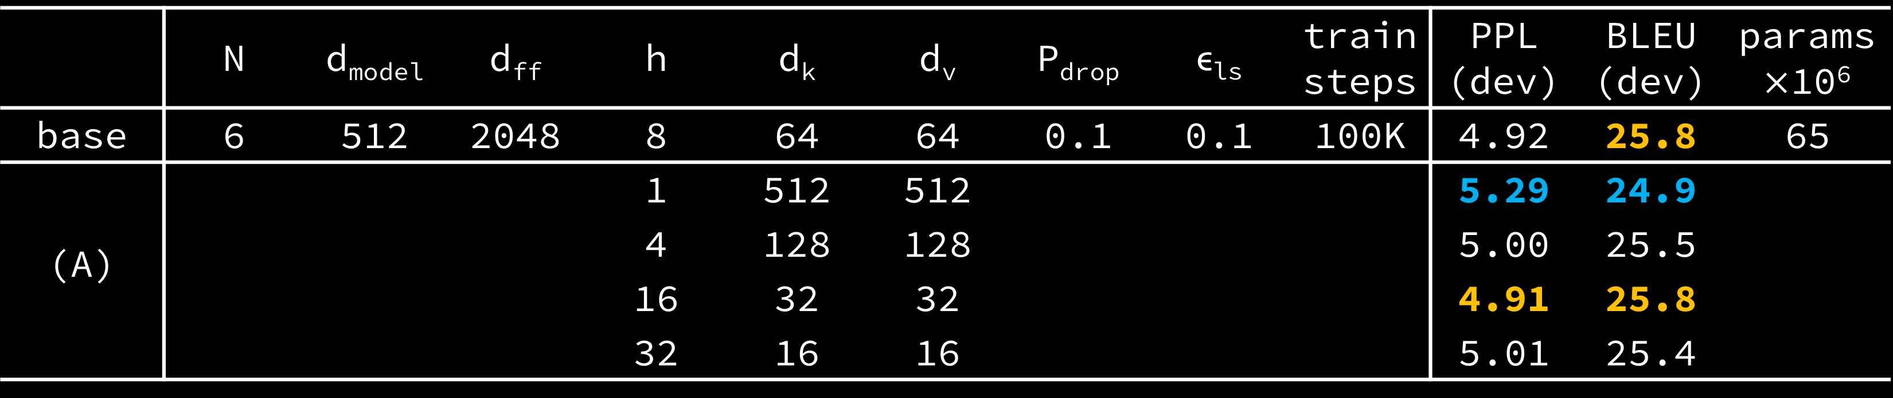
 | N | d_{model} | d_{ff} | h | d_{k} | d_{v} | P_{drop} | ϵ_{ls} | train steps | PPL (dev) | BLEU (dev) | params$×$10⁶
base | 6 | 512 | 2048 | 8 | 64 | 64 | 0.1 | 0.1 | 100K | 4.92 | 25.8 | 65
(A) |  |  |  | 1 | 512 | 512 |  |  |  | 5.29 | 24.9
 |  |  |  | 4 | 128 | 128 |  |  |  | 5.00 | 25.5
 |  |  |  | 16 | 32 | 32 |  |  |  | 4.91 | 25.8
 |  |  |  | 32 | 16 | 16 |  |  |  | 5.01 | 25.4

Slide 39
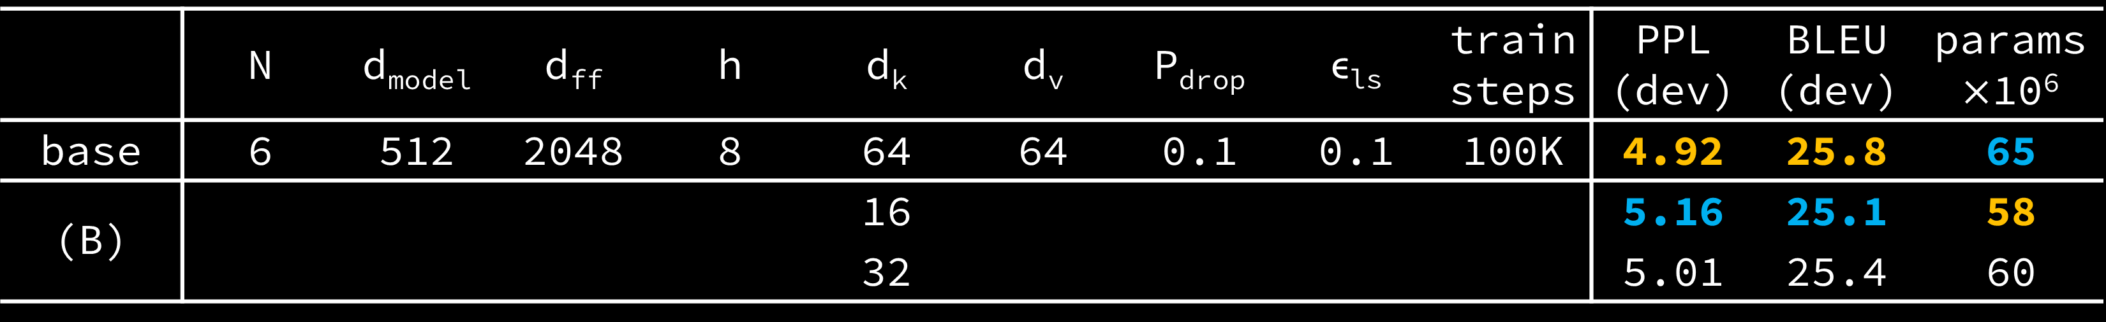
 | N | d_{model} | d_{ff} | h | d_{k} | d_{v} | P_{drop} | ϵ_{ls} | train steps | PPL (dev) | BLEU (dev) | params$×$10⁶
base | 6 | 512 | 2048 | 8 | 64 | 64 | 0.1 | 0.1 | 100K | 4.92 | 25.8 | 65
(B) |  |  |  |  | 16 |  |  |  |  | 5.16 | 25.1 | 58
 |  |  |  |  | 32 |  |  |  |  | 5.01 | 25.4 | 60

Slide 40
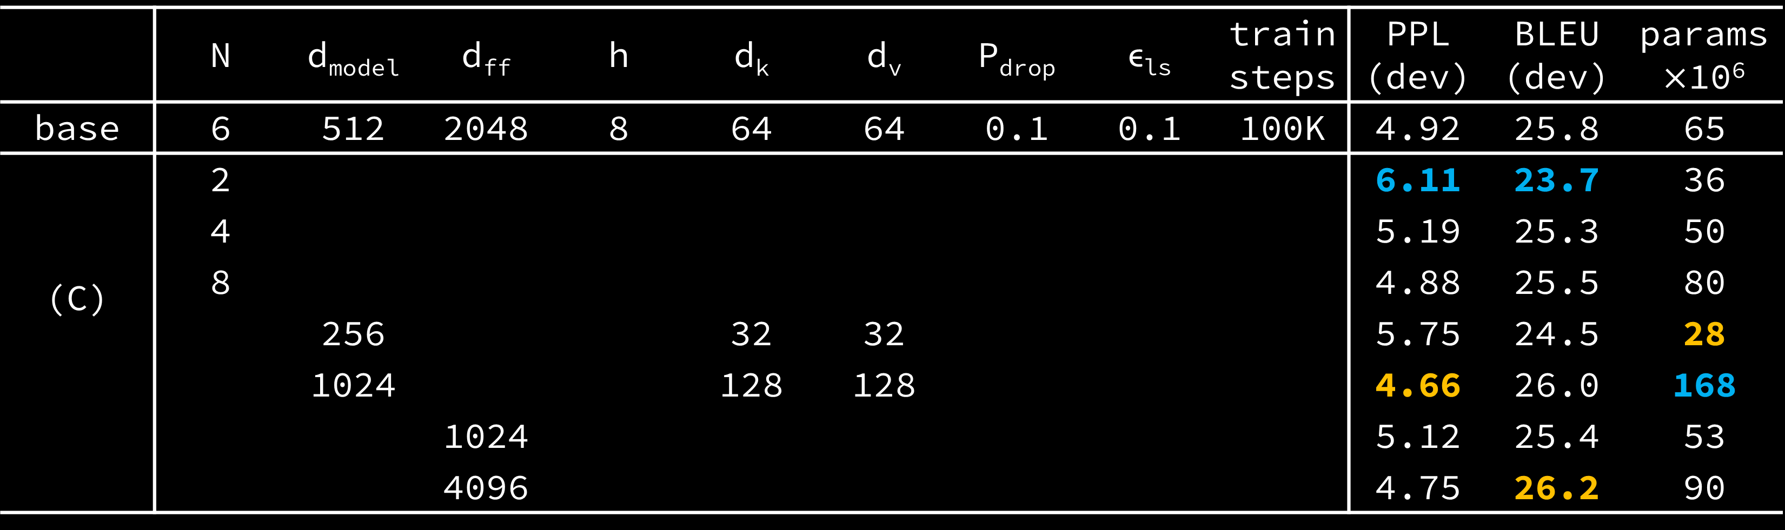
 | N | d_{model} | d_{ff} | h | d_{k} | d_{v} | P_{drop} | ϵ_{ls} | train steps | PPL (dev) | BLEU (dev) | params$×$10⁶
base | 6 | 512 | 2048 | 8 | 64 | 64 | 0.1 | 0.1 | 100K | 4.92 | 25.8 | 65
(C) | 2 |  |  |  |  |  |  |  |  | 6.11 | 23.7 | 36
 | 4 |  |  |  |  |  |  |  |  | 5.19 | 25.3 | 50
 | 8 |  |  |  |  |  |  |  |  | 4.88 | 25.5 | 80
 |  | 256 |  |  | 32 | 32 |  |  |  | 5.75 | 24.5 | 28
 |  | 1024 |  |  | 128 | 128 |  |  |  | 4.66 | 26.0 | 168
 |  |  | 1024 |  |  |  |  |  |  | 5.12 | 25.4 | 53
 |  |  | 4096 |  |  |  |  |  |  | 4.75 | 26.2 | 90

Slide 41
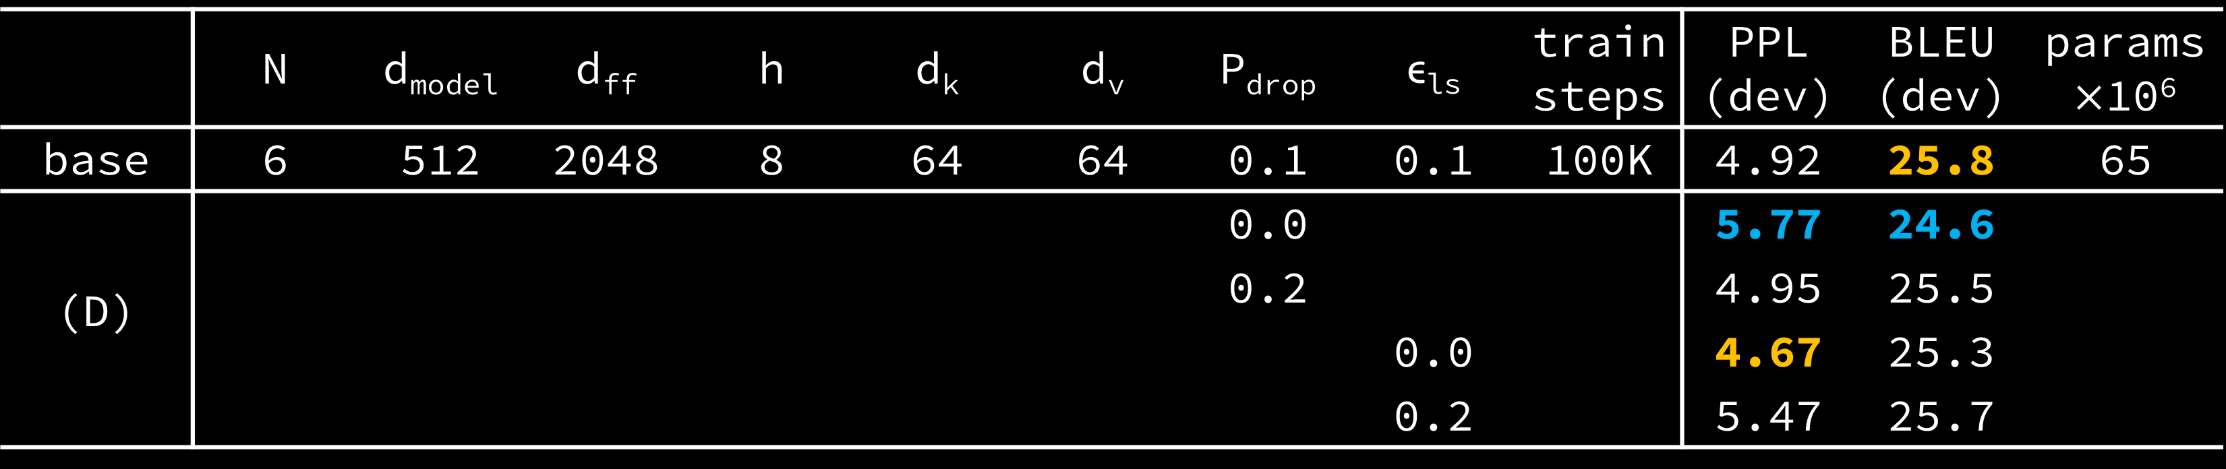
 | N | d_{model} | d_{ff} | h | d_{k} | d_{v} | P_{drop} | ϵ_{ls} | train steps | PPL (dev) | BLEU (dev) | params$×$10⁶
base | 6 | 512 | 2048 | 8 | 64 | 64 | 0.1 | 0.1 | 100K | 4.92 | 25.8 | 65
(D) |  |  |  |  |  |  | 0.0 |  |  | 5.77 | 24.6
 |  |  |  |  |  |  | 0.2 |  |  | 4.95 | 25.5
 |  |  |  |  |  |  |  | 0.0 |  | 4.67 | 25.3
 |  |  |  |  |  |  |  | 0.2 |  | 5.47 | 25.7

Slide 42
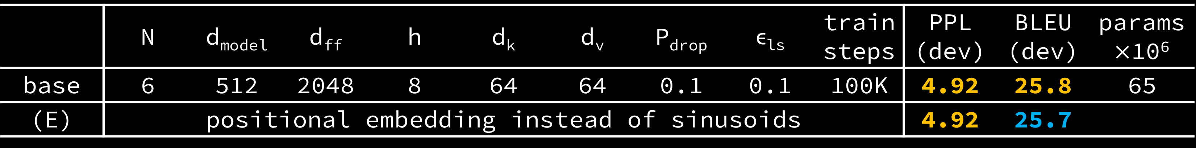
 | N | d_{model} | d_{ff} | h | d_{k} | d_{v} | P_{drop} | ϵ_{ls} | train steps | PPL (dev) | BLEU (dev) | params$×$10⁶
base | 6 | 512 | 2048 | 8 | 64 | 64 | 0.1 | 0.1 | 100K | 4.92 | 25.8 | 65
(E) | positional embedding instead of sinusoids |  |  |  |  |  |  |  |  | 4.92 | 25.7

Slide 43
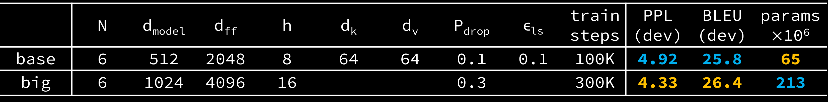
 | N | d_{model} | d_{ff} | h | d_{k} | d_{v} | P_{drop} | ϵ_{ls} | train steps | PPL (dev) | BLEU (dev) | params$×$10⁶
base | 6 | 512 | 2048 | 8 | 64 | 64 | 0.1 | 0.1 | 100K | 4.92 | 25.8 | 65
big | 6 | 1024 | 4096 | 16 |  |  | 0.3 |  | 300K | 4.33 | 26.4 | 213

Slide 44
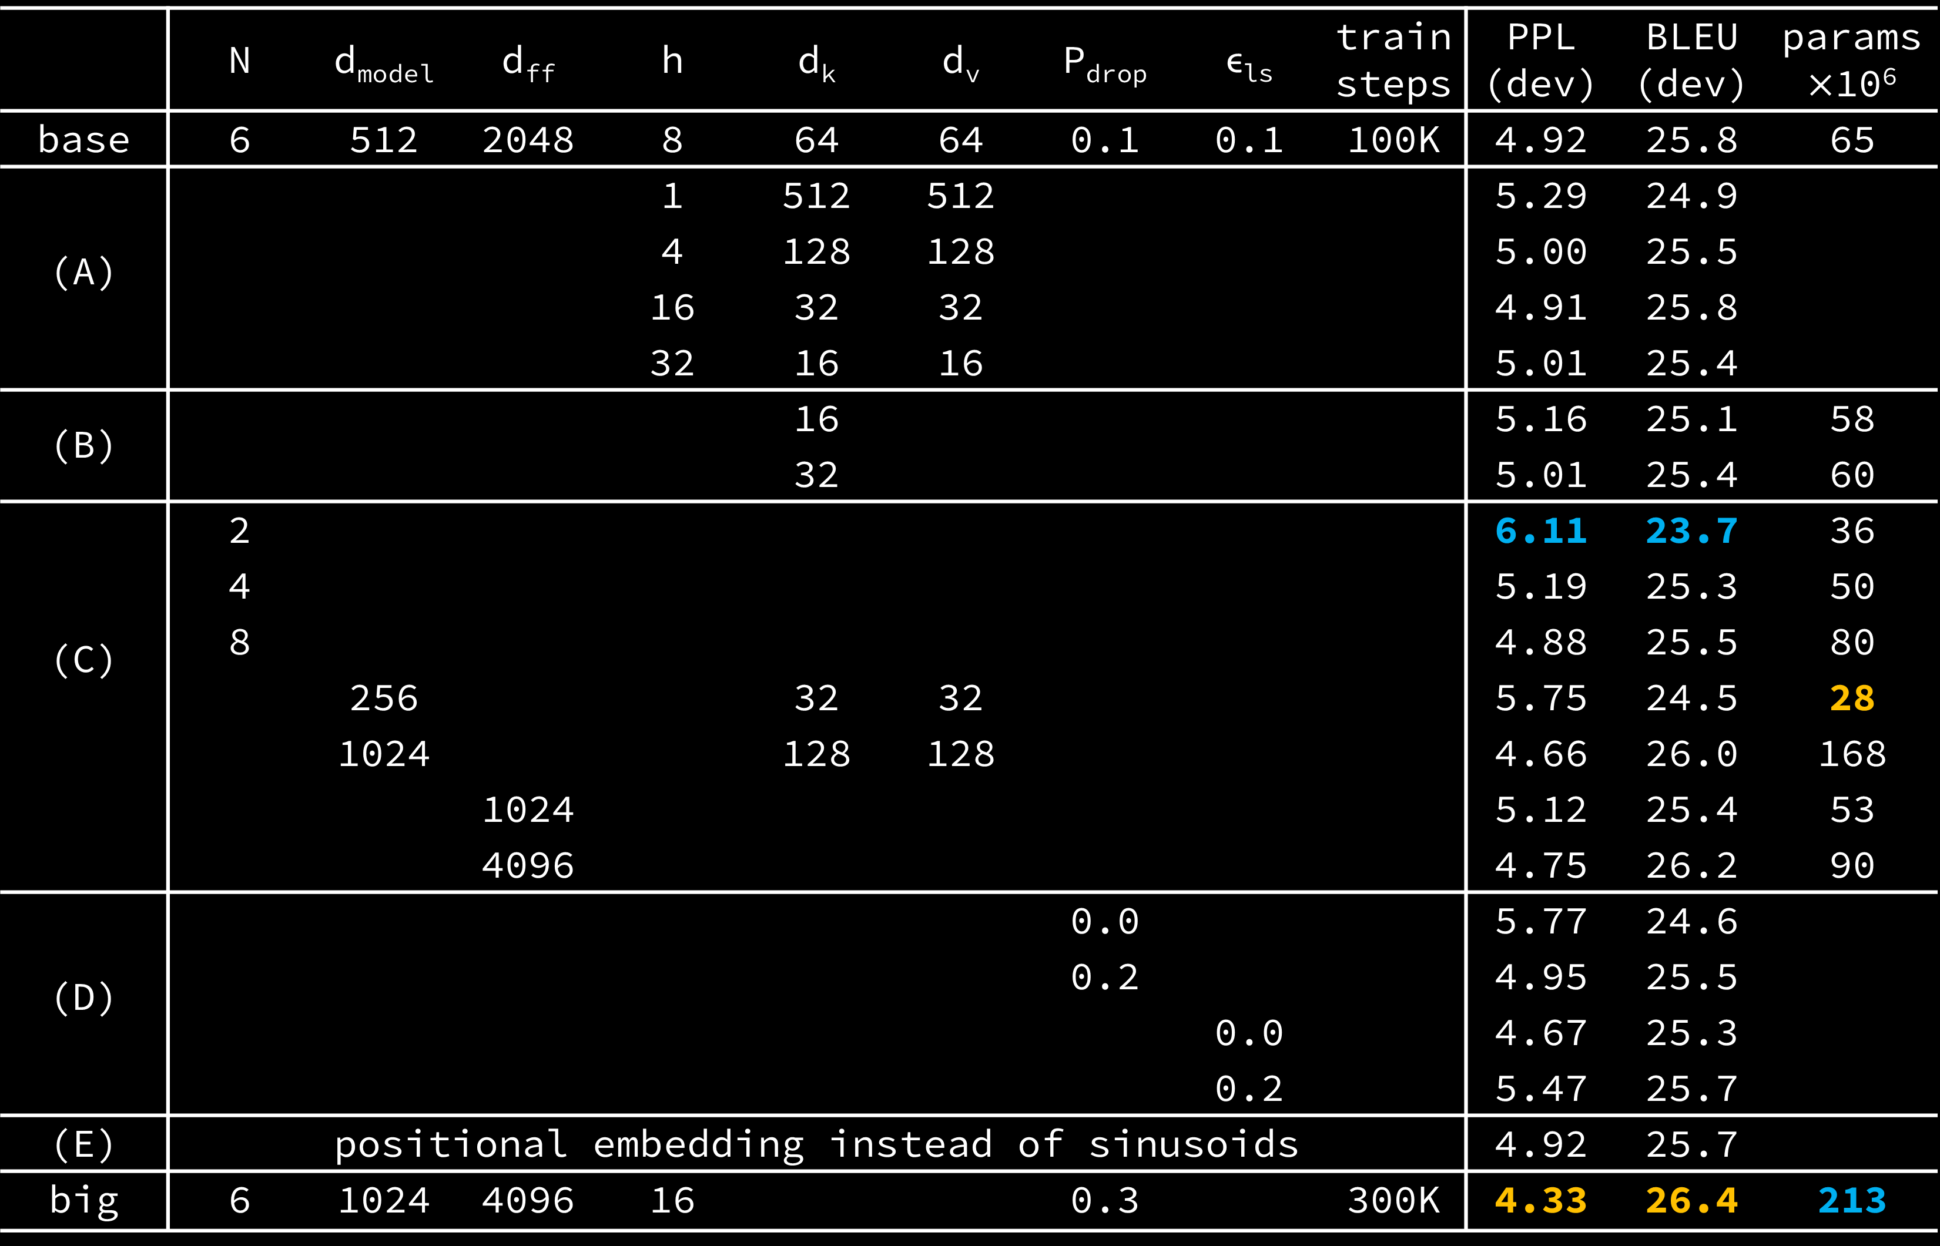
 | N | d_{model} | d_{ff} | h | d_{k} | d_{v} | P_{drop} | ϵ_{ls} | train steps | PPL (dev) | BLEU (dev) | params$×$10⁶
base | 6 | 512 | 2048 | 8 | 64 | 64 | 0.1 | 0.1 | 100K | 4.92 | 25.8 | 65
(A) |  |  |  | 1 | 512 | 512 |  |  |  | 5.29 | 24.9
 |  |  |  | 4 | 128 | 128 |  |  |  | 5.00 | 25.5
 |  |  |  | 16 | 32 | 32 |  |  |  | 4.91 | 25.8
 |  |  |  | 32 | 16 | 16 |  |  |  | 5.01 | 25.4
(B) |  |  |  |  | 16 |  |  |  |  | 5.16 | 25.1 | 58
 |  |  |  |  | 32 |  |  |  |  | 5.01 | 25.4 | 60
(C) | 2 |  |  |  |  |  |  |  |  | 6.11 | 23.7 | 36
 | 4 |  |  |  |  |  |  |  |  | 5.19 | 25.3 | 50
 | 8 |  |  |  |  |  |  |  |  | 4.88 | 25.5 | 80
 |  | 256 |  |  | 32 | 32 |  |  |  | 5.75 | 24.5 | 28
 |  | 1024 |  |  | 128 | 128 |  |  |  | 4.66 | 26.0 | 168
 |  |  | 1024 |  |  |  |  |  |  | 5.12 | 25.4 | 53
 |  |  | 4096 |  |  |  |  |  |  | 4.75 | 26.2 | 90
(D) |  |  |  |  |  |  | 0.0 |  |  | 5.77 | 24.6
 |  |  |  |  |  |  | 0.2 |  |  | 4.95 | 25.5
 |  |  |  |  |  |  |  | 0.0 |  | 4.67 | 25.3
 |  |  |  |  |  |  |  | 0.2 |  | 5.47 | 25.7
(E) | positional embedding instead of sinusoids |  |  |  |  |  |  |  |  | 4.92 | 25.7
big | 6 | 1024 | 4096 | 16 |  |  | 0.3 |  | 300K | 4.33 | 26.4 | 213

Slide 45
model | BLEU |  |  | Training Cost (FLOPs)
 | EN-DE | EN-FR |  | EN-DE | EN-FR
ByteNet | 23.75
Deep-Att + PosUnk |  | 39.2 |  |  | 1.0·10²⁰
GNMT + RL | 24.6 | 39.92 |  | 2.3·10¹⁹ | 1.4·10²⁰
ConvS2S | 25.16 | 40.46 |  | 9.6·10¹⁸ | 1.5·10²⁰
MoE | 26.03 | 40.56 |  | 2.0·10¹⁹ | 1.2·10²⁰
Deep-Att + PosUnk Ensemble |  | 40.4 |  |  | 8.0·10²⁰
GNMT + RL Ensemble | 26.30 | 41.16 |  | 1.8·10²⁰ | 1.1·10²¹
ConvS2S Ensemble | 26.36 | 41.29 |  | 7.7·10¹⁹ | 1.2·10²¹
Transformer (base model) | 27.3 | 38.1 |  | 3.3·10¹⁸
Transformer (big) | 28.4 | 41.8 |  | 2.3·10¹⁹

Slide 46
depth K
depth K
length K
length Q
$×$
$=$
length Q
length K
Q
T
QK
K

Slide 47

length K
length K
length Q
length Q
$$=$$
$$($$
$$)$$
$$Softmax$$
$\frac{ }{\sqrt{depth K} }$
Attention
Weight

Slide 48
length K
depth V
depth V
length Q
$×$
$=$
length K
length Q
Attention
Weight
V
Head

Slide 49

Embedding length
Multi-Head Attention Output
length Q
depth V $×$ Head number
length Q
Linear

Slide 50
-1e30
length Q
length Q
length Q
length Q
$+$
length Q
$=$
length Q
QK
Masking
QK
Masking

Slide 51
length Q
length Q
length Q
$$=$$
length Q
$$($$
$$)$$
$$Softmax$$
$\frac{ }{\sqrt{depth K} }$
Attention
Weight

Slide 52
注意力
就是
你
注意力
所
就是
你
所
Attention
Weight

