Slide 1
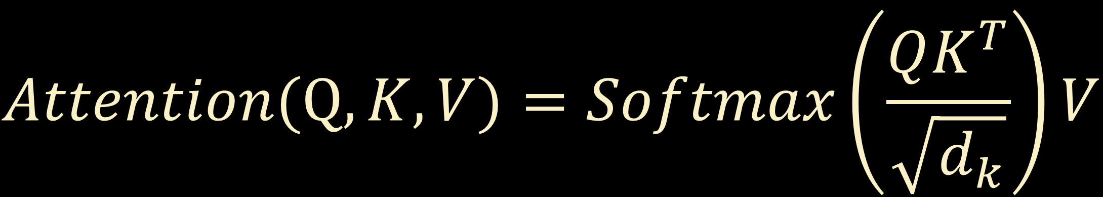
$$Attention(Q,K,V)=Softmax\left(\frac{QK^{T}}{\sqrt{d_{k}}}\right)V$$

Slide 2
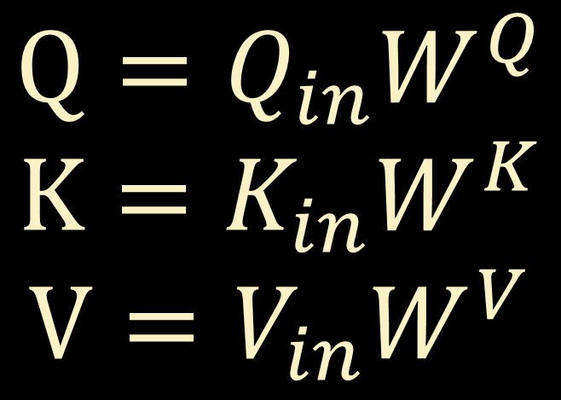
$$Q=Q_{in}W^{Q}$$
$$K=K_{in}W^{K}$$
$$V=V_{in}W^{V}$$

Slide 3
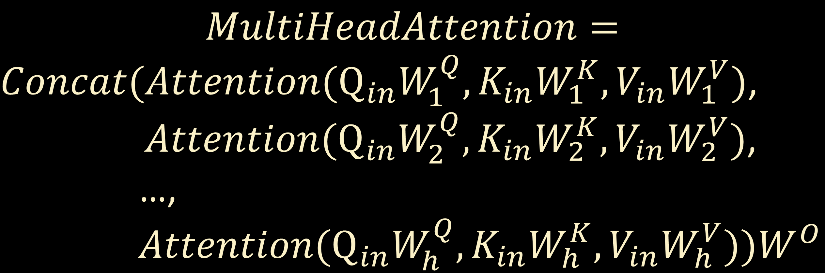
$$MultiHeadAttention=$$
$Concat(Attention(Q_{in}W_{1}^{Q},K_{in}W_{1}^{K},V_{in}W_{1}^{V})$, $Attention(Q_{in}W_{2}^{Q},K_{in}W_{2}^{K},V_{in}W_{2}^{V})$,
…,
$$Attention(Q_{in}W_{h}^{Q},K_{in}W_{h}^{K},V_{in}W_{h}^{V}))W^{O}$$

Slide 4
$$PositionalEncoding(Input)=Input+PE$$

Slide 5
$$PE[pos,2i]=sin⁡(pos/{10000}^{2i/d_{embedding}})$$
$$PE[pos,2i+1]=cos⁡(pos/{10000}^{2i+1/d_{embedding}})$$

