Slide 1
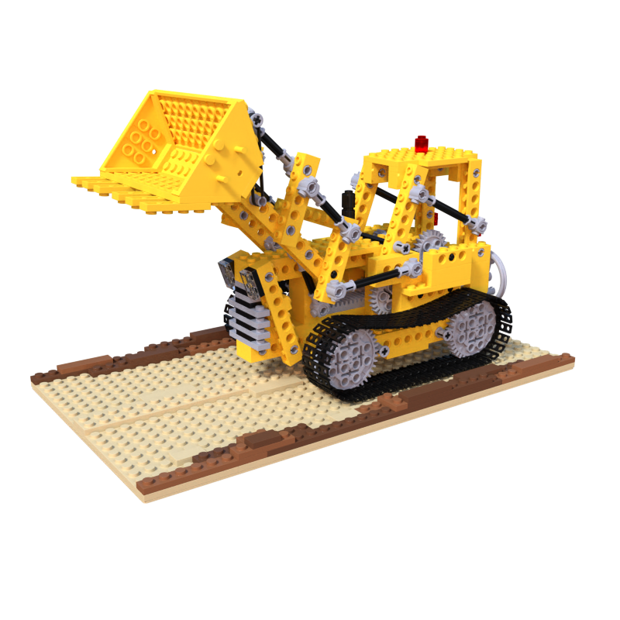
Scene Encoder
Renderer

Slide 2
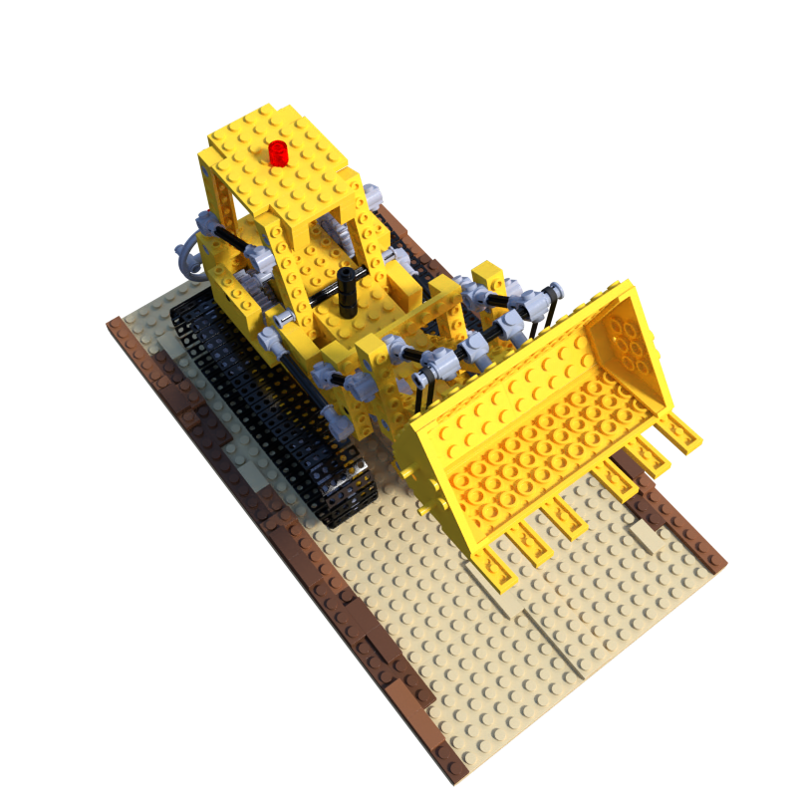
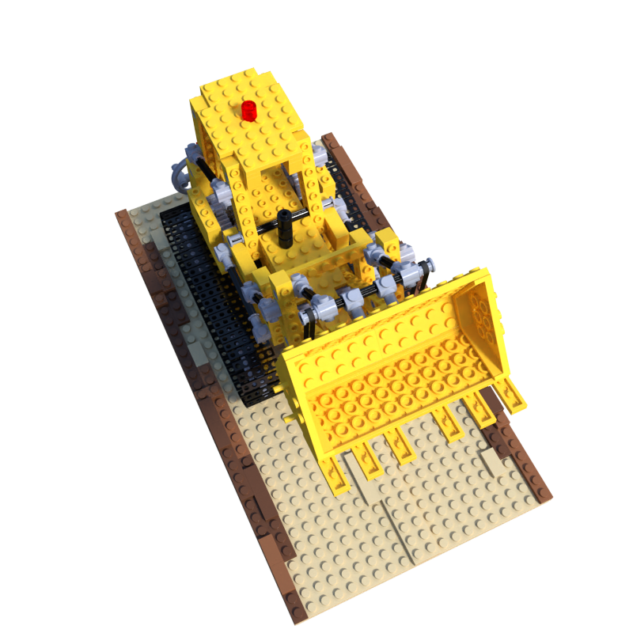
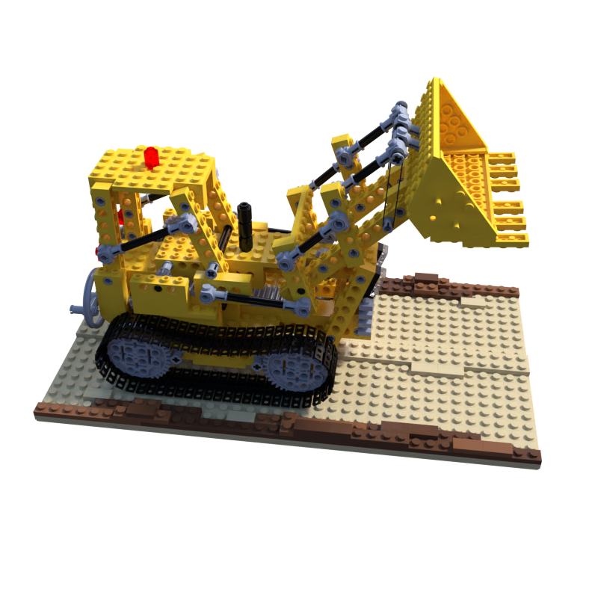
Scene Encoder

Slide 3
...
Scene
Embedding
(Values)
Flatten
...
Q
Scene
Position
Encoding
(Keys)
...
...
Multi Head
Attention
K
...
V
View
Position
Encoding
(Query)
View
Embedding

Slide 4
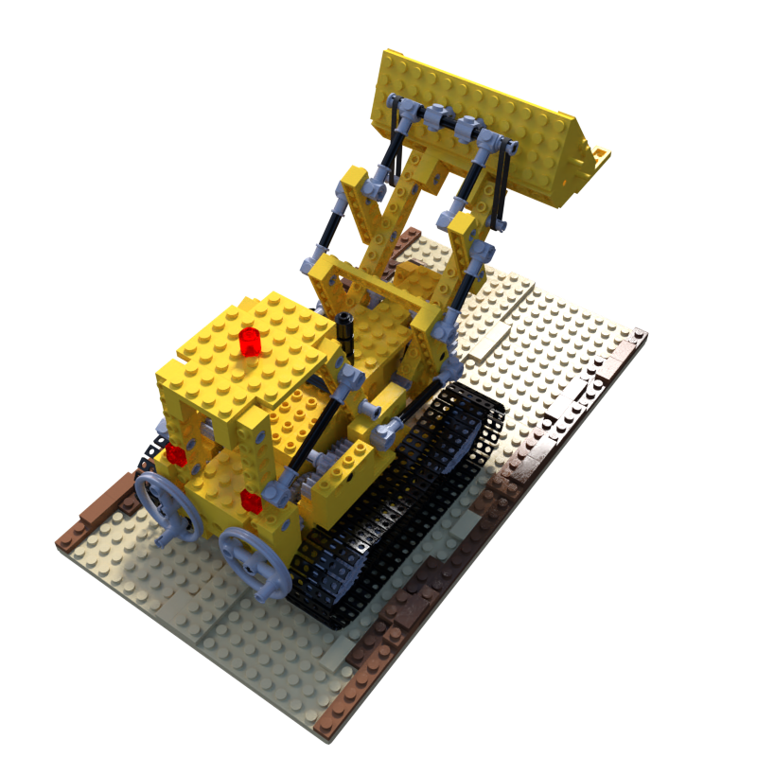
View
Embedding
Renderer

Slide 5
Object Embedding
...
Flatten
Address
(Position
Encoding)
...
Target
Position
Encoding

