Slide 1
Digital Image Processing Final Project
Segmentation of Carpal Tunnel from magnetic resonance image (MRI)

Slide 2
Outline
Background
Objective
Data
Reference
Evaluation
Other information

Slide 3
Background
In recent years, carpal tunnel syndrome (CTS) becomes a common disease due to the heavy load in repetitive wrist work.
The carpal tunnel is the passageway on the palmar side of wrist that connects the forearm to the hand. It is bounded by the transverse carpal ligament and carpal bones, several flexor tendon, median nerve pass through it.
Transverse carpal ligament 橫腕韌帶
Median nerve 正中神經
Flexor tendons 屈肌腱
Carpal tunnel 腕隧道
Carpal bone 腕骨

Slide 4
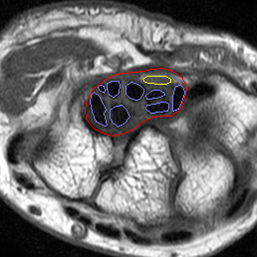
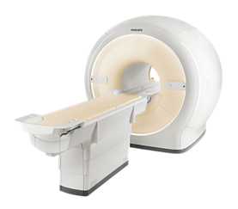
Background
Ultrasonography and magnetic resonance imaging are widely applied in clinical diagnosis.
Some researches shows that there are several information, such as the size of the median nerve or the tissue brightness in carpal tunnel, can be used as the basis for diagnosing the severity of CTS.
The labeled magnetic resonance image.

Slide 5
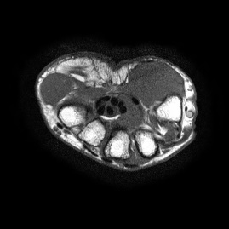
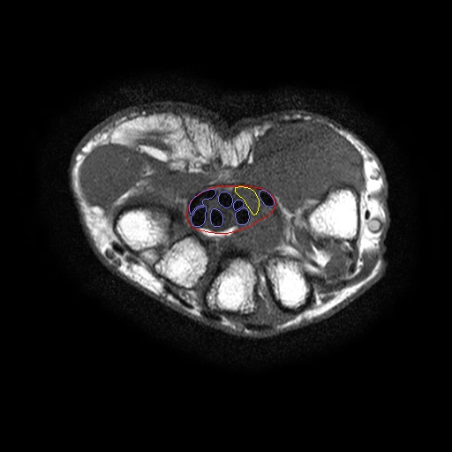
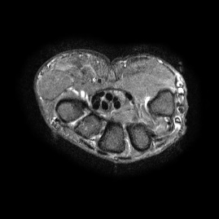
Objective
CTS can be diagnosed from MR images.
An accurate segmentation of tissue of wrist is very important.
Target :
Automatic segment the tissue of wrist (including flexor tendon, median nerve, and carpal tunnel) from a pair of transverse view multi-modal (including T1-weighted, and T2-weighted) MR images.
Output
Input

Slide 6
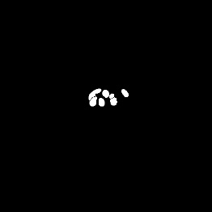
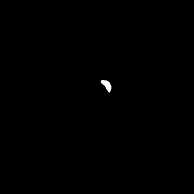

Data
Ten MR image sequences were captured from five normal cases and five CTS patients. Both T1-weighted (T1) and T2-weighted (T2) images of transverse view were given as the training samples.
Each cross-section image contains 512x512 pixels and each image sequence consists of sixteen or twenty slices with 2 mm thickness containing the carpal tunnel.
The contours of carpal tunnel, flexor tendon, and median nerve was labeled by one expert.
flexor tendon
T1
median nerve
T2
carpal tunnel
Source image
Ground truth image

Slide 7
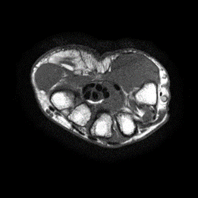
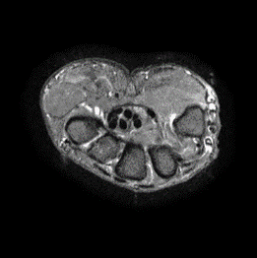


Project Goal
You are asked to segment the three CTS tissues, including medium nerve, tendon, and carpal tunnel, from the two given MR image pair.
You are given with the two MR and ground truth image sequences.
You can use the image processing skills as well as deep learning methods for this homework.

Slide 8
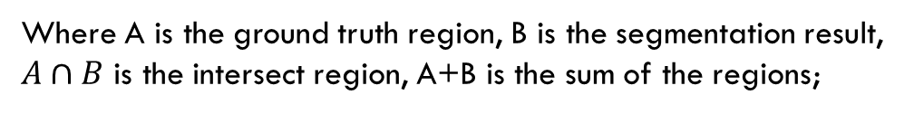

Evaluation
Use the Dice Coefficient(DC) to evaluate your segmentation result with the ground truth
DC = $\frac{2(A∩B)}{(A+B)}$
Where A is the ground truth region, B is the segmentation result,
$A∩B$ is the intersect region, A+B is the sum of the regions;

Slide 9
Requirement
1) Read a pair of image sequences (T1,T2) and its ground truth from your program interface.
2) Run your program and let user choose any image show the overlapping of segmentation result (yellow(Median nerve), blue(Flexor tendons),red(Carpal tunnel)) on the original input image in the program interface.
3) Show the evaluation result (DC).
Sequence DC(mean) :
Median nerve : 0.81
Flexor tendons : 0.83
Carpal tunnel : 0.83
Current image DC :
Median nerve : 0.90
Flexor tendons : 0.92
Carpal tunnel : 0.95
Result

Slide 10
Evaluation
You should clearly show the number of training, validation and testing images of your evaluation.
If you are using training base methods, 5 fold cross-validation is required. In this case, each fold contains 2 image sequences.
You should evaluation the segmentation result of each fold and show the average of them.
Round 1
f1
f2
f3
f4
f5
Round 2
f1
f2
f3
f4
f5
Blue: training
Yellow: testing
Round 3
f1
f2
f3
f4
f5
Round 4
f1
f2
f3
f4
f5
Round 5
f1
f2
f3
f4
f5
Notes:
5-fold cross-validation

Slide 11
Notice
The report should be written in Chinese or English, and 4 pages at least. The report should include the questions, methods, results, discussion and conclusion. Please print it with your named on it and hand it in at the demonstration.
The demonstration will be held in Room 65702 during 2021/01/12,13,14. The schedule will be announced in advance on the course web side.
If you cannot attend the scheduled demonstration, please inform the teaching assistant one week earlier for changing demo time.
If you are not EE or CSIE student, you are allowed to use the matlab 2019 to do this project. EE or CSIE students should use Visual Studio C# or C++ (VS2017) (note: Python 3.8 with tensorflow 2.1 / pytorch 1.6 should be used when you are using deep learning methods).
For deep learning methods, if you have to use any special library or version, please contact TA in advance. Basically an executable file of your project is required when doing demonstration. However, when you need to run it from source code, it is better to test your program first before the demonstration (contact TA if needed).
It is not allowed to copy homework from other classmates, but discussions are encouraged.

Slide 12
File Upload
Please compress the program source code, execution file(release mode) and report as a zip file and upload it to FTP before 11:59 p.m. of 2021/01/10(Sun).
ftp://140.116.247.97 port:102
id: imagehw
password: imagehw
The format of the zip file name :
[student id]_[version].zip
e.g. P78901234_VS.zip.
e.g. P78901234_PY.zip
Please add your version number if you have any new update
e.g. P78901234_VS_v02.zip

Slide 13
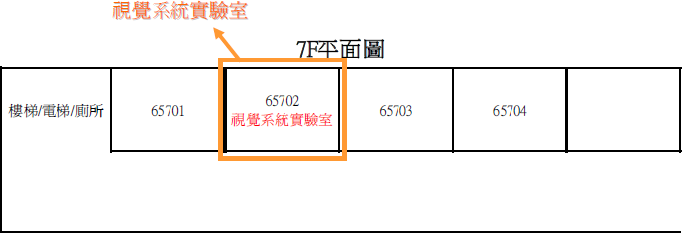
Vision System Lab (Room 65702)

Slide 14

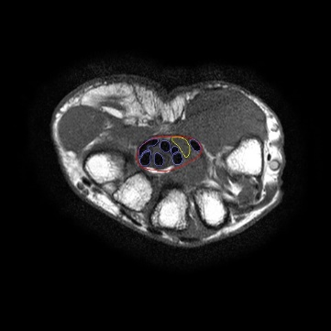


GUI LAYOUT SAMPLE
Select T1 sequence
Select T1 image
Select T2 sequence
Select T2 image
Select GT sequence
Select GT image
Run
Sequence DC(mean) :
Median nerve : 0.85
Flexor tendons : 0.87
Carpal tunnel : 0.83
image DC :
Median nerve : 0.90
Flexor tendons : 0.92
Carpal tunnel : 0.95
image
gt
result
5/20

Slide 15
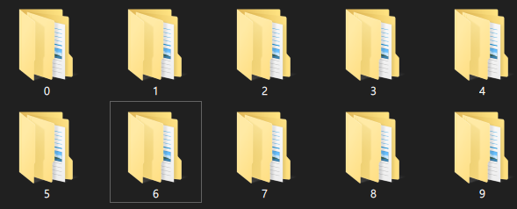
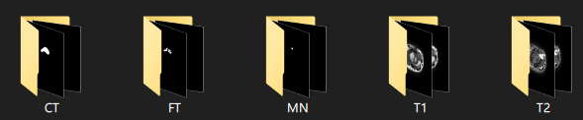
Each case has about 20 images and labels

Slide 16
References
J. Long, E. Shelhamer and T. Darrell, "Fully Convolutional Networks for Semantic Segmentation," in Conference on Computer Vision and Pattern Recognition, 2015.
L. Vese and T. Chan, “A multiphase level set framework for image segmentation using the mumford and shah model,” International Journal of Computer Vision, vol. 50, no. 3, pp. 271–293, December 2002.
Ronneberger, O., Fischer, P., & Brox, T. (2015, October). U-net: Convolutional networks for biomedical image segmentation. In International Conference on Medical image computing and computer-assisted intervention (pp. 234-241). Springer, Cham.
B. Romera-Paredes and P. H. S. Torr, "Recurrent Instance Segmentation," in Computer Vision and Pattern Recognition, 2015.
Z. Zhang, Q. Liu, and Y. Wang, “Road extraction by deep residual u-net,” IEEE Geoscience and Remote Sensing Letters, 2018, http://arxiv.org/abs/1711.10684.
S. J´egou, M. Drozdzal, D. Vazquez, A. Romero, and Y. Bengio, “The one hundred layers tiramisu: fully convolutional densenets for semantic segmentation,” in Proceedings of IEEE Conference on Computer Vision and Pattern Recognition Workshops (CVPRW), pp. 1175–1183, Honolulu, HI, USA, July 2017.
L.-C. Chen, G. Papandreou, F. Schroff and H. Adam, "Rethinking Atrous Convolution for Semantic Image Segmentation," in Computer Vision and Pattern Recognition, 2017.
L.-C. Chen, Y. Zhu, G. Papandreou, F. Schroff and H. Adam, "Encoder-Decoder with Atrous Separable Convolution for Semantic Image Segmentation," in Computer Vision and Pattern Recognition, 2018.
L. M. Wong, L. Shi, F. Xiao and J. F. Griffith, "Fully automated segmentation of wrist bones on T2-weighted fat-suppressed MR images in early rheumatoid arthritis," Quant Imaging Med Surg, pp. 579-589, 2019.
H.-C. Chen, Y.-N. Sun, Y.-Y. Wang, C.-H. Lin, C.-K. Wang and I.-M. Jou, "Segmentation of flexor tendons within carpal tunnel from magnetic resonance image," 2010 International Computer Symposium (ICS2010), pp. 932-935, 2010.

Slide 17
Information
NCKU moodle
TA:
hunghsiang617@gmail.com
kcl852967@gmail.com

