Slide 1
Frame_{start}
Renderer Module
Encoder
Driver
Module
Renderer Module
Decoder
State_{n}
State_{n+1}
Start
State
Frame_{n}
Frame_{n+1}
Frame_{n+t}
......

Slide 2


Frame_{n-t}
Frame_{n-2}
Frame_{n-1}
Frame_{n}
$$−1≤S≤1$$
......
量化
......
$$\hat{s}=\{−1,0,1\}$$
Frame_{n-t}
Frame_{n-2}
Frame_{n-1}
Frame_{n}

Slide 3
Encoder Backward
No Optimization
Frame
Encoder Forward
Frame’
Decoder Forward
Decoder Backward

Slide 4
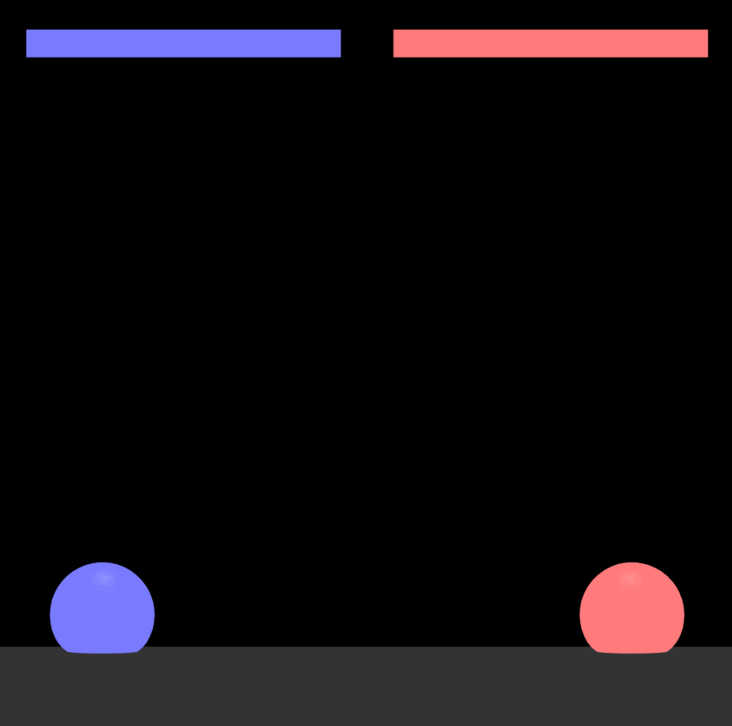
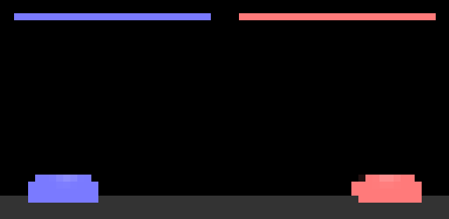
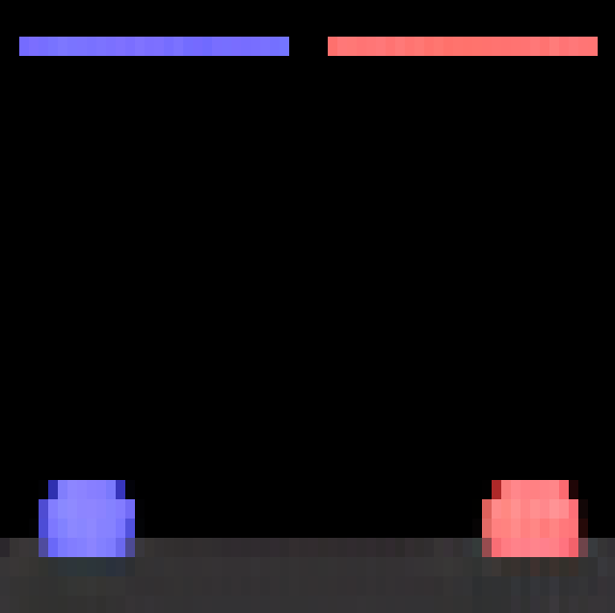
1080 px
64 px
resize
1080 px
32 px
64 px
32 px
512d

Slide 5
n-t
n-2
n-1
n
Position
Encoding
......
+
+
+
+
Act Embedding
......
+
+
+
+
State Embedding
......
Transformer Decoder
......
Frame_{n}
n-t+1
n-1
n
n+1

Slide 6
Content
(2,4,32)
Position
(384)
(512)
(8,16,1)
Flatten & Concatenate
Content
(2,4,32)
(8,16,64)
x
(512)
Position
(8,16,1)
Sub pixel conv & Bilinear resize

Slide 7
Output
Output
+
Transformer Decoder Block
Feed Forward
+
Input
MHA
Output

Slide 8



控制網路
$${\text{S}}_{prev} ,{\text{S}}_{next}$$
記憶池
狀態
動作
$$Action$$
環境
$$Reward$$
獎勵

