Slide 1
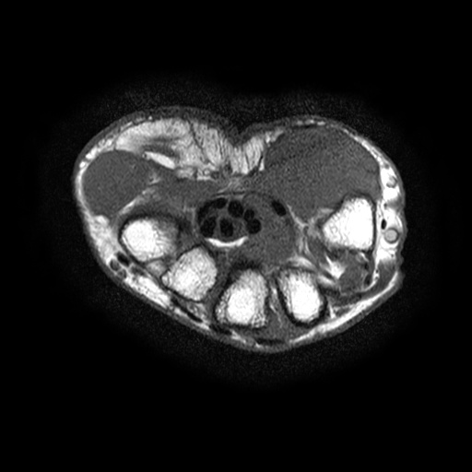

Slide 3


Slide 5

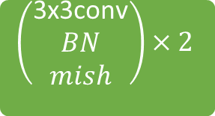
Input：(256,256,2)
(256,256,32)
(128,128,120)
(128,128,128)
(128,128,64)
(128,128,32)
(128,128,128)
(64,64,128)
(128,128,32)
+
(32,32,256)
(128,128,32)
(256,256,32)
(16,16,512)
(128,128,32)
(256,256,32)
output：(256,256,3)
$$\left(\begin{aligned}\text{3}\text{x}\text{3}\text{conv} \\ BN \\ mish\end{aligned}\right)×2$$
$$Pixel shuffle$$

