Slide 1
Volume
Rendering
(One Sample)
Renderer
Render
View
Rebuild
View
Scene PE
Scene Images
View PE
(One Sample)

Slide 2
Volume
Rendering
(One Sample)
Renderer
Rebuild
View
Scene Encoder
Scene PE
View PE
(One Sample)
Scene Images

Slide 3
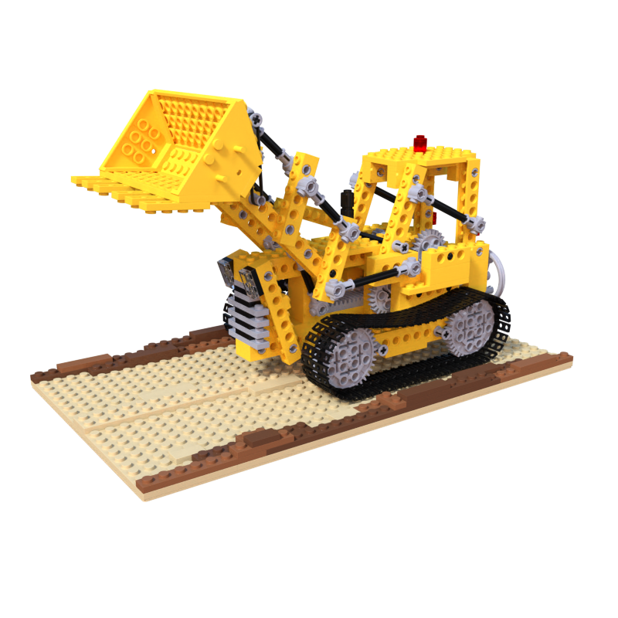
Scene Encoder
Renderer

Slide 4
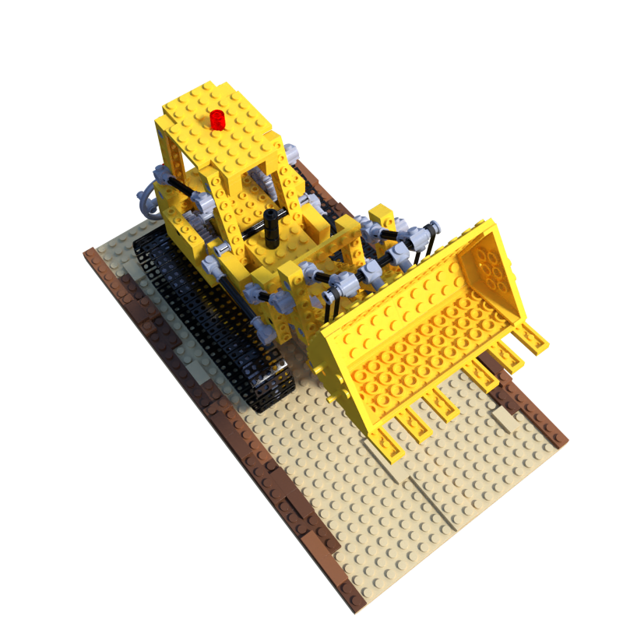
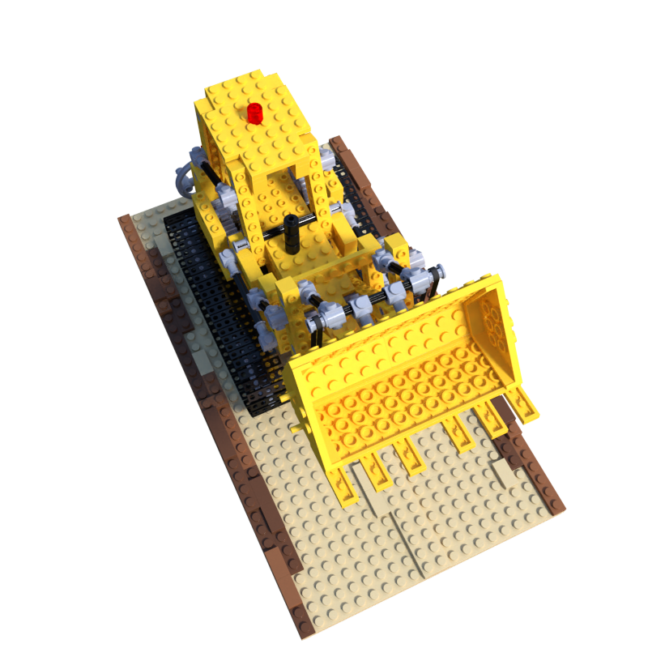
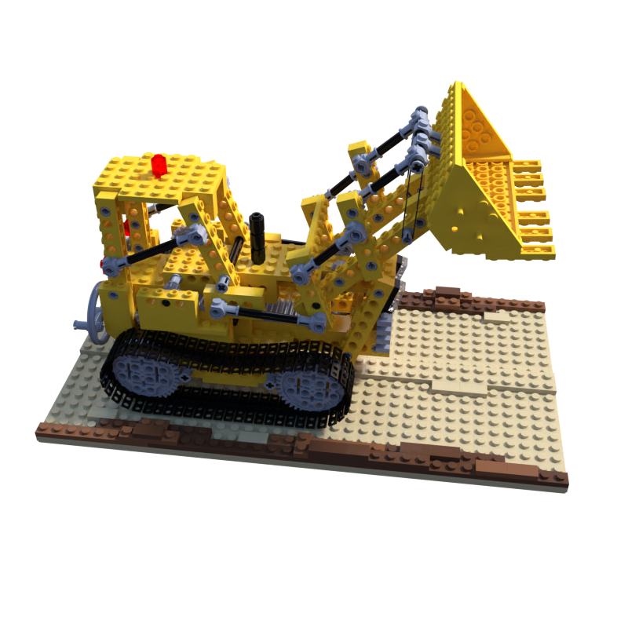
Scene Encoder

Slide 5
...
Scene
Embedding
(Values)
Flatten
...
Q
Scene
Position
Encoding
(Keys)
...
...
Multi Head
Attention
K
...
V
View
Position
Encoding
(Query)
View
Embedding

Slide 6
...
Scene
Embedding
(Values)
Flatten
...
...
...
Q
Scene
Position
Encoding
(Keys)
...
Multi Head
Attention
...
K
...
V
View
Position
Encoding
(Query)
View
Embedding

Slide 7
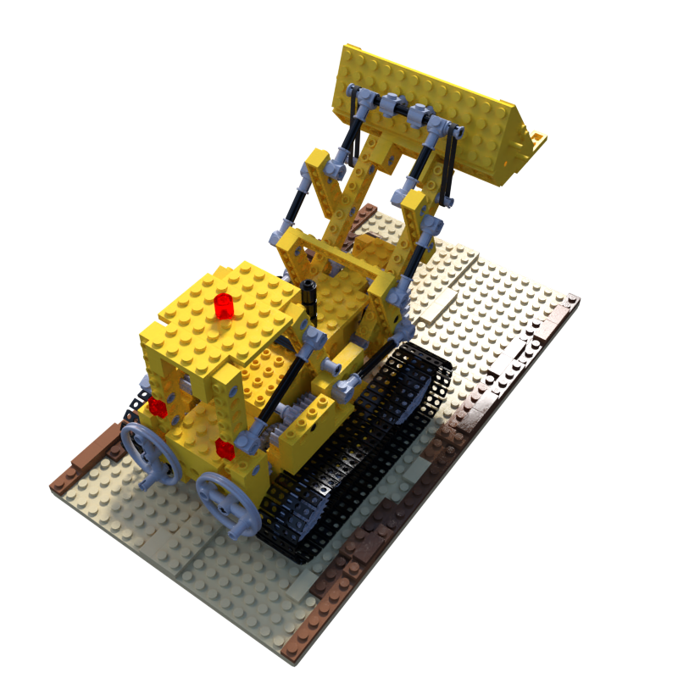
View
Embedding
Renderer

Slide 8
Object Embedding
...
Flatten
Address
(Position
Encoding)
...
Target
Position
Encoding

