Slide 1
Backward
Predict Net
p
Similarity
z
Momentum
z'
Encoder
Encoder'
+N₁
+N₂
S

Slide 2
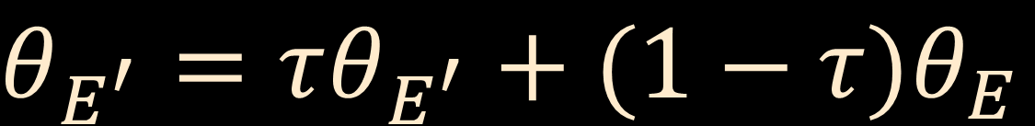
$$θ_{E^{′}}=τθ_{E^{′}}+(1−τ)θ_{E}$$

Slide 3
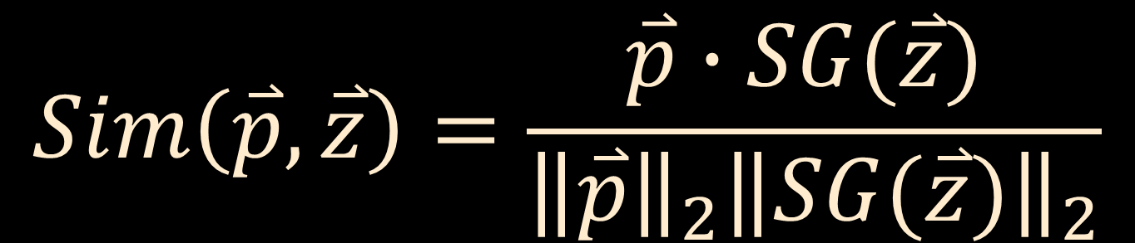
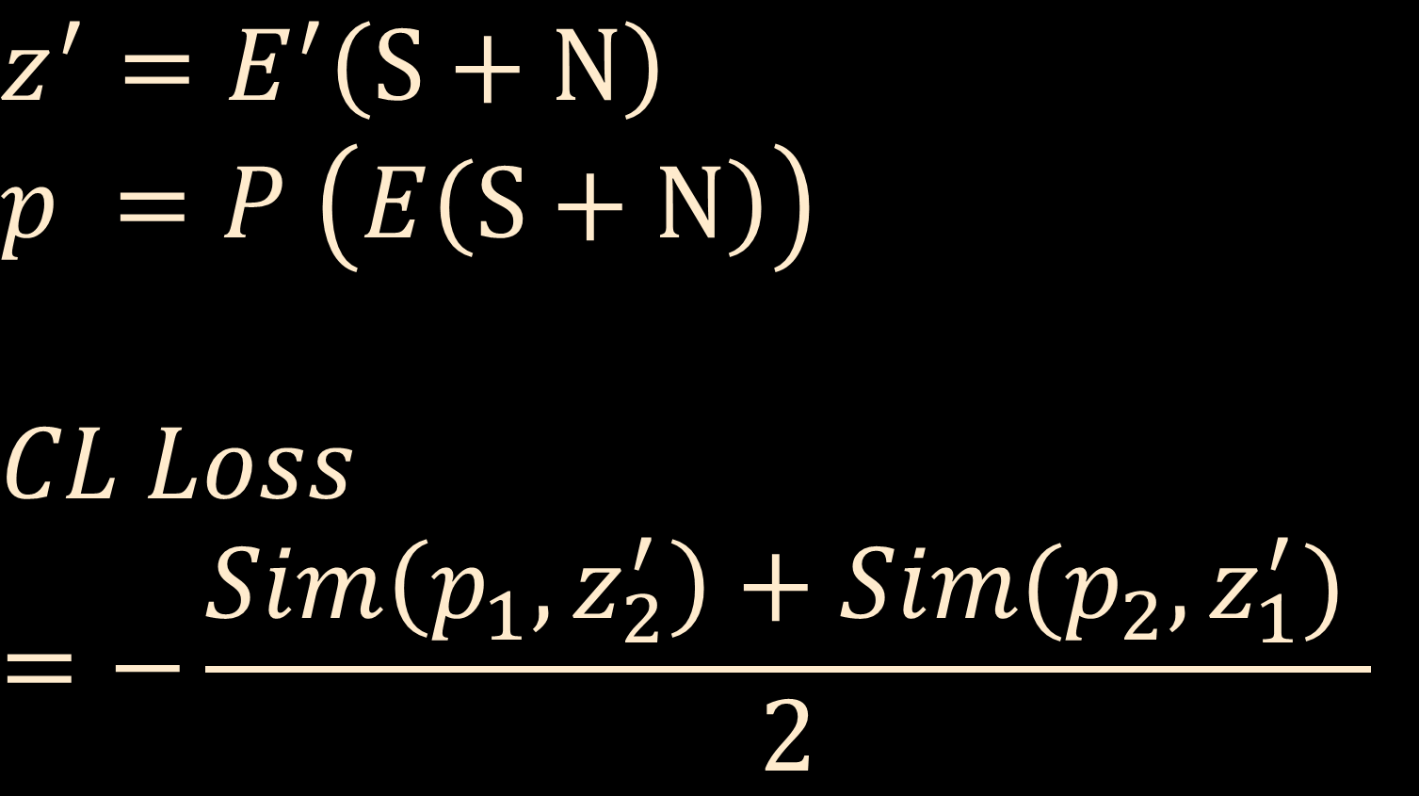
$$Sim\left(\overset{⃑}{p},\overset{⃑}{z}\right)=\frac{\overset{⃑}{p}∙SG(\overset{⃑}{z}) }{{\left\|\overset{⃑}{p}\right\|}_{2}{\left\|SG(\overset{⃑}{z})\right\|}_{2}}$$
$$z^{′}=E^{′}\left(S+N\right)$$
$$p =P \left(E\left(S+N\right)\right)$$
$$CL Loss=−\frac{Sim\left(p_{1},z_{2}^{′}\right)+Sim(p_{2},z_{1}^{′}) }{2}$$

Slide 4
Backward
Backward
Similarity
Similarity
p₁
p₂
Predict Net
Predict Net
z₁
z₂
Encoder
Encoder
+N₁
+N₂
S

Slide 5
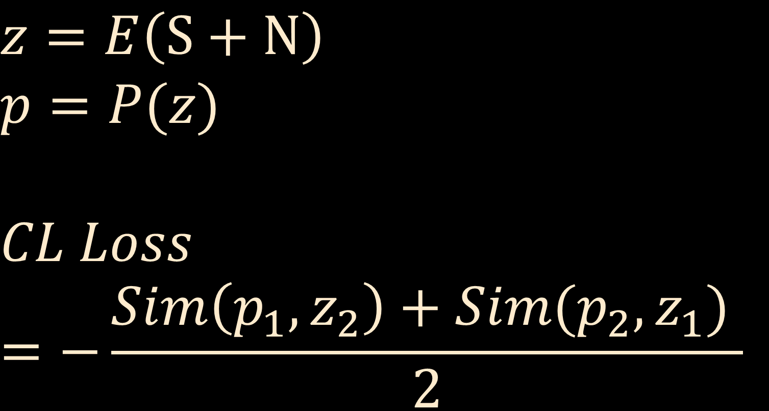
$$z=E\left(S+N\right)$$
$$p=P(z)$$
$$CL Loss=−\frac{Sim\left(p_{1},z_{2}\right)+Sim(p_{2},z_{1}) }{2}$$

Slide 6
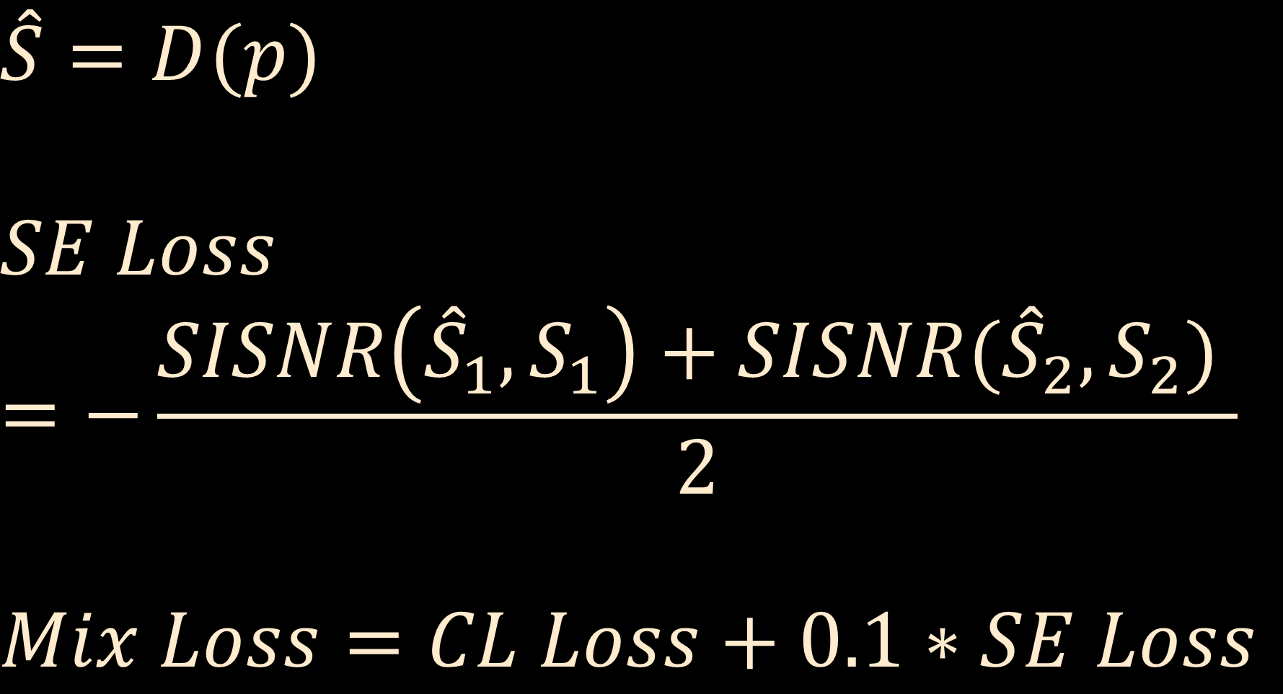
$$\hat{S}=D(p)$$
$$SE Loss=−\frac{SISNR\left({\hat{S}}_{1},S_{1}\right)+SISNR({\hat{S}}_{2},S_{2}) }{2}$$
$$Mix Loss=CL Loss+0.1∗SE Loss$$

Slide 7
Noisy
Speech
Encoder
Predict Net
Decoder
Enhanced
Speech

Slide 8
Conv1d(C_{i},C_{o},5,group=g)
GELU()
Maxpool1d(4,4)
BatchNorm1d()
Down Sample Block(C_{i},C_{o},g)

Slide 9
BatchNorm1d()
Conv1d(C_{i},N*2,5)
GELU()
Chunk(2)
Main Block(C_{i},N,k,d,g)
BatchNorm1d()
Conv1d(N,N,d*2-1, group=g)
GELU()
Conv1d(N,N,k, dila=d,group=g)
GELU()
Add
BatchNorm1d()
Conv1d(N,C_{i},5)
GELU()
Add

Slide 10
DSB(1,32)
DSB(32,64)
DSB(64,128)
bz,1,(l 64)->bz,64,l
Conv1d(64,128,3)
Concatenate()
Conv1d(256,128,1)
Main Block(128,256,9,16,8)
Main Block(128,256,9,16,8)
Main Block(128,256,9,16,8)
Main Block(128,256,9,16,8)
Encoder
Main Block(128,256,9,16,8)
Main Block(128,256,9,16,8)
Predict Net
Conv1d(128,64,3)
bz,64,l->bz,1,(l 64)
Decoder

Slide 11
DSB(1,32)
DSB(32,64)
DSB(64,128)
bz,1,(l 64)->bz,64,l
Conv1d(64,128,3)
Concatenate()
Conv1d(256,128,1)
Main Block(128,256,9,16,8)
Main Block(128,256,9,16,8)
Main Block(128,256,9,16,8)
Main Block(128,256,9,16,8)
Main Block(128,256,9,16,8)
Main Block(128,256,9,16,8)
Conv1d(128,64,3)
bz,64,l->bz,1,(l 64)

