Slide 1
Volume
Rendering
(One Sample)
Renderer
Render
View
Rebuild
View
Scene PE
Scene Images
View PE
(One Sample)

Slide 2
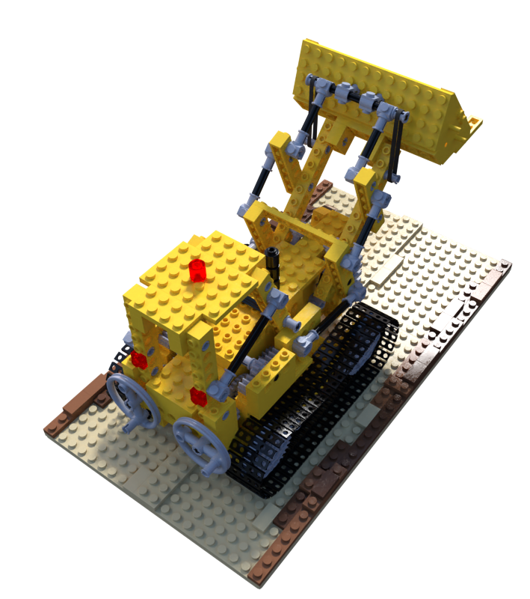
Multi Depth
View
Positional
Encoding
RGBA
RGBA
RGBA
RGBA
NeRF
Volume Rendering

Slide 3
Volume
Rendering
(One Sample)
Renderer
Rebuild
View
Key PE
Encoder
Query PE
Encoder
Scene Encoder
Scene PE
View PE
(One Sample)
Scene Images

Slide 4
Scene Images’
Renderer
Scene Encoder
Scene Images

Slide 5
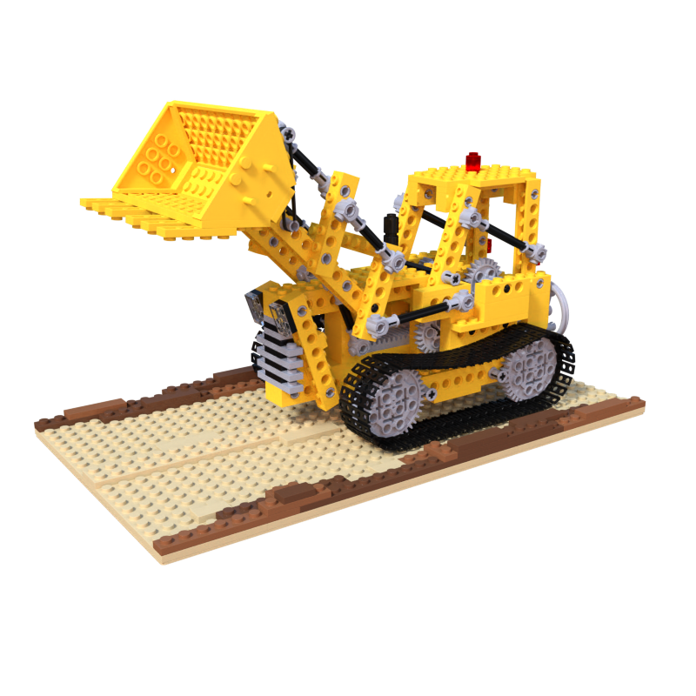

Slide 6
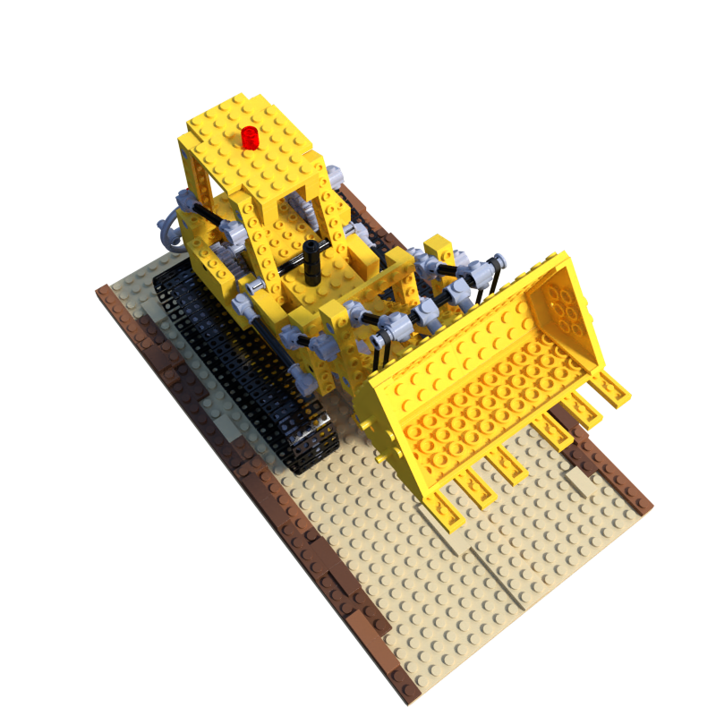
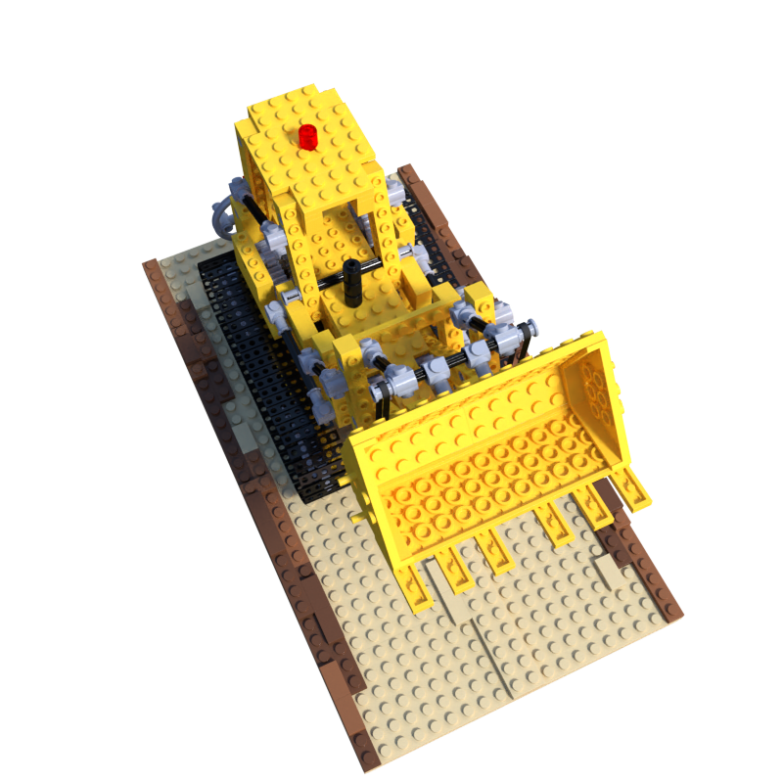
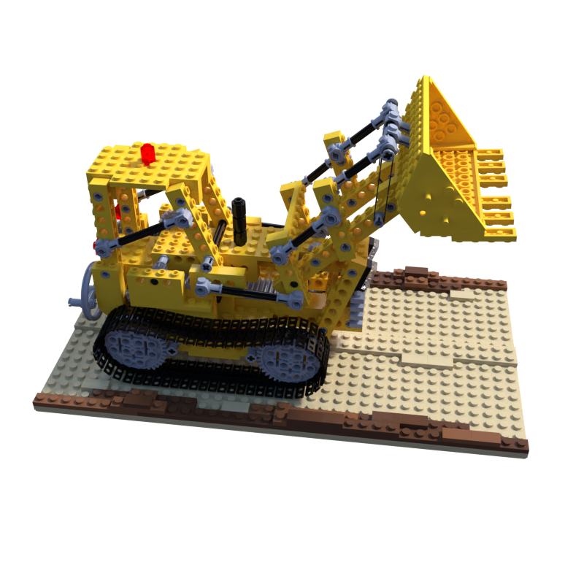
Scene Encoder

Slide 7
...
Scene
Embedding
(Values)
Flatten
...
...
...
Q
Scene PE Embedding
(Keys)
...
Multi Head
Attention
...
K
...
V
View PE
Embedding
(Query)
View
Embedding

Slide 8
...
...
...
...
Q
...
Multi Head
Attention
...
K
...
V

Slide 9
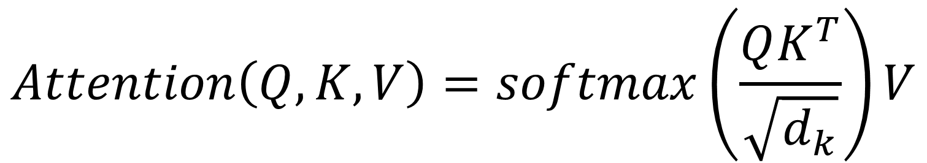
$$MHA\left(Q,K,V\right)=Concat\left({head}_{1},…,{head}_{h}\right)W^{O}$$
$${head}_{i}=Attention\left(QW_{i}^{Q},KW_{i}^{K},VW_{i}^{V}\right)$$
$$Attention\left(Q,K,V\right)=softmax\left(\frac{QK^{T}}{\sqrt{d_{k}}}\right)V$$

Slide 10
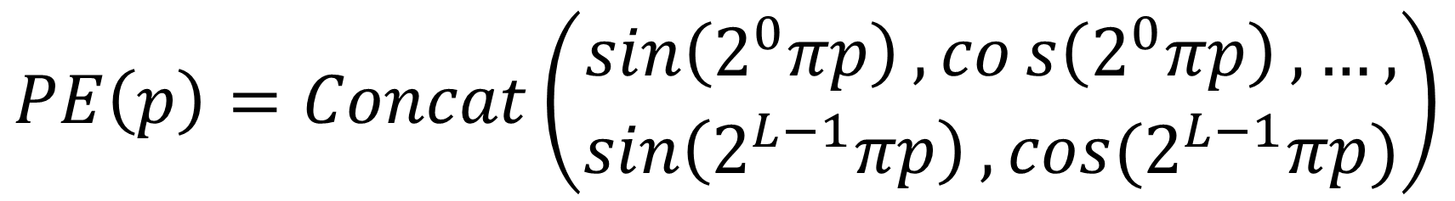
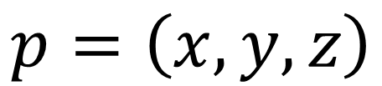
$$PE\left(p\right)=Concat\left(\begin{aligned}\sin\left(2^{0}πp\right),cos\left(2^{0}πp\right),…, \\ \sin\left(2^{L−1}πp\right), cos⁡(2^{L−1}πp)\end{aligned}\right)$$
$$p=\left(x,y,z\right)$$

Slide 11
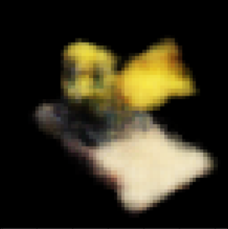
Multi
Depth
View
Embedding
RGBA
RGBA
RGBA
RGBA
Renderer
Volume Rendering

Slide 12
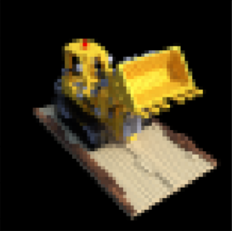
Target
Pred
SSIM( , )

Slide 13

Position
Encoding
Target
Image
H
H
W
W

Slide 14
Object Embedding
...
Flatten
Address
(Position
Encoding)
...
Target
Position
Encoding

