Slide 1
Industrialized Growth In Developing Economies
PhD Dissertation Defense
TOORAJ HELMI
BOSTON, MASSACHUSETTS
APRIL 2017

Slide 2
Outline
Introduction
Chapter 1: Supply Side Dynamics in Closed Developing Economies
DSGE Equations
Chapter 2: General Equilibrium Growth in Closed Economies
Growth at General Equilibrium
Steady State Analysis
Impact of Government Intervention on Growth
Optimum Subsidy and Growth Speed
Chapter 3: Sovereign Debt and Growth in Open Economies
Growth Limitation in a Closed Economy
Expanding Growth Using Sovereign Debt
Borrowing Policies
Modeling Default
Production Quality Impact

Slide 3
Goals
Primary Goal: To derive a dynamic model to explain industrialized growth for developing countries.
Secondary Goals: Use my model to analyze the following:
Government’s role to trigger and speed up the development.
Taxation and subsidization impact.
Impact of sovereign debt on growth.
Farewell and societal impacts.
Possibility of default.
Quality of manufacturing production.
Policy Recommendations:
Domestic polices: taxation and subsidies.
Foreign polices: borrowing.

Slide 4
Related Research
Growth
1. Endogenous innovation in the theory of growth (Grossman, 93)
2. Endogenous Technological Change (Romer, 90)
3. Frankel Lucas’s Human Capital Model (1988)
Debt
Debt Dynamics and Default
Impact of Foreign Borrowing on Growth
1. Debt path determined by the course of overall fiscal balances (Escolano, 2010)
2. General equilibrium model of sovereign default and business cycles (Mendoza 2011)
3. Debt Overhang (Krugman, et al 2010)
1. Growth, debt and economic transformation: The capital flight problem (Calvo 98)
2. Sovereign Debt: A premier (Eaton 93)
3. External Debt and Growth (Patitillo, et al 02)
Me
Me

Slide 5
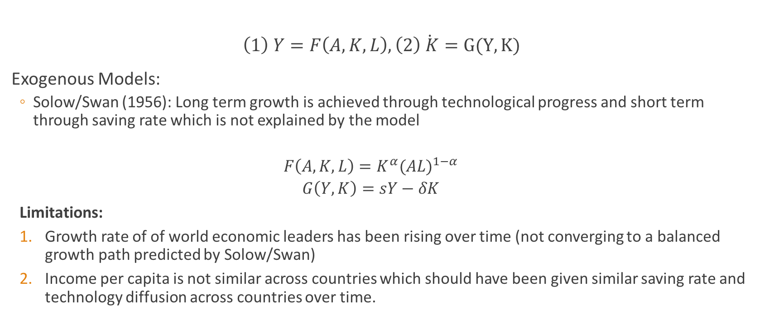
Growth Research
$\left(1\right) Y=F\left(A,K,L\right), \left(2\right)\dot{ K}=G(Y,K)$
Exogenous Models:
Solow/Swan (1956): Long term growth is achieved through technological progress and short term through saving rate which is not explained by the model
$$F\left(A,K,L\right)=K^{α}{(AL)}^{1−α}$$
$$G\left(Y,K\right)=sY−δK$$
Limitations:
Growth rate of of world economic leaders has been rising over time (not converging to a balanced growth path predicted by Solow/Swan)
Income per capita is not similar across countries which should have been given similar saving rate and technology diffusion across countries over time.

Slide 6

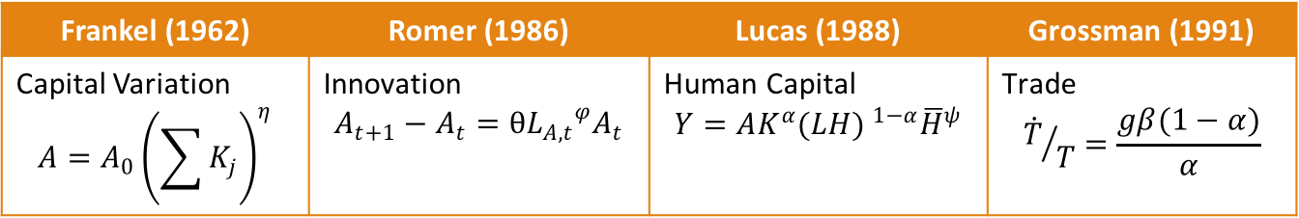
Growth Research
Endogenous Models:
Endogenous saving rate: Ramsey/Cass/Coopman (1965): ${\dot{c}}/c=\frac{r−θ}{ρ}$
Endogenous technology
Limitations:
Do not fully combine internal and external factors in growth, e.g. government subsidy or foreign borrowing.
Frankel (1962) | Romer (1986) | Lucas (1988) | Grossman (1991)
Capital Variation $$A=A_{0}{\left(\sum{K_{j}}\right)}^{η}$$ | Innovation $$A_{t+1}−A_{t}=θ{L_{A,t}}^{φ}A_{t}$$ | Human Capital $$Y=AK^{α}{(LH) }^{1−α}{\overline{H}}^{ψ}$$ | Trade $${\dot{T}}/T=\frac{gβ(1−α)}{α}$$

Slide 7
Debt Research
Only focus on the borrowing separate from the internal dynamics of growth: A BLACK BOX
Calvo (1998) identifies traps the might defeat he growth endeavor.
Patitillo (2002) applies a regression analysis on HIPC countries to find what level of debt is optimum.
Krugman(2010} focuses on inability of countries to borrow due to debt overhang.
Mendoza(2011) derives a model for default but look the economy as a black box.
My study is differentiated because it is A WHITE BOX
Interaction of internal growth and external debt and possibly default.
Provides a comprehensive model including government domestic and foreign policies.
Explains how industrializations takes place beyond Romer’s model.
Generalizes Romer’s general equilibrium.

Slide 8
Industrialization Stylized Facts
Fact | How I Have Used it
Requires significant amount of investment in the initial stages | Effect of Gov’t domestic policies on growth
Funded by bank loans | Effect of sovereign debt on growth
Established domestically controlled public or publically supported enterprises | Domestic subsidized innovation and manufacturing sectors
Home-grown research and technology generation is very important in achieving high quality in production
Fact | How I Have Used it
International markets significantly increase demand but also increase the risk of default | Steady state level of debt/output ratio
Pushes for higher quality to compete in International markets | Quantifying the impact of quality on default possibility

Slide 9
Chapter 1
SUPPLY SIDE DYNAMICS IN CLOSED DEVELOPING ECONOMIES

Slide 10
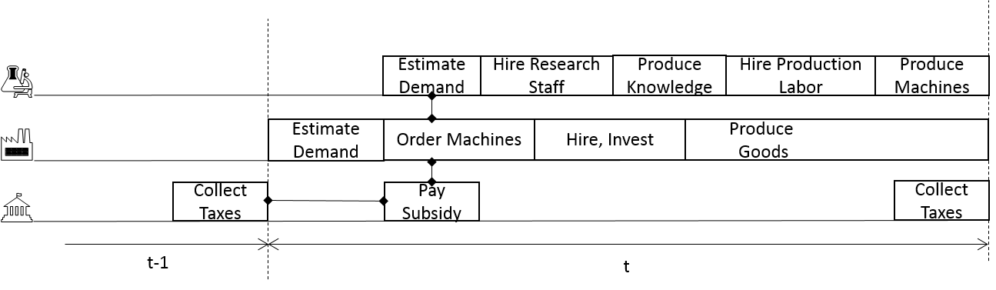
Components of the Model

Slide 11
Assumptions
Each firm maximizes the profits for each period separately.
The tax rate remains fixed for the duration of industrialization.
Government maximizes output for the entire period of industrialization.
Justification for assumptions 1 and 3: Private firms also consider long term in their strategies, however, their plans are not as long as gov’t specific policies to overhaul the economy which can span decades.

Slide 12
R&D Sector

Slide 13
Primary Sectors

Slide 14
Government

Slide 15
Solution for Special Form

Slide 16
Closed Economy Solution

Slide 17
Chapter 2
General Equilibrium Growth in Closed Economies

Slide 18

Supply Side
R & D Sector:
$A_{t+1}−A_{t}=θ{L_{A,t}}^{φ}A_{t}$
Manufacturing Sector:
$Y={L_{Y,t}}^{β}{K_{Y,t}}^{α}\sum_{i=0}^{A_{t}}{h_{i}}$
Product Maximizing Firms:
$Π_{Y,t}=(1−τ_{t})\left[p_{y,t}{L_{Y,t}}^{β}{K_{Y,t}}^{α}\sum_{i=0}^{A_{t}}{{h_{i}}^{γ}}−w_{t}L_{Y,t}−r_{t}K_{Y,t}−\sum_{i=0}^{A_{t}}{{p_{i,t}h}_{i}}+\sum_{i=0}^{A_{t}}{{s_{t}p_{i,t}h}_{i}}\right]$

Slide 19
Two Effective Subsidy Level Propositions
Effective Subsidy Level
A level of subsidy that equates the marginal revenue of innovation to its cost.

Slide 20
Supply Side Model

Slide 21

Supply Side Solution
Division of Labor:
${L_{Y,t}=QL}_{A,t}^{φ−1}$ where $Q=\frac{Br(1−s_{t})}{γ\left(1−γ\right)θφ}$
$When φ=0.5: L_{A,t}= {\left(\frac{\sqrt{Q^{2}+4L}−Q}{2}\right)}^{2}$
Firm Output:
$Y_{t}=A_{t}{C_{t}}^{γ}{L_{Y,t}}^{Β}{K_{Y,t}}^{Λ}$
$Λ=\frac{α}{1−γ}$ and $B=\frac{β}{1−γ}$ , and $C_{t}={\left[\frac{γ^{2}p_{y,t}}{(1−s_{t})(1+r)}\right]}^{\frac{1}{1−γ}}$
Supply Side Growth:
$g_{s,t}={\left(1+θ{L_{A,t}}^{φ}\right)}^{\frac{1}{1−Λ}}−1$

Slide 22

Growth at Equilibrium
Demand side utility:
${U(C}_{t})= \sum_{s=t}^{∞}{d^{s−t}\frac{c_{s}^{1−ρ}}{1−ρ}}$
Demand side growth:
$g_{d,t}={\left[\left(1+r_{t}\right)d\right]}^{\frac{1}{ρ}}−1$
$g_{d,m}=g_{s,m}⟹{\left(1+θ{L_{A,t}}^{φ}\right)}^{\frac{1}{1−Λ}}={\left[\left(1+r_{t}\right)d\right]}^{\frac{1}{ρ}}$

Slide 23
Growth vs Interest Rate

Slide 24
Economy Output

Slide 25
Income Per Capita

Slide 26
Chapter 3
Sovereign Debt and Growth in Open Economies

Slide 27

Growth Limitation in a Closed Economy
$\sum_{i=0}^{A_{t}}{{s_{t}p_{i,t}h}_{i}}<T_{t}$
$T_{t}=τ_{t}\left[{L_{Y,t}}^{β}{K_{Y,t}}^{α}\sum_{i=0}^{A_{t}}{{h_{i}}^{γ}}−w_{t}L_{Y,t}−r_{t}K_{Y,t}−\sum_{i=0}^{A_{t}}{{p_{i,t}h}_{i}}+\sum_{i=0}^{A_{t}}{{s_{t}p_{i,t}h}_{i}}\right]$
$s_{A,t}≤\frac{(1−γ)(1−B)(1−Λ)τ_{t}}{γ+(1−γ)(1−B)(1−Λ)τ_{t}}$

Slide 28
Maximum Attainable Subsidy
This is for a tax rate 0f 100%
For a tax rate of 50% the max attainable subsidy rate is 25%

Slide 29
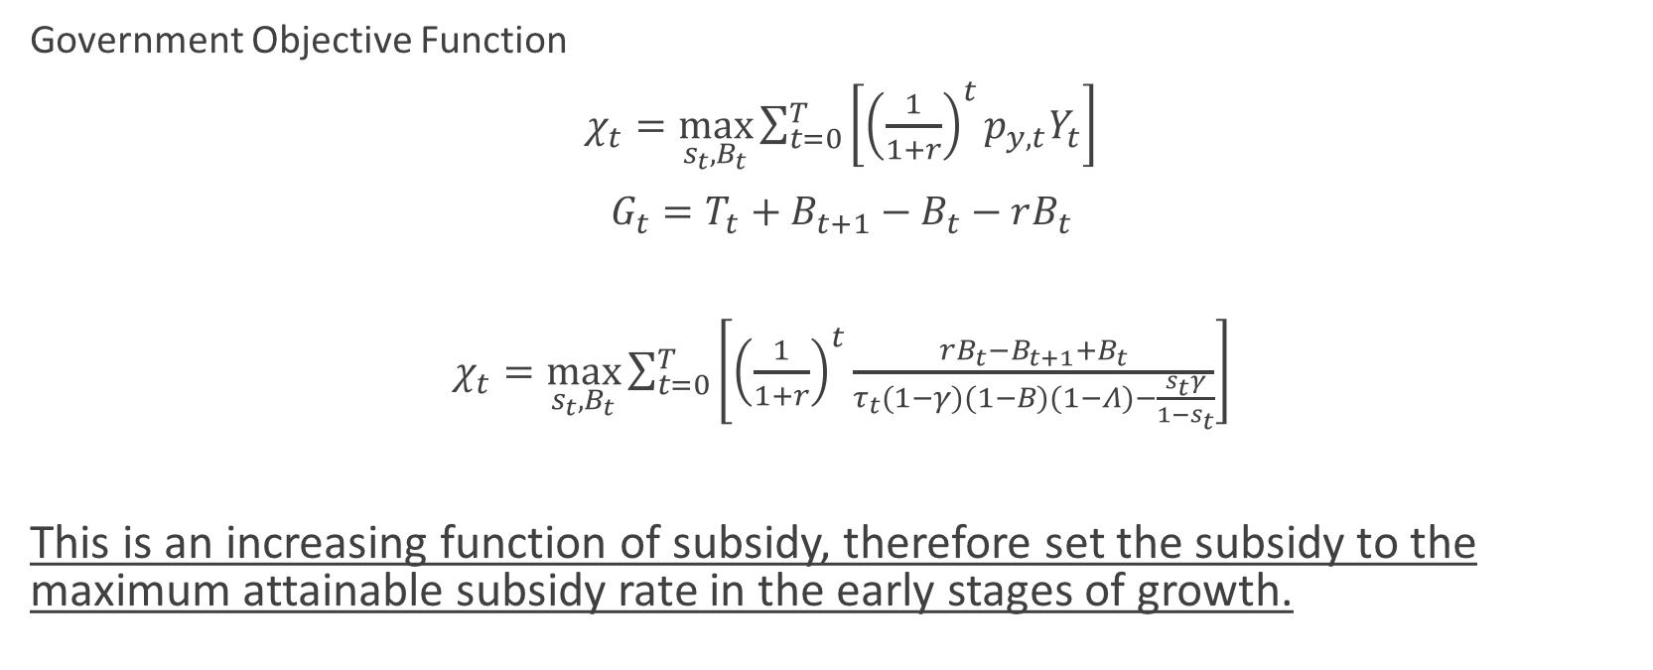
Expanding Growth Using Sovereign Debt
Government Objective Function
$χ_{t}=\max_{s_{t},B_{t}}{\sum_{t=0}^{T}{\left[{\left(\frac{1}{1+r}\right)}^{t}p_{y,t}Y_{t}\right]}}$
$G_{t}=T_{t}+B_{t+1}−B_{t}−rB_{t}$
$χ_{t}=\max_{s_{t},B_{t}}{\sum_{t=0}^{T}{\left[{\left(\frac{1}{1+r}\right)}^{t}\frac{rB_{t}−B_{t+1}+B_{t}}{τ_{t}(1−γ)(1−B)(1−Λ)−\frac{s_{t}γ}{1−s_{t}}}\right]}}$
This is an increasing function of subsidy, therefore set the subsidy to the maximum attainable subsidy rate in the early stages of growth.

Slide 30
Short-Term Borrowing Policies
The Growth-First Policy:
In the early stages of growth, government borrows to be able to subsidize above the attainable rate.
The Growth-and-Distribution Policy:
In the early stages of growth, government borrow to be able to subsidize above the attainable rate and also provide a minimum level of income per capita.

Slide 31
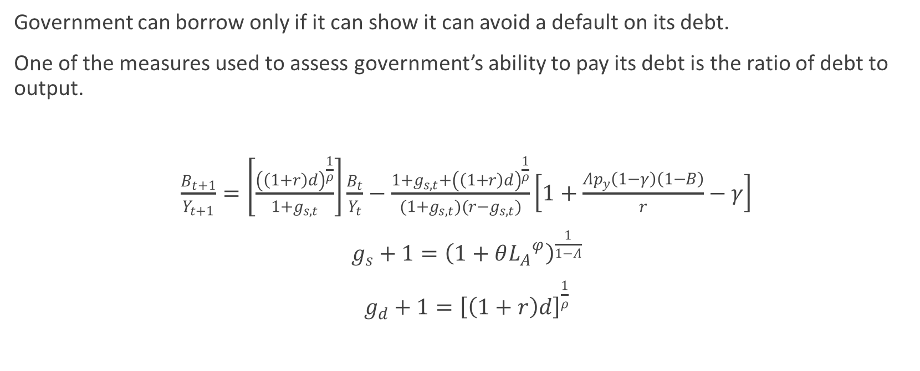
Mid-to-Long-Term Borrowing
Government can borrow only if it can show it can avoid a default on its debt.
One of the measures used to assess government’s ability to pay its debt is the ratio of debt to output.
$\frac{B_{t+1}}{Y_{t+1}}=\left[\frac{{\left(\left(1+r\right)d\right)}^{\frac{1}{ρ}}}{1+g_{s,t}}\right]\frac{B_{t}}{Y_{t}}−\frac{1+g_{s,t}+{\left(\left(1+r\right)d\right)}^{\frac{1}{ρ}}}{(1+g_{s,t})(r−g_{s,t})}\left[1+\frac{Λp_{y}\left(1−γ\right)\left(1−Β\right)}{r}−γ\right]$
$g_{s}+1={\left(1+θ{L_{A}}^{φ}\right)}^{\frac{1}{1−Λ}}$
${g_{d}+1=\left[\left(1+r\right)d\right]}^{\frac{1}{ρ}}$

Slide 32

Steady-State Analysis Case 1. Stable Debt to Output Ratio
$g_{s}>g_{d}$
debt to output ratio will be stable and converges to the steady state ξ:
$ξ=\frac{1+\frac{Λp_{y}\left(1−γ\right)\left(1−Β\right)g_{s}}{r} −γ}{r−g_{s}}$
Capped Growth:
$g^{∗}=\frac{1−γ−ηr}{\frac{Λp_{y}\left(1−γ\right)\left(1−Β\right)g_{s}}{r} −η}$

Slide 33

Case 2. Romer’s Case and Case 3. Transient Unstable Case
$g_{s, t}=g_{d}=g^{∗}$
Discussed in [Romer 1990]
Transition to steady state is instantaneous and $B_{t}={ηY}_{0}{(1+g^{∗})}^{t}$.
$g_{s, t}<g_{d, t}$
Debt to output ratio will be transiently unstable.

Slide 34
One Example
β=0.3, α=0.4, γ=0.3, r=2%, θ=0.01, ϕ=0.5, d=0.93, P_{Y,t}=1, ρ=1, and population growth=0%. τ=50%
Maximum attainable subsidy is 13%
Income-per-capita has reduced from 3.19 to 1.87
Assume that government decides to keep income-per-capita at least at 75% of its original level.

Slide 35

Modeling Default
Lending country’s interest rate is raised from its original level r₁ to r₂ where $1+g_{s, t}> {\left(\left(1+r_{2}\right)d\right)}^{\frac{1}{ρ}}$ .
This will reduce the steady state DOR.
$ΔDOR=\frac{\left(r_{2}−r_{1}\right)\left(1−γ+\frac{r_{2}+r_{1}−g}{r_{2}r_{1}}V\right)}{(r_{2}−g)(r_{1}−g)}$

Slide 36
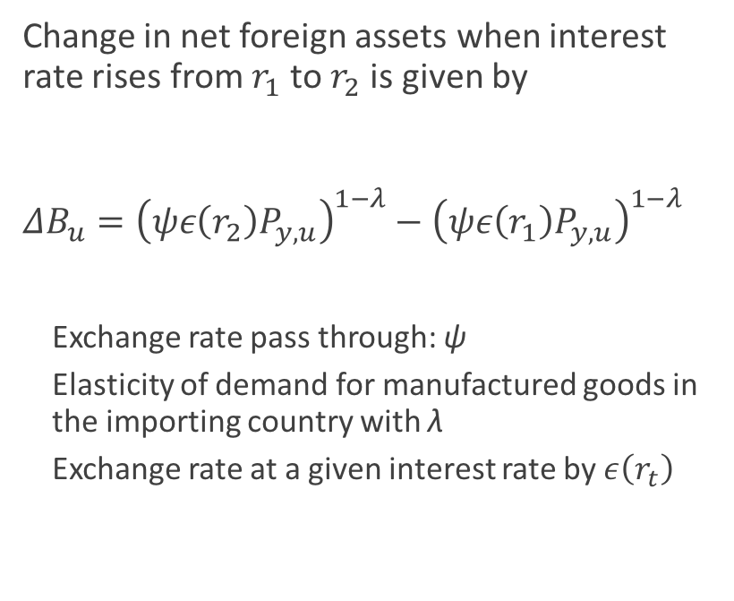
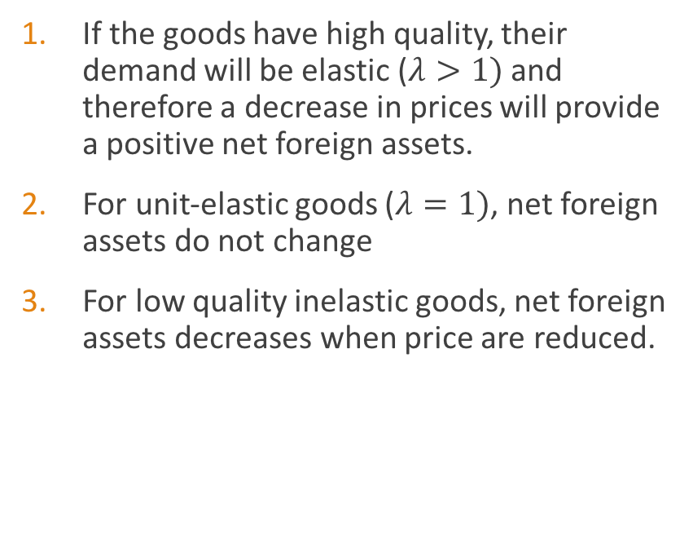
Production Quality Impact
Change in net foreign assets when interest rate rises from $r_{1}$ to $r_{2}$ is given by
${ΔB}_{u}={\left(ψε\left(r_{2}\right)P_{y,u}\right)}^{1−λ}−{\left(ψε\left(r_{1}\right)P_{y,u}\right)}^{1−λ}$
Exchange rate pass through: ψ
Elasticity of demand for manufactured goods in the importing country with λ
Exchange rate at a given interest rate by $ε\left(r_{t}\right)$
If the goods have high quality, their demand will be elastic ($λ>1)$ and therefore a decrease in prices will provide a positive net foreign assets.
For unit-elastic goods ($λ=1)$, net foreign assets do not change
For low quality inelastic goods, net foreign assets decreases when price are reduced.

Slide 37
Conclusion
The borrower should use the funds to increase its long-term capacity to produce at world-level quality, increase its domestic growth, and guarantee its debt obligations.
The borrower not only must consider growth but also welfare effects of its borrowing policy.

Slide 38
Future Research
This study does not consider other important economic factors that have considerable impact on growth including
Inflation
Distributional effects
Currency destabilization
Recessionary periods caused by external shocks
This thesis considers a positive scenario in which the industrializing economy can execute per its plan, there are always chances of facing unforeseen shocks

Slide 39
THANK YOU!

