Slide 1

Mongo.DB({
presenter: “Tooraj Taraz”,
course: “DataBases Lab”
});

Slide 2

Structured Query Language
SELECT CustomerName, City, Country FROM Customers;
SELECT * FROM Customers
WHERE Country='Mexico';
CREATE TABLE Orders (
OrderID int NOT NULL,
OrderNumber int NOT NULL,
PersonID int,
PRIMARY KEY (OrderID),
CONSTRAINT FK_PersonOrder FOREIGN KEY (PersonID)
REFERENCES Persons(PersonID)
);

Slide 3


NoSQL - MongoDB

Slide 4
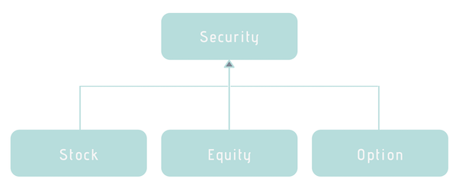
Polymorphic Schema
The grand schema
OOP (Inheritance)

Slide 5
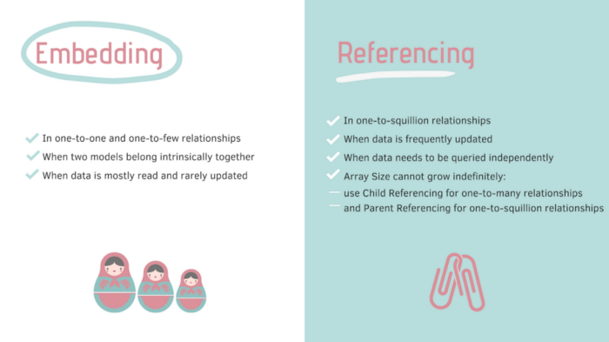
To Embed or Not to Embed: That is The Question!

Slide 6
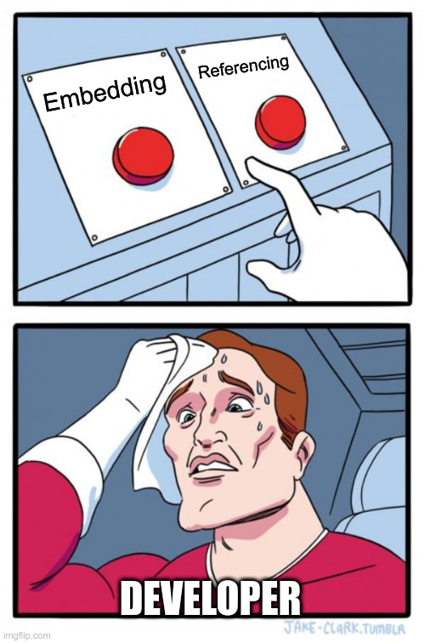
MEMES!

Slide 7

MEMES!

Slide 8

MEMES!

Slide 9
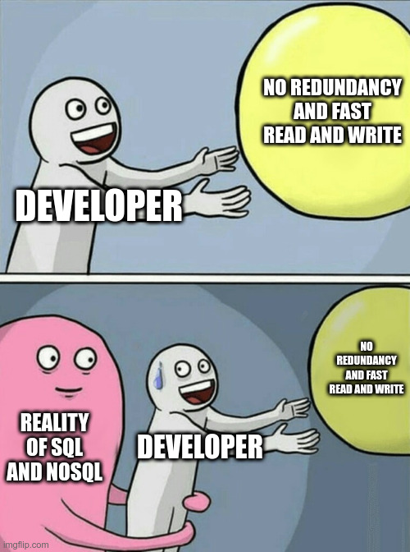
MEMES!

Slide 10
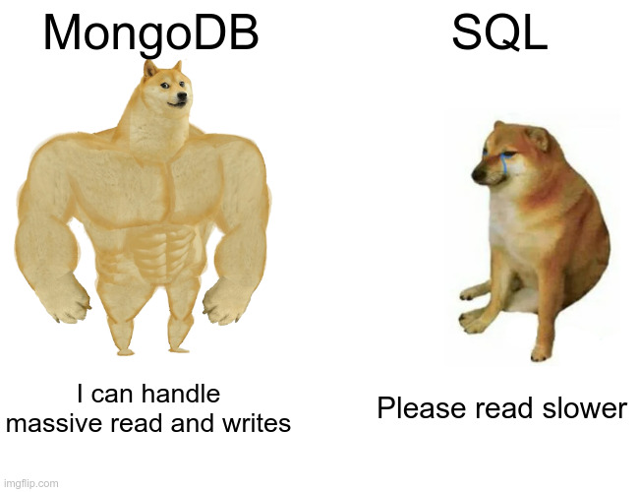
MEMES!

Slide 11
MySQL vs MongoDB
CREATE TABLE people (
id MEDIUMINT NOT NULL
AUTO_INCREMENT,
user_id Varchar(30),
age Number,
status char(1),
PRIMARY KEY (id)
)
INSERT INTO people(user_id,
age,
status)
VALUES ("bcd001",
45,
"A")
SELECT *
FROM people
WHERE status = "A"
ORDER BY user_id DESC
db.people.insertOne( {
user_id: "abc123",
age: 55,
status: "A"
} )
db.people.insertOne({
user_id: "bcd001", age: 45, status: "A"
})
db.people.find(
{ status: "A" } ).sort( { user_id: -1 }
)

Slide 12
MySQL vs MongoDB
Data uses schemas
Relations!
Data is distrebuted across multiple tables
Vertical scaling
Speed limitations
FREE as in FREEDOM
Schema-less
No/very few relations
Data is nested in a few collections
Both horizontal and vertical scaling
Greate performace for mass read and simple writes
OpenSource BUT NOT FREE

Slide 13
Q&A

