Slide 1


SICO
Surgical Interception Attacks by Manipulating BGP Communities
Henry Birge-Lee
Liang Wang, Jennifer Rexford, Prateek Mittal
Notes:
Add description about how communities work and let adversaries launch interception attacks.

Slide 2
BGP is vulnerable to hijacks
BGP: Routing protocol used between autonomous systems
No inherent authentication method
Networks can falsely claim ownership of IP prefixes and announce malicious routes (i.e., a BGP hijack)

Slide 3

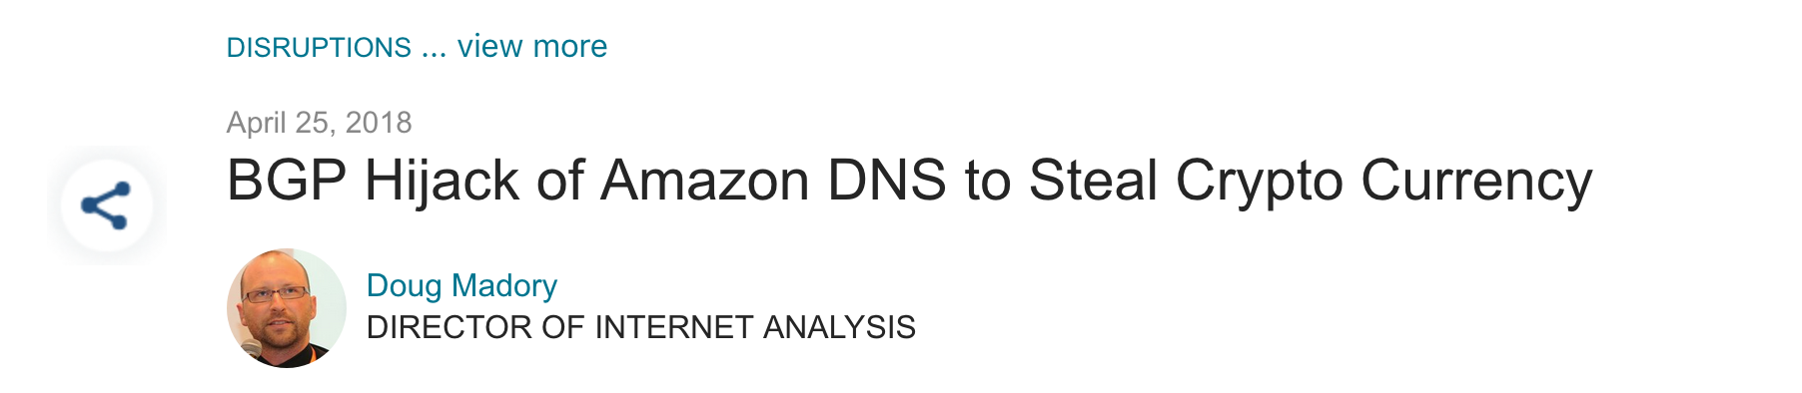

BGP is vulnerable to hijacks
BGP: Routing protocol used between autonomous systems
No inherent authentication method
Networks can falsely claim ownership of IP prefixes and announce malicious routes (i.e., a BGP hijack)

Slide 4



BGP hijacks and limitations
I originate 1.2.3.0/24
BGP Hijack:
I originate 1.2.3.0/24
instead
Limitation: victim partially loses Internet connectivity (can be detected with monitoring frameworks)
Limitation: adversary cannot perform passive traffic analysis or full man-in-the-middle attacks

Slide 5
BGP hijack vs interception
BGP Hijack:
BGP Interception:

Slide 6

Launching interception is challenging
Real Internet topology example from Taiwan DNS resolver hijack
Rest of Internet
Routes data to adversary
AS B
AS A
AS B
AS A
AS C
AS C
Adversary

Slide 7
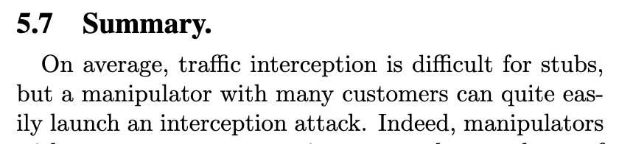
Previous views on Interception
Goldberg et al.
How Secure Are Secure Interdomain Routing Protocols
ACM SIGCOMM ‘10
84% of ASes on the Internet are stubs

Slide 8
Previous views on Interception
BGP communities allow stub networks to launch interception attacks
Goldberg et al.
How Secure Are Secure Interdomain Routing Protocols
ACM SIGCOMM ‘10
84% of ASes on the Internet are stubs

Slide 9
Our Contributions
Use seemingly benign BGP communities to enable 48% of ASes (incl. stubs) to launch interception
Demonstrate viability and effectiveness of these attacks in the wild
Introduce targeted BGP attacks that increase stealth and decrease attack cost
Notes:
Mention that 48% reflects current support for communities and in general community support is increasing.

Slide 10
Overview
How communities enable interception
Real-world evaluation
Targeted SICO attacks
Simulation-based evaluation

Slide 11
An interception scenario
Rest of Internet
Client
1.2.3.0/24
AS 4230
AS 18881
No announcement to AS B
Route reserved for traffic forwarding
AS A
AS A
AS B
I originate 1.2.3.0/24
Routes data to adversary
Routes data to victim
Adversary

Slide 12
An interception scenario
Rest of Internet
Rest of Internet
Client
1.2.3.0/24
AS 18881
AS A
I can get to 1.2.3.0/24
AS A
AS B
Existing route vs AS A’s route?
Routes data to adversary
Routes data to victim
Adversary

Slide 13
An interception scenario
Rest of Internet
Client
1.2.3.0/24
AS 4230
AS 1
AS A
AS B
I can get to 1.2.3.0/24
AS B
AS A’s route is better (local pref, length, IGP)
Routes data to adversary
Routes data to victim
Adversary

Slide 14
A failed interception scenario
Rest of Internet
Rest of Internet
Rest of Internet
Client
1.2.3.0/24
No way of forwarding packets to victim
AS 1
AS 1
AS A
AS 2
AS 2
AS B
Routes data to adversary
Routes data to victim
Adversary

Slide 15
SICO Attacks: Exploiting BGP Communities
BGP communities:
Tags attached to BGP announcements
Can control announcement propagation (e.g., prevent exporting routes to neighbors)
Support for propagation controlling communities by 21 of top 30 ISPs (as per as-rank.caida.org)

Slide 16
SICO Attacks: Exploiting BGP Communities
BGP communities:
Tags attached to BGP announcements
Can control announcement propagation (e.g., prevent exporting routes to neighbors)
Support for propagation controlling communities by 21 of top 30 ISPs (as per as-rank.caida.org)
The same communities that allow for benign traffic engineering can be exploited to enable interception!

Slide 17
SICO Example
Rest of Internet
Client
1.2.3.0/24
AS 4230
AS 18881
AS A
AS A
AS B
I originate 1.2.3.0/24
Communities: AS A should not export update to AS B
Routes data to adversary
Routes data to victim
Adversary

Slide 18
SICO Example
Rest of Internet
Rest of Internet
Client
I can get to 1.2.3.0/24
1.2.3.0/24
AS 18881
AS A
AS A
AS B
nothing
Routes data to adversary
Routes data to victim
Adversary

Slide 19
SICO Example
Rest of Internet
Rest of Internet
Client
1.2.3.0/24
Communities leave AS-path unaffected allowing for maximum effect
AS 4230
AS 18881
AS 1
AS A
AS B
Valid route to victim
Routes data to adversary
Routes data to victim
Adversary

Slide 20


Targeting a BGP attack to specific IPs
Untargeted interception attack:
Many irrelevant source addresses affected
Targeted interception attack:
Only relevant sources affected

Slide 21
Why target a BGP attack to specific sources?
Cheaper: affecting fewer source addresses reduces traffic volume and cost
Stealthier: unaffected sources cannot detect attack via effect on throughput or latency
Greater viability: viable against high-volume prefixes

Slide 22
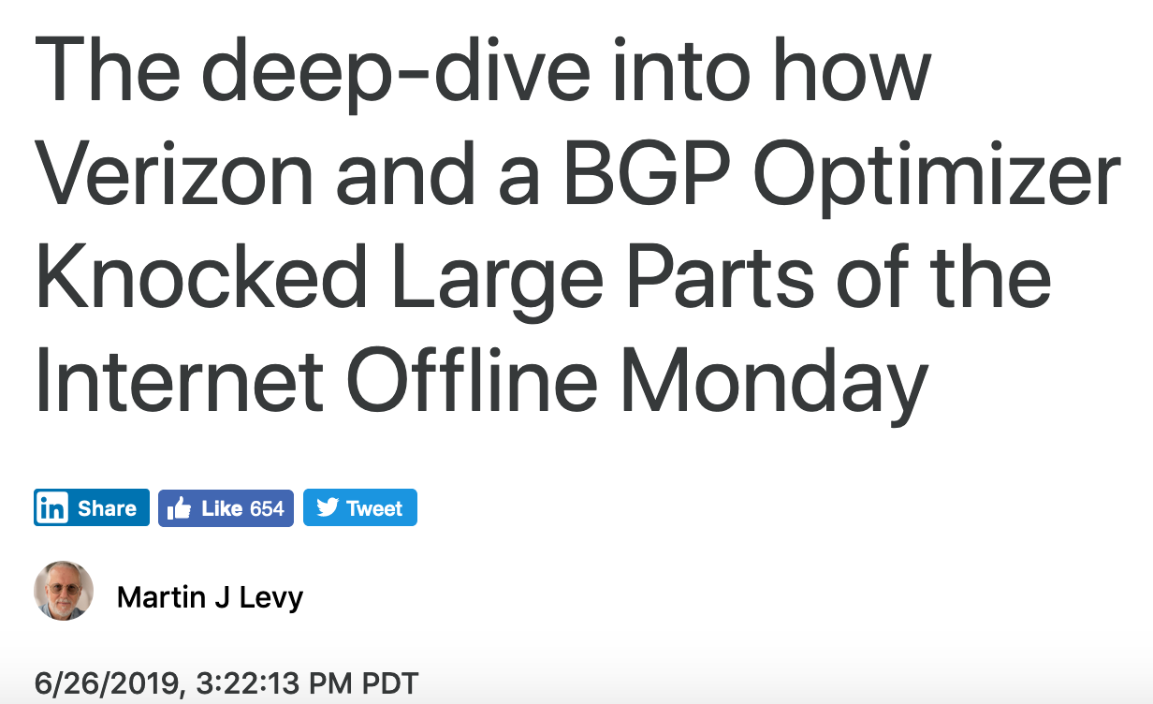
Why target a BGP attack to specific sources?
Cheaper: affecting fewer source addresses reduces traffic volume and cost
Stealthier: unaffected sources cannot detect attack via effect on throughput or latency
Greater viability: viable against high-volume prefixes
An interception is just a DOS if adversary can’t handle traffic volume

Slide 23
Targeted SICO Example
Rest of Internet
Rest of Internet
Rest of Internet
Client
1.2.3.0/24
AS 4230
AS 18881
AS A
I originate 1.2.3.0/24
Communities: Only announce route along path to target client
AS A
AS B
Routes data to adversary
Routes data to victim
Adversary

Slide 24
Targeted SICO Example
Rest of Internet
Rest of Internet
Client
1.2.3.0/24
Selective reduction in spread to increase stealth and reduce cost
AS 18881
AS A
AS A
AS B
Routes data to adversary
Routes data to victim
Adversary

Slide 25
Overview
How communities enable interception
Real-world evaluation
Targeted SICO attacks
Simulation-based evaluation

Slide 26
Ethically Launching Attacks
Used PEERING testbed
Hijack/intercept only our own prefixes
Repeated experiments with two different adversaries (Amsterdam and Seattle)

Slide 27
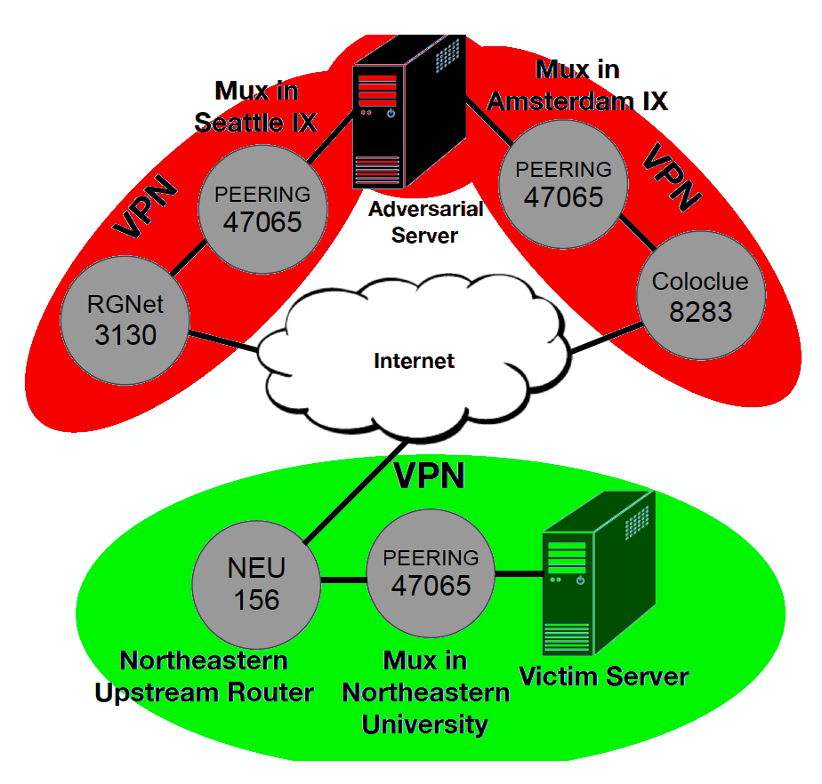
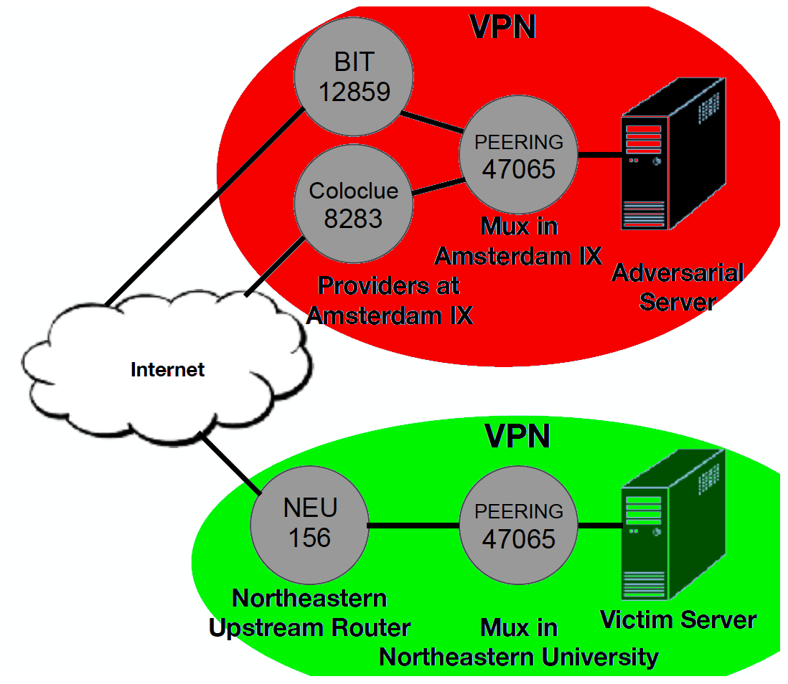
Experimental Setup
Amsterdam
Traffic:
to adversary
to victim
Seattle

Slide 28
Real-world Evaluation Methodology
Engineer interception attack with BGP communities at each location
Compare with previous works:
Test selective neighbor announcement (i.e., only announce to one provider)
Compare propagation to AS-path poisoning (i.e., interception via AS-path manipulation)

Slide 29
Real-world Evaluation Results
Successfully launched interception with communities at both locations
Selective neighbor announcement failed to achieve interception at either location
SICO attacks propagated significantly further than AS-path poisoning attacks …

Slide 30
How to measure spread
Internet
Ping requests
Adversary
Victim

Slide 31
How to measure spread
Internet
Ping response
Ping responses
2 out of 3 hosts
66% spread
Adversary
Victim
Spread = fraction of hosts routed to adversary

Slide 32
Spread Comparison
Prior works
Location | Maximum achievable interception spread | Spread SICO | Spread path poisoning | Selective neighbor announcement
Amsterdam | 68.9% | 68.8% | 52.6% | NA
Seattle | 43.9% | 38.9% | 12.4% | NA
SICO improves spread significantly compared to path poisoning

Slide 33
Overview
How communities enable interception
Real-world evaluation
Targeted SICO attacks
Simulation-based evaluation

Slide 34

Use of traditional interception against Tor
Excessive traffic volume breaks connections and prevents traffic correlation
Tor exit
Tor exit
really-popular-site.com
Sun et al.
RAPTOR: Routing Attacks on Privacy in Tor
USENIX Security ‘15
Adversary

Slide 35
Targeted interception against Tor
Irrelevant traffic is unaffected
Tor exit
Tor exit
really-popular-site.com
Adversary has capacity to maintain connections
Adversary

Slide 36
Targeting top
eight Tor exits
Tor exit node IP | Tor node ASN | Targeted attack spread
46.165.245.154 | 28753 | 5.5%
94.23.150.81 | 16276 | 1.8%
31.220.0.225 | 206264 | 0.2%
62.210.177.181 | 12876 | 0.5%
199.249.230.72 | 62744 | 3.3%
178.32.181.96 | 16276 | 1.9%
195.206.105.217 | 9009 | 8.0%
176.9.44.232 | 24940 | 0.7%
Average | NA | 2.7%

Slide 37
Targeting top
eight Tor exits
Tor exit node IP | Tor node ASN | Targeted attack spread
46.165.245.154 | 28753 | 5.5%
94.23.150.81 | 16276 | 1.8%
31.220.0.225 | 206264 | 0.2%
62.210.177.181 | 12876 | 0.5%
199.249.230.72 | 62744 | 3.3%
178.32.181.96 | 16276 | 1.9%
195.206.105.217 | 9009 | 8.0%
176.9.44.232 | 24940 | 0.7%
Average | NA | 2.7%
Average targeted attack spread was only 2.7% compared to 68.8% from untargeted interception

Slide 38
Overview
How communities enable interception
Real-world evaluation
Targeted SICO attacks
Simulation-based evaluation

Slide 39
Simulation Evaluation Results
Found community support by 21/top 30 ASes (by degree) through routing policy inspection
Studied Internet topology around supporting ASes via CAIDA AS-relations data set
48% of ASes capable of launching SICO attacks counting community forwarding

Slide 40
Simulation Evaluation Results
Only multi-homed ASes are capable of interception
48% of all ASes represents 83% of multi-homed ASes

Slide 41



Takeaways
Questions?
BGP communities let adversaries shape malicious announcements
This enables effective interception
Even stub ASes can feasibly intercept traffic
Future threat models should consider adversaries that can launch and target interception attacks
Thanks to support from

