Slide 1


Slide 2
Initial information
Stack: React
Data: Excel
Theme: Bootstrap

Slide 3

1.Header
Navbar: Schedule, Players, Teams, Latest News, Leaderboard
I applied animation on Logo of header.

Slide 4
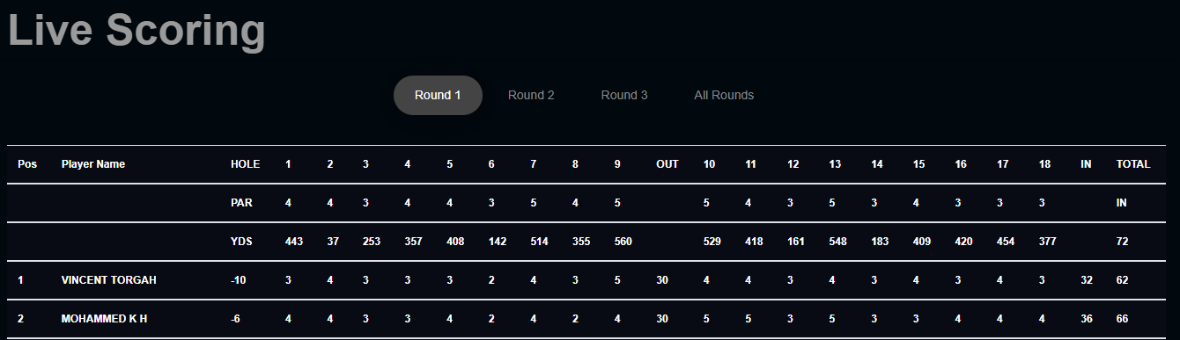
2.Live Scoring
Scoring: Round 1, Round 2, Round 3 and All Rounds
All data is loaded from excel automatically real-time.

Slide 5
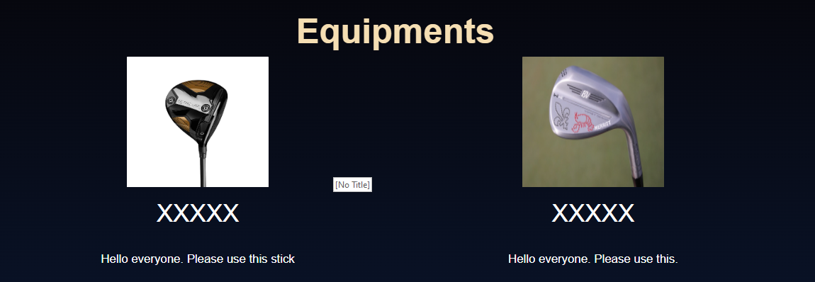
3.Equipment
All equipment are displayed here.

Slide 6
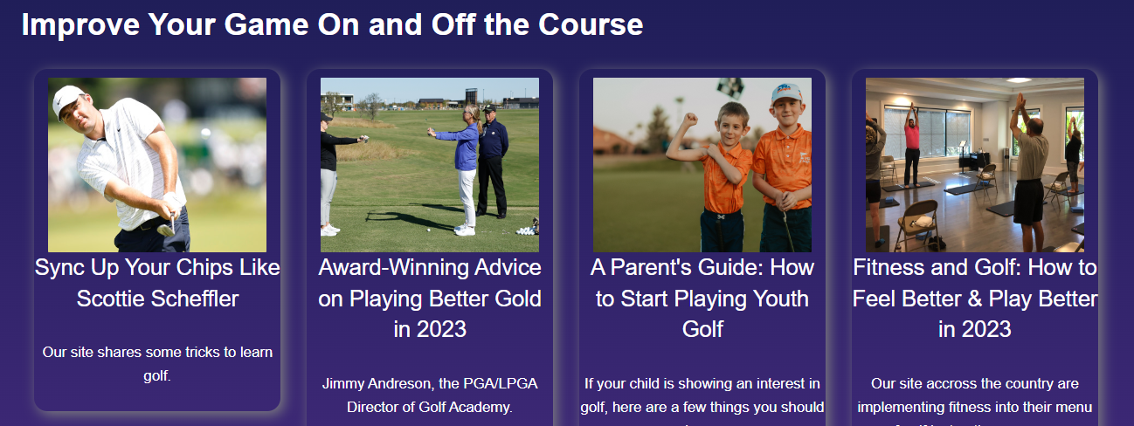
4.Course
All Course are displayed here.

Slide 7

5.Team Members
We are going to introduce main members.

Slide 8

6.Contact
Contact form to meet our team.

Slide 9
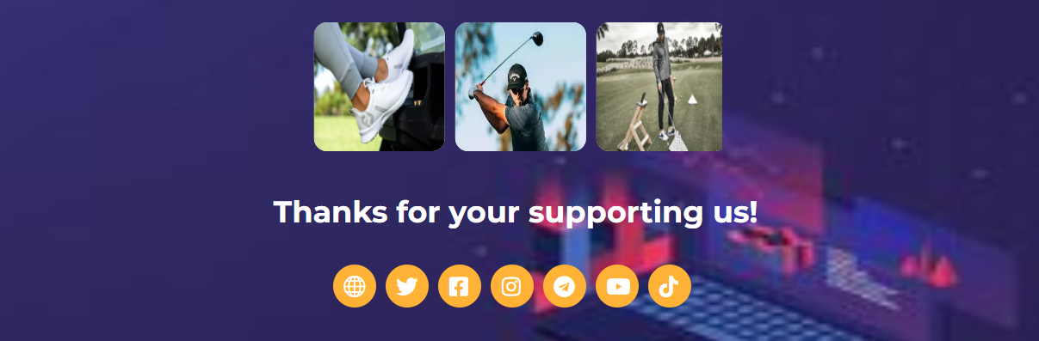
7.Service

