Slide 1
Testing the lifestyle difference with machine learning on the 2 sides of the ‘Latte Line’ of Sydney
Coursera
IBM Data Science Specialization
Course 9 - Capstone Project
Author: Szabolcs Szombath
Date: 09/02/2020

Slide 2
What is the Latte Line?
City districts are divers in many ways. Ideally there is no wealth-based segregation, but the difference between districts can be quite apparent.
In Sydney, the 'latte line’ allegory is used to divide the city to the prosperous North-East and the less attractive South-West.
While statistical data support this allegory, none of the sides are homogenous and in general people on both sides can live the way they want.

Slide 3
The Latte Line of Sydney

Slide 4
Use of data to evaluate the 'latte line'
In order to use machine learning algorithms with regard to this question, the following data sets are needed:
➢ List of neighbourhoods
➢ Area and population size of neighbourhoods
➢ Geocode of neighbourhoods
➢ Foursquare venue list of the given areas
➢ Information on which neighbourhoods are above/below the line

Slide 5
Questions to decide
Granularity of neighbourhoods
Matching neighbourhoods with Foursquare locations
Using venues as a mean of comparison
Location of the Latte Line
Success criteria

Slide 6
Data sources
A list of neighbourhoods of Sydney
Population size and area size of neighbourhoods
Foursquare API with venues

Slide 7
Normalising data
Assign latitude and longitude columns to the data set
Calculating radius
Assigning latte-line label to data set
Addressing data scarcity

Slide 8
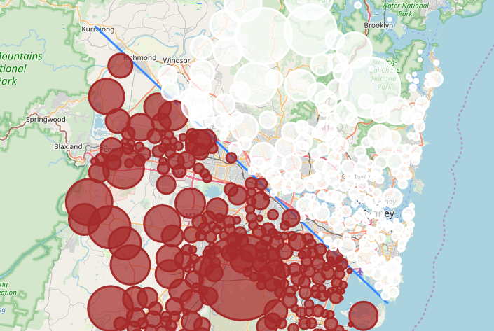
Dataset prepared for fetching Foursquare venue data

Slide 9
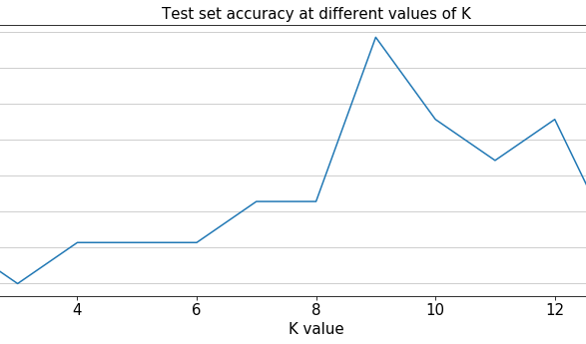
Algorithms - K Neighbours Classifier

Slide 10
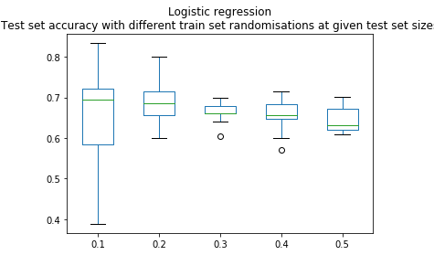
Algorithms - Logistic Regression

Slide 11
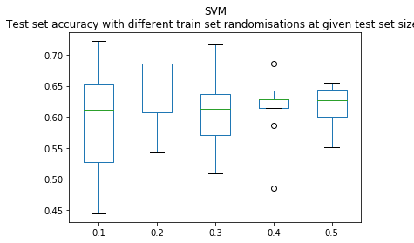
Algorithms - SVM

Slide 12
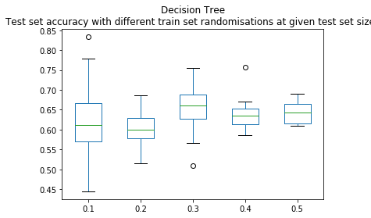
Algorithms - Decision Tree

Slide 13
Conclusion
4 machine algorithms have been tested whether with their help we can predict from Foursquare data if a suburb is north or south of the Latte Line.
Due to the low number of elements in the samples we can consider that the use of 90% of records in the training set is overfitting thus exclude their validity to test the latte line.
K Neighbours passed the initially set 75% accuracy expectations, Logistic regression was relatively close (considering the threshold was arbitrary), while SVM and Decision Tree performed below our pass mark. This suggest that based on venue types it is technically possible to predict the location of a suburb on the 2 sides of the latte line.

Slide 14
Final thoughts
Based on venue types not only the 'Latte Line' quality can be determined since suburbs differ from and resemble to each other in many factors.
Using a different labelling e.g. to hilly and beach-side areas would also be successful, just as commercial versus residential, dense and central versus far-away and secluded.
While technically it was possible to find similarities between suburbs on the same side of the line based on venue types, it does not necessarily mean that the underlying cause is lifestyle.

