Slide 1
Processes
Process Concept
Process Scheduling
Operations on Processes
Interprocess Communication
Examples of IPC Systems
Communication in Client-Server Systems

Slide 2
Process Concept
An operating system executes a variety of programs:
Batch system –jobs
Time-shared systems –user programs or tasks
Textbook uses the terms job and process almost interchangeably
Process –a program in execution; process execution must progress in sequential fashion
A process includes:
program counter
Stack
data section

Slide 3
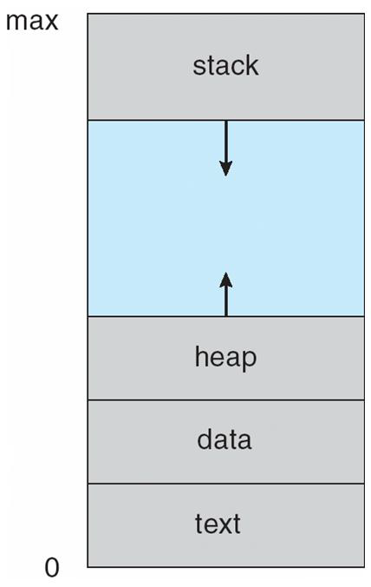
Process in Memory

Slide 4
Process State
As a process executes, it changes state
new: The process is being created
running: Instructions are being executed
waiting: The process is waiting for some event to occur
ready: The process is waiting to be assigned to a processor
terminated: The process has finished execution

Slide 5
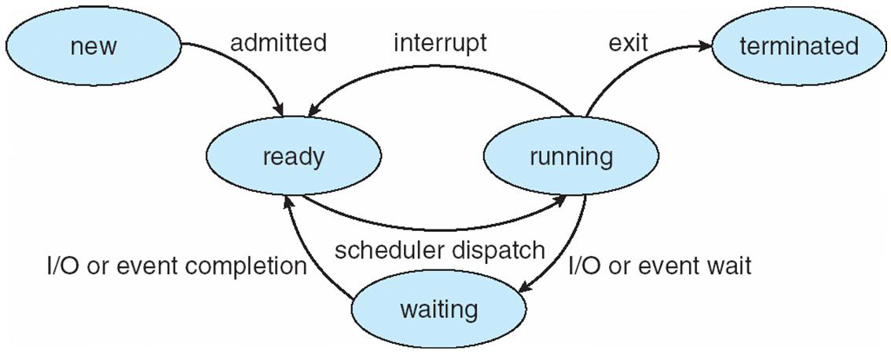
Process State

Slide 6
Process Control Block (PCB)
Information associated with each process
Process state
Program counter
CPU registers
CPU scheduling information
Memory-management information
I/O status information

Slide 7
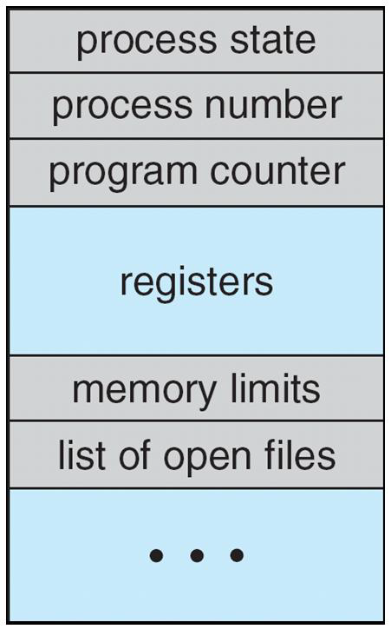
Process Control Block (PCB)

Slide 8
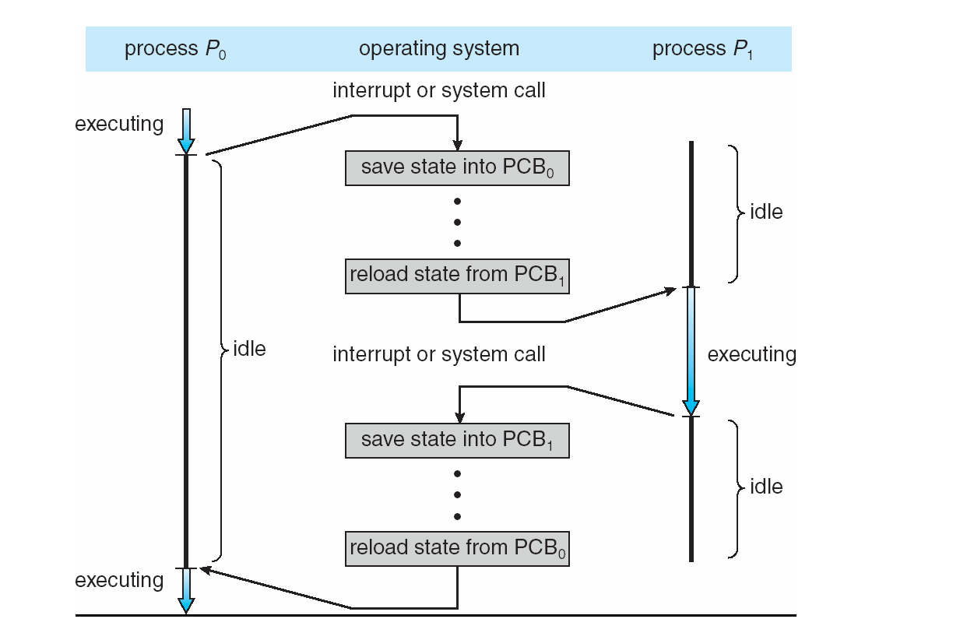

Slide 9
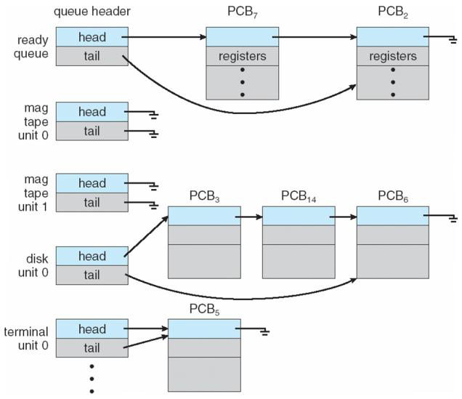
Ready Queue And Various I/O Queues

Slide 10
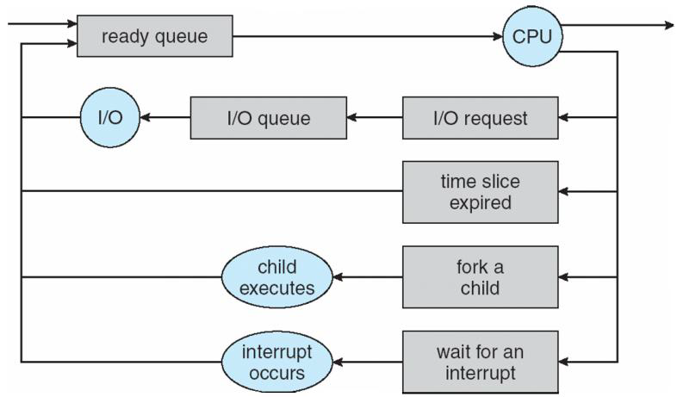
Representation of Process Scheduling

Slide 11
Schedulers
Long-term scheduler(or job scheduler) –selects which processes should be brought into the ready queue
Short-term scheduler(or CPU scheduler) –selects which process should be executed next and allocates CPU

Slide 12
Schedulers
Short-term scheduler is invoked very frequently (milliseconds) (must be fast)
Long-term scheduler is invoked very infrequently (seconds, minutes) (may be slow)
The long-term scheduler controls the degree of multiprogramming
Processes can be described as either:
I/O-bound process–spends more time doing I/O than computations, many short CPU bursts
CPU-bound process–spends more time doing computations; few very long CPU bursts

Slide 13
Context Switch
When CPU switches to another process, the system must save the state of the old process and load the saved state for the new process via a context switch
Context of a process represented in the PCB
Context-switch time is overhead; the system does no useful work while switching
Time dependent on hardware support

Slide 14
Process Creation
Parent process create children processes, which, in turn create other processes, forming a tree of processes
Generally, process identified and managed via a process identifier (pid)
Resource sharing
Parent and children share all resources
Children share subset of parent’s resources
Parent and child share no resources
Execution
Parent and children execute concurrently
Parent waits until children terminate

Slide 15
Process Creation
Address space
Child duplicate of parent
Child has a program loaded into it
UNIX examples
Fork system call creates new process
Exec system call used after a fork to replace the process’ memory space with a new program

Slide 16
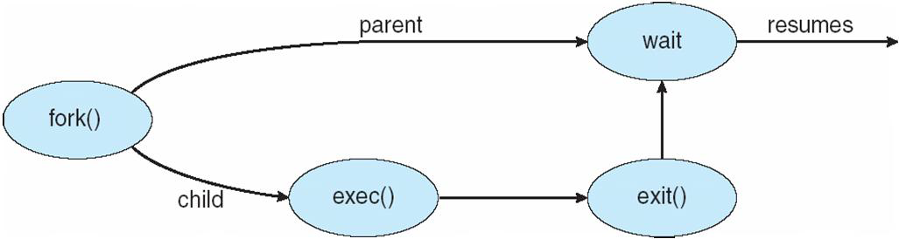
Process Creation

Slide 17
C program - fork
#include <stdio.h>
#include <stdlib.h>
int main()
{
int i, pid;
printf("My process ID is %d\n", getpid());
for ( i = 0; i < 3; i++ ) {
pid = fork();
if ( pid != 0 ) {
printf("I am the parent => PID = %d, child ID = %d\n", getpid(), pid);
}
else {
printf("I am the child => PID = %d\n", getpid());
}
}
while(1);
return(0);
}

Slide 18
C program - fork
#include <stdio.h>
int main()
{
int i, pid;
printf("My process ID is %d\n", getpid());
for ( i = 0; i < 3; i++ ) {
pid = fork();
if ( pid == 0 ) {
printf("I am the child => PID = %d\n", getpid());
while(1);
}
else
printf("I am the parent => PID = %d, child ID = %d\n", getpid(), pid);
}
while(1);
return(0);
}

Slide 19
C program - fork
#include <stdio.h>
#include <unistd.h>
#include <sys/types.h>
#include <sys/wait.h>
int main()
{
int i, status;
pid_t pid, pid_array[3];
printf("My process ID is %d\n", getpid());
for ( i = 0; i < 3; i++ ) {
pid = fork();
if ( pid == 0 ) {
printf("I am the child => PID = %d\n", getpid());
while(1);
}
else {
printf("I am the parent => PID = %d, child ID = %d\n", getpid(), pid);
pid_array[i] = pid;
}
}
//while( 1 ) {
for ( i = 0; i < 3; i++ ) {
if (pid = wait(&status)) {
printf("Process ID %d has terminated\n", pid);
}
}
return(0);
}

Slide 20
C program - fork
int main()
{
pid_t pid;
/* fork another process */
pid = fork();
if (pid < 0) { /* error occurred */
fprintf(stderr, "Fork Failed");
exit(-1);
}
else if (pid == 0) { /* child process */
execlp("/bin/ls", "ls", NULL);
}
else { /* parent process */
/* parent will wait for the child to complete */
wait (NULL);
printf ("Child Complete");
exit(0);
}
}

Slide 21
Process Creation –win32
BOOL CreateProcess(
LPCTSTR lpApplicationName, // name of executable module
LPTSTR lpCommandLine, // command line string
LPSECURITY_ATTRIBUTES lpProcessAttributes, // SD
LPSECURITY_ATTRIBUTES lpThreadAttributes, // SD
BOOL fInheritHandles, // handle inheritance option
DWORD dwCreationFlags, // creation flags
LPVOID lpEnvironment, // new envirnment block
LPCTSTR lpCurrentDirectory, // current directory name
LPSTARTUPINFO lpStartupInfo, // startup information
LPPROCESS_INFORMATION lpProcessInformation // process information
);

Slide 22
Process Creation –win32
STARTUPINFO si ;
PROCESS_INFORMATION pi;
ZeroMemory(&si,sizeof(si));
si.cb=sizeof(si);
ZeroMemory(&si,sizeof(pi));
char szExe[MAX_PATH] = “mspaint.exe";
///// HINSTANCE hInstance = GetModuleHandle(NULL);
//// GetModuleFileName(hInstance, szExe, MAX_PATH);
if(!CreateProcess(0, szExe, 0, 0, FALSE, 0, 0, 0, &si, &pi))
{ printf(“Create Process failed”); return -1;
}
// optionally wait for process to finish
WaitForSingleObject(pi.hProcess, INFINITE);
printf(“Child complete”);
CloseHandle(pi.hProcess);
CloseHandle(pi.hThread);

Slide 23
Process Termination
Process executes last statement and asks the operating system to delete it (exit)
Output data from child to parent (via wait)
Process’ resources are deallocated by operating system
Parent may terminate execution of children processes (abort)
Child has exceeded allocated resources
Task assigned to child is no longer required
If parent is exiting
Some operating system do not allow child to continue if its parent terminates
–All children terminated -cascading termination

Slide 24
Interprocess Communication
Processes within a system may be independent or cooperating
Cooperating process can affect or be affected by other processes, including sharing data
Reasons for cooperating processes:
Information sharing
Computation speedup
Modularity
Convenience
Cooperating processes need interprocess communication (IPC)
Two models of IPC
Shared memory
Message passing

Slide 25
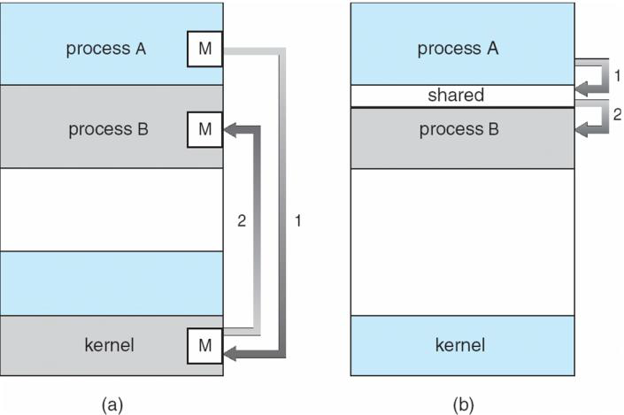
Communications Models

Slide 26
Cooperating Processes
Independent process cannot affect or be affected by the execution of another process
Cooperating process can affect or be affected by the execution of another process
Advantages of process cooperation
Information sharing
Computation speed-up
Modularity
Convenience

Slide 27
Signals
A signal is a limited form of inter-process communication used in Unix, Unix-like, and other POSIX-compliant operating systems.
It is an asynchronous notification sent to a process or to a specific thread within the same process in order to notify it of an event that occurred.
When a signal is sent, the operating system interrupts the target process's normal flow of execution. Execution can be interrupted during any non-atomic instruction. If the process has previously registered a signal handler, that routine is executed. Otherwise the default signal handler is executed.
Signals have been around since the 1970s Bell Labs Unix and are more recently specified in the POSIX standard.

Slide 28
Signals
examples of Linux signal types:
SIGINT : interrupt from keyboard
SIGFPE : floating point exception
SIGKILL : terminate receiving process
SIGCHLD : child process stopped or terminated
SIGSEGV : segment access violation
Signals are not presented to the process immediately when they are generated. They must wait until the process is running again.
If a process has specified its own signal handler. The Kernel must call the signal handler The program counter is set to the signal handling routine and the parameters to the routine are added to the call frame or registers.

Slide 29
Handling signals
Signal handlers can be installed with the signal() system call.
If a signal handler is not installed for a particular signal, the default handler is used. Otherwise the signal is intercepted and the signal handler is invoked.
The process can also specify two default behaviors, without creating a handler: ignore the signal (SIG_IGN) and use the default signal handler (SIG_DFL).
There are two signals which cannot be intercepted and handled: SIGKILL and SIGSTOP.

Slide 30
Signals - example
#include <stdio.h>
#include <signal.h>
//#include <unistd.h>
int ctrl_c_count = 0;
void (* old_handler)(int);
void ctrl_c(int);
void main () {
int c;
old_handler = signal (SIGINT, ctrl_c );
while ((c = getchar()) != '\n');
printf("ctrl_c count = %d\n", ctrl_c_count);
(void) signal (SIGINT, old_handler);
for (;;);
}
void ctrl_c(int signum) {
(void) signal (SIGINT, ctrl_c); // signals are automatically reset
++ctrl_c_count;
} //see also the POSIX sigaction() call - more complex but better

Slide 31
Masking signals with sigprocmask()
the (modern) "POSIX" function used to mask signals in the global context, is the sigprocmask() system call. It allows us to specify a set of signals to block, and returns the list of signals that were previously blocked. This is useful when we'll want to restore the previous masking state once we're done with our critical section.
Note: each process on a unix system has its own signals mask, which is used by the operating system to specify which signals should be delivered to the proces, and which should be blocked. The sigprocmask system call is used to take a signals mask we created in user space, and update the one in stored in the kernel, using this user-space mask. The mask stored in the kernel is the one later considered by the operating system, when deciding whether to deliver a signal to the process, or block it.
sigprocmask() accepts 3 parameters:
int how defines if we want to add signals to the current process's mask (SIG_BLOCK), remove them from the current mask (SIG_UNBLOCK), or completely replace the current mask with the new mask (SIG_SETMASK).
const sigset_t *setThe set of signals to be blocked, or to be added to the current mask, or removed from the current mask (depending on the 'how' parameter).
sigset_t *oldsetIf this parameter is not NULL, then it'll contain the previous mask. We can later use this set to restore the situation back to how it was before we called sigprocmask().

Slide 32
Example – signals masking
void catch_int(int sig_num) {
sigset_t mask_set; /* used to set a signal masking set. */
sigset_t old_set; /* used to store the old mask set. */
/* re-set the signal handler again to catch_int, for next time */ signal(SIGINT, catch_int);
/* block any further signals while we're inside the handler. */ sigfillset(&mask_set);
sigprocmask(SIG_SETMASK, &mask_set, &old_set);
/// signal handling code
/* restore old mask */
sigprocmask(SIG_SETMASK, &old_set, &mask_set, );

Slide 33
Implementing Timers Using Signals
#include <unistd.h>
#include <signal.h>
char user[40]; /* buffer to read user name from the user */ /* define an alarm signal handler. */
void catch_alarm(int sig_num) {
printf("Operation timed out. Exiting...\n\n"); exit(0); }
. . /* and inside the main program... */ . .
/* set a signal handler for ALRM signals */
signal(SIGALRM, catch_alarm);
/* prompt the user for input */
printf("Username: ");
fflush(stdout);
/* start a 30 seconds alarm */
alarm(30);
/* wait for user input */
gets(user);
/* remove the timer, now that we've got the user's input */
alarm(0);
. . /* do something with the received user name */

Slide 34
"Do" and "Don't" inside A Signal Handler
Make it short
Proper Signal Masking
Careful with "fault" signals
Careful with timers - only use one timer at a time
Signals are NOT an event driven framework
How to send Signals to another process? Kill(..)

Slide 35
pipes
Pipe is an effective way of communication between process. Pipe has descriptors. One descriptor is used for reading while other end is used for writing.
Usage of pipe is to have communication between child and parent process. We also use pipe to redirect of output of a process to another process. We often use pipe in our shell scripts.

Slide 36
Unidirectional, FIFO, unstructured data stream
Fixed maximum size
Simple flow control
pipe() system call creates two file descriptors. Why?
Implemented using filesystem, sockets or STREAMS (bidirectional pipe).

Slide 37
Implementation
In most Unix-like systems, all processes of a pipeline are started at the same time, with their streams appropriately connected, and managed by the scheduler together with all other processes running on the machine.
An important aspect of this, setting Unix pipes apart from other pipe implementations, is the concept of buffering: for example a sending program may produce 5000 bytes per second, and a receiving program may only be able to accept 100 bytes per second, but no data is lost. Instead, the output of the sending program is held in a queue.
When the receiving program is ready to read data, the operating system sends its data from the queue, then removes that data from the queue. If the queue buffer fills up, the sending program is suspended (blocked) until the receiving program has had a chance to read some data and make room in the buffer. In Linux, the size of the buffer is 65536 bytes.

Slide 38
example- Using a pipe to send data from parent to a child
#include <stdio.h>
#include <unistd.h>
#include <stdlib.h>
#include <string.h>
int main(int argc, char *argv[])
{
int f_des[2];
static char message[BUFSIZ];
if ( argc != 2 ) {
fprintf(stderr, "Usage: %s message\n", *argv);
exit(1);
}
if ( pipe(f_des) == -1 ) {
perror("Pipe");
exit(2);
}
switch ( fork() ) {
case -1:
perror("Fork");
exit(3);

Slide 39
Example- cont.
case 0: /* In the child */
close(f_des[1]);
if ( read(f_des[0], message, BUFSIZ) != -1 ) {
printf("Message received by child: [%s]\n", message);
fflush(stdout);
}
else {
perror("Read");
exit(4);
}
break;
default: /* In the parent */
close(f_des[0]);
if ( write(f_des[1], argv[1], strlen(argv[1])) != -1 ) {
printf("Message sent by parent: [%s]\n", argv[1]);
fflush(stdout);
}
else {
perror("Write");
exit(5);
}
}
exit(0);
}

Slide 40
Named Pipes (FIFOs - First In First Out)
A named pipe works much like a regular pipe, but does have some noticeable differences.
Named pipes exist as a device special file in the file system.
Processes of different ancestry can share data through a named pipe.
When all I/O is done by sharing processes, the named pipe remains in the file system for later use.

Slide 41
Creating a FIFO
To create a FIFO in C, we can make use of the mknod() system call:
PROTOTYPE:
int mknod( char *pathname, mode_t mode, dev_t dev); RETURNS: 0 on success, -1 on error:
mknod("/tmp/MYFIFO", S_IFIFO|0666, 0);

Slide 42
FIFO Operations
I/O operations on a FIFO are essentially the same as for normal pipes, with once major exception. An ``open'' system call or library function should be used to physically open up a channel to the pipe.

Slide 43
fifoserver.c
#include <stdio.h>
#include <stdlib.h>
#include <sys/stat.h>
#include <unistd.h>
#include <linux/stat.h>
#define FIFO_FILE "MYFIFO"
int main(void) {
FILE *fp;
char readbuf[80]; /* Create the FIFO if it does not exist */
umask(0);
mknod(FIFO_FILE, S_IFIFO|0666, 0);
while(1) {
fp = fopen(FIFO_FILE, "r");
fgets(readbuf, 80, fp);
printf("Received string: %s\n", readbuf);
fclose(fp); }
return(0); }

Slide 44
fifoclient.c
#include <stdio.h>
#include <stdlib.h>
#define FIFO_FILE "MYFIFO"
int main(int argc, char *argv[])
{ FILE *fp;
if ( argc != 2 ) {
printf("USAGE: fifoclient [string]\n"); exit(1); }
if((fp = fopen(FIFO_FILE, "w")) == NULL) { perror("fopen"); exit(1); }
fputs(argv[1], fp);
fclose(fp);
return(0);
}

Slide 45
Blocking Actions on a FIFO
Normally, blocking occurs on a FIFO. In other words, if the FIFO is opened for reading, the process will "block" until some other process opens it for writing. This action works vice-versa as well.
If this behavior is undesirable, the O_NONBLOCK flag can be used in an open() call to disable the default blocking action.
Can you think of another way to have a non-blocking FIFO?

Slide 46
Named Pipes –Win32
Here’s a quick overview of the steps required to create and use a simple named pipe to send data from a server program to a client program. Server program:
Call CreateNamedPipe(..) to create an instance of a named pipe.
Call ConnectNamedPipe(..) to wait for the client program to connect.
Call WriteFile(..) to send data down the pipe.
Call CloseHandle(..) to disconnect and close the pipe instance.

Slide 47
Named Pipes –Win32
Client program:
Call CreateFile(..) to connect to the pipe.
Call ReadFile(..) to get data from the pipe.
Output data to the screen.
Call CloseHandle(..) to disconnect from the pipe.
For more details visit
http://msdn.microsoft.com/en-us/library/windows/desktop/aa365590(v=vs.85).aspx

Slide 48
PIPE NAMES-win32
You can name Win32 pipes almost anything you like, as long as they start with the prefix “\\.\pipe\”. In practice it becomes ”\\\\.\\pipe\\”
Everything after that in the name is up to you, so long as you don’t use backslashes though
don’t exceed 256 characters in total

Slide 49
READ/WRITE MODES
There are two main modes of read/write operation available on pipes: byte stream, and message. The difference is fairly small, but can be very significant depending on your application.
Message mode simply makes a distinction between each set of data sent down the pipe. If a program sends 50 bytes, then 100 bytes, then 40 bytes, the receiving program will receive it in these separate blocks (and will therefore need to read the pipe at least 3 times to receive everything).
On the other hand, byte stream mode lets all the sent data flow continuously. In our example of 50, 100, then 40 bytes, the client could happily receive everything in a single 190-byte chunk. Which mode you choose depends on what your programs need to do

Slide 50
OVERLAPPED PIPE IO
By default, pipe operations in Win32 are synchronous, or blocking. That means your program (or specifically the thread which handles the pipe operations) will need to wait for each operation to complete before it can continue.
Using overlapped pipe IO means that pipe operations can process in the background while your program continues to do other things (including running other pipe operations in some cases). This can be very helpful, but it means you have to keep track of which operations are in progress, and monitor them for completion.
An alternative to overlapped operation is to run synchronous pipe operations in a separate thread. If your pipe IO needs are fairly simple then this may be a simpler option.

Slide 51
BUFFERED INPUT/OUTPUT
When calling “CreateNamedPipe(..)” you can choose to specify buffer sizes for outbound and inbound data.
These can be very helpful for program performance, particularly in synchronous operation.
If your buffer size is 0 (which is entirely valid) then every byte of data must be read from the other end of the pipe before the write operation can be completed
However, if a buffer is specified then a certain amount of data can linger in the pipe before it gets read. This can allow the sending program to carry on with other tasks without needing to use overlapped pipe IO.

Slide 52
CreateNamedPipe
HANDLE hPipe;
hPipe = CreateNamedPipe(
g_szPipeName, // pipe name
PIPE_ACCESS_DUPLEX, // read/write access PIPE_TYPE_MESSAGE | // message type pipe PIPE_READMODE_MESSAGE | // message-read mode PIPE_WAIT, // blocking mode PIPE_UNLIMITED_INSTANCES, // max. instances BUFFER_SIZE, // output buffer size
BUFFER_SIZE, // input buffer size NMPWAIT_USE_DEFAULT_WAIT, // client time-out NULL); // default security attribute

Slide 53
Message Passing
In a Message passing system there are no shared variables. IPC facility provides two operations for fixed or variable sized message:
send(message)
receive(message)
If processes P and Q wish to communicate, they need to:
establish a communication link
exchange messages via send and receive
Implementation of communication link
physical (e.g., shared memory, hardware bus)
logical (e.g., syntax and semantics, abstractions)

Slide 54
Implementation Questions
How are links established?
Can a link be associated with more than two processes?
How are links made known to processes?
How many links can there be between every pair/group of communicating processes?
What is the capacity of a link?
Is the size of a message that the link can accommodate fixed or variable?
Is a link unidirectional or bi-directional?

Slide 55
Message Passing Systems
Exchange messages over a communication link
Methods for implementing the communication link and primitives (send/receive):
Direct or Indirect communications (Naming)
Symmetric or Asymmetric communications
Automatic or Explicit buffering
Send-by-copy or send-by-reference
fixed or variable sized messages

Slide 56
Message Queues
Message queues can be best described as an internal linked list within the kernel's addressing space. Messages can be sent to the queue in order and retrieved from the queue in several different ways. Each message queue (of course) is uniquely identified by an IPC identifier.

Slide 57
Internal and User Data Structures
Message buffer : the msgbuf structurebe thought of as a template for message data.
Kernel msg structure : message details
Kernel msqid_ds structure: queue details
Kernel ipc_perm structure: permission information for IPC objects.

Slide 58
Message buffer
The msgbuf structure can be thought of as a template for message data.
It is up to the programmer to define structures of this type.
struct msgbuf { long mtype; /* type of message */ char mtext[1]; /* message data*/ };
struct my_msgbuf { long mtype; /* Message type */ long request_id; /* Request identifier */ struct client info; /* Client information structure */ };

Slide 59
SYSTEM CALL: msgget()
In order to create a new message queue, or access an existing queue, the msgget() system call is used
int msgget ( key_t key, int msgflg );
The first argument to msgget() is the key value (in our case returned by a call to ftok()).
the msgflg argument
IPC_CREAT: Create the queue if it doesn't already exist in the kernel.
IPC_EXCL: When used with IPC_CREAT, fail if queue already exists.
Msgget() returns the message queue identifier

Slide 60
Example- open_queue()
int open_queue( key_t keyval )
{
int qid;
if((qid = msgget( keyval, IPC_CREAT | 0660 )) == -1)
{
return(-1);
}
return(qid);
}

Slide 61
SYSTEM CALL: msgsnd()
Once we have the queue identifier, we can begin performing operations on it. To deliver a message to a queue, you use the msgsnd system call:
int msgsnd ( int msqid, struct msgbuf *msgp, int msgsz, int msgflg );
RETURNS: 0 on success -1 on error
msgsnd: queue identifier
msgp: pointer to the message buffer.
Msgsz: size of the message in bytes, excluding the length of the message type (4 byte long).
msgflg : 0 (ignored), or:
IPC_NOWAIT If the message queue is full, then the message is not written to the queue.

Slide 62
Example- send_message
int send_message( int qid, struct mymsgbuf *qbuf )
{
int result, length;
/* The length is essentially the size of the structure minus sizeof(mtype) */
length = sizeof(struct mymsgbuf) - sizeof(long);
if((result = msgsnd( qid, qbuf, length, 0)) == -1)
{
return(-1);
}
return(result);
}

Slide 63
#include <stdio.h>
#include <stdlib.h>
#include <linux/ipc.h>
#include <linux/msg.h>
main() {
int qid;
key_t msgkey;
struct mymsgbuf {
long mtype; /* Message type */
int request; /* Work request number */
double salary; /* Employee's salary */ } msg;
/* Generate our IPC key value */
msgkey = ftok(".", 'm');
/* Open/create the queue */
if(( qid = open_queue( msgkey)) == -1)
{ perror("open_queue"); exit(1); }
/* Load up the message with arbitrary test data */
msg.mtype = 1; /* Message type must be a positive number! */
msg.request = 1; /* Data element #1 */
msg.salary = 1000.00; /* Data element #2 (my yearly salary!)*/
if((send_message( qid, &msg )) == -1)
{ perror("send_message"); exit(1); } }

Slide 64
SYSTEM CALL: msgrcv()
Retrieving the message from the queue is done using the msgrcv() system call:
int msgrcv ( int msqid, struct msgbuf *msgp, int msgsz, long mtype, int msgflg );
RETURNS: Number of bytes copied into message buffer
msqid,msgp and msgsz same as msgsnd()
mtype: specifies the type of message to retrieve from the queue
msgflg: IPC_NOWAIT is passed as a flag, and no messages are available, the call returns ENOMSG to the calling process. Otherwise, the calling process blocks

Slide 65
Example- read_message()
int read_message( int qid, long type, struct mymsgbuf *qbuf )
{
int result, length;
/* The length is essentially the size of the structure minus sizeof(mtype) */
length = sizeof(struct mymsgbuf) - sizeof(long);
If((result = msgrcv( qid, qbuf, length, type, 0)) == -1)
{ return(-1); }
return(result);
}

Slide 66
Example- peek_message()
int peek_message( int qid, long type )
{
int result, length;
if((result = msgrcv( qid, NULL, 0, type, IPC_NOWAIT)) == -1)
{
if(errno == E2BIG)
return(TRUE);
}
return(FALSE);
}

Slide 67
SYSTEM CALL: msgctl()
To perform control operations on a message queue, you use the msgctl() system call.
int msgctl( int msgqid, int cmd, struct msqid_ds *buf );
RETURNS: 0 on success
cmd:
IPC_STAT: Retrieves the msqid_ds structure for a queue, and stores it in the address of the buf argument.
IPC_SET: Sets the value of the ipc_perm member of the msqid_ds structure for a queue. Takes the values from the buf argument.
IPC_RMID: Removes the queue from the kernel.

Slide 68
Example- remove_queue
int remove_queue( int qid )
{
if( msgctl( qid, IPC_RMID, 0) == -1)
{
return(-1);
}
return(0);
}

Slide 69
Example- Server
#include…..
#define KEY 500
struct msg
{
long int type;
char a[1024];
int pid;
}p,p1;
int main()
{
int m;
m=msgget(KEY,0666|IPC_CREAT);
p.type=1;
printf("\nEnter the msg");
scanf("%s",&p.a);
pid_t pid;
p.pid=getpid();
msgsnd(m,&p,sizeof(p),0);
msgrcv(m,&p1,sizeof(p),p.pid,0);
printf("%s",p1.a);
}

Slide 70
Example- Client
#define KEY 500
struct msg
{
long int type;
char a[1024];
int pid;
}p;
int main()
{
int m,n,fd,m1;
m=msgget(KEY,0666|IPC_CREAT);
while(1)
{
msgrcv(m,&p,sizeof(p),1,0);
printf("Filename from client %s\n",p.a);
fd=open(p.a,O_RDONLY);
n=read(fd,p.a,1024);
p.type=p.pid;
p.pid=getpid();
msgsnd(m,&p,sizeof(p),0);
} }

Slide 71
Example- Output
Enter the msg strcmp.c
Filename from client strcmp.c
#include<stdio.h>
#include<unistd.h>
#include<sys/types.h>
#include<sys/stat.h>
#include<stdlib.h>
#include<string.h>
int main(int argc,char *argv[])
{
if(strcmp(argv[1],argv[2])==0)
printf("The given strings are equal");
else
printf("The strings are not equal");
}

Slide 72
Mailslot – Win32
Mailslot is used for one way inter-process communications.
There is a Mailslot server which will be read-only; it will just read the client sent messages.
The clients will be write-only clients, sending messages to the server.
Mailslot messages can be of around 400 bytes only.
Mailslot can broadcast messages in a domain. If processes in a domain create a mailslot with the same name, then a message that is sent to that mailslot is sent to all of these processes.

Slide 73
Mailslot Win32 APIs
Following are some of the Win32 APIs that are used when working with Mailslot:
CreateMailSlot()
GetMailslotInfo()
SetMailslotInfo()
ReadFile()
WriteFile()
CloseHandle()

Slide 74
Mailslot name
A Mailslot name needs to be in the following format:
\\ComputerName\mailslot\[path\]name
\\DomainName\mailslot\[path\]name
\\*\mailslot\[path\]name

Slide 75
Demo

Slide 76
Shared Memory
Shared memory can best be described as the mapping of an area (segment) of memory that will be mapped and shared by more than one process.
This is by far the fastest form of IPC.
information is mapped directly from a memory segment, and into the addressing space of the calling process
A segment can be created by one process, and subsequently written to and read from by any number of processes.

Slide 77
Shared memory - unix
the kernel maintains a special internal data structure for each shared memory segment which exists within its addressing space. This structure is of type shmid_ds, and is defined in linux/shm.h
The shared memory is managed using four system calls
shmget()
shmat()
shmctl()
shmdt()

Slide 78
SYSTEM CALL: shmget()
In order to create a new shared memory, or access an existing one, the shmget() system call is used.
int shmget ( key_t key, int size, int shmflg );
RETURNS: shared memory segment identifier on success -1 on error
key :the IPC key value (in our case returned by a call to ftok()).
the msgflg argument
IPC_CREAT: Create the segment if it doesn't already exist in the kernel.
IPC_EXCL: When used with IPC_CREAT, fail if segment already exists.

Slide 79
Example- open_segment
int open_segment( key_t keyval, int segsize )
{
int shmid;
if((shmid = shmget( keyval, segsize, IPC_CREAT | 0660 )) == -1)
{
return(-1);
}
return(shmid);
}

Slide 80
SYSTEM CALL: shmat()
Once a process has a valid IPC identifier for a given segment, the next step is for the process to attach or map the segment into its own addressing space
int shmat ( int shmid, char *shmaddr, int shmflg);
RETURNS: address at which segment was attached to the process, or -1 on error
If the addr argument is zero (0), the kernel tries to find an unmapped region
if the SHM_RDONLY flag is OR'd in with the flag argument, then the shared memory segment will be mapped in, but marked as readonly.

Slide 81
Example- attach_segment
char *attach_segment( int shmid )
{
return(shmat(shmid, 0, 0));
}

Slide 82
SYSTEM CALL: shmctl()
int shmctl ( int shmqid, int cmd, struct shmid_ds *buf );
Commands:
IPC_STAT Retrieves the shmid_ds structure for a segment, and stores it in the address of the buf argument
IPC_SET Sets the value of the ipc_perm member of the shmid_ds structure for a segment. Takes the values from the buf argument.
IPC_RMID Marks a segment for removal.
The IPC_RMID command doesn't actually remove a segment from the kernel. Rather, it marks the segment for removal. The actual removal itself occurs when the last process currently attached to the segment has properly detached it. Of course, if no processes are currently attached to the segment, the removal seems immediate.

Slide 83
SYSTEM CALL: shmdt()
int shmdt ( char *shmaddr );
After a shared memory segment is no longer needed by a process, it should be detached by calling this system call.
this is not the same as removing the segment from the kernel! After a detach is successful, the shm_nattch member of the associates shmid_ds structure is decremented by one. When this value reaches zero (0), the kernel will physically remove the segment.

Slide 84
shm_server.c
#include <sys/types.h>
#include <sys/ipc.h
#include <sys/shm.h>
#include <stdio.h>
#define SHMSZ 27
main() {
char c; int shmid; key_t key;
char *shm, *s;
key = 5678; /* * Create the segment. */
if ((shmid = shmget(key, SHMSZ, IPC_CREAT | 0666)) < 0)
{ perror("shmget"); exit(1); }
/* * Now we attach the segment to our data space. */
if ((shm = shmat(shmid, NULL, 0)) == (char *) -1)
{ perror("shmat"); exit(1); }
/* * Now put some things into the memory for the * other process to read. */
s = shm;
for (c = 'a'; c <= 'z'; c++) *s++ = c; *s = NULL;
/* * Finally, we wait until the other process * changes the first character of our memory * to '*', indicating that it has read what * we put there. */
while (*shm != '*') sleep(1);
exit(0); }

Slide 85
shm_client.c
#include <sys/types.h>
#include <sys/ipc.h
#include <sys/shm.h>
#include <stdio.h>
#define SHMSZ 27
main() {
char c; int shmid; key_t key;
char *shm, *s;
key = 5678; /* * Locate the segment.. */
if ((shmid = shmget(key, SHMSZ, IPC_CREAT | 0666)) < 0)
{ perror("shmget"); exit(1); }
/* * Now we attach the segment to our data space. */
if ((shm = shmat(shmid, NULL, 0)) == (char *) -1)
{ perror("shmat"); exit(1); }
/* * Now read what the server put in the memory. */
for (s = shm; *s != NULL; s++) putchar(*s);
putchar('\n');
/* * Finally, change the first character of the * segment to '*', indicating we have read * the segment. */
*shm = '*'; exit(0); }

Slide 86
Memory Mapped files – win32
File mapping is an efficient way for two or more processes on the same computer to share data.
In order to access the file's contents, the processes uses virtual address space called file view.
Processes read from and write to the file view using pointers, just as they would with dynamically allocated memory.

Slide 87
Shared memory win32 APIs
Following are some of the Win32 APIs that are used when working with shared memory (memory mapped objects):
CreateFileMapping() : create shared memory
MapViewOfFile() : attach the process to the shared segment
UnMapViewOfFile() detach the process from the shared segment
CloseHandle()

Slide 88
CreateFileMapping()
HANDLE CreateFileMapping(
HANDLE hFile,// handle to file to map -- INVALID_HANDLE_VALUE, if only shared memory LPSECURITY_ATTRIBUTES lpFileMappingAttributes,
DWORD flProtect, // protection for mapping object DWORD dwMaximumSizeHigh,
DWORD dwMaximumSizeLow,
LPCTSTR lpName// name of file-mapping object);
The flProtect argument can be one of the following.
PAGE_READONLY - memory is readonly
PAGE_READWRITE - memory is readable and writable
PAGE_WRITECOPY - memory is readable, after memory has been written too.

Slide 89
MapViewOfFile()
LPVOID MapViewOfFile(
HANDLE hFileMappingObject,// file-mapping object DWORD dwDesiredAccess,// access mode DWORD dwFileOffsetHigh,// file offset DWORD dwFileOffsetLow,// file offset DWORD dwNumberOfBytesToMap);
Function maps a buffer referred to by the file mapping object to the local process space of the current process. The function returns NULL, if there was an error. Otherwise, it returns a legal address. The dwDesiredAccess has the following values:
FILE_MAP_READ - mapping can only be read only
FILE_MAP_WRITE - mapping can either be read or write

Slide 90
UnMapViewOfFile()
A file buffer that was mapped to the current process space is realeased with this function. The lpBaseAddress argument takes the return value from the MapViewOfFile function. The return value of this function is TRUE on success.
BOOL UnmapViewOfFile( LPCVOID lpBaseAddress);

Slide 91
Example
struct TSharedMemory {
DWORD m_dwProcessID; // Process ID from client
CHAR m_cText[512]; // Text from client to server
UINT m_nTextLength; // Returned from client
};
m_hMap = ::CreateFileMapping(
(HANDLE) INVALID_HANDLE_VALUE,
NULL,
PAGE_READWRITE,
0,
sizeof(TSharedMemory),
“ApplicationSpecificSharedMem");
m_pMsg = (TSharedMemory*)::MapViewOfFile(m_hMap,FILE_MAP_WRITE,0,0,sizeof(TSharedMemory));
// read and write to the memory
::CloseHandle(m_hMap);

Slide 92
Semaphores
Semaphores can best be described as counters used to control access to shared resources by multiple processes. They are most often used as a locking mechanism to prevent processes from accessing a particular resource while another process is performing operations on it.
think of them as resource counters
it is important to realize that semaphores are actually implemented as sets ( Unix ), rather than as single entities.

Slide 93
Semaphores- Unix
As with message queues, the kernel maintains a special internal data structure for each semaphore set which exists within its addressing space. This structure is of type semid_ds
sem structure exists for every semaphore in the set and contains information like the current count

Slide 94
SYSTEM CALL: semget()
int semget ( key_t key, int nsems, int semflg );
RETURNS: semaphore set IPC identifier on success -1 on error
key :the IPC key value (in our case returned by a call to ftok()).
the msgflg argument
IPC_CREAT: Create the semaphore set if it doesn't already exist in the kernel.
IPC_EXCL: When used with IPC_CREAT, fail if semaphore already exists.

Slide 95
Example - open_semaphore_set
int open_semaphore_set( key_t keyval, int numsems )
{
int sid;
if ( ! numsems )
return(-1);
if((sid = semget( mykey, numsems, IPC_CREAT | 0660 )) == -1)
{ return(-1); }
return(sid);
}

Slide 96
SYSTEM CALL: semop()
int semop ( int semid, struct sembuf *sops, unsigned nsops);
RETURNS: 0 on success (all operations performed) -1 on error
The first argument to semget() is the key value (in our case returned by a call to semget).
The second argument (sops) is a pointer to an array of operations to be performed on the semaphore set
the third argument (nsops) is the number of operations in that array.

Slide 97
struct sembuf {
ushort sem_num; /* semaphore index in array */ short sem_op; /* semaphore operation */ short sem_flg; /* operation flags */
};
If sem_op is negative, then its value is subtracted from the semaphore. This correlates with obtaining resources that the semaphore controls
If sem_op is positive, then it's value is added to the semaphore. This correlates with returning resources back to the application's semaphore set
if sem_op is zero (0), then the calling process will sleep() until the semaphore's value is 0. This correlates to waiting for a semaphore to reach 100% utilization.

Slide 98
example
struct sembuf acquire = {0, -1, SEM_UNDO},
release = {0, 1, SEM_UNDO};
semid = semget(ipc_key, 2, IPC_CREAT | IPC_EXCL | 0660)) ;
semop(semid, &acquire, 1);
/// use the shared recource
semop(semid, &release, 1);

Slide 99
SYSTEM CALL: semctl()
int semctl ( int semid, int semnum, int cmd, union semun arg );
IPC_STAT Retrieves the semid_ds structure for a set, and stores it in the address of the buf argument in the semun union.
IPC_SET Sets the value of the ipc_perm member of the semid_ds structure for a set. Takes the values from the buf argument of the semun union.
IPC_RMID Removes the set from the kernel.
GETALL Used to obtain the values of all semaphores in a set. The integer values are stored in an array of unsigned short integers pointed to by the array member of the union.
GETNCNT Returns the number of processes currently waiting for resources.
GETPID Returns the PID of the process which performed the last semop call.
GETVAL Returns the value of a single semaphore within the set.
GETZCNT Returns the number of processes currently waiting for 100% resource utilization.
SETALL Sets all semaphore values with a set to the matching values contained in the array member of the union.
SETVAL Sets the value of an individual semaphore within the set to the val member of the union.

Slide 100
union semun {
int val; /* value for SETVAL */
struct semid_ds *buf; // buffer for IPC_STAT & IPC_SET
ushort *array; // array for GETALL & SETALL
struct seminfo *__buf; // buffer for IPC_INFO
void *__pad; };
int get_sem_val( int sid, int semnum )
{
return( semctl(sid, semnum, GETVAL, 0));
}
#define MAX_PRINTERS 5
printer_usage()
{
int x;
for(x=0; x<MAX_PRINTERS; x++)
printf("Printer %d: %d\n\r", x, get_sem_val( sid, x ));
}

Slide 101
Consider the following function, which could be used to initialize a new semaphore value:
void init_semaphore( int sid, int semnum, int initval)
{
union semun semopts;
semopts.val = initval;
semctl( sid, semnum, SETVAL, semopts);
}

Slide 102
Semaphores – Win32
CreateSemaphore( ) : create new or open existing semaphore
WaitForSingleObject(): acquire semaphore
ReleaseSemaphore(): release semaphore
CloseHandle()

Slide 103
CreateSemaphore()
HANDLE CreateSemaphore( LPSECURITY_ATTRIBUTES lpSemaphoreAttributes, LONG lInitialCount, LONG lMaximumCount, LPCTSTR lpName );

Slide 104
WaitForSingleObject()
DWORD WINAPI WaitForSingleObject(
HANDLE hHandle,
DWORD dwMilliseconds );

Slide 105
ReleaseSemaphore
BOOL WINAPI ReleaseSemaphore(
HANDLE hSemaphore,
LONG lReleaseCount,
LPLONG lpPreviousCount );
lReleaseCount The amount by which the semaphore object's current count is to be increased. The value must be greater than zero. If the specified amount would cause the semaphore's count to exceed the maximum count that was specified when the semaphore was created, the count is not changed and the function returns FALSE.

Slide 106
Introduction to Socket Programming

Slide 107
Server and Client
Server and Client exchange messages over the network through a common Socket API
Server
Clients
user
space
ports
TCP/UDP
TCP/UDP
Socket API
kernel
space
IP
IP
Ethernet Adapter
Ethernet Adapter
hardware

Slide 108
User Datagram Protocol(UDP): An Analogy
UDP
Single socket to receive messages
No guarantee of delivery
Not necessarily in-order delivery
Datagram – independent packets
Must address each packet
Postal Mail
Single mailbox to receive messages
Unreliable ☺
Not necessarily in-order delivery
Each letter is independent
Must address each reply
Postal Mail
Single mailbox to receive letters
Unreliable ☺
Not necessarily in-order delivery
Letters sent independently
Must address each reply
Example UDP applications
Multimedia, voice over IP

Slide 109
Transmission Control Protocol (TCP): An Analogy
TCP
Reliable – guarantee delivery
Byte stream – in-order delivery
Connection-oriented – single socket per connection
Setup connection followed by data transfer
Telephone Call
Guaranteed delivery
In-order delivery
Connection-oriented
Setup connection followed by conversation
Example TCP applications
Web, Email, Telnet

Slide 110
Network Addressing Analogy
Telephone Call
Network Programming
Professors at CMU
Applications/Servers
412-268-8000 ext.123
412-268-8000 ext.654
Web
Port 80
Mail
Port 25
Extension
Port No.
Telephone No
IP Address
Central Number
Network No.
Exchange
Host Number
Area Code
15-441 Students
Clients

Slide 111
Concept of Port Numbers
Port numbers are used to identify “entities” on a host
Port numbers can be
Well-known (port 0-1023)
Dynamic or private (port 1024-65535)
Servers/daemons usually use well-known ports
Any client can identify the server/service
HTTP = 80, FTP = 21, Telnet = 23, ...
/etc/service defines well-known ports
Clients usually use dynamic ports
Assigned by the kernel at run time
NTP
daemon
Web server
port 123
port 80
TCP/UDP
IP
Ethernet Adapter

Slide 112
Names and Addresses
Each attachment point on Internet is given unique address
Based on location within network – like phone numbers
Humans prefer to deal with names not addresses
DNS provides mapping of name to address
Name based on administrative ownership of host

Slide 113
Internet Addressing Data Structure
#include <netinet/in.h>
/* Internet address structure */
struct in_addr {
u_long s_addr; /* 32-bit IPv4 address */
}; /* network byte ordered */
/* Socket address, Internet style. */
struct sockaddr_in {
u_char sin_family; /* Address Family */
u_short sin_port; /* UDP or TCP Port# */
/* network byte ordered */
struct in_addr sin_addr; /* Internet Address */
char sin_zero[8]; /* unused */
};
sin_family = AF_INET selects Internet address family

Slide 114
Byte Ordering
union {
u_int32_t addr; /* 4 bytes address */
char c[4];
} un;
/* 128.2.194.95 */
un.addr = 0x8002c25f;
/* c[0] = ? */
c[0] c[1] c[2] c[3]
Big Endian
Sun Solaris, PowerPC, ...
Little Endian
i386, alpha, ...
Network byte order = Big Endian
128
2
194
95
95
194
2
128

Slide 115
Byte Ordering Functions
Converts between host byte order and network byte order
‘h’ = host byte order
‘n’ = network byte order
‘l’ = long (4 bytes), converts IP addresses
‘s’ = short (2 bytes), converts port numbers
#include <netinet/in.h>
unsigned long int htonl(unsigned long int hostlong);
unsigned short int htons(unsigned short int hostshort);
unsigned long int ntohl(unsigned long int netlong);
unsigned short int ntohs(unsigned short int netshort);

Slide 116
Lecture Overview
Background
TCP vs. UDP
Byte ordering
Socket I/O
TCP/UDP server and client
I/O multiplexing

Slide 117
What is a Socket?
A socket is a file descriptor that lets an application read/write data from/to the network
socket returns an integer (socket descriptor)
fd < 0 indicates that an error occurred
socket descriptors are similar to file descriptors
AF_INET: associates a socket with the Internet protocol family
SOCK_STREAM: selects the TCP protocol
SOCK_DGRAM: selects the UDP protocol
int fd; /* socket descriptor */
if ((fd = socket(AF_INET, SOCK_STREAM, 0)) < 0) }
perror(“socket”);
exit(1);
}

Slide 118
TCP Server
For example: web server
What does a web server need to do so that a web client can connect to it?
Web Server
Port 80
TCP
IP
Ethernet Adapter

Slide 119
Socket I/O: socket()
Since web traffic uses TCP, the web server must create a socket of type SOCK_STREAM
int fd; /* socket descriptor */
if((fd = socket(AF_INET, SOCK_STREAM, 0)) < 0) {
perror(“socket”);
exit(1);
}
socket returns an integer (socket descriptor)
fd < 0 indicates that an error occurred
AF_INET associates a socket with the Internet protocol family
SOCK_STREAM selects the TCP protocol

Slide 120
Socket I/O: bind()
A socket can be bound to a port
int fd; /* socket descriptor */
struct sockaddr_in srv; /* used by bind() */
/* create the socket */
srv.sin_family = AF_INET; /* use the Internet addr family */
srv.sin_port = htons(80); /* bind socket ‘fd’ to port 80*/
/* bind: a client may connect to any of my addresses */
srv.sin_addr.s_addr = htonl(INADDR_ANY);
if(bind(fd, (struct sockaddr*) &srv, sizeof(srv)) < 0) {
perror("bind"); exit(1);
}
Still not quite ready to communicate with a client...

Slide 121
Socket I/O: listen()
listen indicates that the server will accept a connection
int fd; /* socket descriptor */
struct sockaddr_in srv; /* used by bind() */
/* 1) create the socket */
/* 2) bind the socket to a port */
if(listen(fd, 5) < 0) {
perror(“listen”);
exit(1);
}
Still not quite ready to communicate with a client...

Slide 122
Socket I/O: accept()
accept blocks waiting for a connection
int fd; /* socket descriptor */
struct sockaddr_in srv; /* used by bind() */
struct sockaddr_in cli; /* used by accept() */
int newfd; /* returned by accept() */
int cli_len = sizeof(cli); /* used by accept() */
/* 1) create the socket */
/* 2) bind the socket to a port */
/* 3) listen on the socket */
newfd = accept(fd, (struct sockaddr*) &cli, &cli_len);
if(newfd < 0) {
perror("accept"); exit(1);
}
accept returns a new socket (newfd) with the same properties as the original socket (fd)
newfd < 0 indicates that an error occurred

Slide 123
Socket I/O: accept() continued...
struct sockaddr_in cli; /* used by accept() */
int newfd; /* returned by accept() */
int cli_len = sizeof(cli); /* used by accept() */
newfd = accept(fd, (struct sockaddr*) &cli, &cli_len);
if(newfd < 0) {
perror("accept");
exit(1);
}
How does the server know which client it is?
cli.sin_addr.s_addr contains the client’s IP address
cli.sin_port contains the client’s port number
Now the server can exchange data with the client by using read and write on the descriptor newfd.
Why does accept need to return a new descriptor?

Slide 124
Socket I/O: read()
read can be used with a socket
read blocks waiting for data from the client but does not guarantee that sizeof(buf) is read
int fd; /* socket descriptor */
char buf[512]; /* used by read() */
int nbytes; /* used by read() */
/* 1) create the socket */
/* 2) bind the socket to a port */
/* 3) listen on the socket */
/* 4) accept the incoming connection */
if((nbytes = read(newfd, buf, sizeof(buf))) < 0) {
perror(“read”); exit(1);
}

Slide 125
TCP Client
For example: web client
How does a web client connect to a web server?
2 Web Clients
TCP
IP
Ethernet Adapter

Slide 126
Dealing with IP Addresses
IP Addresses are commonly written as strings (“128.2.35.50”), but programs deal with IP addresses as integers.
Converting strings to numerical address:
struct sockaddr_in srv;
srv.sin_addr.s_addr = inet_addr(“128.2.35.50”);
if(srv.sin_addr.s_addr == (in_addr_t) -1) {
fprintf(stderr, "inet_addr failed!\n"); exit(1);
}
Converting a numerical address to a string:
struct sockaddr_in srv;
char *t = inet_ntoa(srv.sin_addr);
if(t == 0) {
fprintf(stderr, “inet_ntoa failed!\n”); exit(1);
}

Slide 127
Translating Names to Addresses
Gethostbyname provides interface to DNS
Additional useful calls
Gethostbyaddr – returns hostent given sockaddr_in
Getservbyname
Used to get service description (typically port number)
Returns servent based on name
#include <netdb.h>
struct hostent *hp; /*ptr to host info for remote*/
struct sockaddr_in peeraddr;
char *name = “www.cs.cmu.edu”;
peeraddr.sin_family = AF_INET;
hp = gethostbyname(name)
peeraddr.sin_addr.s_addr = ((struct in_addr*)(hp->h_addr))->s_addr;

Slide 128
Socket I/O: connect()
connect allows a client to connect to a server...
int fd; /* socket descriptor */
struct sockaddr_in srv; /* used by connect() */
/* create the socket */
/* connect: use the Internet address family */
srv.sin_family = AF_INET;
/* connect: socket ‘fd’ to port 80 */
srv.sin_port = htons(80);
/* connect: connect to IP Address “128.2.35.50” */
srv.sin_addr.s_addr = inet_addr(“128.2.35.50”);
if(connect(fd, (struct sockaddr*) &srv, sizeof(srv)) < 0) {
perror(”connect"); exit(1);
}

Slide 129
Socket I/O: write()
write can be used with a socket
int fd; /* socket descriptor */
struct sockaddr_in srv; /* used by connect() */
char buf[512]; /* used by write() */
int nbytes; /* used by write() */
/* 1) create the socket */
/* 2) connect() to the server */
/* Example: A client could “write” a request to a server */
if((nbytes = write(fd, buf, sizeof(buf))) < 0) {
perror(“write”);
exit(1);
}

Slide 130
Review: TCP Client-Server Interaction
TCP Server
socket()
bind()
TCP Client
listen()
socket()
accept()
connection establishment
connect()
data request
read()
write()
data reply
write()
read()
close()
end-of-file notification
read()
close()
from UNIX Network Programming Volume 1, figure 4.1

Slide 131
UDP Server Example
For example: NTP daemon
What does a UDP server need to do so that a UDP client can connect to it?
NTP
daemon
Port 123
UDP
IP
Ethernet Adapter

Slide 132
Socket I/O: socket()
The UDP server must create a datagram socket…
int fd; /* socket descriptor */
if((fd = socket(AF_INET, SOCK_DGRAM, 0)) < 0) {
perror(“socket”);
exit(1);
}
socket returns an integer (socket descriptor)
fd < 0 indicates that an error occurred
AF_INET: associates a socket with the Internet protocol family
SOCK_DGRAM: selects the UDP protocol

Slide 133
Socket I/O: bind()
A socket can be bound to a port
int fd; /* socket descriptor */
struct sockaddr_in srv; /* used by bind() */
/* create the socket */
/* bind: use the Internet address family */
srv.sin_family = AF_INET;
/* bind: socket ‘fd’ to port 80*/
srv.sin_port = htons(80);
/* bind: a client may connect to any of my addresses */
srv.sin_addr.s_addr = htonl(INADDR_ANY);
if(bind(fd, (struct sockaddr*) &srv, sizeof(srv)) < 0) {
perror("bind"); exit(1);
}
Now the UDP server is ready to accept packets…

Slide 134
Socket I/O: recvfrom()
read does not provide the client’s address to the UDP server
int fd; /* socket descriptor */
struct sockaddr_in srv; /* used by bind() */
struct sockaddr_in cli; /* used by recvfrom() */
char buf[512]; /* used by recvfrom() */
int cli_len = sizeof(cli); /* used by recvfrom() */
int nbytes; /* used by recvfrom() */
/* 1) create the socket */
/* 2) bind to the socket */
nbytes = recvfrom(fd, buf, sizeof(buf), 0 /* flags */,
(struct sockaddr*) &cli, &cli_len);
if(nbytes < 0) {
perror(“recvfrom”); exit(1);
}

Slide 135
Socket I/O: recvfrom() continued...
nbytes = recvfrom(fd, buf, sizeof(buf), 0 /* flags */,
(struct sockaddr*) cli, &cli_len);
The actions performed by recvfrom
returns the number of bytes read (nbytes)
copies nbytes of data into buf
returns the address of the client (cli)
returns the length of cli (cli_len)
don’t worry about flags

Slide 136
UDP Client Example
How does a UDP client communicate with a UDP server?
2 UDP Clients
ports
TCP
IP
Ethernet Adapter

Slide 137
Socket I/O: sendto()
write is not allowed
Notice that the UDP client does not bind a port number
a port number is dynamically assigned when the first sendto is called
int fd; /* socket descriptor */
struct sockaddr_in srv; /* used by sendto() */
/* 1) create the socket */
/* sendto: send data to IP Address “128.2.35.50” port 80 */
srv.sin_family = AF_INET;
srv.sin_port = htons(80);
srv.sin_addr.s_addr = inet_addr(“128.2.35.50”);
nbytes = sendto(fd, buf, sizeof(buf), 0 /* flags */,
(struct sockaddr*) &srv, sizeof(srv));
if(nbytes < 0) {
perror(“sendto”); exit(1);
}

Slide 138
Review: UDP Client-Server Interaction
UDP Server
socket()
bind()
UDP Client
recvfrom()
socket()
blocks until datagram received from a client
sendto()
data request
data reply
sendto()
recvfrom()
close()
from UNIX Network Programming Volume 1, figure 8.1

Slide 139
The UDP Server
UDP Server
How can the UDP server service multiple ports simultaneously?
Port 3000
Port 2000
UDP
IP
Ethernet Adapter

Slide 140
UDP Server: Servicing Two Ports
int s1; /* socket descriptor 1 */
int s2; /* socket descriptor 2 */
/* 1) create socket s1 */
/* 2) create socket s2 */
/* 3) bind s1 to port 2000 */
/* 4) bind s2 to port 3000 */
while(1) {
recvfrom(s1, buf, sizeof(buf), ...);
/* process buf */
recvfrom(s2, buf, sizeof(buf), ...);
/* process buf */
}
What problems does this code have?

Slide 141
Socket I/O: select()
int select(int maxfds, fd_set *readfds, fd_set *writefds,
fd_set *exceptfds, struct timeval *timeout);
FD_CLR(int fd, fd_set *fds); /* clear the bit for fd in fds */
FD_ISSET(int fd, fd_set *fds); /* is the bit for fd in fds? */
FD_SET(int fd, fd_set *fds); /* turn on the bit for fd in fds */
FD_ZERO(fd_set *fds); /* clear all bits in fds */
maxfds: number of descriptors to be tested
descriptors (0, 1, ... maxfds-1) will be tested
readfds: a set of fds we want to check if data is available
returns a set of fds ready to read
if input argument is NULL, not interested in that condition
writefds: returns a set of fds ready to write
exceptfds: returns a set of fds with exception conditions

Slide 142
Socket I/O: select()
int select(int maxfds, fd_set *readfds, fd_set *writefds,
fd_set *exceptfds, struct timeval *timeout);
struct timeval {
long tv_sec; /* seconds /
long tv_usec; /* microseconds */
}
timeout
if NULL, wait forever and return only when one of the descriptors is ready for I/O
otherwise, wait up to a fixed amount of time specified by timeout
if we don’t want to wait at all, create a timeout structure with timer value equal to 0
Refer to the man page for more information

Slide 143
Socket I/O: select()
select allows synchronous I/O multiplexing
int s1, s2; /* socket descriptors */
fd_set readfds; /* used by select() */
/* create and bind s1 and s2 */
while(1) {
FD_ZERO(&readfds); /* initialize the fd set */
FD_SET(s1, &readfds); /* add s1 to the fd set */
FD_SET(s2, &readfds); /* add s2 to the fd set */
if(select(s2+1, &readfds, 0, 0, 0) < 0) {
perror(“select”);
exit(1);
}
if(FD_ISSET(s1, &readfds)) {
recvfrom(s1, buf, sizeof(buf), ...);
/* process buf */
}
/* do the same for s2 */
}

Slide 144
More Details About a Web Server
How can a a web server manage
multiple connections simultaneously?
Web Server
Port 8001
Port 80
TCP
IP
Ethernet Adapter

Slide 145
Socket I/O: select()
int fd, next=0; /* original socket */
int newfd[10]; /* new socket descriptors */
while(1) {
fd_set readfds;
FD_ZERO(&readfds); FD_SET(fd, &readfds);
/* Now use FD_SET to initialize other newfd’s
that have already been returned by accept() */
select(maxfd+1, &readfds, 0, 0, 0);
if(FD_ISSET(fd, &readfds)) {
newfd[next++] = accept(fd, ...);
}
/* do the following for each descriptor newfd[n] */
if(FD_ISSET(newfd[n], &readfds)) {
read(newfd[n], buf, sizeof(buf));
/* process data */
}
}
Now the web server can support multiple connections...

Slide 146
Remote Procedure Call
Notes:
Assumptions:
Graduate level
Operating Systems
Making Choices about operation systems
Why a micro-century? …just about enough time for one concept

Slide 147
Message-oriented Protocols
Many still in widespread use
Traditional TCP/IP and Internet protocols
Difficult to design and implement
Especially with more sophisticated middleware
Many difficult implementation issues for each new implementation
Formatting
Uniform representation of data
Client-server relationships
…

Slide 148
Remote Procedure Call (RPC)
The most common framework for newer protocols and for middleware
Used both by operating systems and by applications
NFS is implemented as a set of RPCs
DCOM, CORBA, Java RMI, etc., are just RPC systems

Slide 149
Remote Procedure Call (RPC)
Fundamental idea: –
Server process exports an interface of procedures or functions that can be called by client programs
similar to library API, class definitions, etc.
Clients make local procedure/function calls
As if directly linked with the server process
Under the covers, procedure/function call is converted into a message exchange with remote server process

Slide 150
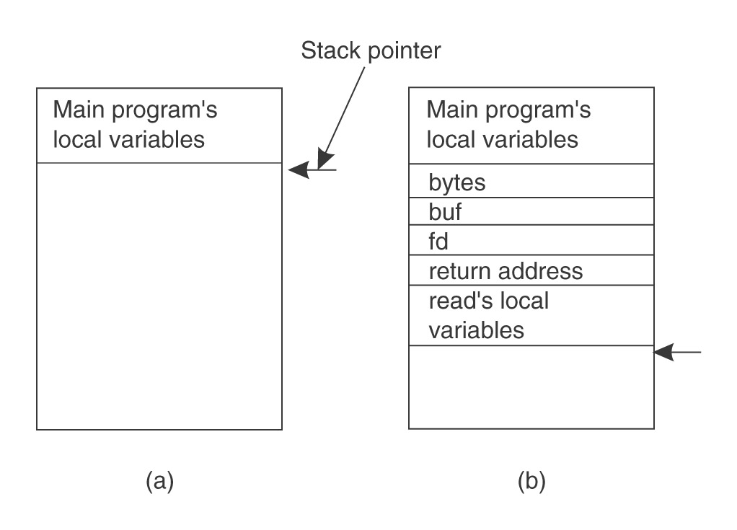
Ordinary procedure/function call
count = read(fd, buf, nbytes)

Slide 151
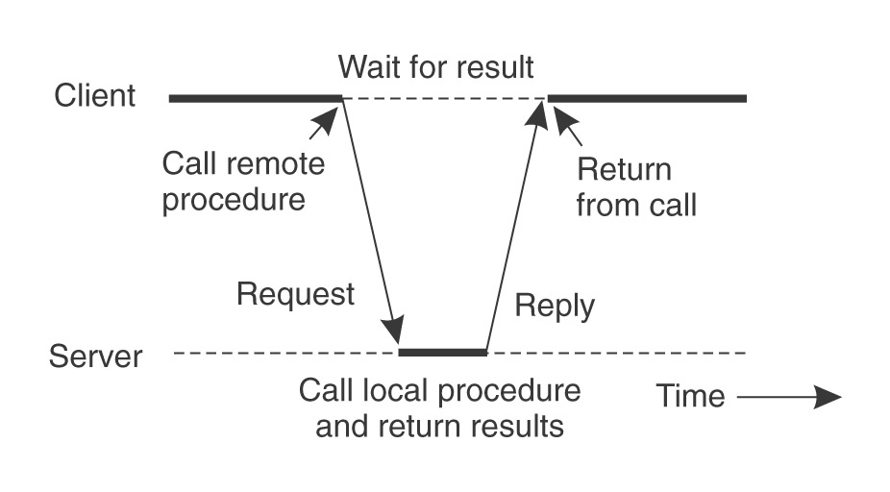
Remote Procedure Call
Would like to do the same if called procedure or function is on a remote server

Slide 152
Solution — a pair of Stubs
Client-side stub
Looks like local server function
Same interface as local function
Bundles arguments into message, sends to server-side stub
Waits for reply, un-bundles results
returns
Server-side stub
Looks like local client function to server
Listens on a socket for message from client stub
Un-bundles arguments to local variables
Makes a local function call to server
Bundles result into reply message to client stub

Slide 153
Result
The hard work of building messages, formatting, uniform representation, etc., is buried in the stubs
Where it can be automated!
Client and server designers can concentrate on the semantics of application
Programs behave in familiar way

Slide 154
RPC – Issues
How to make the “remote” part of RPC invisible to the programmer?
What are semantics of parameter passing?
E.g., pass by reference?
How to bind (locate & connect) to servers?
How to handle heterogeneity?
OS, language, architecture, …
How to make it go fast?

Slide 155
RPC Model
A server defines the service interface using an interface definition language (IDL)
the IDL specifies the names, parameters, and types for all client-callable server procedures
A stub compiler reads the IDL declarations and produces two stub functions for each server function
Server-side and client-side

Slide 156
RPC Model (continued)
Linking:–
Server programmer implements the service’s functions and links with the server-side stubs
Client programmer implements the client program and links it with client-side stubs
Operation:–
Stubs manage all of the details of remote communication between client and server

Slide 157
RPC Stubs
A client-side stub is a function that looks to the client as if it were a callable server function
I.e., same API as the server’s implementation of the function
A server-side stub looks like a caller to the server
I.e., like a hunk of code invoking the server function
The client program thinks it’s invoking the server
but it’s calling into the client-side stub
The server program thinks it’s called by the client
but it’s really called by the server-side stub
The stubs send messages to each other to make the RPC happen transparently (almost!)

Slide 158
RPC Information Flow
bundle
args
Client
(caller)
call
send
Packet
Handler
Client
Stub
return
receive
unbundle
ret vals
mbox2
Machine A
Network
Network
Machine B
bundle
ret vals
mbox1
Server
(callee)
return
Server
Stub
send
Packet
Handler
call
receive
unbundle
args

Slide 159
Marshalling Arguments
Marshalling is the packing of function parameters into a message packet
the RPC stubs call type-specific functions to marshal or unmarshal the parameters of an RPC
Client stub marshals the arguments into a message
Server stub unmarshals the arguments and uses them to invoke the service function
on return:
the server stub marshals return values
the client stub unmarshals return values, and returns to the client program

Slide 160
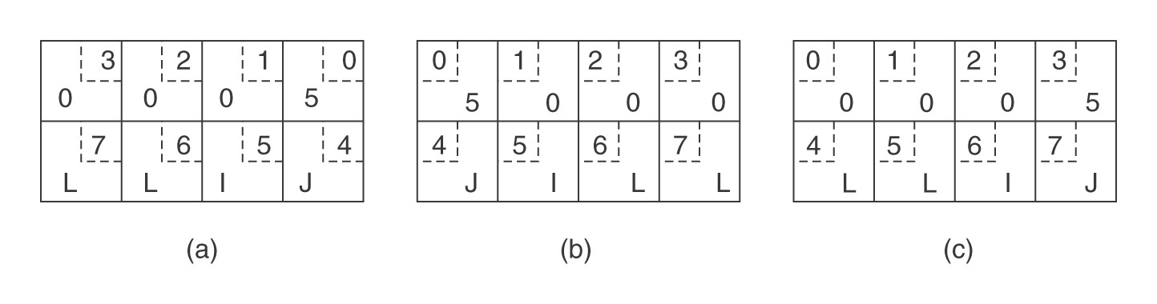
Issue #1 — representation of data
Big endian vs. little endian
Sent by Pentium
Rec’d by SPARC
After inversion

Slide 161
Representation of Data (continued)
IDL must also define representation of data on network
Multi-byte integers
Strings, character codes
Floating point, complex, …
…
example: Sun’s XDR (external data representation)
Each stub converts machine representation to/from network representation
Clients and servers must not try to cast data!

Slide 162
Issue #2 — Pointers and References
read(int fd, char* buf, int nbytes)
Pointers are only valid within one address space
Cannot be interpreted by another process
Even on same machine!
Pointers and references are ubiquitous in C, C++
Even in Java implementations!

Slide 163
Pointers and References — Restricted Semantics
Option: call by value
Sending stub dereferences pointer, copies result to message
Receiving stub conjures up a new pointer
Option: call by result
Sending stub provides buffer, called function puts data into it
Receiving stub copies data to caller’s buffer as specified by pointer

Slide 164
Pointers and References — Restricted Semantics (continued)
Option: call by value-result
Caller’s stub copies data to message, then copies result back to client buffer
Server stub keeps data in own buffer, server updates it; server sends data back in reply
Not allowed:–
Call by reference

Slide 165
Transport of Remote Procedure Call
Option — TCP
Connection-based, reliable transmission
Useful but heavyweight, less efficient
Necessary if repeating a call produces different result
Alternative — UDP
If message fails to arrive within a reasonable time, caller’s stub simply sends it again
Okay if repeating a call produces same result

Slide 166
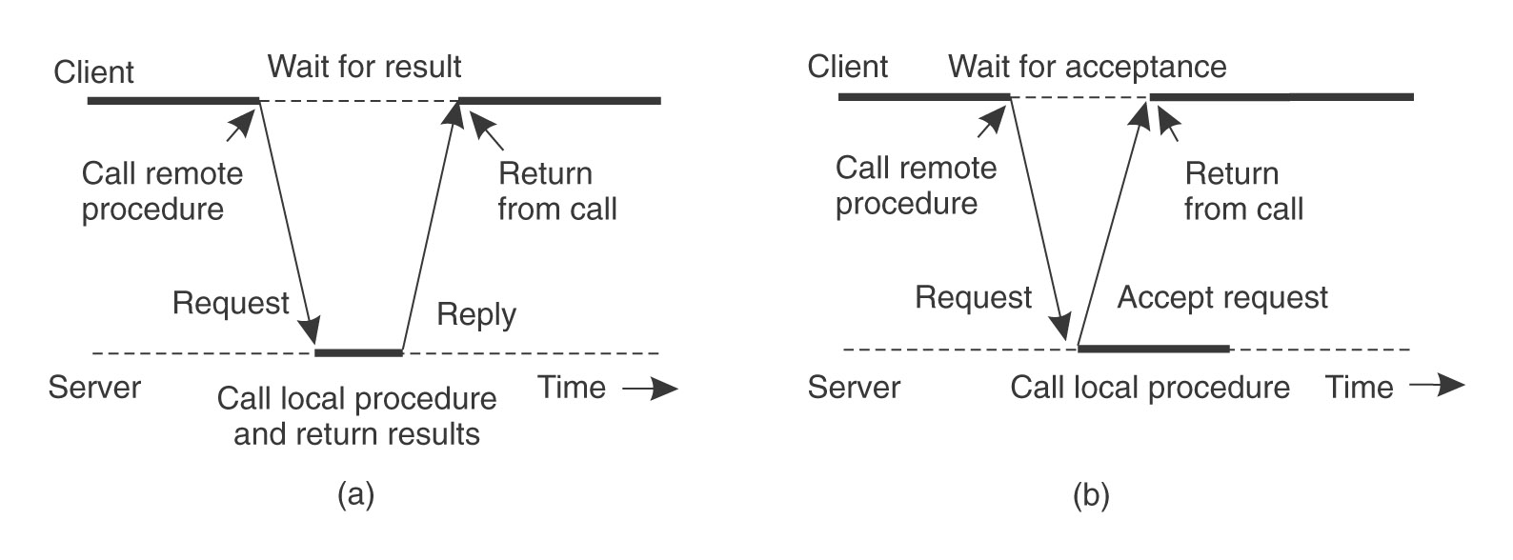
Asynchronous RPC
Analogous to spawning a thread
Caller must eventually wait for result
Analogous to join

Slide 167
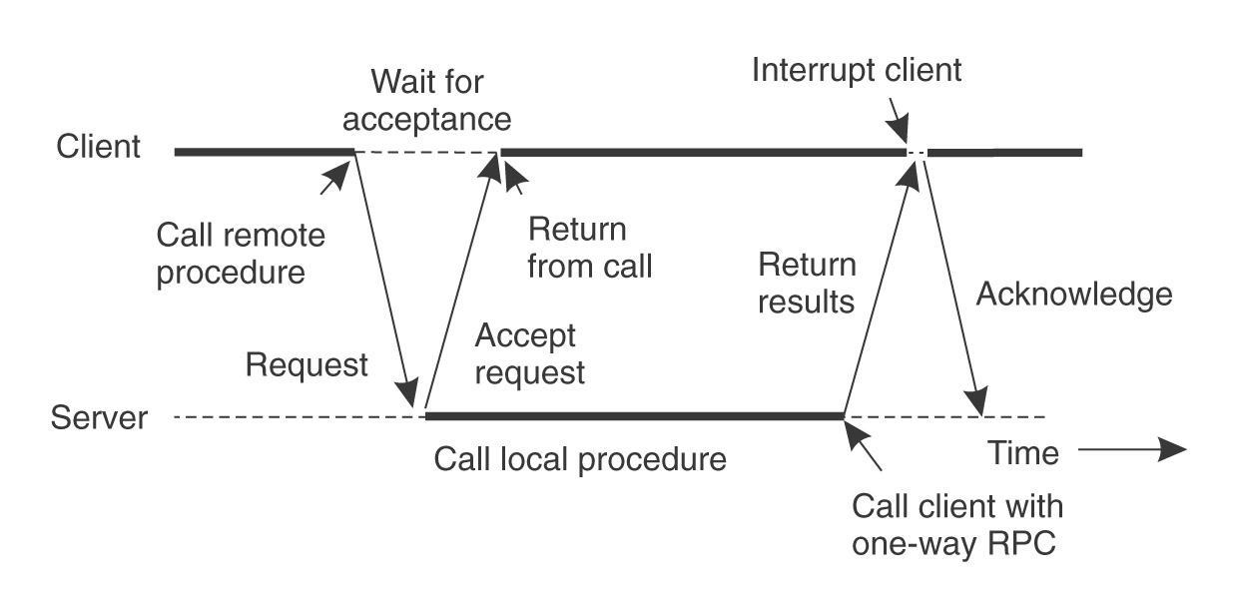
Asynchronous RPC (continued)
Analogous to spawning a thread
Caller must eventually wait for result
Analogous to join
Or be interrupted (software interrupt)

Slide 168
RPC Binding
Binding is the process of connecting the client to the server
the server, when it starts up, exports its interface
identifies itself to a network name server
tells RPC runtime that it is alive and ready to accept calls
the client, before issuing any calls, imports the server
RPC runtime uses the name server to find the location of the server and establish a connection
The import and export operations are explicit in the server and client programs

Slide 169
Remote Procedure Call is used …
Between processes on different machines
E.g., client-server model
Between processes on the same machine
More structured than simple message passing
Between subsystems of an operating system
Windows XP (called Local Procedure Call)

Slide 170
POSIX Thread Programming
Standard Thread Library for POSIX-compliant systems
Supports thread creation and management
Synchronization using
– mutex variables
– condition variables
At the time of creation, different attributes can be assigned to
– threads
– mutex/condition variables

Slide 171
Using Posix Thread Library
To use this library, #include <pthread.h> in your
program.
To compile, link with the pthread library:
gcc hello.c -o hello –lpthread

Slide 172
Data Types in POSIX
special data type for threads (pthread_t)
mutex variables for mutual exclusion (pthread_mutex_t)
mutex variables are like binary semaphores
a mutex variable can be in either locked or unlocked state
condition variables using which thread can sleep
until some other thread signals the condition (pthread_cond_t)
various kind of attribute types used when initializing:
threads (pthread_attr_t)
mutex variables (pthread_mutexattr_t)
condition variables (pthread_condattr_t)

Slide 173
Functions and Data Types
All POSIX thread functions have the form:
pthread[ _object ] _operation
Most of the POSIX thread library functions return 0 in case of success and some non-zero error-number in case of a failure.

Slide 174
Threads and Their Attributes
pthread_create() function is used to create a new thread.
A thread is created with specification of certain
attributes such as:
Detach state (default non-detached)
Stack address
Stack size
int pthread_create (pthread_t *thread_id,
const pthread_attr_t *attributes,
void *(*thread_function)(void *),
void *arguments);

Slide 175
Example
#include <stdio.h>
#include <pthread.h>
main() {
pthread_t f2_thread, f1_thread, f3_thread; int i1=1,i2=2;
void *f2(), *f1(),*f3();
pthread_create(&f1_thread,NULL,f1,&i1);
pthread_create(&f2_thread,NULL,f2,&i2);
pthread_create(&f3_thread,NULL,f3,NULL);
…
}
void *f1(int *i){
…
}
void *f2(int *i){
…
}
void *f3() {
}

Slide 176
Joining and Exiting
A thread can wait for the completion of a non-detached thread by using
pthread_join ( pthread_t thread, void **status)
(All threads are created non-detached by default, so they are “joinable” by default).
If any thread executes the system call exit( ), the entire process terminates.
If the main thread completes its execution, it implicitly calls exit( ), and this again terminates the process.
A thread (the main, or another thread ) can exit by calling pthread_exit( ), this does not terminate the process.

Slide 177
Example
#include <stdio.h>
#include <pthread.h>
main() {
pthread_t f2_thread, f1_thread;
void *f2(), *f1();
pthread_create(&f1_thread,NULL,f1,NULL);
pthread_create(&f2_thread,NULL,f2,NULL);
pthread_join(f1_thread,NULL);
pthread_join(f1_thread,NULL);
pthread_exit(0);
}
void *f1(){
…
pthread_exit(0);
}
void *f2(){
…
pthread_exit(0);
}

Slide 178
Setting Thread Attributes
Define and initialize attribute object:
pthread_attr_t attr;
pthread_attr_init (&attr );
For example, set the detach state:
pthread_attr_setdetachstate(&attr, THREAD_CREATE_DETACHED );
Or, you can use “default attributes” when creating the thread.

Slide 179
Mutex Variables
Used for mutual exclusion locks.
A mutex variable can be either locked or unlocked
pthread_mutex_t lock; // lock is a mutex variable
Lock operation
pthread_mutex_lock( &lock ) ;
Unlock operation
pthread_mutex_unlock( &lock )
Initialization of a mutex variable by default attributes
pthread_mutex_init( &lock, NULL );

Slide 180
Example
#include <stdio.h>
#include <pthread.h>
pthread_mutex_t region_mutex = PTHREAD_MUTEX_INITIALIZER;
int b; /* buffer size = 1; */
main() {
pthread_t producer_thread, consumer_thread;
void *producer(),
void *consumer();
pthread_create(&consumer_thread,NULL,consumer,NULL);
pthread_create(&producer_thread,NULL,producer,NULL);
pthread_join(consumer_thread,NULL);
}
void put_buffer(int i){
b = i;
}
int get_buffer(){
return b ;
}

Slide 181
Example
void *producer(){
int i = 0;
while (1) {
pthread_mutex_lock(&region_mutex);
put_buffer(i);
pthread_mutex_unlock(&region_mutex);
i++;
}
}
void *consumer(){
int i,v;
for (i=0;i<100;i++) {
pthread_mutex_lock(&region_mutex);
v = get_buffer();
pthread_mutex_unlock(&region_mutex);
printf(“got %d “,v);
}
}
Competition synchronization

Slide 182
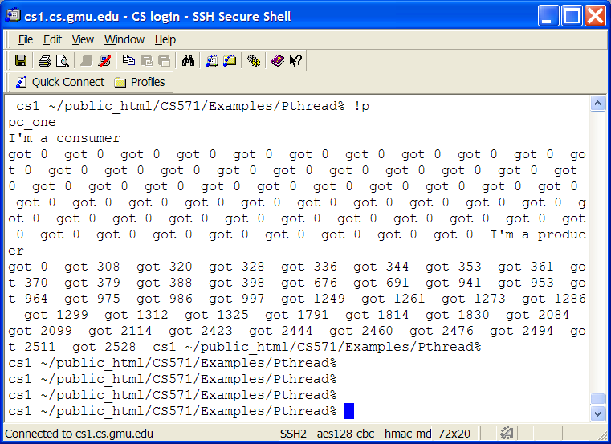
Example output

Slide 183
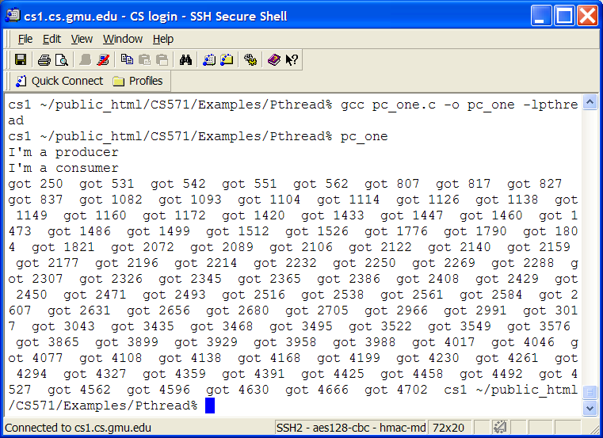
Example output

Slide 184
Reader/Writer
pthread_mutex_t rw_mutex = PTHREAD_MUTEX_INITIALIZER;
pthread_mutex_t reader_mutex = PTHREAD_MUTEX_INITIALIZER;
int num_readers = 0;
main()
{ …}
void *reader()
{ while (1) {
pthread_mutex_lock(&reader_mutex);
num_readers++;
if (num_readers == 1) pthread_mutex_lock(&rw_mutex);
pthread_mutex_unlock(&reader_mutex);
/* read */
pthread_mutex_lock(&reader_mutex);
num_readers--;
if (num_readers == 0) pthread_mutex_unlock(&rw_mutex);
pthread_mutex_unlock(&reader_mutex);
}
}
void *writer()
{ while ( 1) {
pthread_mutex_lock(&rw_mutex);
/* write */
pthread_mutex_unlock(&rw_mutex);
}
}

Slide 185
Condition Variables
In a critical section (i.e. where a mutex has been used), a thread can suspend itself on a condition variable if the state of the computation is not right for it to proceed.
It will suspend by waiting on a condition variable.
It will, however, release the critical section lock (mutex) .
When that condition variable is signaled, it will become ready again; it will attempt to reacquire that critical section lock and only then will be able proceed.
With Posix threads, a condition variable can be associated with only one mutex variable!

Slide 186
Condition Variables
pthread_cond_t SpaceAvailable;
pthread_cond_init (&SpaceAvailable, NULL );
pthread_cond_wait (&condition, &mutex)
pthread_cond_signal(&condition)
unblock one waiting thread on that condition variable (that thread should still get the “lock” before proceeding)
pthread_cond_broadcast(&condition)
unblock all waiting threads on that condition variable (now all of them will compete to get the “lock”)

Slide 187
Condition Variables
Example:
pthread_mutex_lock ( &mutex );
. . . . .
pthread_cond_wait ( &SpaceAvailable, &mutex);
// now proceed again
. . .
pthread_mutex_unlock( &mutex );
Some other thread will execute:
pthread_cond_signal ( &SpaceAvailable );
The signaling thread has priority over any thread that may be awakened
– “Signal-and-continue” semantics

Slide 188
Producer-Consumer Problem
Producer will produce a sequence of integers, and deposit each integer in a bounded buffer
(implemented as an array).
All integers are positive, 0..999.
Producer will deposit -1 when finished, and then
terminate.
Buffer is of finite size: 5 in this example.
Consumer will remove integers, one at a time, and print them.
It will terminate when it receives -1.

Slide 189
Definitions and Globals
#include <sys/time.h>
#include <stdio.h>
#include <pthread.h>
#include <errno.h>
#define SIZE 10
pthread_mutex_t region_mutex = PTHREAD_MUTEX_INITIALIZER;
pthread_cond_t space_available = PTHREAD_COND_INITIALIZER;
pthread_cond_t data_available = PTHREAD_COND_INITIALIZER;
int b[SIZE]; /* buffer */
int size = 0; /* number of full elements */
int front,rear=0; /* queue */

Slide 190
Producer Thread
void *producer()
{
int i = 0;
while (1) {
pthread_mutex_lock(&region_mutex);
while (size == SIZE) {
pthread_cond_broadcast(&data_available);
pthread_cond_wait(&space_available,&region_mutex);
}
if(i>99) i=-1;
add_buffer(i);
pthread_cond_broadcast(&data_available);
pthread_mutex_unlock(&region_mutex);
if (i==-1) break;
i = i + 1;
}
pthread_exit(NULL);
}

Slide 191
Consumer Thread
void *consumer()
{
int i,v;
While(1){
pthread_mutex_lock(&region_mutex);
while (size == 0) {
pthread_cond_broadcast(&space_available);
pthread_cond_wait(&data_available,&region_mutex);
}
v = get_buffer();
pthread_cond_broadcast(&space_available);
pthread_mutex_unlock(&region_mutex);
if (v==-1) break;
printf("got %d ",v);
}
pthread_exit(NULL);
}

Slide 192
Main program
main()
{
pthread_t producer_thread,consumer_thread;
void *producer(),*consumer();
pthread_create(&consumer_thread,NULL,consumer,NULL);
pthread_create(&producer_thread,NULL,producer,NULL);
pthread_join(consumer_thread,NULL);
}
void add_buffer(int i){
b[rear] = i; size++;
rear = (rear+1) % SIZE;
}
int get_buffer(){
int v;
v = b[front]; size--;
front= (front+1) % SIZE;
return v ;
}

Slide 193
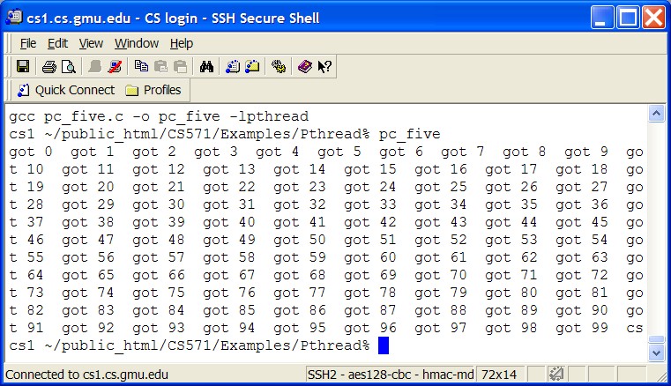
Output

Slide 194
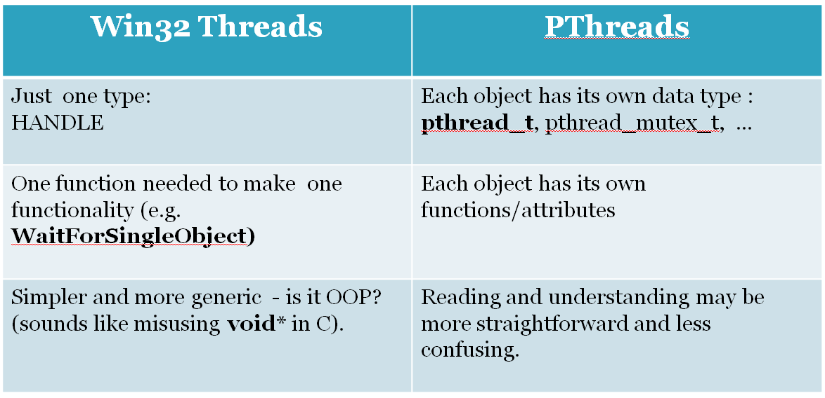
Win32 vs. POSIX Interface 1. Function calls

Slide 195
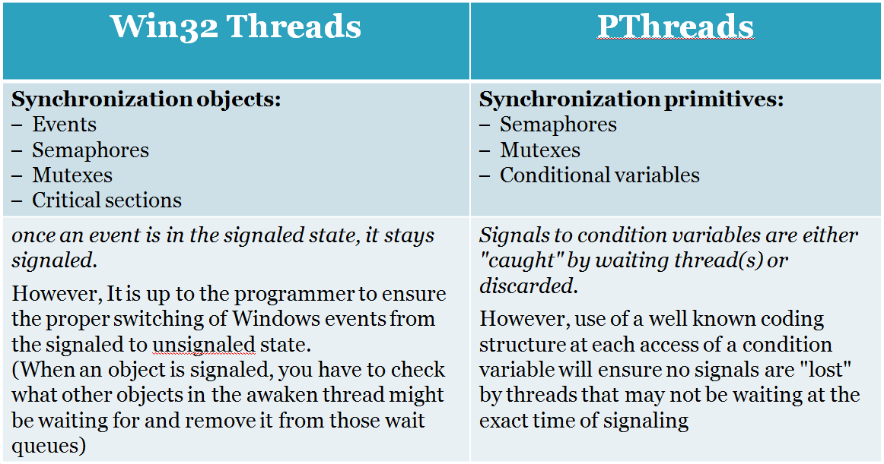
Win32 vs. POSIX Interface 2. Synchronization overhead

Slide 196
More issues to consider
Historically, hardware vendors have implemented their own proprietary versions of threads.
In Windows, the thread is the basic execution unit, and the process is a container that holds this thread. In Linux, the basic execution unit is the process
Some may claim POSIX threads are a low-level API and Windows threads are a high-level API
In Windows the thread scheduling code is implemented in the kernel.
In Linux realm, there are several drafts of the POSIX threads standard. Differences between drafts exist! Especially many scheduling mechanisms exist (user and kernel-level threads).
The current POSIX standard is defined only for the C language.

Slide 197
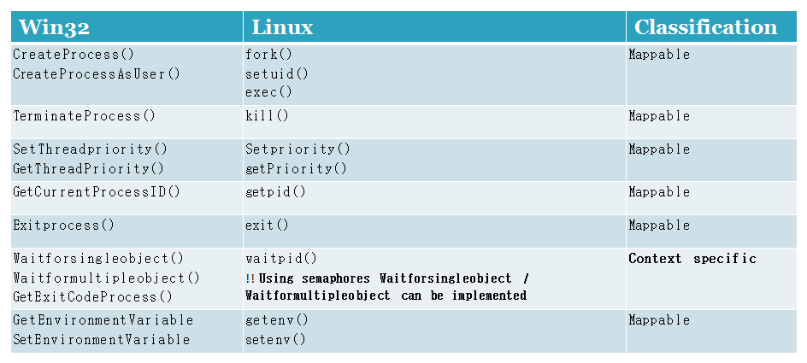
Mapping Win32 to Pthreads 1. Process Mapping
Mappable: Both the Windows and Linux constructs provide similar functionality.
Context: The decision to use a specific Linux construct(s) depends on the application context
!! More on WaitForMultipleObjects may be found under the following reference: http://www.ibm.com/developerworks/linux/library/l-ipc2lin3.html

Slide 198
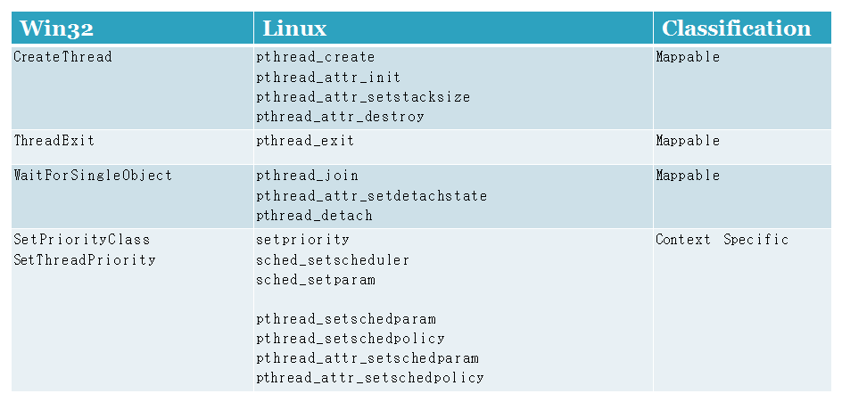
Mapping Win32 to Pthreads 2. Thread Mapping
Mappable: Both the Windows and Linux constructs provide similar functionality.
Context: The decision to use a specific Linux construct(s) depends on the application context

Slide 199
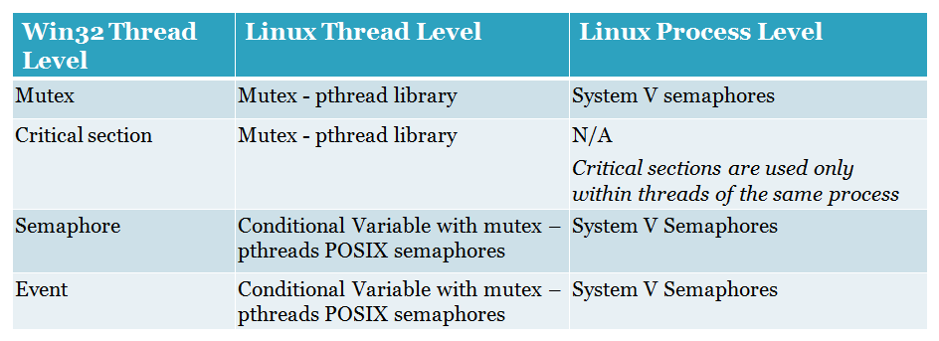
Mapping Win32 to Pthreads 3. Synchronization
!! Conditional Variables: While mutexes implement synchronization by controlling thread access to data, condition variables allow threads to synchronize based upon the actual value of data. See more under: https://computing.llnl.gov/tutorials/pthreads

Slide 200
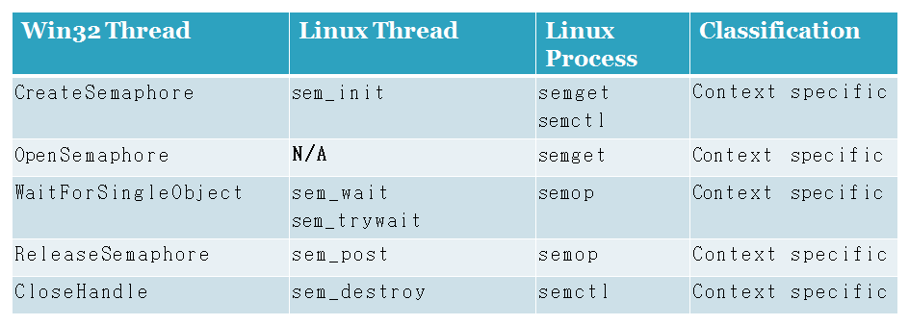

Mapping Win32 to Pthreads Synchronization (semaphores)
Notice: Win32 semaphores are created within a thread, and propagated all over the system.
POSIX semaphores are wither for inter-thread within a process, or inter-process entities.
!! opensemaphore function enables multiple processes to open handles of the same semaphore object. The function succeeds only if some process has already created the semaphore by using the CreateSemaphore function.

Slide 201
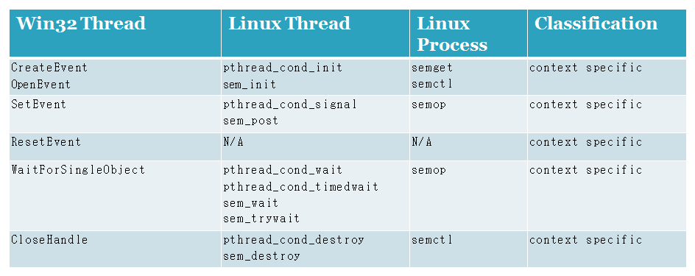

Mapping Win32 to Pthreads Synchronization (events)
Notice (See conclusion in the next slide).
- Events are Windows specific objects.
- POSIX semaphores with count set to 1 provide similar functionality to the Windows events.
However, they don't provide timeout in the wait functions.
- Conditional variables & Mutex in pthreads provide event-based synchronization between threads, but they are synchronous.

Slide 202
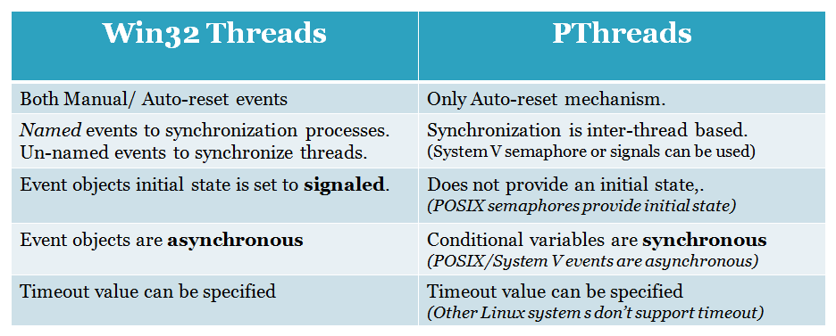
Mapping Win32 to Pthreads Synchronization (events) - conclusion

Slide 203
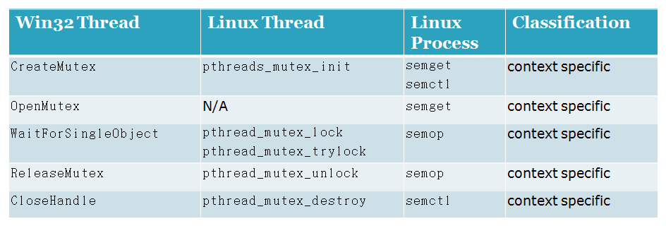
Mapping Win32 to Pthreads Synchronization (mutex)
Notice (See conclusion in the next slide). Some major differences reside, including:
- Named and un-named mutexes.
- Ownershiop at creation.
- Timeout during wait.
- Recursive mutexes.

Slide 204
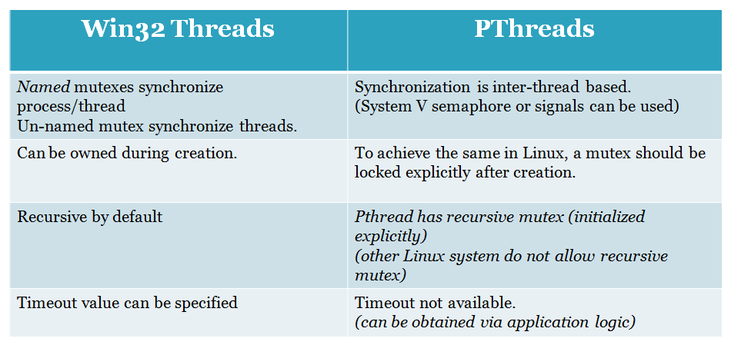
Mapping Win32 to Linux Synchronization (mutex) - conclusion

Slide 205
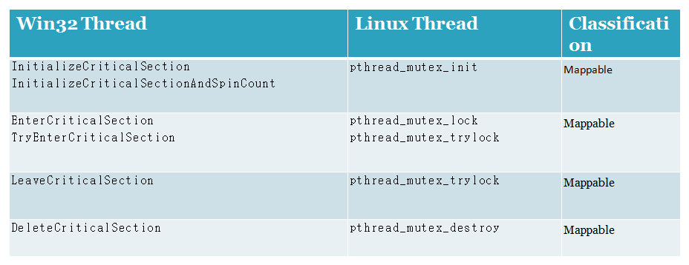
Mapping Win32 to Linux Synchronization (Critical Sections)
Notice: Since the critical sections are used only between the threads of the same process, Pthreads mutex can be used to achieve the same functionality on Linux systems.
1 - In general, mutex objects are more CPU intensive and slower to use than critical sections due to a larger amount of bookkeeping, and the deep execution path into the kernel taken to acquire a mutex. The equivalent functions for accessing a critical section remain in thread context, and consist of merely checking and incrementing/decrementing lock-count related data. This makes critical sections light weight, fast, and easy to use for thread synchronization within a process. 2- In Win32 The primary benefit of using a mutex object is that a mutex can be named and shared across process boundaries.

Slide 206
References
POSIX Threads Programming https://computing.llnl.gov/tutorials/pthreads/
Why pthreads are better than Win32 http://softwarecommunity.intel.com/ISN/Community/en-US/forums/post/840096.aspx
Why Windows threads are better than pthreads: http://softwareblogs.intel.com/2006/10/19/why-windows-threads-are-better-than-posix-threads/
Port Windows IPC apps to Linux (including code examples)
http://www.ibm.com/developerworks/linux/library/l-ipc2lin1.html
http://www.ibm.com/developerworks/linux/library/l-ipc2lin2.html
http://www.ibm.com/developerworks/linux/library/l-ipc2lin3.html

Slide 207
Introduction to OpenMP

Slide 208
Introduction to OpenMP
What is OpenMP?
Open specification for Multi-Processing
“Standard” API for defining multi-threaded shared-memory programs
www.openmp.org – Talks, examples, forums, etc.
High-level API
Preprocessor (compiler) directives ( ~ 80% )
Library Calls ( ~ 19% )
Environment Variables ( ~ 1% )

Slide 209
A Programmer’s View of OpenMP
OpenMP is a portable, threaded, shared-memory programming specification with “light” syntax
Exact behavior depends on OpenMP implementation!
Requires compiler support (C or Fortran)
OpenMP will:
Allow a programmer to separate a program into serial regions and parallel regions, rather than T concurrently-executing threads.
Hide stack management
Provide synchronization constructs
OpenMP will not:
Parallelize (or detect!) dependencies
Guarantee speedup
Provide freedom from data races

Slide 210
Outline
Introduction
Motivating example
Parallel Programming is Hard
OpenMP Programming Model
Easier than PThreads
Microbenchmark Performance Comparison
vs. PThreads
Discussion
specOMP

Slide 211
Current Parallel Programming
Start with a parallel algorithm
Implement, keeping in mind:
Data races
Synchronization
Threading Syntax
Test & Debug
Debug
Debug

Slide 212
Motivation – Threading Library
void* SayHello(void *foo) {
printf( "Hello, world!\n" );
return NULL;
}
int main() {
pthread_attr_t attr;
pthread_t threads[16];
int tn;
pthread_attr_init(&attr);
pthread_attr_setscope(&attr, PTHREAD_SCOPE_SYSTEM);
for(tn=0; tn<16; tn++) {
pthread_create(&threads[tn], &attr, SayHello, NULL);
}
for(tn=0; tn<16 ; tn++) {
pthread_join(threads[tn], NULL);
}
return 0;
}

Slide 213
Motivation
Thread libraries are hard to use
P-Threads/Solaris threads have many library calls for initialization, synchronization, thread creation, condition variables, etc.
Programmer must code with multiple threads in mind
Synchronization between threads introduces a new dimension of program correctness

Slide 214
Motivation
Wouldn’t it be nice to write serial programs and somehow parallelize them “automatically”?
OpenMP can parallelize many serial programs with relatively few annotations that specify parallelism and independence
OpenMP is a small API that hides cumbersome threading calls with simpler directives

Slide 215
Better Parallel Programming
Start with some algorithm
Embarrassing parallelism is helpful, but not necessary
Implement serially, ignoring:
Data Races
Synchronization
Threading Syntax
Test and Debug
Automatically (magically?) parallelize
Expect linear speedup

Slide 216
Motivation – OpenMP
int main() {
// Do this part in parallel
printf( "Hello, World!\n" );
return 0;
}

Slide 217
Motivation – OpenMP
int main() {
omp_set_num_threads(16);
// Do this part in parallel
#pragma omp parallel
{
printf( "Hello, World!\n" );
}
return 0;
}

Slide 218
OpenMP Parallel Programming
Start with a parallelizable algorithm
Embarrassing parallelism is good, loop-level parallelism is necessary
Implement serially, mostly ignoring:
Data Races
Synchronization
Threading Syntax
Test and Debug
Annotate the code with parallelization (and synchronization) directives
Hope for linear speedup
Test and Debug

Slide 219
Programming Model - Threading
Serial regions by default, annotate to create parallel regions
Generic parallel regions
Parallelized loops
Sectioned parallel regions
Thread-like Fork/Join model
Arbitrary number of logical thread creation/ destruction events
Fork
Join

Slide 220
Programming Model - Threading
int main() {
}
// serial region
printf(“Hello…”);
// parallel region
#pragma omp parallel
{
printf(“World”);
}
Fork
// serial again
printf(“!”);
Join
Hello…WorldWorldWorldWorld!

Slide 221
Programming Model – Nested Threading
Fork/Join can be nested
Nesting complication handled “automagically” at compile-time
Independent of the number of threads actually running
Fork
Fork
Join
Join

Slide 222
Programming Model – Thread Identification
Master Thread
Thread with ID=0
Only thread that exists in sequential regions
Depending on implementation, may have special purpose inside parallel regions
Some special directives affect only the master thread (like master)
0
Fork
0 1 2 3 4 5 6 7
Join
0

Slide 223
Programming Model – Data/Control Parallelism
Data parallelism
Threads perform similar functions, guided by thread identifier
Control parallelism
Threads perform differing functions
One thread for I/O, one for computation, etc…
Fork
Join

Slide 224
Programming Model – Concurrent Loops
OpenMP easily parallelizes loops
No data dependencies between iterations!
Preprocessor calculates loop bounds for each thread directly from serial source
?
for( i=0; i < 25; i++ ) {
printf(“Foo”);
}
#pragma omp parallel for
?

Slide 225
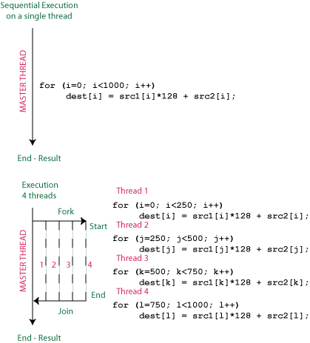

Slide 226
Programming Model – Loop Scheduling
schedule clause determines how loop iterations are divided among the thread team
static([chunk]) divides iterations statically between threads
Each thread receives [chunk] iterations, rounding as necessary to account for all iterations
Default [chunk] is ceil( # iterations / # threads )
dynamic([chunk]) allocates [chunk] iterations per thread, allocating an additional [chunk] iterations when a thread finishes
Forms a logical work queue, consisting of all loop iterations
Default [chunk] is 1
guided([chunk]) allocates dynamically, but [chunk] is exponentially reduced with each allocation

Slide 227
Programming Model – Loop Scheduling
for( i=0; i<16; i++ )
{
doIteration(i);
}
// Static Scheduling
int chunk = 16/T;
int base = tid * chunk;
int bound = (tid+1)*chunk;
for( i=base; i<bound; i++ )
{
doIteration(i);
}
Barrier();
#pragma omp parallel for \
schedule(static)

Slide 228
Programming Model – Loop Scheduling
// Dynamic Scheduling
int current_i;
while( workLeftToDo() )
{
current_i = getNextIter();
doIteration(i);
}
Barrier();
for( i=0; i<16; i++ )
{
doIteration(i);
}
#pragma omp parallel for \
schedule(dynamic)

Slide 229
Programming Model – Data Sharing
// shared, globals
int bigdata[1024];
void* foo(void* bar) {
// private, stack
int tid;
/* Calculation goes
here */
}
Parallel programs often employ two types of data
Shared data, visible to all threads, similarly named
Private data, visible to a single thread (often stack-allocated)
int bigdata[1024];
void* foo(void* bar) {
int tid;
#pragma omp parallel \
shared ( bigdata ) \
private ( tid )
{
/* Calc. here */
}
}
PThreads:
Global-scoped variables are shared
Stack-allocated variables are private
OpenMP:
shared variables are shared
private variables are private

Slide 230
Programming Model - Synchronization
OpenMP Synchronization
OpenMP Critical Sections
Named or unnamed
No explicit locks
Barrier directives
Explicit Lock functions
When all else fails – may require flush directive
Single-thread regions within parallel regions
master, single directives
#pragma omp critical
{
/* Critical code here */
}
#pragma omp barrier
omp_set_lock( lock l );
/* Code goes here */
omp_unset_lock( lock l );
#pragma omp single
{
/* Only executed once */
}

Slide 231
Programming Model - Summary
Threaded, shared-memory execution model
Serial regions and parallel regions
Parallelized loops with customizable scheduling
Concurrency expressed with preprocessor directives
Thread creation, destruction mostly hidden
Often expressed after writing a serial version through annotation

Slide 232
Outline
Introduction
Motivating example
Parallel Programming is Hard
OpenMP Programming Model
Easier than PThreads
Microbenchmark Performance Comparison
vs. PThreads
Discussion
specOMP

Slide 233
Performance Concerns
Is the overhead of OpenMP too high?
How do the scheduling and synchronization options affect performance?
How does autogenerated code compare to hand-written code?
Can OpenMP scale?
4 threads? 16? More?
What should OpenMP be compared against?
PThreads?
MPI?

Slide 234
Performance Comparison: OMP vs. Pthreads
PThreads
Shared-memory, portable threading implementation
Explicit thread creation, destruction (pthread_create)
Explicit stack management
Synch: Locks, Condition variables
Microbenchmarks implemented in OpenMP, PThreads
Explore OpenMP loop scheduling policies
Comparison vs. tuned PThreads implementation

Slide 235
Methodology
Microbenchmarks implemented in OpenMP and PThreads, compiled with similar optimizations, same compiler (Sun Studio)
Execution times measured on a 16-processor Sun Enterprise 6000 (cabernet.cs.wisc.edu), 2GB RAM, 1MB L2 Cache
Parameters varied:
Number of processors (threads)
Working set size
OpenMP loop scheduling policy

Slide 236

Microbenchmark: Ocean
Conceptually similar to SPLASH-2’s ocean
Simulates ocean temperature gradients via successive-approximation
Operates on a 2D grid of floating point values
“Embarrassingly” Parallel
Each thread operates in a rectangular region
Inter-thread communication occurs only on region boundaries
Very little synchronization (barrier-only)
Easy to write in OpenMP!

Slide 237
Microbenchmark: Ocean
for( t=0; t < t_steps; t++) {
for( x=0; x < x_dim; x++) {
for( y=0; y < y_dim; y++) {
ocean[x][y] = /* avg of neighbors */
}
}
}
#pragma omp parallel for \
shared(ocean,x_dim,y_dim) private(x,y)
// Implicit Barrier Synchronization
temp_ocean = ocean;
ocean = other_ocean;
other_ocean = temp_ocean;

Slide 238
Microbenchmark: Ocean
ocean_dynamic – Traverses entire ocean, row-by-row, assigning row iterations to threads with dynamic scheduling.
ocean_static – Traverses entire ocean, row-by-row, assigning row iterations to threads with static scheduling.
OpenMP
ocean_squares – Each thread traverses a square-shaped section of the ocean. Loop-level scheduling not used—loop bounds for each thread are determined explicitly.
ocean_pthreads – Each thread traverses a square-shaped section of the ocean. Loop bounds for each thread are determined explicitly.
PThreads

Slide 239
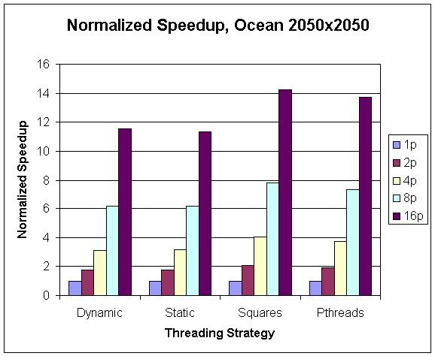
Microbenchmark: Ocean

Slide 240
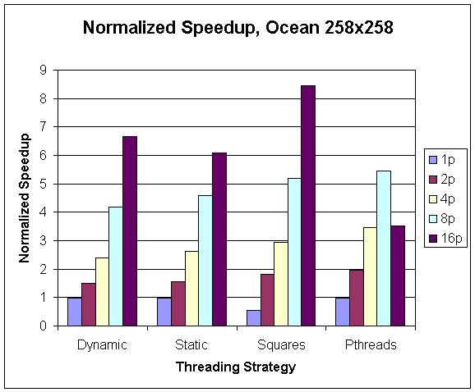
Microbenchmark: Ocean

Slide 241
Evaluation
OpenMP scales to 16-processor systems
Was overhead too high?
In some cases, yes
Did compiler-generated code compare to hand-written code?
Yes!
How did the loop scheduling options affect performance?
dynamic or guided scheduling helps loops with variable interation runtimes
static or predicated scheduling more appropriate for shorter loops
Is OpenMP the right tool to parallelize scientific application?

Slide 242
Limitations
OpenMP Requires compiler support
Sun Studio compiler
Intel VTune
Polaris/OpenMP (Purdue)
OpenMP does not parallelize dependencies
Often does not detect dependencies
Nasty race conditions still exist!
OpenMP is not guaranteed to divide work optimally among threads
Programmer-tweakable with scheduling clauses
Still lots of rope available

Slide 243
Limitations
Doesn’t totally hide concept of volatile data
From a high-level, use of OMP’s locks can seem like consistency violations if flush directive is forgotten
Workload applicability
Easy to parallelize “scientific” applications
How might one create an OpenMP web server? Database?
Adoption hurdle
Search www.sourceforge.net for “OpenMP”:
3 results (out of 72,000)

Slide 244
Summary
OpenMP is a compiler-based technique to create concurrent code from (mostly) serial code
OpenMP can enable (easy) parallelization of loop-based code
Lightweight syntactic language extensions
OpenMP performs comparably to manually-coded threading
Scalable
Portable
Not a silver bullet for all applications

Slide 245
More Information
www.openmp.org
OpenMP official site
www.llnl.gov/computing/tutorials/openMP/
A handy OpenMP tutorial
www.nersc.gov/nusers/help/tutorials/openmp/
Another OpenMP tutorial and reference

Slide 246
Consistency Violation?
#pragma omp parallel for \
shared(x) private(i)
for( i=0; i<100; i++ ) {
#pragma omp atomic
x++;
}
printf(“%i”,x);
#pragma omp parallel for \
shared(x) private(i)
for( i=0; i<100; i++ ) {
omp_set_lock(my_lock);
x++;
omp_unset_lock(my_lock);
}
printf(“%i”,x);
100
96
100
#pragma omp flush

Slide 247
OpenMP Syntax
General syntax for OpenMP directives
Directive specifies type of OpenMP operation
Parallelization
Synchronization
Etc.
Clauses (optional) modify semantics of Directive
#pragma omp directive [clause…] CR

Slide 248
OpenMP Syntax
PARALLEL syntax
Ex: Output: (T=4)
#pragma omp parallel [clause…] CR
structured_block
#pragma omp parallel
{
printf(“Hello!\n”);
} // implicit barrier
Hello!
Hello!
Hello!
Hello!

Slide 249
OpenMP Syntax
DO/for Syntax (DO-Fortran, for-C)
Ex:
#pragma omp parallel
{
#pragma omp for private(i) shared(x) \
schedule(static,x/N)
for(i=0;i<x;i++) printf(“Hello!\n”);
} // implicit barrier
Note: Must reside inside a parallel section
#pragma omp for [clause…] CR
for_loop

Slide 250
OpenMP Syntax
More on Clauses
private() – A variable in private list is private to each thread
shared() – Variables in shared list are visible to all threads
Implies no synchronization, or even consistency!
schedule() – Determines how iterations will be divided among threads
schedule(static, C) – Each thread will be given C iterations
Usually T*C = Number of total iterations
schedule(dynamic) – Each thread will be given additional iterations as-needed
Often less efficient than considered static allocation
nowait – Removes implicit barrier from end of block

Slide 251
OpenMP Syntax
PARALLEL FOR (combines parallel and for)
Ex:
#pragma omp parallel for shared(x)\
private(i) \
schedule(dynamic)
for(i=0;i<x;i++) {
printf(“Hello!\n”);
}
#pragma omp parallel for [clause…] CR
for_loop

Slide 252
OpenMP Syntax
ATOMIC syntax
Ex:
#pragma omp parallel shared(x)
{
#pragma omp atomic
x++;
} // implicit barrier
#pragma omp atomic CR
simple_statement

Slide 253
OpenMP Syntax
CRITICAL syntax
Ex:
#pragma omp parallel shared(x)
{
#pragma omp critical
{
// only one thread in here
}
} // implicit barrier
#pragma omp critical CR
structured_block

Slide 254
OpenMP Syntax
ATOMIC vs. CRITICAL
Use ATOMIC for “simple statements”
Can have lower overhead than CRITICAL if HW atomics are leveraged (implementation dep.)
Use CRITICAL for larger expressions
May involve an unseen implicit lock

Slide 255
OpenMP Syntax
MASTER – only Thread 0 executes a block
SINGLE – only one thread executes a block
No implied synchronization
#pragma omp master CR
structured_block
#pragma omp single CR
structured_block

Slide 256
OpenMP Syntax
BARRIER
Locks
Locks are provided through omp.h library calls
omp_init_lock()
omp_destroy_lock()
omp_test_lock()
omp_set_lock()
omp_unset_lock()
#pragma omp barrier CR

Slide 257
OpenMP Syntax
FLUSH
Guarantees that threads’ views of memory is consistent
Why? Recall OpenMP directives…
Code is generated by directives at compile-time
Variables are not always declared as volatile
Using variables from registers instead of memory can seem like a consistency violation
Synch. Often has an implicit flush
ATOMIC, CRITICAL
#pragma omp flush CR

Slide 258
OpenMP Syntax
Functions
omp_set_num_threads()
omp_get_num_threads()
omp_get_max_threads()
omp_get_num_procs()
omp_get_thread_num()
omp_set_dynamic()
omp_[init destroy test set unset]_lock()

Slide 259
Microbenchmark: Ocean
Thread 0
Thread 1
Thread 2
Thread 3

Slide 260
Microbenchmark: Ocean

Slide 261
Microbenchmark: Ocean

Slide 262
Microbenchmark: Ocean

Slide 263
Microbenchmark: Ocean

Slide 264
Microbenchmark: Ocean

