Slide 1
ENCS3310
Advanced Digital Design
Lecture1
Verilog HDL-1
Dr. Abdellatif Abu-Issa

Slide 2
Verilog HDL
Verilog HDL (Hardware Description Language)
  Started as proprietary language (owned by Cadence)
  Opened to outside, became IEEE Standard 1364
  Widely used in industry (simpler than VHDL)
Uses of Verilog (and other HDLs)
  Hardware specification
  PLD and ASIC synthesis
    Synthesis: “automatic” generation of “netlist” (used in IC design and gate-level design) from high-level design description
  Design documentation
  Logic simulation

Slide 3
Hardware Description Language
Similar to a Programming Language
  Customized for description of digital hardware
  Important difference: hardware is inherently parallel
Hardware Description Methods
  Behavioral description
    Procedural description of how device should operate
  Structural description
    Specifies how device is connected internally
  Mixed behavioral/structural description

Slide 4
Basic Verilog Description
Starts with module, ends with endmodule
  Similar to a “C language” function definition
  Signal parameters are defined as input, output, or inout
  C language based definition
    Uses many C constructs and operators
    Sub-module instantiation instead of sub-function call
    Most behavioral descriptions enclosed in always blocks
    Inherently parallel execution behavior

Slide 5
Example-1 (2x1 MUX)
x
s
s
1
x₁
x₂
f (s, x₁, x₂)
0
0
0
0
f
x
1
0
0
0
1
0
x
f
s
2
1
0
1
0
1
x
2
0
1
1
1
(b) Circuit
(c) Graphical symbol
1
0
0
0
1
0
1
1
s
f (s, x₁, x₂)
1
1
0
0
0
x₁
1
1
1
1
x₂
1
(a)
Truth
table
(d)
More
compact
truth-table
representation

Slide 6
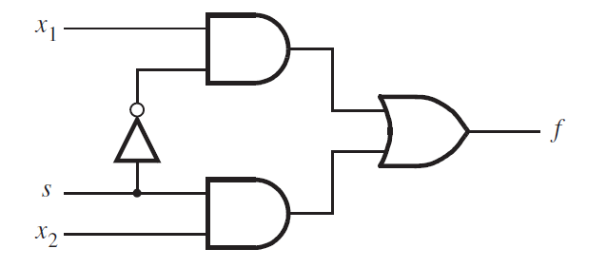
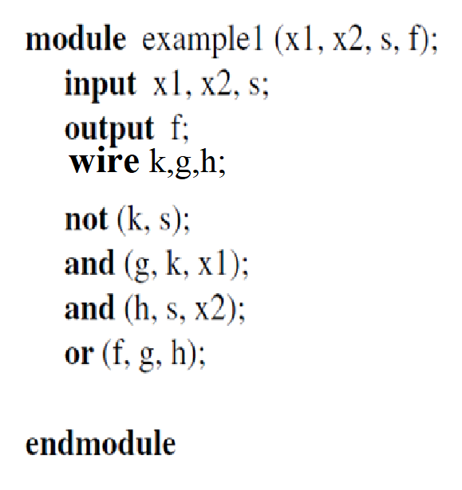
Example-1 (2x1 MUX)
Gate Level Description

Slide 7
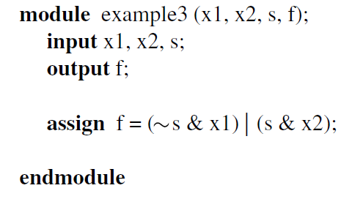
Example-1 (2x1 MUX)
Data Flow Description

Slide 8
Concurrent and Sequential Verilog
Hardware is concurrent by nature
  All hardware components are active all of the time
  Statements in Verilog are current by default
    Sequences of Verilog statements execute concurrently
Some hardware circuits are modeled as executing in a sequential manner
  For example, sequential logic devices, clock signals, …
  Sequences of Verilog statements enclosed within an always or initial block execute one after the other

Slide 9
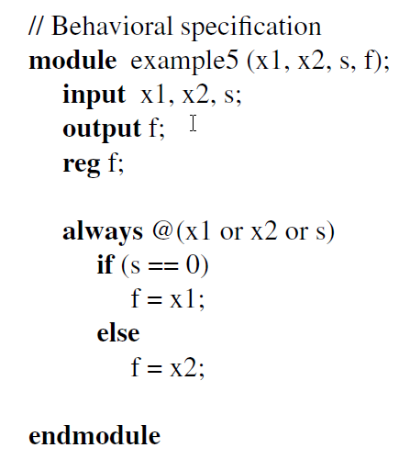
Example-1 (2x1 MUX)
Using Sequential Statement

Slide 10
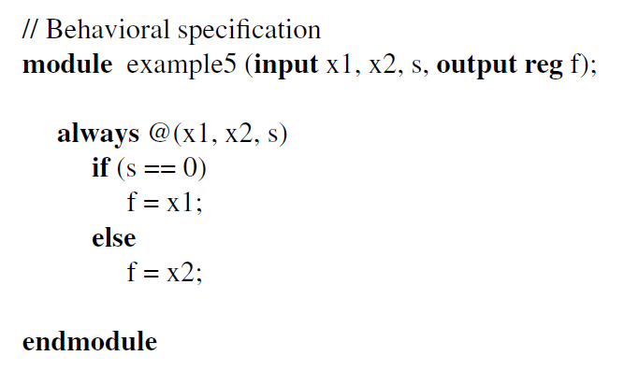
Example-1 (2x1 MUX)
More Compact Code

Slide 11
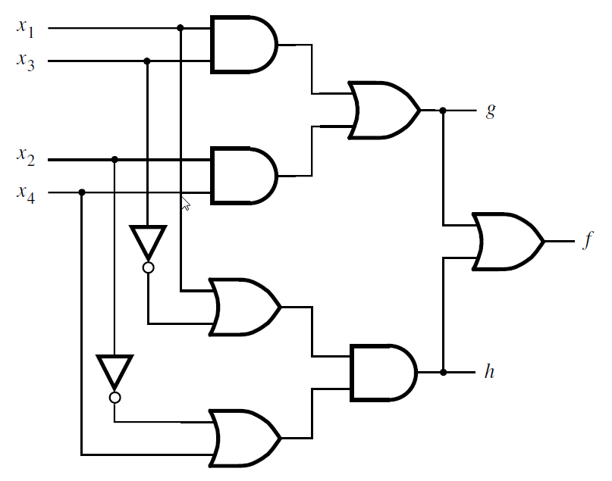
Example-2 - Gate Level
module example2 (x1, x2, x3, x4, f, g, h);
input x1, x2, x3, x4;
output f, g, h;
wire z1,z2,z3,z4;
and (z1, x1, x3);
and (z2, x2, x4);
or (g, z1, z2);
or (z3, x1, ~x3);
or (z4, ~x2, x4);
and (h, z3, z4);
or (f, g, h);
endmodule

Slide 12
Example-2 – Data Flow
module example4 (x1, x2, x3, x4, f, g, h);
input x1, x2, x3, x4;
output f, g, h;
assign g = (x1 & x3) | (x2 & x4);
assign h = (x1 | ~x3) & (~x2 | x4);
assign f = g | h;
endmodule

Slide 13
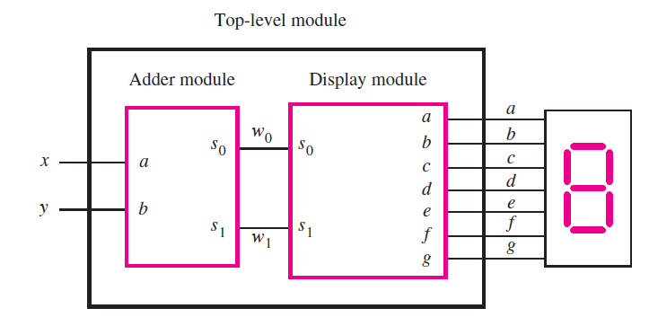
Example-3 – Structural Description

Slide 14
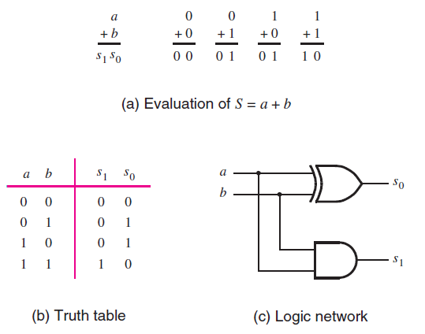
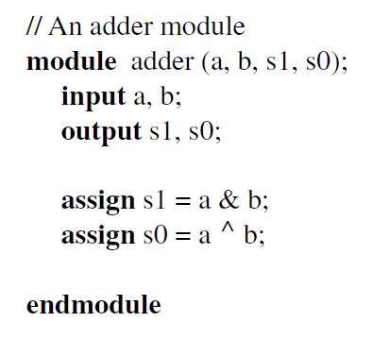
Example-3 – Structural Description
Half Adder Component

Slide 15
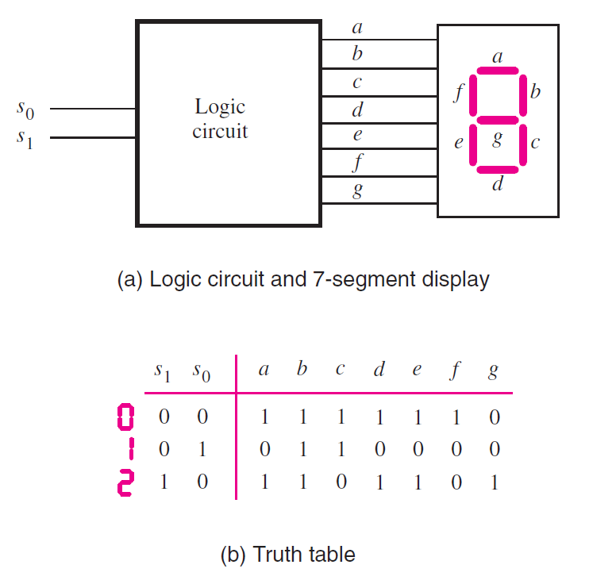
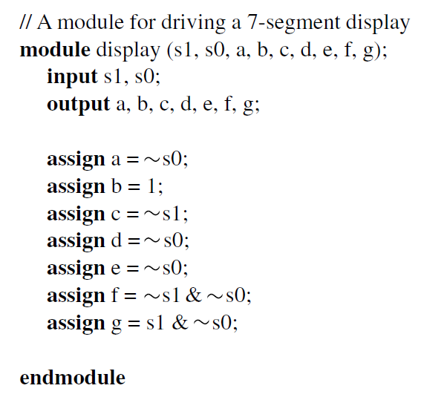
Example-3 – Structural Description
Seven-Segment Component

Slide 16
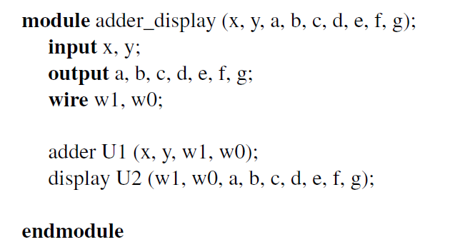
Example-3 – Structural Description

Slide 17
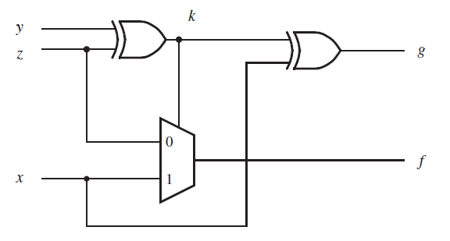
Exercise-1

Slide 18
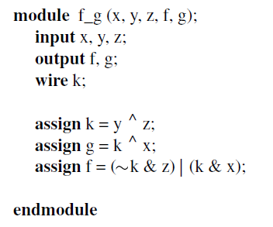
Exercise-1 - Solution

Slide 19
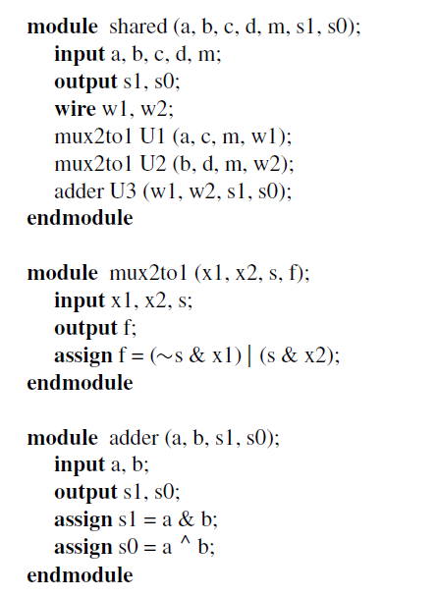
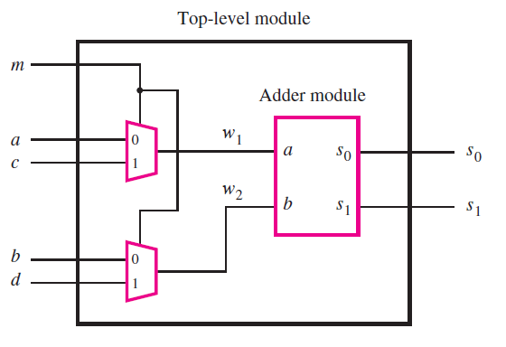
Example-4 – Structural Description

