Slide 1
ENCS3310
Advanced Digital Design
Dr. Abdellatif Abu-Issa
Memories in Verilog

Slide 2
Introduction
Multidimensional Array
Memories

Slide 3
Arrays
An array is
  list of items
  all of same type
  indexed by a number.

Slide 4
Arrays
reg [31:0] x[127:0]; // 128-element array of 32-bit wide reg
wire[15:0] y[ 7:0], z[7:0]; //2 arrays of 16-bit wide wires indexed from 7 to 0
reg [ 7:0] mema [255:0]; // 256-entry memory mema of 8-bit registers
reg arrayb [ 7:0][255:0]; // two-dimensional array of one bit register
reg [7:0] arrayc [3:0][1:0]; // two-dimensional array of 8-bit register
Assigning Values to Arrays
mema = 0; // Illegal syntax - Attempt to write to entire array
arrayb[1] = 0; // Illegal syntax - Attempt to write to elements [1][255]...[1][0]
arrayb[1][31:12] = 0; // Illegal syntax - Attempt to write to multiple elements
mema[1] = 0; // Assigns 0 to the second element of mema
arrayb[1][0] = 0; // Assigns 0 to the bit referenced by indices [1][0]
arrayc[0][0]= 8’h3c; //Assign 3c to arrayc[0][0]

Slide 5
Arrays Inintial Values
reg [7:0] slaves_inload [3:1] =
'{8'b10001000, 8'b10101010, 8'b11101101};

Slide 6
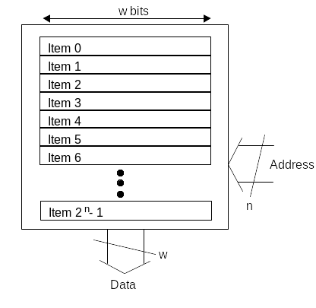
Memories
Read-only memory (ROM):
  Holds list of items
  One item selected by input address

Slide 7
Memory example: exam marks
Student
Mark
Student
Mark
0
72
0
48
1
49
1
31
2
67
2
43
3
53
3
35
4
43
4
2B
5
57
5
39
6
61
In Hex
6
3D
7
37
7
25
8
48
8
30
9
55
9
37
10
79
A
4F
11
51
B
33
12
40
C
28
13
61
D
3D
14
58
E
3A
15
62
F
3E

Slide 8
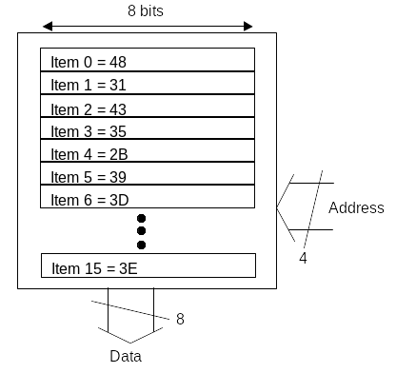
Memory example: exam marks
Student
Mark
0
48
1
31
2
43
In ROM
3
35
4
2B
5
39
6
3D
7
25
8
30
9
37
A
4F
B
33
C
28
Input Student-ID (4-bit, or 1 hex digit)
Output student mark (8-bit or 2 hex digits)
D
3D
E
3A
F
3E

Slide 9
Memory example: exam marks
Student
Mark
0
48
1
31
2
43
In ROM
3
35
4
2B
5
39
6
6
3D
7
25
8
30
9
37
A
4F
3D
B
33
C
28
Input Student-ID (4-bit, or 1 hex digit)
Output student mark (8-bit or 2 hex digits)
D
3D
E
3A
F
3E

Slide 10
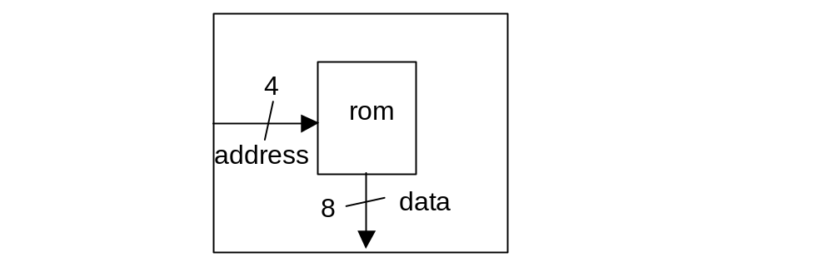
module for ROM Example
module rom(address,data);
input [3:0] address;
output [7:0] data;
endmodule

Slide 11
Setting up ROM data
reg [7:0] mem [0:15] = '{8'h48,8'h31,8'h43, 8'h35, 8'h2B, 8'h39, 8'h3D, 8'h25, 8'h30, 8'h37, 8'h4F, 8'h33, 8'h28, 8'h3D, 8'h3A, 8'h3E};

Slide 12
Reading out selected data item
assign data = mem[address];

Slide 13
Complete Code of the ROM
module rom(address,data);
input [3:0] address;
output [7:0] data;
reg [7:0] mem [0:15] = '{8'h48,8'h31,8'h43, 8'h35, 8'h2B, 8'h39, 8'h3D, 8'h25, 8'h30, 8'h37, 8'h4F, 8'h33, 8'h28, 8'h3D, 8'h3A, 8'h3E};
assign data = mem[address];
endmodule

Slide 14
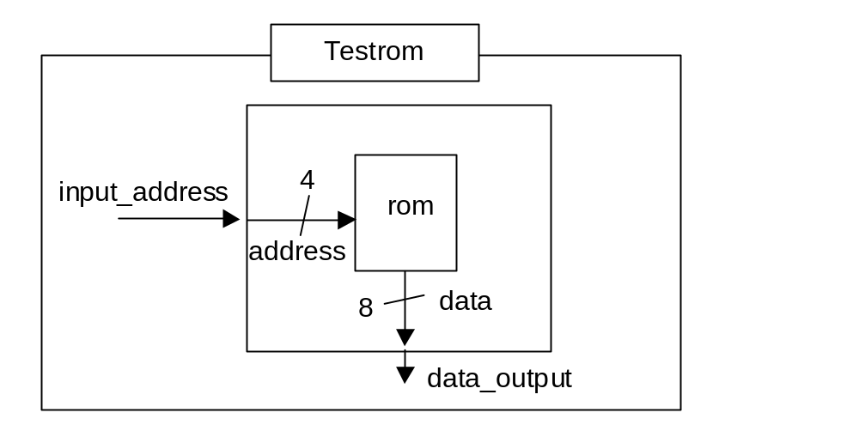
Test bench for the ROM
module rom_tb;
reg [3:0] address;
wire [7:0] data;
rom rom1(address,data);
initial
begin
address = 4'b0000;
repeat(15)
#10ns address = address+1;
end;
endmodule
Create closed system (no inputs or outputs)
Internally it has reg that attach to input and wire to attach to output of device being tested

Slide 15
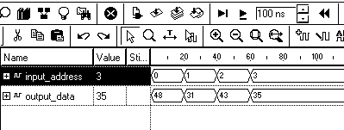
Test bench for the ROM

Slide 16
Test bench for the ROM
Student
Mark
0
48
1
31
2
43
3
35
4
2B
5
39
6
3D
As address is given,
Indexed data item appears at output
7
25
8
30
9
37
A
4F
B
33
C
28
D
3D
E
3A
F
3E

Slide 17
Simple RAM Model
module ram_single(out_data,address, in_data, we, clk);
output reg [7:0] out_data;
input [7:0] in_data;
input [6:0] address;
input we, clk;
reg [7:0] mem [127:0];
always @(posedge clk)
begin
if (we)
mem[address] <= in_data;
else
out_data <= mem[address];
end
endmodule

Slide 18
Summary
  Memory model
  Arrays

