Slide 1
Advanced Digital Design
ENCS3310
Dr. Abdellatif Abu-Issa
Design Verification Overview

Slide 2
Introduction
How to write test benches:
  Test out design in simulation
  Automatically decide if the design works
  Flag errors to the user

Slide 3
A Proper Test Bench
The test benches we have used so far have not been complete testbenches for verification purposes
A full testbench
  runs a simulation
  automatically checks the answers for correctness
  notifies the user of any error

Slide 4
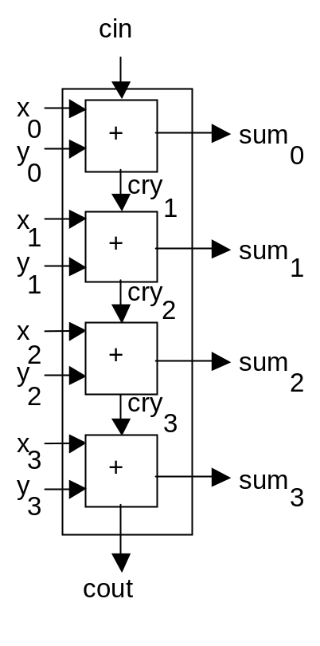
Example: adder circuit
Example of earlier lectures: 4-bit adder
We’ll write a test bench
Result of 4 bit addition
needs 5 bits to represent

Slide 5
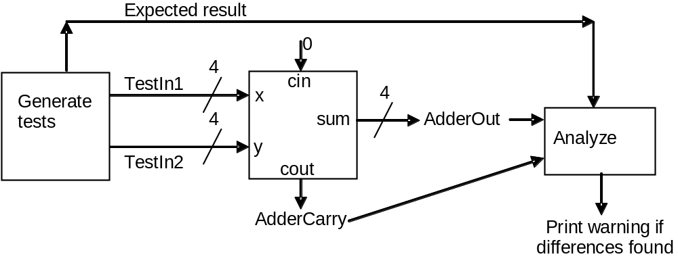
Test Bench Example
Full test bench for adder example
TestIn1 and TestIn2 will cycle through all possible values
Correct output will be calculated
Discrepancies will be reported

Slide 6
Test Bench Entity
module adder_test;
endmodule

Slide 7
Test Bench Architecture
module adder_test;
//Declarations of test inputs and outputs (reg and wire)
//Place one instance of test generator
test_generator TG(connections)
//Place one instance of the Unit Under Test
adder4 DUT(connections)
//Place one instance of result analyzer
result_analyzer RA(connections)
endmodule

Slide 8
Test Bench Architecture
module adder_test;
//Declarations of test inputs and outputs
//Place one instance of test generator
test_generator TG(connections)
//Place one instance of the Unit Under Test
adder4 DUT(connections)
//Place one instance of result analyzer
result_analyzer RA(connections)
endmodule

Slide 9
Test Bench Architecture
module adder_test;
//Declarations of test inputs and outputs
//Place one instance of test generator
test_generator TG(connections)
//Place one instance of the Unit Under Test
adder4 DUT(connections)
//Place one instance of result analyzer
result_analyzer RA(connections)
endmodule

Slide 10
Test Bench Architecture
module adder_test;
//Declarations of test inputs and outputs
//Place one instance of test generator
test_generator TG(connections)
//Place one instance of the Unit Under Test
adder4 DUT(connections)
//Place one instance of result analyzer
result_analyzer RA(connections)
endmodule

Slide 11
TG: Generating the Test Inputs
Loop all possible values (use for loop) or repeat…etc.
Produce the behavioural output using direct operations

Slide 12
RA: Checking for Errors
    ASSERT condition REPORT message SEVERITY severity;
Assertion is not supported in Verilog, but we can build a task and make assertion inside

Slide 13
Doing the Automatic Checking
ASSERT ExpectedResult(3 DOWNTO 0) = ActualAdd
and ExpectedResult(4) = ActualCarry
PRINT "Adder output is incorrect"

Slide 14
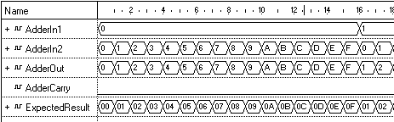
Running our testbench
Simulation goes through all possible inputs
Reports any discrepancies between required output and actual output

