Slide 1
ENCS3310
Advanced Digital Design
Dr. Abdellatif Abu-Issa
Lecture 2
Verilog Iterative Designs

Slide 2
Introduction
Contents
  Handling signals many bits wide
  Iterative Deign

Slide 3
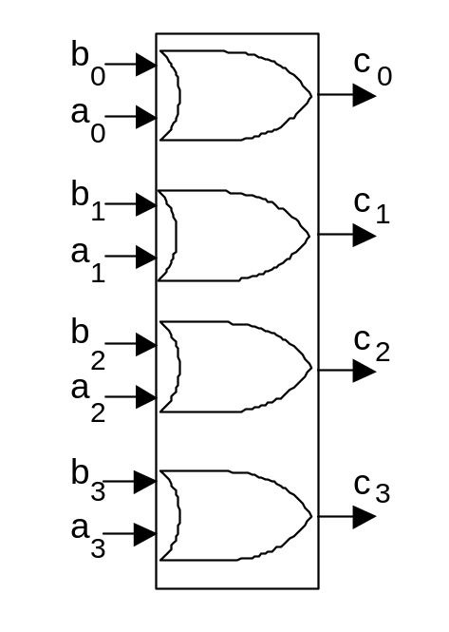
Example of 4-bit device
module orgate1 (a,b,c);
input [0:3] a, b;
output[0:3] c;
assign c[0]= a[0] | b[0];
assign c[1]= a[1] | b[1];
assign c[2]= a[2] | b[2];
assign c[3]= a[3] | b[3];
endmodule

Slide 4
Example of 4-bit device
module orgate2 (a,b,c);
input [0:3] a, b;
output[0:3] c;
assign c[0:3]= a[0:3] | b[0:3];
endmodule

Slide 5
Example of 4-bit device
module orgate3 (a,b,c);
input [0:3] a, b;
output[0:3] c;
assign c= a | b;
endmodule

Slide 6
Example of 4-bit device
module orgate4 (a,b,c);
input [0:3] a, b;
output reg[0:3] c;
integer i;
always@(a,b)
begin
for (i=0; i<4; i=i+1)
begin
c[i]= a[i] | b[i];
end
end
endmodule

Slide 7
Example of 4-bit device
module orgate5 (a,b,c);
input [0:3] a, b;
output[0:3] c;
genvar i;
generate
for (i = 0; i <=3; i = i+1)
begin:array1
assign c[i] = a[i] | b[i];
end
endgenerate
endmodule

Slide 8
Example of 4-bit device
module orgate6 (a,b,c);
input [0:3] a, b;
output[0:3] c;
genvar i;
generate
for (i = 0; i <=3; i = i+1)
begin:or_array
or (c[i],a[i],b[i]);
end
endgenerate
endmodule

Slide 9
Aggregates
module example1 ();
wire [0:3] nibble1, nibble2;;
assign nibble1 = 4'b1110,
nibble2 = 4'b1101;
endmodule
Positional assignment
nibble1 = ( 1 , 1 , 1 , 0);
0 1 2 3

Slide 10
Concatenation: using the , operator
merges two vectors to produce a longer vector.
module example2 ();
wire [0:3] nibble1, nibble2;
wire [0:7] byte1;
assign nibble1 = 4'b1110,
nibble2 = 4'b1101,
byte1 = {nibble1,nibble2};
endmodule
byte gets value ( ‘1','1',‘1',‘0',‘1',‘1',‘0',‘1')

Slide 11
Concatenation: the & operator
merges two vectors to produce a longer vector.
module example2 ();
wire [0:3] nibble1, nibble2;
wire [0:7] byte1;
assign nibble1 = 4'b1110,
nibble2 = 4'b1101,
byte1 = {nibble1,nibble2};
endmodule
byte gets value ( ‘1','1',‘1','0',‘1',‘1',‘0',‘1')

Slide 12
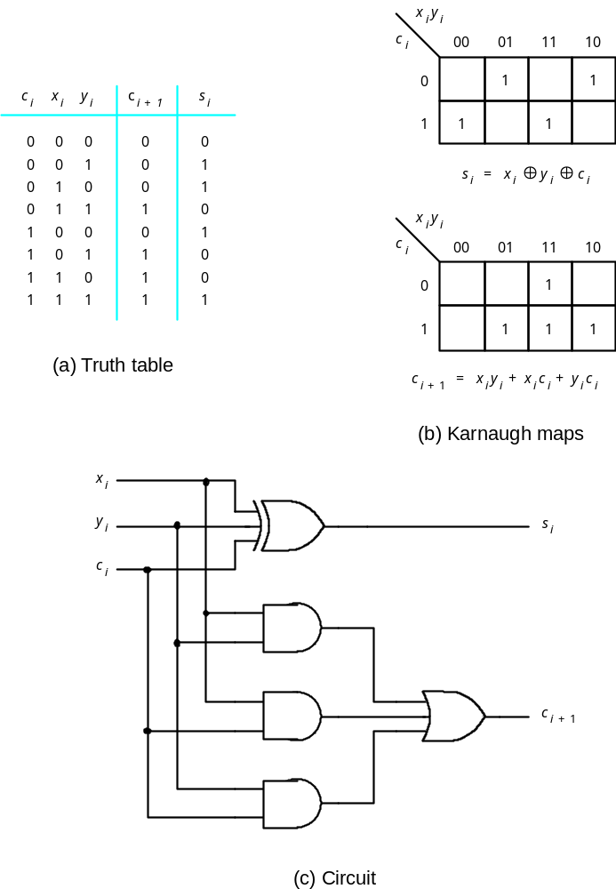
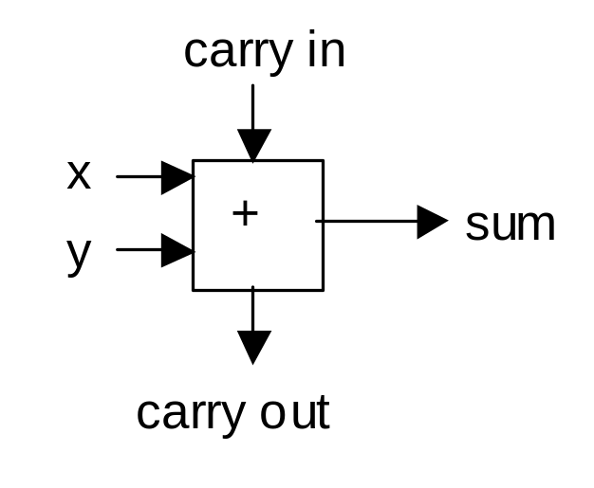
Structural Designs Example
4-bit Adder

Slide 13
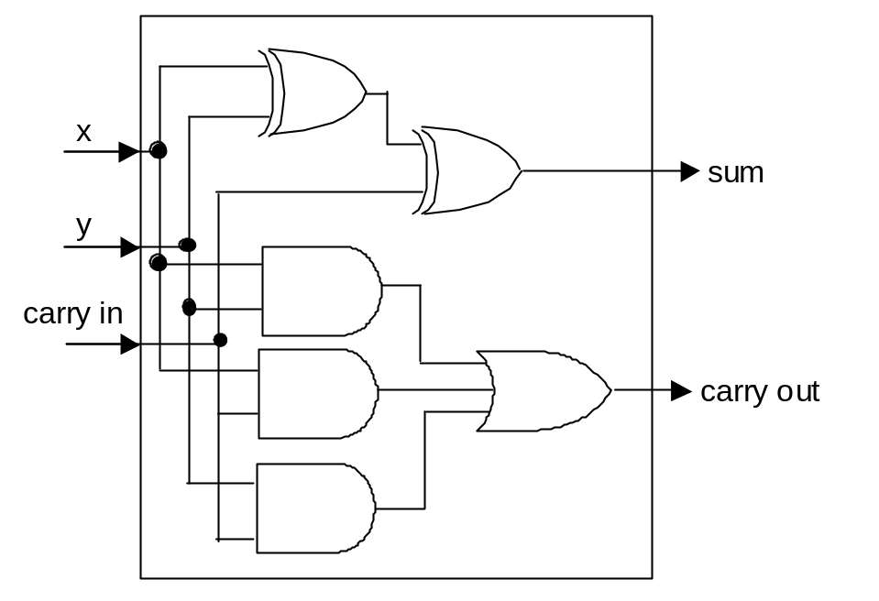
Structural Designs Example
4-bit Adder
module fulladd (Cin, x, y, s, Cout);
input Cin, x, y;
output s, Cout;
wire z1, z2, z3;
xor (s, x, y, Cin);
and (z1, x, y);
and (z2, x, Cin);
and (z3, y, Cin);
or (Cout, z1, z2, z3);
endmodule

Slide 14
Structural Designs Example
4-bit Adder
module fulladd (Cin, x, y, s, Cout);
input Cin, x, y;
output s, Cout;
assign s = x ^ y ^ Cin;
assign Cout = (x & y) | (x & Cin) | (y & Cin);
endmodule

Slide 15
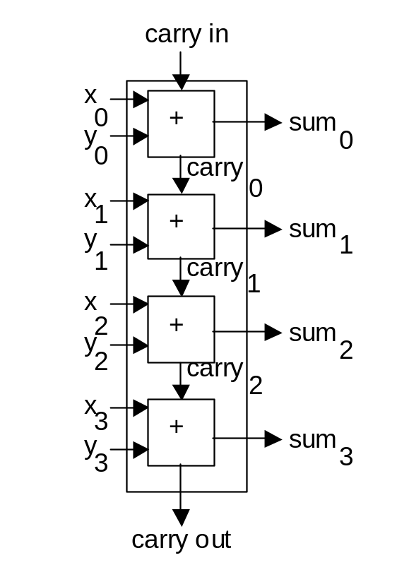
Structural Design Example
4-bit Adder
module adder4 (carryin, x3, x2, x1, x0, y3, y2, y1, y0, s3, s2, s1, s0, carryout);
input carryin, x3, x2, x1, x0, y3, y2, y1, y0;
output s3, s2, s1, s0, carryout;
wire c0,c1,c2;
fulladd stage0 (carryin, x0, y0, s0, c0);
fulladd stage1 (c0, x1, y1, s1, c1);
fulladd stage2 (c1, x2, y2, s2, c2);
fulladd stage3 (c2, x3, y3, s3, carryout);
endmodule

Slide 16
Structural Design Example
4-bit Adder
module adder4 (carryin, X, Y, S, carryout);
input carryin;
input [3:0] X, Y;
output [3:0] S;
output carryout;
wire [2:0] C;
fulladd stage0 (carryin, X[0], Y[0], S[0], C[0]);
fulladd stage1 (C[0], X[1], Y[1], S[1], C[1]);
fulladd stage2 (C[1], X[2], Y[2], S[2], C[2]);
fulladd stage3 (C[2], X[3], Y[3], S[3], carryout);
endmodule

Slide 17
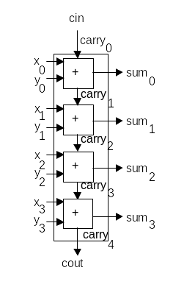
Iterative Structural Design Example 4-bit Adder – Position Association
module adder4 (carryin, X, Y, S, carryout);
input carryin;
input [3:0] X, Y;
output [3:0] S;
output carryout;
wire [4:0] C;
genvar i;
assign C[0] = carryin;
assign carryout = C[4];
generate
for (i = 0; i <= 3; i = i+1)
begin:addbit
fulladd stage (C[i], X[i], Y[i], S[i], C[i+1]);
end
endgenerate
endmodule

Slide 18
Iterative Structural Design Example
4-bit Adder – Named Association
module adder4 (carryin, X, Y, S, carryout);
input carryin;
input [3:0] X, Y;
output [3:0] S;
output carryout;
wire [4:0] C;
genvar i;
assign C[0] = carryin;
assign carryout = C[4];
generate
for (i = 0; i <= 3; i = i+1)
begin:addbit
fulladd stage (.Cin(C[i]), .x(X[i]), .y(Y[i]), .s(S[i]), .Cout(C[i+1]));
end
endgenerate
endmodule

Slide 19
Iterative Behavioral Design Example
4-bit Adder
module adder4 (carryin, X, Y, S, carryout);
input carryin;
input [3:0] X, Y;
output reg [3:0] S;
output reg carryout;
reg [4:0] C;
integer k;
always @(X, Y, carryin)
begin
C[0] = carryin;
for (k = 0; k < 4; k = k+1)
begin
S[k] = X[k] ^ Y[k] ^ C[k];
C[k+1] = (X[k] & Y[k]) | (X[k] & C[k]) | (Y[k] & C[k]);end
carryout = C[4]; end endmodule

Slide 20
Iterative Behavioral Design Example
4-bit Adder (Using Assign for C0 and C4)
module adder4 (carryin, X, Y, S, carryout);
input carryin;
input [3:0] X, Y;
output reg [3:0] S;
output reg carryout;
reg [4:0] C;
integer k;
assign C[0] = carryin;
carryout = C[4];
always @(X, Y, carryin)
begin
for (k = 0; k < 4; k = k+1)
begin
S[k] = X[k] ^ Y[k] ^ C[k];
C[k+1] = (X[k] & Y[k]) | (X[k] & C[k]) | (Y[k] & C[k]);
end end endmodule

Slide 21
Iterative Behavioral Design Example
4-bit Adder (Simplest Way)
module adder4 (carryin, X, Y, S, carryout);
input carryin;
input [3:0] X, Y;
output [3:0] S;
output carryout;
assign {carryout,S} = X + Y + carryin;
endmodule

