Slide 1
ENCS3310
Advanced Digital Design
Dr Abdellatif Abu-Issa
Lecture 3
How Verilog deals with time

Slide 2
Introduction
Verilog simulation tells us how our design responds to changes in inputs
We want to know
  How fast can our design go?
  Will it produce spurious outputs (glitches)?
We will look at
  How Verilog simulations work
  How signals change with time
  How we specify delays on gates

Slide 3
Synthesis and Modelling
Verilog for synthesis:
  assign c = a + b;
Input to synthesis tool
Written by human being

Slide 4
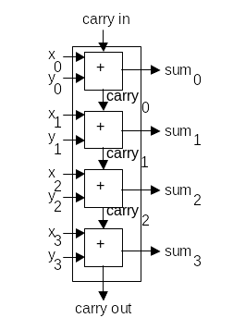
Synthesis and Modelling
Output of synthesis tool:
Netlist to accomplish required function

Slide 5
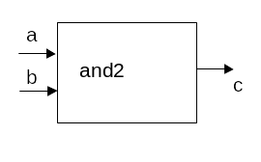
Synthesis and Modelling
What’s this?
Model of real-world component
Enables simulator to predict performance of synthesized circuit, by tracking delays of the components that build the circuit
To simulate timings we need to model delay

Slide 6
The Delay in Gates
a
b
c
10 ns
Whenever a or b changes, c computes a new value
c doesn’t get this value until 10 ns later

Slide 7
Time units
and #(10ns)(c,b,a); // inserting delay to a gate
assign #(10ns) c = a & b;//inserting delay to assign
Unit | Name | Meaning
PS | picosecond | 10⁻¹² seconds
NS | nanosecond | 10⁻⁹ seconds
US | microsecond | 10⁻⁶ seconds
MS | millisecond | 10⁻³ seconds
S | second

Slide 8
Time units
module ckt2 (x,y,z);
input x,y;
output z;
wire n1, n2;
and #(10ns)g1(n1,x,y);
and #(10ns)g2(n2,n1,y);
xor #(15ns)g3(z,n2,x);
endmodule
Smallest unit of time: delta (in case no delay was specified)
Delta: “a moment” or “an instant”

Slide 9
How Verilog processes delays
Example:
Build a circuit from two gates
AND gate: delay = 10 ns
XOR gate: delay = 15 ns

Slide 10
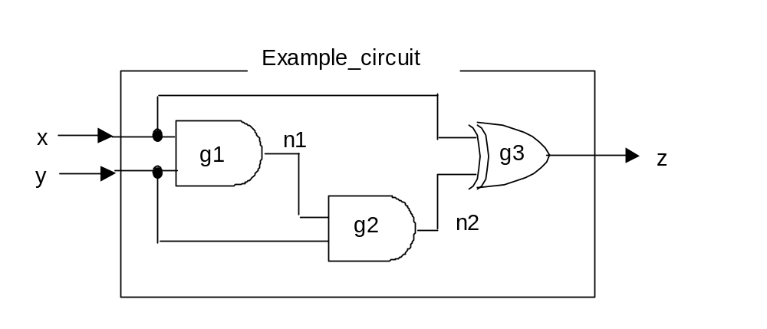
Example circuit
Gates are connected where same wire name appears in output list of one gate and input list of another
module ckt2 (x,y,z);
input x,y;
output z;
wire n1, n2;
and #(10ns)g1(n1,x,y);
and #(10ns)g2(n2,n1,y);
xor #(15ns)g3(z,n2,x);
endmodule

Slide 11
Example circuit (Another way of Modelling delay to assign)
module ckt2 (x,y,z);
input x,y;
output z;
wire n1, n2;
assign #(10ns)n1= x & y;
assign #(10ns)n2=n1 & y;
assign #(15ns)z= n2 ^ x;
endmodule

Slide 12
Simulation
Give it some example inputs:
At time zero, x=’0’ and y=’1’.
  (So n1=’0’, n2=’0’ and z=’0’.)
At time 100 ns, x becomes ‘1’
0
0
100 ns
0

Slide 13
How does Verilog simulate this?
The simulator maintains an event queue. Lists
  What value each signal has now
  What value it will get in future
Simulator advances through time, updating event queue

Slide 14
Verilog simulation
x
0
y
0
0
n1
1
0
n2
z
0
50
100
150
time
Time = 0
Signal Name: | x | y | n1 | n2 | z
Present value: | 0 | 1 | 0 | 0 | 0
Next value: | 1
Event time: | 100
Advance to time of next event on queue

Slide 15
Verilog simulation
x
1
y
0
0
n1
1
0
n2
z
0
50
100
150
time
Time = 100
Signal Name: | x | y | n1 | n2 | z
Present value: | 1 | 1 | 0 | 0 | 0
Next value:
Event time:
All gates with x on input list recompute their outputs

Slide 16
Verilog simulation
x
1
y
0
0
n1
1
0
n2
z
0
50
100
150
time
Time = 100
Signal Name: | x | y | n1 | n2 | z
Present value: | 1 | 1 | 0 | 0 | 0
Next value: |  |  | 1 |  | 1
Event time: |  |  | 110 |  | 115
Advance to time of next event on queue

Slide 17
Verilog simulation
x
1
y
0
1
n1
1
0
n2
z
0
50
100
150
time
Time = 110
Signal Name: | x | y | n1 | n2 | z
Present value: | 1 | 1 | 1 | 0 | 0
Next value: |  |  |  |  | 1
Event time: |  |  |  |  | 115
All gates with n1 on input list recompute their outputs

Slide 18
Verilog simulation
x
1
y
0
1
n1
1
0
n2
z
0
50
100
150
time
Time = 110
Signal Name: | x | y | n1 | n2 | z
Present value: | 1 | 1 | 1 | 0 | 0
Next value: |  |  |  | 1 | 1
Event time: |  |  |  | 120 | 115
Advance to time of next event on queue

Slide 19
Verilog simulation
x
1
y
1
1
n1
1
0
n2
z
0
50
100
150
time
Time = 115
Signal Name: | x | y | n1 | n2 | z
Present value: | 1 | 1 | 1 | 0 | 1
Next value: |  |  |  | 1
Event time: |  |  |  | 120
All gates with z on input list recompute their outputs

Slide 20
Verilog simulation
x
1
y
1
1
n1
1
0
n2
z
0
50
100
150
time
Time = 115
Signal Name: | x | y | n1 | n2 | z
Present value: | 1 | 1 | 1 | 0 | 1
Next value: |  |  |  | 1
Event time: |  |  |  | 120
Advance to time of next event on queue

Slide 21
Verilog simulation
x
1
y
1
1
n1
1
1
n2
z
0
50
100
150
time
Time = 120
Signal Name: | x | y | n1 | n2 | z
Present value: | 1 | 1 | 1 | 1 | 1
Next value:
Event time:
All gates with n2 on input list recompute their outputs

Slide 22
Verilog simulation
x
1
y
1
1
n1
1
1
n2
z
0
50
100
150
time
Time = 120
Signal Name: | x | y | n1 | n2 | z
Present value: | 1 | 1 | 1 | 1 | 1
Next value: |  |  |  |  | 0
Event time: |  |  |  |  | 135
Advance to time of next event on queue

Slide 23
Verilog simulation
x
1
y
0
1
n1
1
1
n2
z
0
50
100
150
time
Time = 135
Signal Name: | x | y | n1 | n2 | z
Present value: | 1 | 1 | 1 | 1 | 0
Next value:
Event time:
Nothing left on queue: continue to end of simulation time

Slide 24
Verilog simulation
x
1
y
0
1
n1
1
1
n2
z
0
50
100
150
time
Time = 200
Signal Name: | x | y | n1 | n2 | z
Present value: | 1 | 1 | 1 | 1 | 0
Next value:
Event time:

Slide 25
Glitches
x
y
n1
n2
z
0
50
100
150
time
For x=0, y=1 static output is 0
For x=1, y=1 static output is also 0
However, output goes briefly to 1: glitch
Detecting these glitches is an important goal of simulation

Slide 26
Glitches
x
y
n1
n2
z
0
50
100
150
time
Glitch occurred because of gate delays
x input to g3 settles immediately
n2 input settles after delay of g1 and g2
If gate delay was not modelled, glitch would not be detected

Slide 27
Delta delay
Problem:
  We don’t know delay when we are doing the design
  If gates don’t have a delay, simulation could be wrong
Solution:
  We don’t specify a delay
  Verilog inserts a delay: delta for gates and assign statements
Delta is smallest possible instant of time
  A “moment”; an “instant”

Slide 28
Example circuit
Gates are connected where same wire name appears in output list of one gate and input list of another
module ckt2 (x,y,z);
input x,y;
output z;
wire n1, n2;
and g1(n1,x,y);
and g2(n2,n1,y);
xor g3(z,n2,x);
endmodule

Slide 29
Verilog simulation: δ delay
x
0
y
0
0
n1
1
0
n2
z
0
50
100
150
time
Time = 0
Signal Name: | x | y | n1 | n2 | z
Present value: | 0 | 1 | 0 | 0 | 0
Next value: | 1
Event time: | 100
Advance to time of next event on queue

Slide 30
Verilog simulation: δ delay
x
1
y
0
0
n1
1
0
n2
z
0
50
100
150
time
Time = 100
Signal Name: | x | y | n1 | n2 | z
Present value: | 1 | 1 | 0 | 0 | 0
Next value:
Event time:
All gates with x on input list recompute their outputs

Slide 31
Verilog simulation: δ delay
x
1
y
0
0
n1
1
0
n2
z
0
50
100
150
time
Time = 100
Signal Name: | x | y | n1 | n2 | z
Present value: | 1 | 1 | 0 | 0 | 0
Next value: |  |  | 1 |  | 1
Event time: |  |  | 100+δ |  | 100+δ
Advance to time of next event on queue

Slide 32
Verilog simulation: δ delay
x
1
y
1
1
n1
1
0
n2
z
0
50
100
150
time
Time = 100 +δ
Signal Name: | x | y | n1 | n2 | z
Present value: | 1 | 1 | 1 | 0 | 1
Next value:
Event time:
All gates with n1 or z on input list recompute their outputs

Slide 33
Verilog simulation: δ delay
x
1
y
1
1
n1
1
0
n2
z
0
50
100
150
time
Time = 100 +δ
Signal Name: | x | y | n1 | n2 | z
Present value: | 1 | 1 | 1 | 0 | 1
Next value: |  |  |  | 1
Event time: |  |  |  | 100+2δ
Advance to time of next event on queue

Slide 34
Verilog simulation: δ delay
x
1
y
1
1
n1
1
1
n2
z
0
50
100
150
time
Time = 100 +2δ
Signal Name: | x | y | n1 | n2 | z
Present value: | 1 | 1 | 1 | 1 | 1
Next value:
Event time:
All gates with n2 on input list recompute their outputs

Slide 35
Verilog simulation: δ delay
x
1
y
1
1
n1
1
1
n2
z
0
50
100
150
time
Time = 100 +2δ
Signal Name: | x | y | n1 | n2 | z
Present value: | 1 | 1 | 1 | 1 | 1
Next value: |  |  |  |  | 0
Event time: |  |  |  |  | 100+3δ
Advance to time of next event on queue

Slide 36
Verilog simulation: δ delay
x
1
y
0
1
n1
1
1
n2
z
0
50
100
150
time
Time = 100+ 3δ
Signal Name: | x | y | n1 | n2 | z
Present value: | 1 | 1 | 1 | 1 | 0
Next value:
Event time:
Nothing left on queue: continue to end of simulation time

Slide 37
Verilog simulation: δ delay
x
1
y
0
1
n1
1
1
n2
z
0
50
100
150
time
Time = 200
Signal Name: | x | y | n1 | n2 | z
Present value: | 1 | 1 | 1 | 1 | 0
Next value:
Event time:
Glitch has been correctly simulated

Slide 38
Verilog simulation: δ delay
In Verilog assignment always has delay:
  assign c = a + b;
  is treated as if it said
  assign c = a + b AFTER delta;
The statement runs whenever a RHS value changes
c computes a new value, but does not get this value until a delta time later
This delay ensures correct simulation

Slide 39
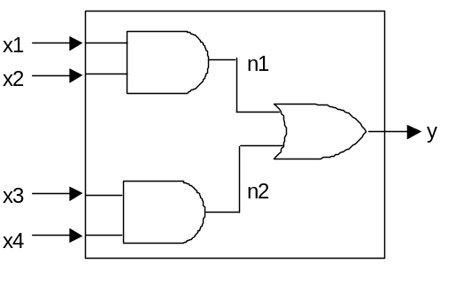
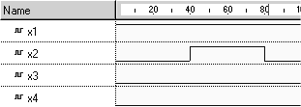
Questions
AND gate delay 10 ns
OR gate delay 15 ns
Question 1
What is the behaviour of n1, n2 and y when the inputs do this:

Slide 40





Questions
(a)
(b)
(c)
(d)
(e)

Slide 41
Inertial behaviour
and #(10)(c,b,a);
a
b
c
10 ns
10 ns
c follows inputs, but with 10 ns delay
Delay is measure of inertia
Gate cannot respond over time periods smaller than 10 ns

Slide 42
What if input pulse is too narrow?
and #(10ns)(c,b,a); // inserting delay to a gate
assign #(10ns) c = a & b; //inserting delay to assign
a
b
c
10 ns
Gate cannot respond over time periods smaller than 10 ns
If input pulse is narrower than this, output does not change: inertial behaviour

Slide 43
Inertial behaviour in Verilog
In Verilog simulation, inertial situations manifest themselves as collisions on the event queue

Slide 44
Example circuit
Gates are connected where same wire name appears in output list of one gate and input list of another
module ckt2 (x,y,z);
input x,y;
output z;
wire n1, n2;
and #(10ns)g1(n1,x,y);
and #(10ns)g2(n2,n1,y);
xor #(25ns)g3(z,n2,x);
endmodule

Slide 45
Verilog simulation: Inertial example
x
0
y
0
0
n1
1
0
n2
z
0
50
100
150
time
Time = 0
Signal Name: | x | y | n1 | n2 | z
Present value: | 0 | 1 | 0 | 0 | 0
Next value: | 1
Event time: | 100
Advance to time of next event on queue

Slide 46
Verilog simulation: Inertial example
x
1
y
0
0
n1
1
0
n2
z
0
50
100
150
time
Time = 100
Signal Name: | x | y | n1 | n2 | z
Present value: | 1 | 1 | 0 | 0 | 0
Next value:
Event time:
All gates with x on input list recompute their outputs

Slide 47
Verilog simulation: Inertial example
x
1
y
0
0
n1
1
0
n2
z
0
50
100
150
time
Time = 100
Signal Name: | x | y | n1 | n2 | z
Present value: | 1 | 1 | 0 | 0 | 0
Next value: |  |  | 1 |  | 1
Event time: |  |  | 110 |  | 125
Advance to time of next event on queue

Slide 48
Verilog simulation: Inertial example
x
1
y
0
1
n1
1
0
n2
z
0
50
100
150
time
Time = 110
Signal Name: | x | y | n1 | n2 | z
Present value: | 1 | 1 | 1 | 0 | 0
Next value: |  |  |  |  | 1
Event time: |  |  |  |  | 125
All gates with n1 on input list recompute their outputs

Slide 49
Verilog simulation: Inertial example
x
1
y
0
1
n1
1
0
n2
z
0
50
100
150
time
Time = 110
Signal Name: | x | y | n1 | n2 | z
Present value: | 1 | 1 | 1 | 0 | 0
Next value: |  |  |  | 1 | 1
Event time: |  |  |  | 120 | 125
Advance to time of next event on queue

Slide 50
Verilog simulation: Inertial example
x
1
y
0
1
n1
1
1
n2
z
0
50
100
150
time
Time = 120
Signal Name: | x | y | n1 | n2 | z
Present value: | 1 | 1 | 1 | 1 | 0
Next value: |  |  |  |  | 1
Event time: |  |  |  |  | 125
All gates with n2 on input list recompute their outputs

Slide 51
Verilog simulation: Inertial example
x
1
y
0
1
n1
1
1
n2
z
0
50
100
150
time
Time = 120
Signal Name: | x | y | n1 | n2 | z
Present value: | 1 | 1 | 1 | 1 | 0
Next value: |  |  |  |  | 1, 0
Event time: |  |  |  |  | 125, 145
Multiple events on queue for z: later over-writes earlier

Slide 52
Verilog simulation: Inertial example
x
1
y
0
1
n1
1
1
n2
z
0
50
100
150
time
Time = 135
Signal Name: | x | y | n1 | n2 | z
Present value: | 1 | 1 | 1 | 1 | 0
Next value:
Event time:
Nothing left on queue: continue to end of simulation time

Slide 53
Verilog simulation: Inertial example
x
1
y
0
1
n1
1
1
n2
z
0
50
100
150
time
Time = 200
Signal Name: | x | y | n1 | n2 | z
Present value: | 1 | 1 | 1 | 1 | 0
Next value:
Event time:

Slide 54
Inertial behaviour
x
y
n1
n2
z
0
50
100
150
Output does not glitch
Inputs to g3 were unequal for 20 ns
g3 cannot output a pulse narrower than 25 ns
Corresponds to inertial behaviour of real devices

Slide 55
Inertial behaviour in Verilog
In Verilog simulation, inertial situations manifest themselves as collisions on the event queue
Later event over-writes earlier event
This ensures inertial behaviour

Slide 56
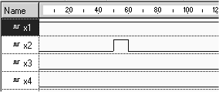
Questions
AND gate delay 10 ns
OR gate delay 15 ns
Question 2
What is the behaviour of n1, n2 and y when the inputs do this:
(the pulse width is 9 ns)

Slide 57



Questions
(a)
(b)
(c)
(d)
(e)

Slide 58
Summary
We want to know timing behaviour of designs
Verilog simulation
  shows how outputs respond to sequence of inputs
  proceeds by tracking evolution of event queue through time
Verilog assignments always have delay, even if we don’t specify delay
Inertial behaviour is ensured by only allowing one entry for each signal on event queue

