Slide 1
ENCS3310
Advanced Digital Design
Dr. Abdellatif Abu-Issa
Lecture 4:
Testbenches

Slide 2
Introduction
Testbenches
  Verilog description of environment
  Apply test inputs
  Look at outputs

Slide 3
Testbenches
Would like to describe test inputs in Verilog
  Powerful
  Portable

Slide 4
Writing a Test Bench
A test bench is an HDL program used for applying stimulus to an HDL design in order to test it and observe its response during simulation.
In addition to the always statement, test benches use the initial statement to provide a stimulus to the circuit under test.
The always statement executes repeatedly in a loop. The initial statement executes only once starting from simulation time=0 and may continue with any operations that are delayed by a given number of units as specified by the symbol #.

Slide 5
Writing a Test Bench (2)
    initial begin
      A=0; B=0;
      #10 A=1;
      #20 A=0; B=1;
    end
The block is enclosed between begin and end. At time=0, A and B are set to 0. 10 time units later, A is changed to 1. 20 time units later (at t=30) a is changed to 0 and B to 1.

Slide 6
Writing a Test Bench (2)
Inputs to a 3-bit truth table can be generated with the initial block
    initial begin
      D = 3’b000; repeat (7)
      #10 D = D + 3’b001;
    end
The 3-bit vector D is initialized to 000 at time=0. The keyword repeat specifies looping statement: one is added to D seven times, once every 10 time units.

Slide 7
Writing a Test-Bench (3)
A stimulus module is an HDL program that has the following form.
  module testname
    Declare local reg and wire identifiers
    Instantiate the design module under test.
    Generate stimulus using initial and always statements
    Display the output response.
  endmodule
A test module typically has no inputs or outputs.
The signals that are applied as inputs to the design module for simulation are declared in the stimulus module as local reg data type.
The outputs of the design module that are displayed for testing are declared in the stimulus model as local wire data type.
The module under test is then instantiated using the local identifiers.

Slide 8
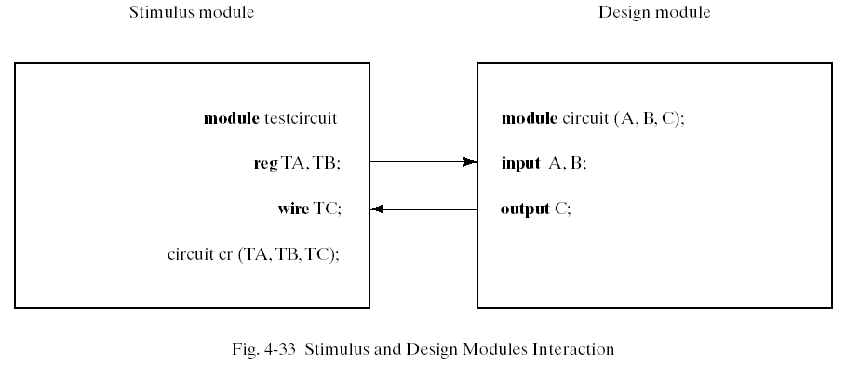
Writing a Test-Bench (4)
The stimulus model generates inputs for the design module by declaring identifiers TA and TB as reg data type, and checks the output of the design unit with the wire identifier TC. The local identifiers are then used to instantiate the design module under test.

Slide 9
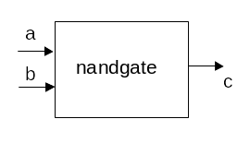
A simulation example from the lab
module nandgate(a,b,c);
input a,b;
output c;
nand g1(c,b,a);
endmodule

Slide 10
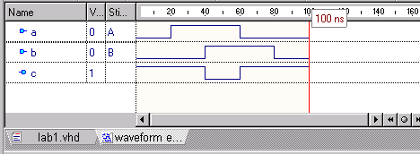
A simulation example from the lab
Used stimulators in ActiveHDL
  Not portable to other Verilog products
  Not very powerful
We’d like to describe test inputs in Verilog

Slide 11
A simulation example from the lab
We need to know Verilog way to:
  represent behaviour of a and b
    Low then high then low again
  apply these inputs to the gate

Slide 12
Multiple assignment to signals
initial
begin
in1= 0; in2=0;
#10ns in1=1;
#10ns in2=1;
#30ns in1=0; in2=1;
end
Normal Verilog assignment runs when RHS signal changes
There are no signals on RHS, only literal values
Statements run exactly once at beginning of simulation
This type of assignment is exempt from inertial behaviour
Multiple transitions can co-exist on queue

Slide 13
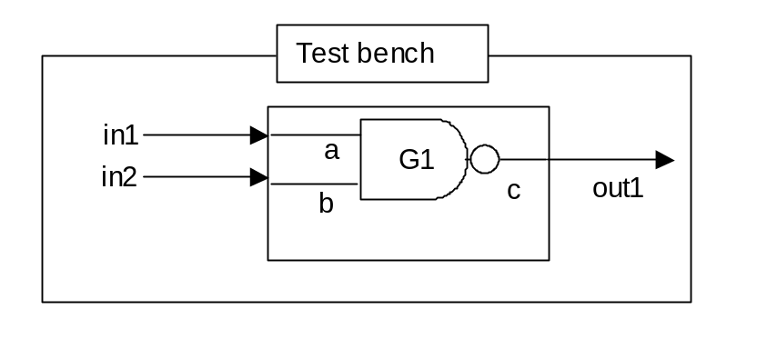
A test bench for the NAND gate
Test bench represents “world around the device we’re simulating”
Contains Verilog simulation of
  input generator (signal generator)
  output observer (logic analyzer)

Slide 14
A test bench for the NAND gate
It’s a closed system with no inputs or outputs:
module nand_test;
endmodule

Slide 15
A test bench for the NAND gate
It contains internal signals:
  in1, in2 that model a signal generator unit
  out1 that models the logic analyzer unit
reg in1,in2;
wire out1;

Slide 16
A test bench for the NAND gate
It contains one copy of the device we want to test
  in1, in2 are connected to its inputs
  out1 is connected to its outputs
nandgate n1(.a(in1),.b(in2),.c(out1));

Slide 17
A test bench for the NAND gate
We need to say how in1 and in2 change with time
initial
begin
in1= 0; in2=0;
#10 in1=1;
#30 in1=0; in2=1;
end

Slide 18
A test bench for the NAND gate
module nand_test;
reg in1,in2;
wire out1;
nandgate n1(.a(in1),.b(in2),.c(out1));
initial
begin
in1= 0; in2=0;
#10ns in1=1;
#10ns in2=1;
#30ns in1=0; in2=1;
end
endmodule

Slide 19
A test bench for the fulladder
module fa_tb();
reg cin,x,y ;
wire s,cout;
fulladd fa0(cin,x,y,s,cout);
initial
begin
{cin,x,y} = 3'b000;
repeat(7)
#10ns {cin,x,y} = {cin,x,y} + 3'b001;
end
endmodule

Slide 20
A Test Bench for our 4-bit Adder
module adder4_tb;
endmodule
Open libraries
Declare port map
Testbench
Work library
cin
x
sum
+
y
cout

Slide 21
A Test Bench for our 4-bit Adder
Declare signals used in our test bench
reg carry_in;
reg [3:0] in1,in2;
wire carry_out;
wire [3:0] sum1;
Testbench
Work library
carry_in
cin
x
sum
+
in1
sum1
y
in2
cout
carry_out

Slide 22
A Test Bench for our 4-bit Adder
Instantiate the adder from the library
adder4 u1
Testbench
Work library
carry_in
cin
cin
x
sum
x
+
in1
+
sum
sum1
y
in2
cout
y
cout
carry_out

Slide 23
A Test Bench for our 4-bit Adder
Wire up the inputs & outputs
adder4 u1(.carryin(carry_in), .X(in1), .Y(in2), .S(sum1), .carryout(carry_out));
Testbench
Work library
carry_in
cin
cin
x
sum
x
+
in1
+
sum
sum1
y
in2
cout
y
cout
carry_out

Slide 24
A Test Bench for our 4-bit Adder
initial
begin
in1= 0; in2=0; carry_in=0;
#10ns in1=3;
#10ns in2=4;
#20ns in1=5;
#40ns in2=1;
end
Give some values to inputs and outputs
Testbench
Work library
carry_in
cin
cin
x
sum
x
+
in1
+
sum
sum1
y
in2
cout
y
cout
carry_out

Slide 25
Verilog System Tasks
The response to the stimulus generated by the initial and always blocks will appear at the output of the simulator as timing diagrams.
It is also possible to display numerical outputs using Verilog system tasks.
  $display – display one-time value of variables or strings with end-of-line return,
  $write – same $display but without going to next line.
  $monitor – display variables whenever a value changes during simulation run.
  $time – displays simulation time
  $finish – terminates the simulation
The syntax for $display,$write and $monitor is of the form
  Task-name (format-specification, argument list);
  E.g. $display(%d %b %b, C,A,B);
  $display(“time = %0d A = %b B=%b”,$time,A,B);

Slide 26
MUX2x1 Description
//Dataflow description of 2-to-1-line multiplexer
module mux2x1_df (A,B,select,OUT);
input A,B,select;
output OUT;
assign OUT = select ? A : B;
endmodule

Slide 27
MUX2x1 Testbench
//Stimulus for mux2x1_df
module testmux;
reg TA,TB,TS; //inputs for mux
wire Y; //output from mux
mux2x1_df mx (TA,TB,TS,Y); // instantiate mux
initial begin
$display ("Select A B Out");
$monitor("Time %0d select=%b A=%b B=%b OUT=%b", $time,TS,TA,TB,Y);
TS = 1; TA = 0; TB = 1;
#10 TA = 1; TB = 0;
#10 TS = 0;
#10 TA = 0; TB = 1;
end
endmodule

Slide 28
MUX2x1 Testbench
module testmux2;
reg TA,TB,TS; //inputs for mux
wire Y; //output from mux
mux2x1_df mx (TA,TB,TS,Y); // instantiate mux
initial begin
$display (" Select A B Out");
$monitor("Time %0d select=%b A=%b B=%b OUT=%b",$time,TS,TA,TB,Y);
{TS,TA,TB} = 3'b000;
repeat(7)
#10 {TS,TA,TB} = {TS,TA,TB} + 3'b001;
end
endmodule

Slide 29
MUX2x1 Testbench
initial begin
$display (" Select A B Out");
$monitor("Time %0d select=%b A=%b B=%b OUT=%b",$time,TS,TA,TB,Y);
TS= 0; TA = 0; TB = 0;
end
always #40ns TS = ~TS;
always #20ns TA = ~TA;
always #10ns TB = ~TB;

Slide 30
Summary
  Test benches
  System Tasks

