Slide 1
ENCS 3310
Advanced Digital Design
Dr. Abdellatif Abu-Issa
Verilog Parameters

Slide 2
Introduction
Verilog Parameters
Generic Parameters

Slide 3
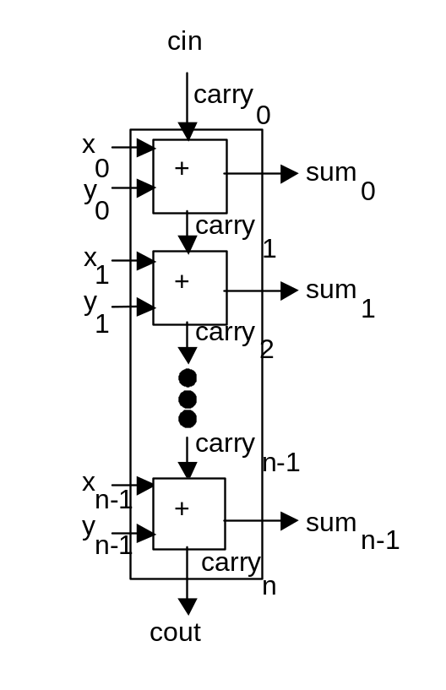
Generic Parameters
Suppose we have a generic hardware design
e.g. an n-bit adder
We are going to place one into our design
How do we say what value n should have?

Slide 4
Generic Adder 1
module addern (carryin, X, Y, S, carryout);
parameter n=32;
input carryin;
input [n-1:0] X, Y;
output reg [n-1:0] S;
output reg carryout;
reg [n:0] C;
integer k;
assign C[0] = carryin,
carryout = C[n];
always @(X, Y, carryin)
begin
for (k = 0; k < n; k = k+1)
begin
S[k] = X[k] ^ Y[k] ^ C[k];
C[k+1] = (X[k] & Y[k]) | (X[k] & C[k]) | (Y[k] & C[k]);
end
end
endmodule

Slide 5
Generic Adder 2
module addern (carryin, X, Y, S, carryout);
parameter n = 32;
input carryin;
input [n-1:0] X, Y;
output [n-1:0] S;
output carryout;
wire [n:0] C;
genvar i;
assign C[0] = carryin;
assign carryout = C[n];
generate
for (i = 0; i <= n-1; i = i+1)
begin:addbit
fulladd stage (C[i], X[i], Y[i], S[i], C[i+1]);
end
endgenerate
endmodule
module fulladd (Cin, x, y, s, Cout);
input Cin, x, y;
output s, Cout;
assign s = x ^ y ^ Cin,
Cout = (x & y) | (x & Cin) | (y & Cin);
endmodule

Slide 6
Generic Adder 3
module addern (carryin, X, Y, S, Cout);
parameter n = 32;
input carryin;
input [n-1:0] X, Y;
output reg Cout;
output reg [n-1:0] S;
always @(X, Y, carryin)
{Cout,S} = X + Y + carryin;
endmodule

Slide 7
Instantiating the Adder – Parameter override1
module adder_instances (A, B, C, D, S, T);
input [15:0] A, B;
input [7:0] C, D;
output [16:0] S;
output [8:0] T;
addern_v1 U1 (1'b0, A, B, S[15:0], S[16]);
defparam U1.n = 16;
addern_v1 U2 (1'b0, C, D, T[7:0], T[8]);
defparam U2.n = 8;
endmodule

Slide 8
Instantiating the Adder – Parameter override2
module adder_instances2 (A, B, C, D, S, T);
input [15:0] A, B;
input [7:0] C, D;
output [16:0] S;
output [8:0] T;
addern_v3 #(16) U1 (1'b0, A, B, S[15:0], S[16]);
addern_v3 #(8) U2 (1'b0, C, D, T[7:0], T[8]);
endmodule

Slide 9
Instantiating the Adder – Parameter override3
module adder_instances2 (A, B, C, D, S, T);
input [15:0] A, B;
input [7:0] C, D;
output [16:0] S;
output [8:0] T;
addern_v3 #(.n(16)) U1 (1'b0, A, B, S[15:0], S[16]);
addern_v3 #(.n(8)) U2 (1'b0, C, D, T[7:0], T[8]);
endmodule

Slide 10
Testbench for 3-bit Adder instance from n-bit adder
module adder_instances4;
reg [2:0] A, B;
wire [3:0] S;
addern_v3 #(.n(3)) U1 (1'b0, A, B, S[2:0], S[3]);
initial
begin
{A,B} = 0;
repeat(63)
#10ns {A,B} = {A,B} +1;
end
endmodule

Slide 11
Summary
Building blocks for assignment
  Verilog parameters
  Generic Parameters
  Parameter override for instantiating generic designs

