Slide 1
ENCS 3310
Advanced Digital Design
Dr. Abdellatif Abu-Issa
Synchronous Logic

Slide 2
Introduction
always block:
  Way of controlling when statements execute
Synchronous logic
  Logic whose function is gated by a clock

Slide 3
Concurrent Verilog
1 module fulladd (Cin, x, y, s, Cout);
2 input Cin, x, y;
3 output s, Cout;
4
5 assign s = x ^ y ^ Cin;
6 assign Cout = (x & y) | (x & Cin) | (y & Cin);
7
8 endmodule
Dataflow description.
Statement runs whenever there is a change in a signal to which it is sensitive
Statement 5 sensitivity list is x, y, cin (all RHS values).
Statement 6 sensitivity list is x, y, cin (all RHS values).

Slide 4
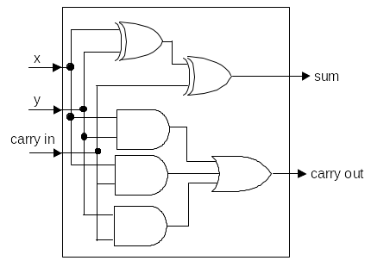
Concurrent Verilog
1 module fulladd (Cin, x, y, s, Cout);
2 input Cin, x, y;
3 output s, Cout;
4
5 assign s = x ^ y ^ Cin;
6 assign Cout = (x & y) | (x & Cin) | (y & Cin);
7
8 endmodule
Gives effective representation of behaviour of real hardware

Slide 5
Concurrent Verilog
1 module fulladd (Cin, x, y, s, Cout);
2 input Cin, x, y;
3 output s, Cout;
4
5 assign s = x ^ y ^ Cin;
6 assign Cout = (x & y) | (x & Cin) | (y & Cin);
7
8 endmodule
Order of statements has no effect on function
This is the same:
1 module fulladd (Cin, x, y, s, Cout);
2 input Cin, x, y;
3 output s, Cout;
4
5 assign Cout = (x & y) | (x & Cin) | (y & Cin);
6 assign s = x ^ y ^ Cin;
7
8 endmodule

Slide 6
always block
Give more precise control over when a block of code should execute
Always @ ( sensitivity list )
begin
Statement 1;
Statement 2;
Statement3;
end
Whenever signal in sensitivity list changes
Block of code executes (sequentially)

Slide 7
always
1 module fulladd (Cin, x, y, s, Cout);
2 input Cin, x, y;
3 output s, Cout;
4
5 assign s = x ^ y ^ Cin;
6 assign Cout = (x & y) | (x & Cin) | (y & Cin);
7
8 endmodule
Statement 5 sensitivity list is x, y, cin (all RHS values).
Statement 6 sensitivity list is x, y, cin (all RHS values).

Slide 8
always
1 module fulladd (Cin, x, y, s, Cout);
2 input Cin, x, y;
3 Output reg s, Cout;
always@(x,y,cin)
begin
6 s = x ^ y ^ Cin;
7 Cout = (x & y) | (x & Cin) | (y & Cin);
8 end
9 endmodule
Sensitivity list has been explicitly given.

Slide 9
Sequential Verilog
Sequential code “flows” like C:
  Powerful
  Must be careful
  (code may have no hardware counterpart)
Concurrent code, each line is free-standing:
  Limiting,
  Behaves like hardware

Slide 10
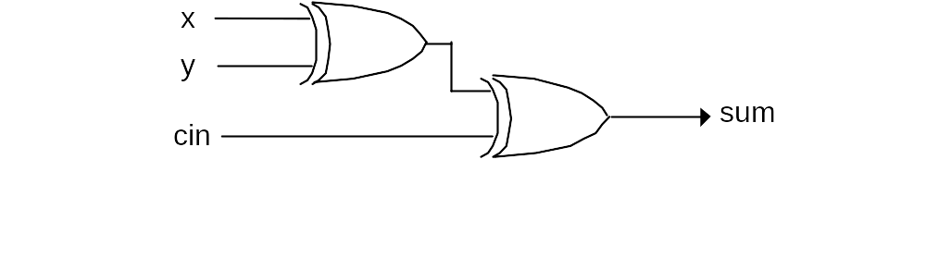
Sequential logic
What is the point of always block?
Combinational circuits change output when any input changes
Assign s = cin ^ x ^ y;
Some circuits ignore their inputs until one particular input changes
  Clock
  Enable
Need sequential blocks to be able to describe them

Slide 11
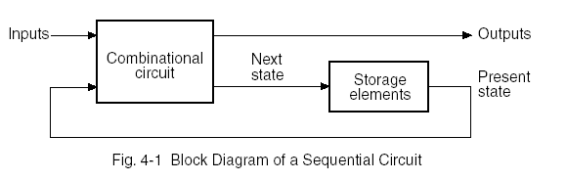
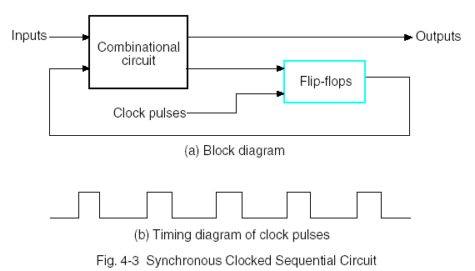
Sequential Circuits

Slide 12
Behavioral Modeling in Sequential Ckts
There are two kinds of behavioral statements in Verilog HDL: initial and always.
The initial behavior executes once beginning at time=0.
The always behavior executes repeatedly and re-executes until the simulation terminates.
A behavior is declared within a module by using the keywords initial or always, followed by a statement or a block of statements enclosed by the keywords begin and end.

Slide 13
Behavioral Modeling in Sequential Ckts (2)
An example of a free-running clock
initial begin
clock = 1’b0;
repeat (30);
#10 clock = ~clock;
end
initial begin
clock = 1’b0;
#300 $finish;
end
always #10 clock = ~clock;

Slide 14
Behavioral Modeling in Sequential Ckts (3)
The always statement can be controlled by delays that wait for a certain time or by certain conditions to become true or by events to occur.
This type of statement is of the form:
  always @ (event control expression)
  Procedural assignment statements
The event control expression specifies the condition that must occur to activate the execution of the procedural assignment statements.
The variables in the left-hand side of the procedural statements must be of the reg data type and must be declared as such.

Slide 15
Behavioral Modeling in Sequential Ckts (4)
The statements within the block, after the event control expression, execute sequentially and the execution suspends after the last statement has executed.
Then the always statement waits again for an event to occur.
Two kind of events:
  Level sensitive (E.g. in combinational circuits and in latches)
    always @(A or B or Reset) will cause the execution of the procedural statements in the always block if changes occur in A or B or Reset.
  Edge-triggered (In synchronous sequential circuits, changes in flip-flops must occur only in response to a transition of a clock pulse.
    always @(posedge clock or negedge reset)will cause the execution of the procedural statements only if the clock goes through a positive transition or if the reset goes through a negative transition.

Slide 16
Behavioral Modeling in Sequential Ckts (5)
A procedural assignment is an assignment within an initial or always statement.
There are two kinds of procedural assignments: blocking and non-blocking
  Blocking assignments (executed sequentially in the order they are listed in a sequential block)
    B = A
    C = B + 1
  Non-blocking assignments (evaluate the expressions on the right hand side, but do not make the assignment to the left hand side until all expressions are evaluated.
    B <= A
    C <= B + 1

Slide 17
Flip-Flops and Latches
The D-latch is transparent and responds to a change in data input with a change in output as long as control input is enabled.
It has two inputs, D and control, and one output Q. Since Q is evaluated in a procedural statement it must be declared as reg type.
Latches respond to input signals so the two inputs are listed without edge qualifiers in the event control expression following the @ symbol in the always statement.
There is one blocking procedural assignment statement and it specifies the transfer of input D to output Q if control is true.

Slide 18
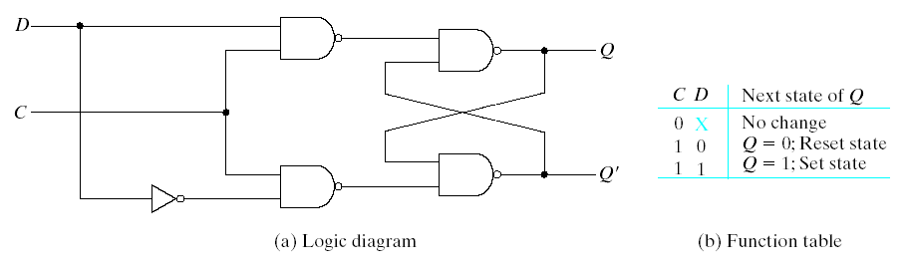
Flip-Flops and Latches
module D_latch(Q,D,control);
output Q;
input D,control;
reg Q;
always @(control or D)
if(control) Q = D; //Same as: if(control==1)
endmodule

Slide 19
Flip-Flops and Latches
//D flip-flop
module D_FF (Q,D,CLK);
output Q;
input D,CLK;
reg Q;
always @(posedge CLK)
Q = D;
endmodule
//D flip-flop with asynchronous reset.
module DFF (Q,D,CLK,RST);
output Q;
input D,CLK,RST;
reg Q;
always @(posedge CLK or negedge RST)
if (~RST) Q = 1'b0; // Same as: if (RST == 0)
else Q = D;
endmodule

Slide 20
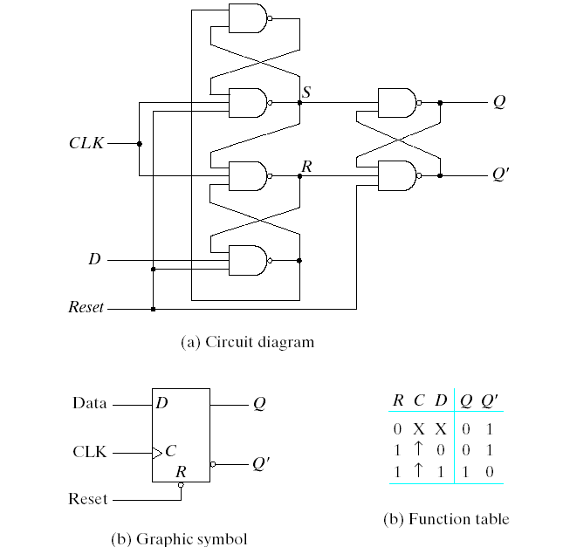
D Flip-Flop with Reset
D Flip-Flop with Asynchronous Reset

Slide 21
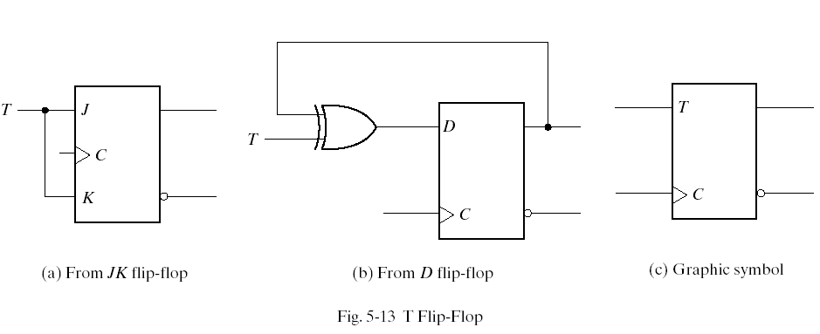
T & J-K Flip-Flops

Slide 22
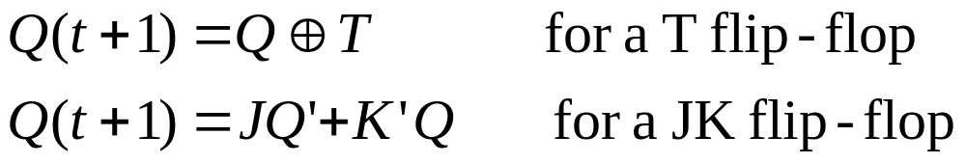
T & J-K Flip-Flops
//JK flip-flop from D flip-flop and gates
module JKFF (Q,J,K,CLK,RST);
output Q;
input J,K,CLK,RST;
wire JK;
assign JK = (J & ~Q) | (~K & Q);
//Instantiate D flipflop
DFF JK1 (Q,JK,CLK,RST);
endmodule
//T flip-flop from D flip-flop and gates
module TFF (Q,T,CLK,RST);
output Q;
input T,CLK,RST;
wire DT;
assign DT = Q ^ T ;
//Instantiate the D flip-flop
DFF TF1 (Q,DT,CLK,RST);
endmodule
Characteristic equations of the flip-flops:

Slide 23
J-K Flip-Flop
// Functional description of JK // flip-flop
module JK_FF (J,K,CLK,Q,Qnot);
output Q,Qnot;
input J,K,CLK;
reg Q;
assign Qnot = ~ Q ;
always @(posedge CLK)
case({J,K})
2'b00: Q = Q;
2'b01: Q = 1'b0;
2'b10: Q = 1'b1;
2'b11: Q = ~ Q;
endcase
endmodule

Slide 24
Example: Blocking Assignment
module example5 (D, Clock, Q1, Q2);
input D, Clock;
output reg Q1, Q2;
always @(posedge Clock)
begin
Q1 = D;
Q2 = Q1;
end
endmodule

Slide 25
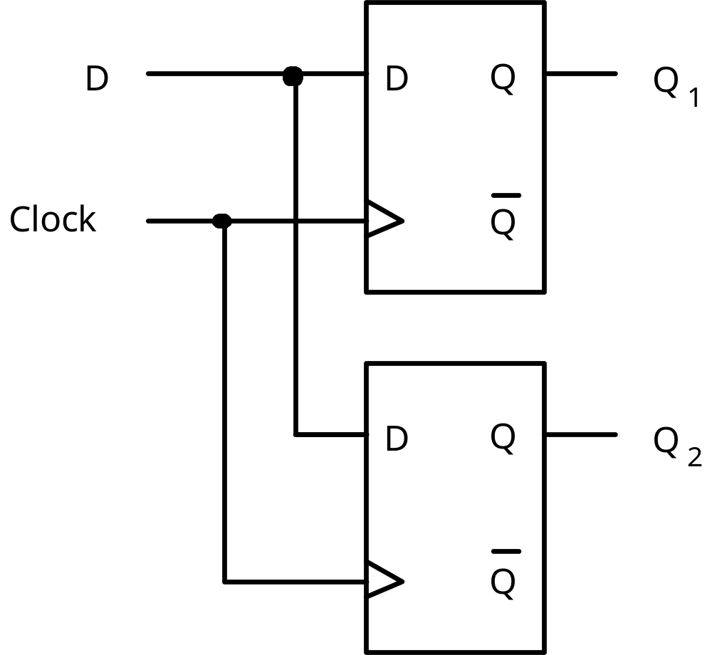
Example: Blocking Assignment (2)

Slide 26
Example: Non-Blocking Assignment
module example6 (D, Clock, Q1, Q2);
input D, Clock;
output reg Q1, Q2;
always @(posedge Clock)
begin
Q1 <= D;
Q2 <= Q1;
end
endmodule

Slide 27
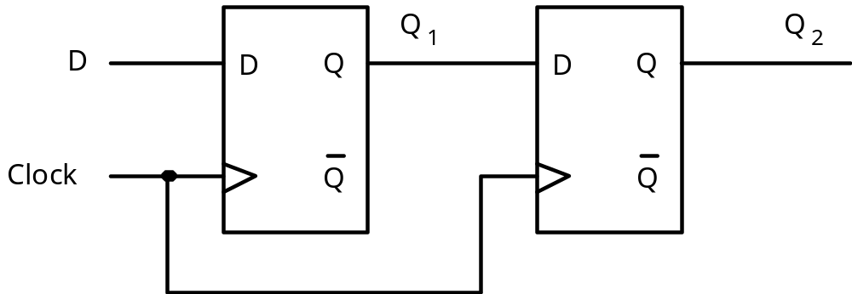
Example: Non-Blocking Assignment (2)

Slide 28
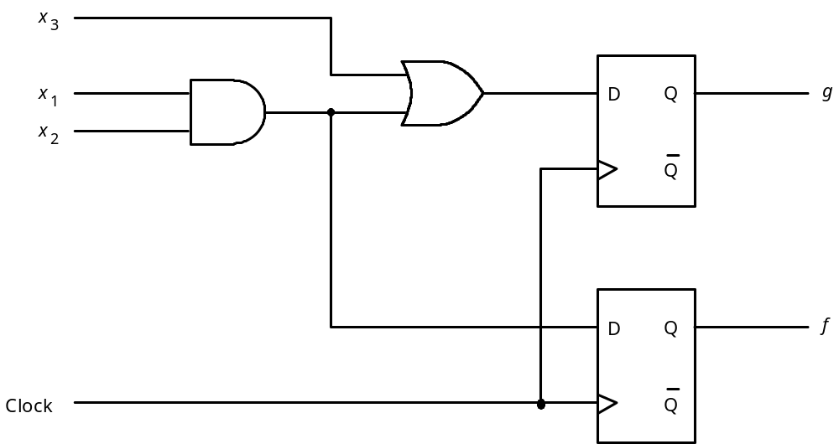
Example7

Slide 29
Example7: Proper Code
module example7 (x1, x2, x3, Clock, f, g);
input x1, x2, x3, Clock;
output reg f, g;
always @(posedge Clock)
begin
f = x1 & x2;
g = f | x3;
end
endmodule

Slide 30
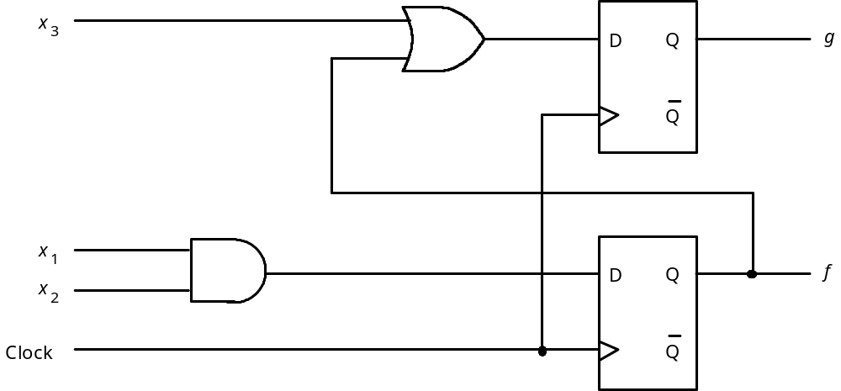
Example8

Slide 31
Example8: Proper Code
module example8 (x1, x2, x3, Clock, f, g);
input x1, x2, x3, Clock;
output reg f, g;
always @(posedge Clock)
begin
f <= x1 & x2;
g <= f | x3;
end
endmodule

Slide 32
Blocking & Non-Blocking Do Same in Some Cases
module flipflop (D, Clock, Resetn, Q);
input D, Clock, Resetn;
output reg Q;
always @(negedge Resetn, posedge Clock)
if (!Resetn)
Q <= 0; //also can be Q = 0;
else
Q <= D; // also can be Q = D;
endmodule

Slide 33
Example: Structural 4-bit Shift Register (1)
module muxdff (D0, D1, Sel, Clock, Q);
input D0, D1, Sel, Clock;
output reg Q;
always @(posedge Clock)
if (!Sel)
Q <= D0;
else
Q <= D1;
endmodule

Slide 34
Example: Structural 4-bit Shift Register (2)
module muxdff (D0, D1, Sel, Clock, Q);
input D0, D1, Sel, Clock;
output reg Q;
wire D;
assign D = Sel ? D1 : D0;
always @(posedge Clock)
Q <= D;
endmodule

Slide 35
Example: Structural 4-bit Shift Register (3)
module shift4 (R, L, w, Clock, Q);
input [3:0] R;
input L, w, Clock;
output [3:0] Q;
wire [3:0] Q;
muxdff Stage3 (w, R[3], L, Clock, Q[3]);
muxdff Stage2 (Q[3], R[2], L, Clock, Q[2]);
muxdff Stage1 (Q[2], R[1], L, Clock, Q[1]);
muxdff Stage0 (Q[1], R[0], L, Clock, Q[0]);
endmodule

Slide 36
Example: Behavioral 4-bit Shift Register
module shift4 (R, L, w, Clock, Q);
input [3:0] R;
input L, w, Clock;
output reg [3:0] Q;
always @(posedge Clock)
if (L)
Q <= R;
else
begin
Q[0] <= Q[1];
Q[1] <= Q[2];
Q[2] <= Q[3];
Q[3] <= w;
end
endmodule

Slide 37
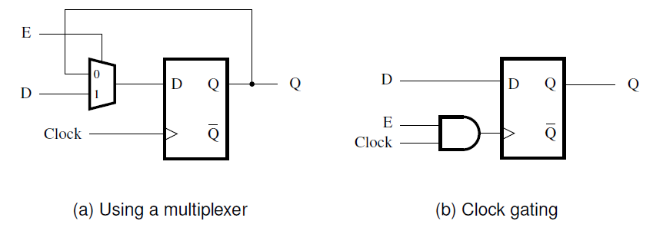
Example: D-FF with Enable (1)

Slide 38
Example: D-FF with Enable (2)
module rege (D, Clock, Resetn, E, Q);
input D, Clock, Resetn, E;
output reg Q;
always @(posedge Clock, negedge Resetn)
if (Resetn == 0)
Q <= 0;
else if (E)
Q <= D;
endmodule

Slide 39
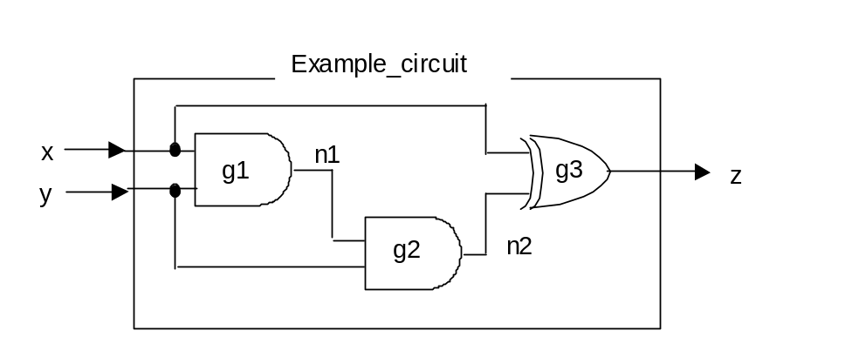
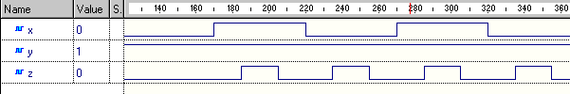
Why synchronous logic?
Clean up glitches
When xy=“01” we expect z=’0’.
When xy=“11” we also expect z=’0’.
Output glitches whenever input changes

Slide 40
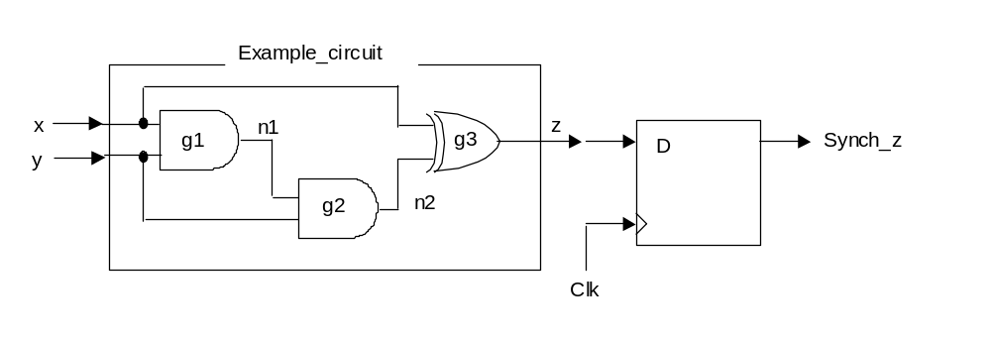
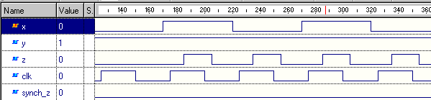
Glitch removal
z is glitchy
Value stored in D type ignores glitches and is always correct
Clock edge occurs after glitching has finished

Slide 41
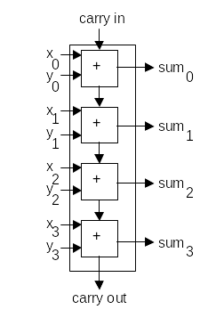
Adder operation
1+0 = ?

Slide 42
Adder operation
1
0
0
0
0
0
0
0
0001 + 0000 = ?
1 + 0 = ?

Slide 43
Adder operation
1
0
1
0
0
0
0
0
0
0
0
0
0001 + 0000 = 0001
1 + 0 = 1

Slide 44
Adder operation
1
0
1
0
Carry chain settles:
New values don’t change anything
0
0
0
0
0
0
0
0
0
0
0
0
0001 + 0000 = 0001
1 + 0 = 1
Correct answer is produced quickly

Slide 45
Carry ripple
1+7 = ?

Slide 46
Carry ripple
1
1
0
1
0
1
0
0
0001 + 0111 = ?
1 + 7 = ?

Slide 47
Carry ripple
1
1
0
0
1
1
0
1
1
0
0
0
0001 + 0111 = 0110
1 + 7 = 6

Slide 48
Carry ripple
1
1
0
1
Carries are generated
Stage 1 input has changed
0
1
1
0
0
1
1
0
0
0
0
0
0001 + 0111 = 0110
1 + 7 = 6

Slide 49
Carry ripple
1
1
0
1
Stage 1 recomputes
Stage 2 input has changed
0
1
0
0
1
1
1
0
0
0
0
0
0001 + 0111 = 0100
1 + 7 = 4

Slide 50
Carry ripple
1
1
0
1
Stage 2 recomputes
Stage 3 input has changed
0
1
0
0
1
1
0
0
1
0
0
0
0001 + 0111 = 0000
1 + 7 = 0

Slide 51
Carry ripple
1
1
0
1
Carry chain has settled
Answer is right now
0
1
0
0
1
1
0
0
1
0
1
0
0001 + 0111 = 1000
1 + 7 = 8

Slide 52

Carry ripple
Settles quickly
Settles slowly
Adder can take a long time to settle
Settling time depends on input values
During settling time, output is garbage

Slide 53
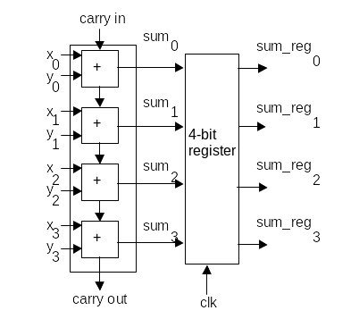
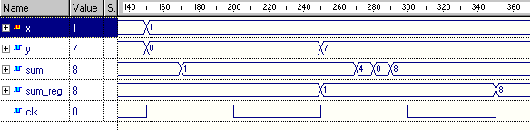
The synchronous adder
Clock rises after glitching has finished
Sum is glitchy
Answer is steady and correct

Slide 54
The synchronous adder
Output occurs one clock cycle after corresponding input
Pipeline: Put inputs in one end Outputs emerge later

Slide 55
Summary
always give us control over when statements execute
always can be used to construct synchronous circuits
RTL coding:
  Say what should happen on what clock cycle
  Synthesis tool builds circuits to give required timing

