Slide 1
ENCS3310
Advanced Digital Design
Dr. Abdellatif Abu-Issa
Primitives
Operators

Slide 2
Introduction
Contents
  User Define Primitives (UDP)
  Operators

Slide 3
Rise, Fall, and Turn-Off Delays
The delays declaration can contain up to three values, such as rise, fall, and turn-off delays.
The time taken for the output of a gate to change from some value to 1 is called a rise delay.
The time taken for the output of a gate to change form some value to 0 is called a fall delay.
The time taken for the output of a gate to change from some value to high impedance is called turn-off delay.

Slide 4
Delays on Primitive Instances
Instances of primitives may include delays
buf b1(a, b); // Zero delay
buf #3 b2(c, d); // Delay of 3
buf #(4,5) b3(e, f); // Rise=4, fall=5
buf #(4,5,2) b4(g,h); //Rise, Fail,Turnoff

Slide 5
User-Defined Primitives (UDP)
Way to define gates and sequential elements using a truth table
Often simulate faster than using expressions, collections of primitive gates, etc.
Gives more control over behavior with X inputs
Most often used for specifying custom gate libraries

Slide 6
UDP Features
UDP’s do not use the keyword module. Instead they are declared with the keyword primitive.
There can be only one output and it must be listed first in the port list and declared with an output keyword.
There can be any number of inputs. The order in which they are listed in the input declaration must conform to the order in which they are given values in the table that follows.
The truth table is enclosed within the keywords table and endtable.
The values of the inputs are listed with a colon (:). The output is always the last entry in a row followed by a semicolon (;).
It ends with the keyword endprimitive.

Slide 7
UDP Features
Symbol | Comments
0 | Logic 0
1 | Logic 1
x | Unknown, can be either logic 0 or 1. Can be used as input/output or current state of sequential UDPs
? | Logic 0, 1 or x. Cannot be output of any UDP
- | No change, only allowed in output of a UDP
ab | Change in value from a to b where a or b is either 0, 1, or x
* | Same as ??, indicates any change in input value
r | Same as 01 -> rising edge on input
f | Same as 10 -> falling edge on input

Slide 8
UDP Example1
//User defined primitive(UDP)
primitive crctp (x,A,B,C);
output x;
input A,B,C;
//Truth table for x(A,B,C) = Minterms (0,2,4,6,7)
table
// A B C : x (Note that this is only a comment)
0 0 0 : 1;
0 0 1 : 0;
0 1 0 : 1;
0 1 1 : 0;
1 0 0 : 1;
1 0 1 : 0;
1 1 0 : 1;
1 1 1 : 1;
endtable
endprimitive
// Instantiate primitive
module declare_crctp;
reg x,y,z;
wire w;
crctp (w,x,y,z);
endmodule

Slide 9
Example2: A Carry UDP
primitive carry(out, a, b, c);
output out;
input a, b, c;
table
00? : 0;
0?0 : 0;
?00 : 0;
11? : 1;
1?1 : 1;
?11 : 1;
endtable
endprimitive
Always have exactly one output
Truth table may include don’t-care (?) entries

Slide 10
A Sequential Primitive
Primitive dff( q, clk, data);
output q; reg q;
input clk, data;
table
// clk data q new-q
(01) 0 : ? : 0; // Latch a 0
(01) 1 : ? : 1; // Latch a 1
(0?) 1 : 1 : 1; // Hold when d and q both 1
(0?) 0 : 0 : 0; // Hold when d and q both 0
(?0) ? : ? : -; // Hold when clk falls
? (??) : ? : -; // Hold when clk stable
endtable
endprimitive

Slide 11
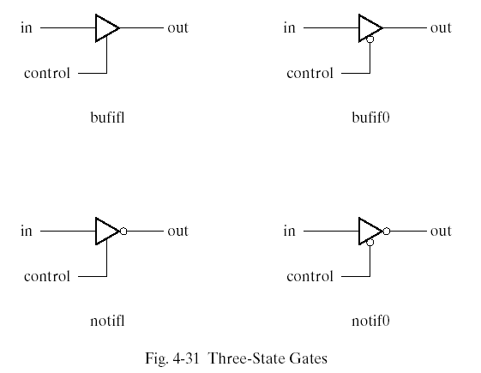
Three-State Gates

Slide 12
Three-State Gates
Three-state gates have a control input that can place the gate into a high-impedance state. (symbolized by z in HDL).
The bufif1 gate behaves like a normal buffer if control=1. The output goes to a high-impedance state z when control=0.
bufif0 gate behaves in a similar way except that the high-impedance state occurs when control=1
Two not gates operate in a similar manner except that the o/p is the complement of the input when the gate is not in a high impedance state.
The gates are instantiated with the statement
  gate name (output, input, control);

Slide 13
Three-State Gates
Keywords wire and tri are examples of net data type.
Nets represent connections between hardware elements. Their value is continuously driven by the output of the device that they represent.
The word net is not a keyword, but represents a class of data types such as wire, wor, wand, tri, supply1 and supply0.
The wire declaration is used most frequently.
The net wor models the hardware implementation of the wired-OR configuration.
The wand models the wired-AND configuration.
The nets supply1 and supply0 represent power supply and ground.

Slide 14
Gate-level Primitives
Verilog provides the following:
and nand logical AND/NAND
or nor logical OR/NOR
xor xnor logical XOR/XNOR
buf not buffer/inverter
bufif0 notif0 Tristate with low enable
bufif1 notif1 Tristate with high enable

Slide 15
Operators
{ } concatenation
+ - * /
arithmetic
% modulus
> >= < <=
relational
! logical NOT
&& logical AND
|| logical OR
== logical equality
!= logical inequality
? : conditional
~ bit-wise NOT
& bit-wise AND
| bit-wise OR
^ bit-wise XOR
^~ ~^ bit-wise XNOR
& reduction AND
| reduction OR
~& reduction NAND
~| reduction NOR
^ reduction XOR
~^ ^~ reduction XNOR
<< shift left
>> shift right

Slide 16
Operator Precedence
[ ] bit-select or part-select
( ) parentheses
!, ~ logical and bit-wise negation
&, |, ~&, ~|, ^, ~^, ^~ reduction operators
+, - unary arithmetic
{ } concatenation
*, /, % arithmetic
+, - arithmetic
<<, >> shift
>, >=, <, <=
relational
==, != logical equality
& bit-wise AND
^, ^~, ~^
bit-wise XOR and XNOR
| bit-wise OR
&& logical AND
|| logical OR
? : conditional

Slide 17
Numbers
Format : <size>’<base><value>
Example : 8’d16
8’h10
8’b00010000
8’o20

Slide 18
Summary
UDP
Operators
3-state gates
Wire types (nets)

