Slide 1
ENCS 3310
Advanced Digital Design
Dr. Abdellatif Abu-Issa
RTL coding

Slide 2
Introduction
RTL coding examples

Slide 3
Flip-Flops and Latches
//D flip-flop
module D_FF (Q,D,CLK);
output Q;
input D,CLK;
reg Q;
always @(posedge CLK)
Q = D;
endmodule
//D flip-flop with asynchronous reset.
module DFF (Q,D,CLK,RST);
output Q;
input D,CLK,RST;
reg Q;
always @(posedge CLK or negedge RST)
if (~RST) Q = 1'b0; // Same as: if (RST = 0)
else Q = D;
endmodule

Slide 4
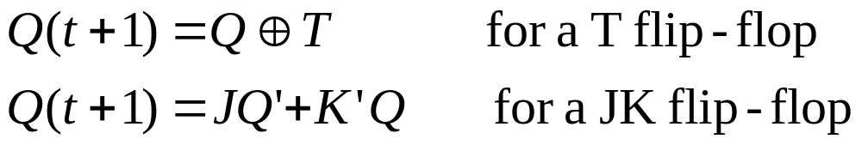
T & J-K Flip-Flops
//T flip-flop from D flip-flop and gates
module TFF (Q,T,CLK,RST);
output Q;
input T,CLK,RST;
wire DT;
assign DT = Q ^ T ;
//Instantiate the D flip-flop
DFF TF1 (Q,DT,CLK,RST);
endmodule
//JK flip-flop from D flip-flop and gates
module JKFF (Q,J,K,CLK,RST);
output Q;
input J,K,CLK,RST;
wire JK;
assign JK = (J & ~Q) | (~K & Q);
//Instantiate D flipflop
DFF JK1 (Q,JK,CLK,RST);
endmodule
Characteristic equations of the flip-flops:

Slide 5
J-K Flip-Flop
// Functional description of JK // flip-flop
module JK_FF (J,K,CLK,Q,Qnot);
output Q,Qnot;
input J,K,CLK;
reg Q;
assign Qnot = ~ Q ;
always @(posedge CLK)
case({J,K})
2'b00: Q = Q;
2'b01: Q = 1'b0;
2'b10: Q = 1'b1;
2'b11: Q = ~ Q;
endcase
endmodule

Slide 6
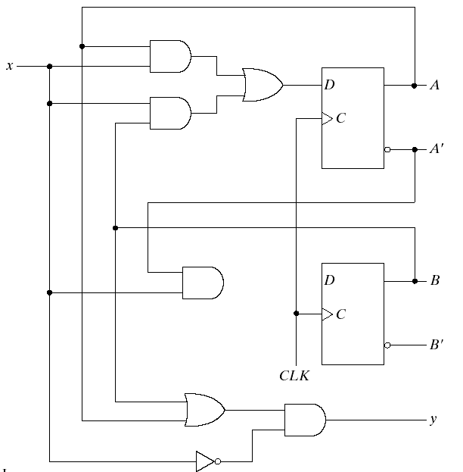
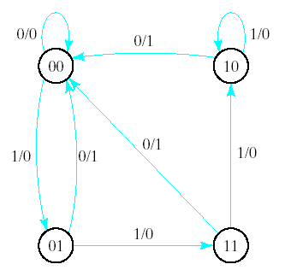
Sequential Circuit – Ex1

Slide 7
Sequential Circuit – Ex1 Behavioral Code
//Mealy state diagram for the circuit
module Mealy_mdl (x,y,CLK,RST);
input x,CLK,RST;
output y;
reg y;
reg [1:0] Prstate,Nxtstate;
parameter S0=2'b00,S1=2'b01,S2=2'b10,S3=2'b11;
always@(posedge CLK or negedge RST)
if (~RST) Prstate = S0; //Initialize to state S0
else Prstate = Nxtstate; //Clock operations

Slide 8
Code…
always @(Prstate or x) //Determine next state
case (Prstate)
S0: if (x) Nxtstate = S1;
S1: if (x) Nxtstate = S3;
else Nxtstate = S0;
S2: if (~x)Nxtstate = S0;
S3: if (x) Nxtstate = S2;
else Nxtstate = S0;
endcase
always @(Prstate or x) //Evaluate output
case (Prstate)
S0: y = 0;
S1: if (x) y = 1'b0; else y = 1'b1;
S2: if (x) y = 1'b0; else y = 1'b1;
S3: if (x) y = 1'b0; else y = 1'b1;
endcase
endmodule

Slide 9
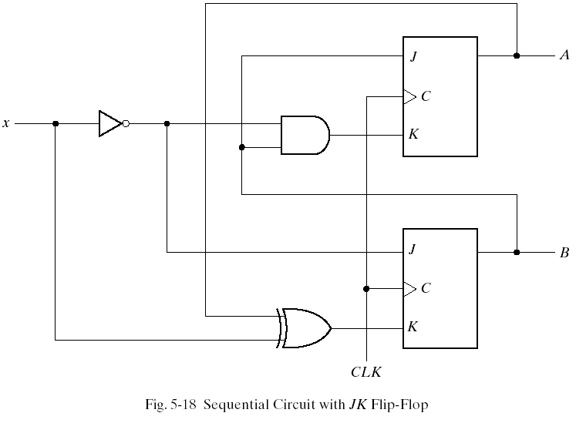
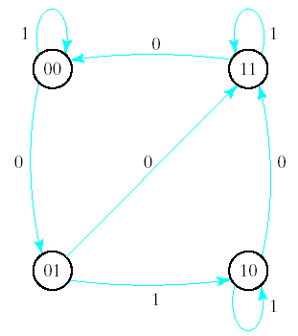
Sequential Circuit-Ex2

Slide 10
Ex2 – Behavioral code
//Moore state diagram
module Moore_mdl (x,AB,CLK,RST);
input x,CLK,RST;
output [1:0]AB;
reg [1:0] state;
parameter S0=2'b00,S1=2'b01,S2=2'b10,S3=2'b11;
always @(posedge CLK or negedge RST)
if (~RST) state = S0; //Initialize to state S0
else
case(state)
S0: if (~x) state = S1;
S1: if (x) state = S2; else state = S3;
S2: if (~x) state = S3;
S3: if (~x) state = S0;
endcase
assign AB = state; //Output of flip-flops
endmodule

Slide 11
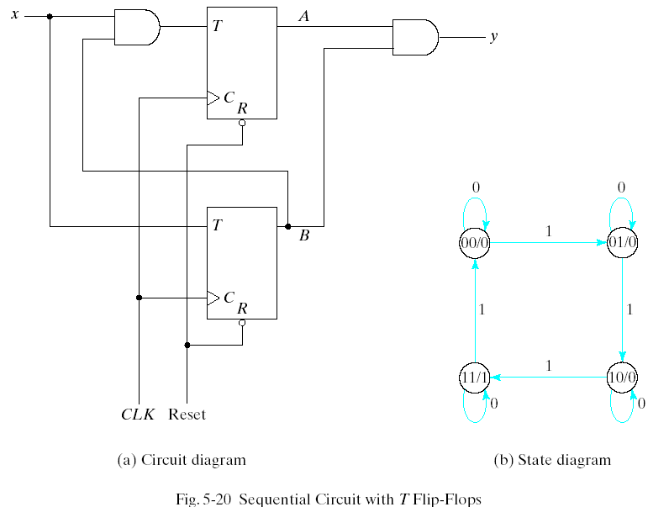
Sequential Circuit Ex3

Slide 12
Ex3 – Structural Code
//Structural description of sequential circuit
module Tcircuit (x,y,A,B,CLK,RST);
input x,CLK,RST;
output y,A,B;
wire TA,TB;
//Flip-flip input equations
assign TB = x,
TA = x & B;
//Output equation
assign y = A & B;
//Instantiate T flip-flops
T_FF BF (B,TB,CLK,RST);
T_FF AF (A,TA,CLK,RST);
endmodule

Slide 13
Structural Code…
//Stimulus for testing seq. cir
module testTcircuit;
reg x,CLK,RST; //inputs for circuit
wire y,A,B; //output from circuit
Tcircuit TC(x,y,A,B,CLK,RST);
initial begin
RST = 0; CLK = 0;
#5 RST = 1;
repeat (16)
#5 CLK = ~CLK;
end
initial begin
x = 0; #15 x = 1;
repeat (8)
#10 x = ~ x;
end
endmodule
//T flip-flop
module T_FF (Q,T,CLK,RST);
output Q;
input T,CLK,RST;
reg Q;
always@(posedge CLK or negedge RST)
if(~RST) Q=1'b0;
else Q=Q^T;
endmodule

Slide 14
HDL for Registers and Counters
Registers and counters can be described in HDL at either the behavioral or the structural level.
In the behavioral, the register is specified by a description of the various operations that it performs similar to a function table.
A structural level description shows the circuit in terms of a collection of components such as gates, flip-flops and multiplexers.
The various components are instantiated to form a hierarchical description of the design similar to a representation of a logic diagram.

Slide 15
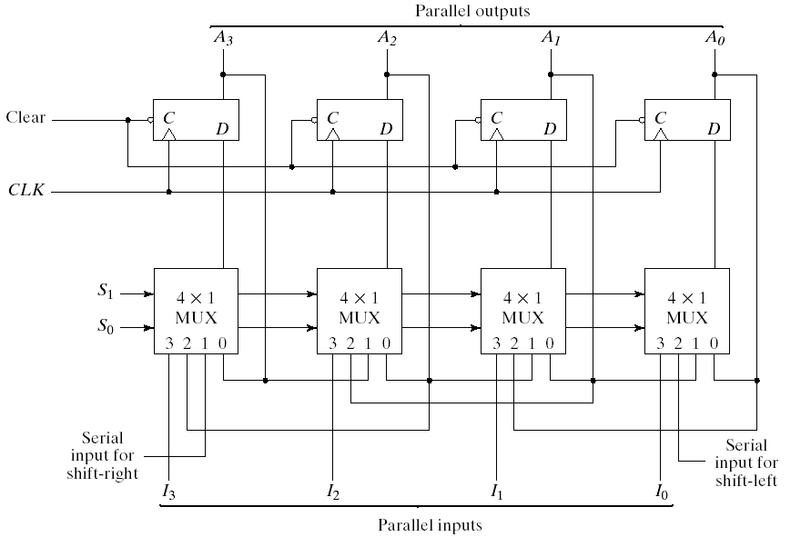
HDL for Registers and Counters (2)
Universal Shift Register Example-1

Slide 16
Universal Shift Register Example-2
4-bit binary counter with parallel load
Clear | CLK | Load | Count | Function
0 | X | X | X | Clear to 0
1 | +ve | 1 | X | Load inputs
1 | +ve | 0 | 1 | Count next binary state
1 | +ve | 0 | 0 | No change
Mode Control
S₁ | S₀ | Register Operation
0 | 0 | No Change
0 | 1 | Shift Right
1 | 0 | Shift Left
1 | 1 | Parallel Load
Function table for 4-bit Universal Shift Register

Slide 17
Universal Shift Register Example-3
//Behavioral description of Universal shift register
module shftreg (s1,s0,Pin,lfin,rtin,A,CLK,Clr);
input s1,s0; //Select inputs
input lfin, rtin; //Serial inputs
input CLK,Clr; //Clock and Clear
input [3:0] Pin; //Parallel input
output [3:0] A; //Register output
reg [3:0] A;
always @ (posedge CLK or negedge Clr)
if (~Clr) A = 4'b0000;
else
case ({s1,s0})
2'b00: A = A; //No change
2'b01: A = {rtin,A[3:1]}; //Shift right
2'b10: A = {A[2:0],lfin}; //Shift left
//Parallel load input
2'b11: A = Pin;
endcase
endmodule

Slide 18
Universal Shift Register Example-4
//Structural description of Universal shift register
module SHFTREG (I,select,lfin,rtin,A,CLK,Clr);
input [3:0] I; //Parallel input
input [1:0] select; //Mode select
input lfin,rtin,CLK,Clr; //Serial input,clock,clear
output [3:0] A; //Parallel output
//Instantiate the four stages
stage ST0 (A[0],A[1],lfin,I[0],A[0],select,CLK,Clr);
stage ST1 (A[1],A[2],A[0],I[1],A[1],select,CLK,Clr);
stage ST2 (A[2],A[3],A[1],I[2],A[2],select,CLK,Clr);
stage ST3 (A[3],rtin,A[2],I[3],A[3],select,CLK,Clr);
endmodule

Slide 19
Universal Shift Register Example -5
//One stage of shift register
module stage(i0,i1,i2,i3,Q,select,CLK,Clr);
input i0,i1,i2,i3,CLK,Clr;
input [1:0] select;
output Q;
reg Q,D;
//4x1 multiplexer
always @ (i0 or i1 or i2 or i3 or select)
case (select)
2'b00: D = i0;
2'b01: D = i1;
2'b10: D = i2;
2'b11: D = i3;
endcase
//Continue - D flip-flop
always@(posedge CLK or negedge Clr)
if (~Clr) Q = 1'b0;
else Q = D;
endmodule

Slide 20
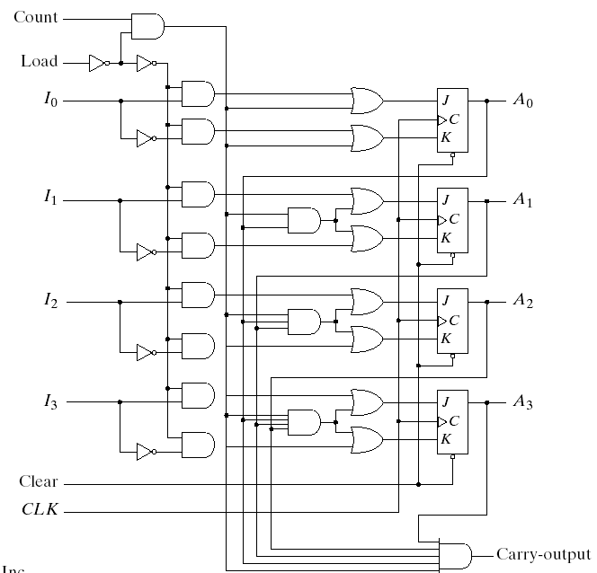
Counter with parallel load –Ex1
4 bit Binary Counter with Parallel Load

Slide 21
Counter with Parallel Load Ex2
//Binary counter with parallel load
module counter (Count,Load,IN,CLK,Clr,A,CO);
input Count,Load,CLK,Clr;
input [3:0] IN; //Data input
output CO; //Output carry
output [3:0] A; //Data output
reg [3:0] A;
assign CO = Count & ~Load & (A == 4'b1111);
always @(posedge CLK or negedge Clr)
if (~Clr) A = 4'b0000;
else if (Load) A = IN;
else if (Count) A = A + 1'b1;
else A = A; // no change, default condition
endmodule

Slide 22
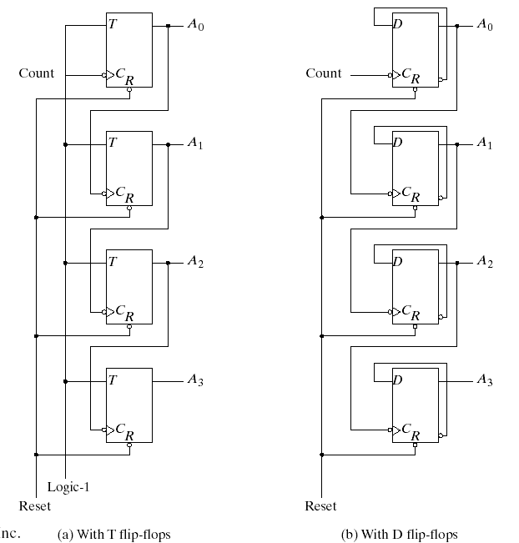
Ripple Counter Example-1
4-bit Binary Ripple Counter

Slide 23
Ripple Counter Example-2
//Ripple counter
module ripplecounter(A0,A1,A2,A3,Count,Reset);
output A0,A1,A2,A3;
input Count,Reset;
//Instantiate complementing flip-flop
CF F0 (A0,Count,Reset);
CF F1 (A1,A0,Reset);
CF F2 (A2,A1,Reset);
CF F3 (A3,A2,Reset);
endmodule
//Complementing flip-flop
//Input to D flip-flop = Q'
module CF (Q,CLK,Reset);
output Q;
input CLK,Reset;
reg Q;
always@(negedge CLK or posedge Reset)
if(Reset) Q=1'b0;
else Q=#2 (~Q);
endmodule

Slide 24
Ripple Counter Example-3
//Stimulus for testing ripple counter
module testcounter;
reg Count;
reg Reset;
wire A0,A1,A2,A3;
//Instantiate ripple counter
ripplecounter RC (A0,A1,A2,A3,Count,Reset);
always
#5 Count = ~Count;
initial
begin
Count = 1'b0;
Reset = 1'b1;
#4 Reset = 1'b0;
#165 $finish;
end
endmodule

Slide 25
Summary
  Shift registers and RTL coding
  Behavioural and Structual Description for Sequential Circuits

