Slide 1
ENCS 3310
Advanced Digital Design
Dr. Abdellatif Abu-Issa
Functions & Tasks
Compiler Directives

Slide 2
Introduction
Contents
  Verilog Tasks
  Verilog Functions
  Compiler Directives

Slide 3
System and Compiler
System tasks
  $time - returns the current simulation time
  $display - similar to printf in C
  $monitor - similar to $display but repeated with every change
  $stop - stops simultion
  $finish - ends simulation
  Many more …
Compiler directives
  A compiler directive is preceded by `
  `define - defines a compiler time constant or macro
  `ifdef, `else, `endif - conditional compilation
  `include - text inclusion

Slide 4
Using Compiler Directives-1
`define pass_accum 4'b0000
`define pass_data 4'b0001
`define ADD 4'b0010
`define AND 4'b0011
module alu(opcode, accum,data, alu_out);
input [7:0] accum, data;
input [3:0] opcode;
output reg [7:0] alu_out;
always@ ( opcode )
begin
//the case is here
end
endmodule
case ( opcode )
`pass_accum : alu_out <= accum;
`pass_data : alu_out <= data;
`ADD : alu_out <= accum + data;
`AND : alu_out <= accum & data;
default : alu_out <= 8'bx;
endcase

Slide 5
Using Compiler Directives-2
`ifdef SELECT_XOR_DESIGN
module selective_design(a,b,c);
input a, b;
output c;
assign c = a ^ b;
endmodule
`else
module selective_design(a,b,c);
input a, b;
output c;
assign c = a | b;
endmodule
`endif

Slide 6
Tasks & Functions in Verilog
Procedures/Subroutines/Functions in SW programming languages
  The same functionality, in different places
Verilog equivalence:
  Tasks and Functions
  Used in behavioral modeling

Slide 7
Differences between...
Functions
  Can enable (call) just another function (not task)
  Execute in 0 simulation time
  No timing control statements allowed
  At least one input
  Return only a single value
Tasks
  Can enable other tasks and functions
  May execute in non-zero simulation time
  May contain any timing control statements
  May have arbitrary input, output, or inouts
  Do not return any value

Slide 8
Differences between… (cont’d)
Both
  are defined in a module
  are local to the module
  can have local variables (registers, but not nets) and events
  contain only behavioral statements
  do not contain initial or always statements
  are called from initial or always statements or other tasks or functions

Slide 9
Differences between… (cont’d)
Tasks can be used for common Verilog code
Function are used when the common code
  is purely combinational
  executes in 0 simulation time
  provides exactly one output
Functions are typically used for conversions and commonly used calculations

Slide 10
Tasks
Keywords: task, endtask
Must be used if the procedure has
  any timing control constructs
  zero or more than one output arguments
  no input arguments

Slide 11
Tasks (cont’d)
Task declaration and invocation
  Declaration syntax
task <task_name>;
<I/O declarations>
<variable and event declarations>
begin // if more than one statement needed
<statement(s)>
end // if begin used!
endtask

Slide 12
Tasks (cont’d)
Task declaration and invocation
  Task invocation syntax
    <task_name>;
    <task_name> (<arguments>);
  input and inout arguments are passed into the task
  output and inout arguments are passed back to the invoking statement when task is completed

Slide 13
Tasks (cont’d)
I/O declaration in modules vs. tasks
  Both used keywords: input, output, inout
  In modules, represent ports
    connect to external signals
  In tasks, represent arguments
    pass values to and from the task

Slide 14
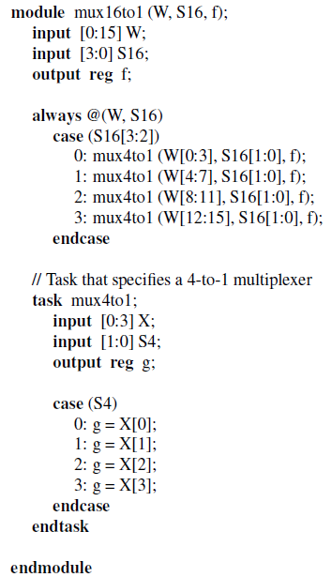
Tasks Example

Slide 15
Task Examples
Use of input and output arguments
module operation;
parameter delay = 10;
reg [15:0] A, B;
reg [15:0] AB_AND, AB_OR, AB_XOR;
initial
$monitor( …);
initial
begin
…
end
always @(A or B)
begin
bitwise_oper(AB_AND, AB_OR, AB_XOR, A, B);
end
task bitwise_oper;
output [15:0] ab_and, ab_or, ab_xor;
input [15:0] a, b;
begin
#delay ab_and = a & b;
ab_or = a | b;
ab_xor = a ^ b;
end
endtask
endmodule

Slide 16
Functions
Keyword: function, endfunction
Can be used if the procedure
  does not have any timing control constructs
  returns exactly a single value
  has at least one input argument

Slide 17
Functions (cont’d)
Function Declaration and Invocation
  Declaration syntax:
    function <range_or_type> <func_name>;
    <input declaration(s)>
    <variable_declaration(s)>
    begin // if more than one statement needed
    <statements>
    end // if begin used
    endfunction

Slide 18
Functions (cont’d)
Function Declaration and Invocation
  Invocation syntax:
    <func_name> (<argument(s)>);

Slide 19
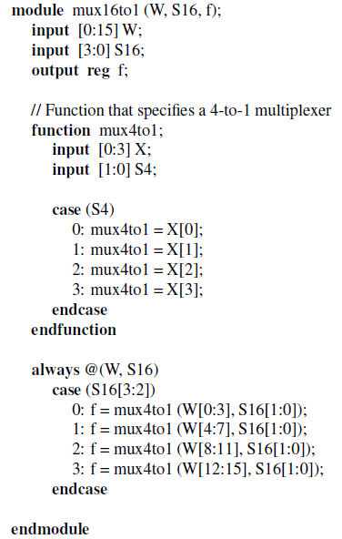
Functions Example – MUX16to1

Slide 20
Function Examples
Parity Generator
module parity;
reg [31:0] addr;
reg parity;
Initial begin
…
end
always @(addr)
begin
parity = calc_parity(addr);
$display("Parity calculated = %b", calc_parity(addr) );
end
function calc_parity;
input [31:0] address;
begin
calc_parity = ^address;
end
endfunction
endmodule

Slide 21
Function Examples
Controllable Shifter
module shifter;
`define LEFT_SHIFT 1'b0
`define RIGHT_SHIFT 1'b1
reg [31:0] addr, left_addr, right_addr;
reg control;
initial
begin
…
end
always @(addr)begin
left_addr =shift(addr, `LEFT_SHIFT);
right_addr =shift(addr,`RIGHT_SHIFT);
end
function [31:0] shift;
input [31:0] address;
input control;
begin
shift = (control==`LEFT_SHIFT) ?(address<<1) : (address>>1);
end
endfunction
endmodule

Slide 22
Tasks and Functions Summary
Tasks and functions in behavioral modeling
  The same purpose as subroutines in SW
  Provide more readability, easier code management
  Are part of design hierarchy
  Tasks are more general than functions
    Can represent almost any common Verilog code
  Functions can only model purely combinational calculations

Slide 23
Summary
Compiler Directives
Tasks
Functions

