Slide 1
Android App Development
PART III
Lifecycle Fundamentals
Birzeit University, Samer Zein (PhD)

Slide 2
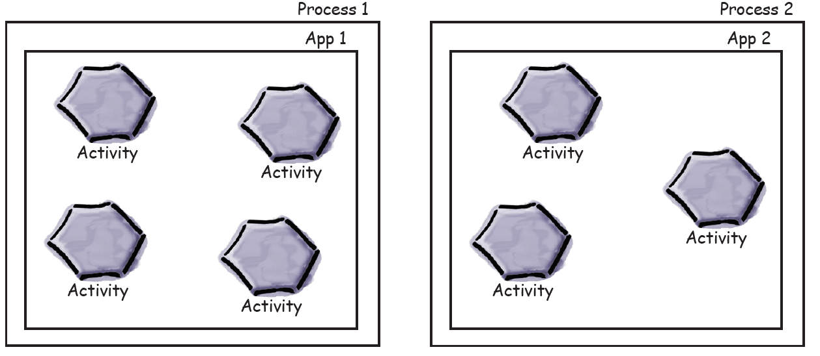
How do Activities Really Work?
In general, an App is a collection of activities, resources…, with one of the activities as main activity.
By Default, each app runs in its own process.
When you start an activity of other app, the Android system checks if there is already a process for that app, if not, it will start new process.

Slide 3
How Activities Really Work..2
But there are still lots of things we don’t yet know about how activities function.
How long does an activity live for?
What happens when your activity disappears from the screen?
Is it still running?
Is it still in memory? And what happens if your app gets interrupted by an incoming phone call?
We want to be able to control the behavior of our activities in a whole range of different circumstances,.

Slide 4
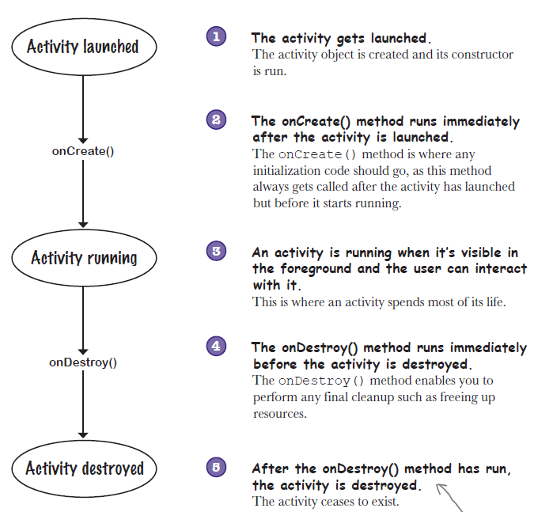
Activity Lifecycle - Intro

Slide 5
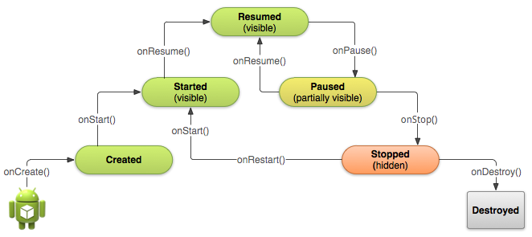
Note that we are not only saying that the OS will hide your app activity(UI)
The OS might transfer your app into a state that does not use CPU and RAM (destroyed)
In Android, it is the Activity Manager which is responsible for managing the Activities.

Slide 6
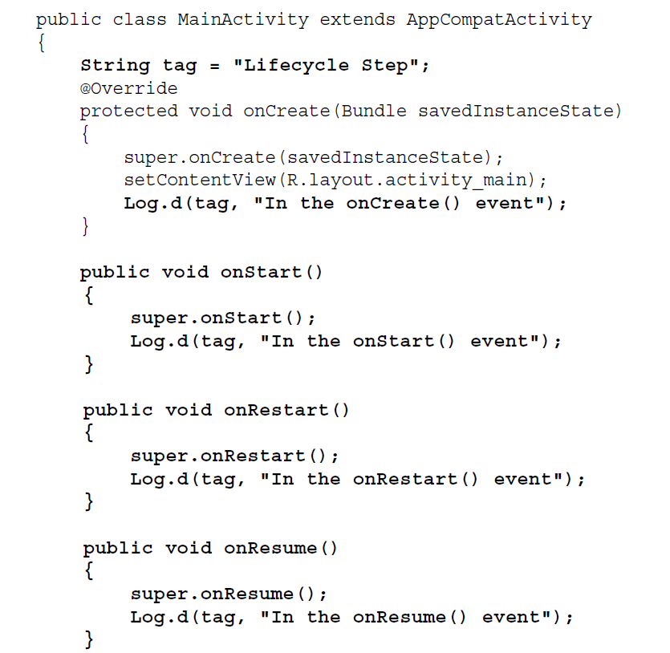
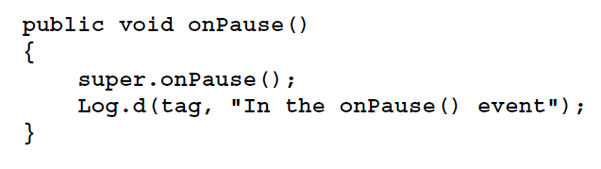
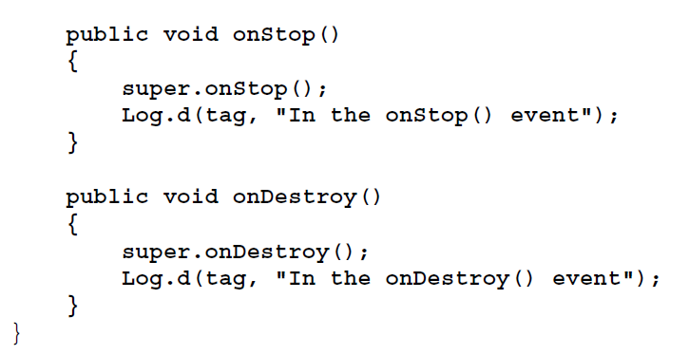
Understanding the Activity Lifecycle via Example

Slide 7
LogCat in Android Studio
Logcat Window is the place where various messages can be printed when an application runs.
Suppose, you are running your application and the program crashes, unfortunately.
Then, Logcat Window is going to help you to debug the output by collecting and viewing all the messages that your emulator throws.
So, this is a very useful component for the app development because this Logcat dumps a lot of system messages and these messages are actually thrown by the emulator.

Slide 8
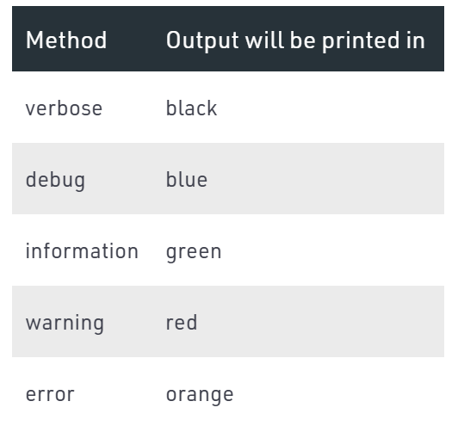
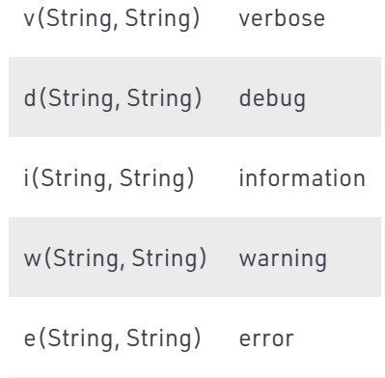
Log Class
The class which is used to print the log messages are actually known as a Log Class

Slide 9
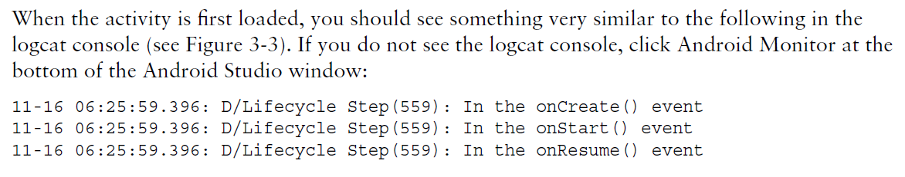
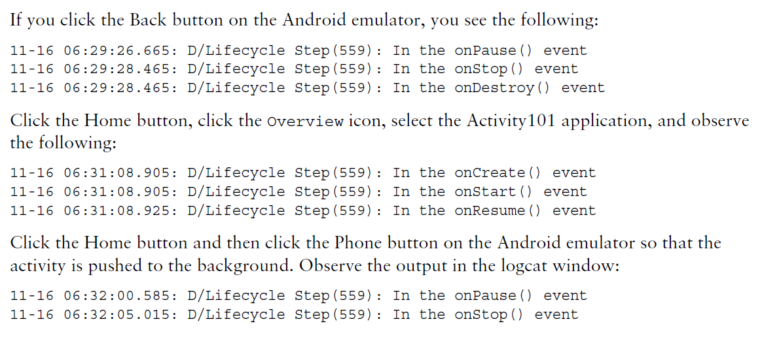
Now let us test our app:

Slide 10
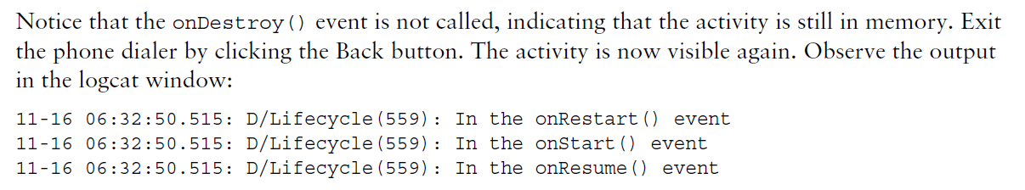
Test our app…cont

Slide 11
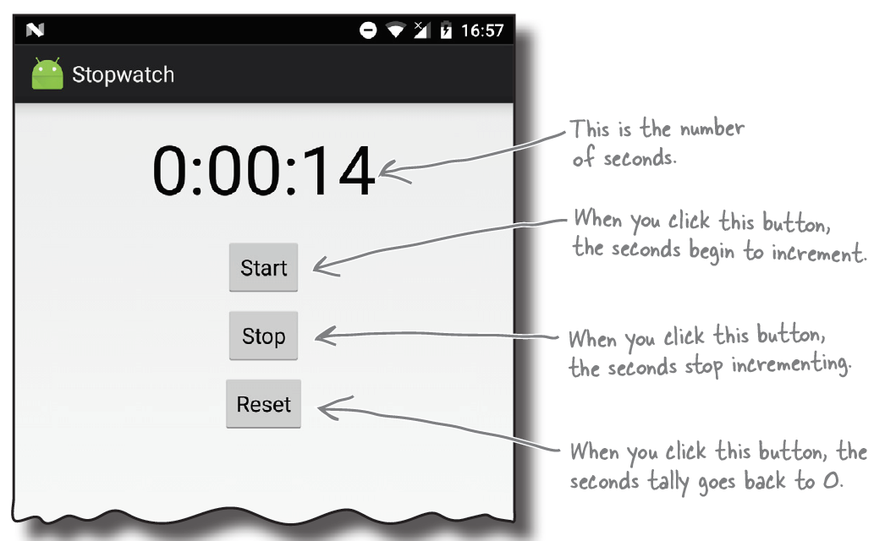
Example App: Stop Watch
In this example, we will start looking at one of the most important peculiarities of Android Development,
Activity Lifecycle

Slide 12
Change of Configuration
When device changes its configuration, the activity is destroyed and re-created.
Such as when you rotate you phone (change orientation)
Or when you change the locale.
The data/data structures you were working on will be lost.
Thus we need to save them if the configuration is changed.
Best way to do this is to implement:

Slide 13
More About Lifecycle States and Challenges
Android OS as well as iOS and Windows Phone require the developers to have well understanding about lifecycle states, events and transitions.
Such understanding and conformance is needed to ensure correct app behavior and data integrity over exceptional behavior such as:
Receiving a phone call
Swapping in and out of the application.
Note that the application lifecycle events are triggered asynchronously by the system depending on the environment.

Slide 14
Lifecycle …2
In traditional desktop applications, the lifecycle is completely transparent to the developer.
The desktop OS takes care of all states of the lifecycle and ensures no data is lost during transitions.
However, this is different in mobile OS such as Android, iOS, J2ME..etc.
For the sake of efficiency and because mobile operating systems have scarce resources, they cannot save the state of your app.
It is the developer’s job to ensure data integrity over state transitions caused by OS.

Slide 15
Lifecycle ..3
Lets assume a Rule:
When an application ensures its own correctness through reacting appropriately to state changes in the application’s life cycle, we say that it conforms to the lifecycle.
Note that the developer has to decide on which data that needs to be preserved over state transitions.
Sometimes the OS can decide to kill your app in order to spare resources, without saving your data.
Data Entered by user via UI is well preserved.
But data generated by app (array list of something) has to be preserved.

Slide 16
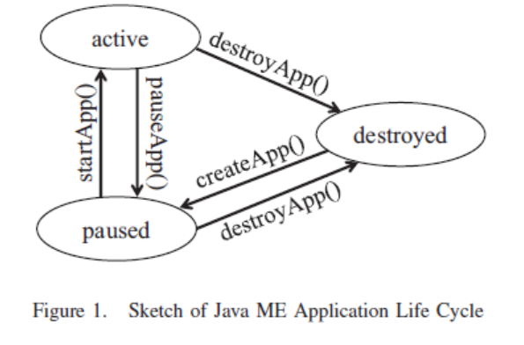
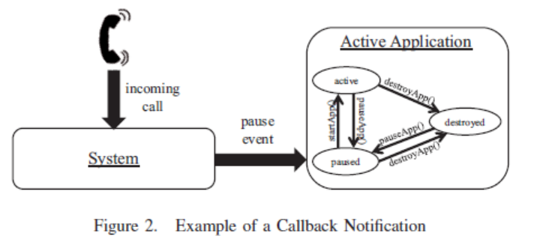
The Concept of Lifecycle is not New
With some minor differences, the same applied to Android, iOS,
Windows Phone 7, and Java ME

Slide 17
Conformance Examples
Of course every app has to be tested on its own. Every app has its own properties.
But generic examples can be shown:
A) In an application with text input (e.g. messenger or text application), the inserted text is stored, when an unpredicted event occurs (e.g. incoming call or SMS), so that after resume the text is still available.
B) An active Voice over Internet Protocol (VoIP) application shall not affect the current call, if receiving text messages (e.g. SMS or e-mail) or declining an incoming call. But it shall hold the current VoIP call, when accepting an incoming phone call.
C) A game application shall be paused in each case of interference.
D) For reasons of power consumption, the GPS- and Bluetooth-using application shall free both resources, if the application is not visible to the end-user.

Slide 18
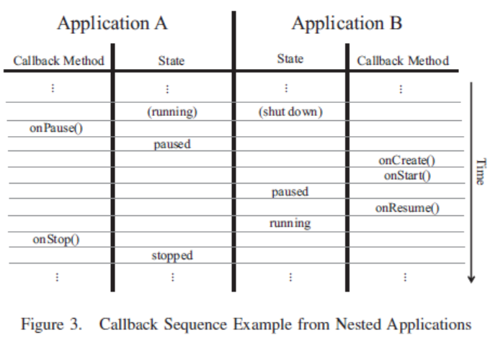
Lifecycle Scheduling
The second activity wont start working not until all the code on the on Pause is done
scheduling strategy puts a high load on life cycles of mobile applications, as each time the user opens a new application, or wants to switch to a different application, multiple life cycle callback-methods are called.

