Slide 1
Android App Development
PART 5
Birzeit University, Samer Zein (PhD) - refs: (Lee 20112) and (Griffiths 2015)

Slide 2
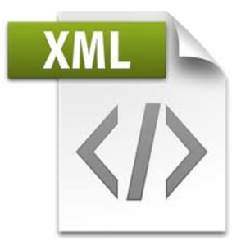

Back To Development: Networking in Android
How to connect to the web using HTTP
How to consume XML web services
How to consume JSON web services

Slide 3
Web Services: Introduction
One common way to communicate with the outside world is through HTTP.
HTTP is no stranger to most people; it is the protocol that drives much of the web’s success.
Using the HTTP protocol, you can perform a wide variety of tasks, such as downloading web pages from a web server, downloading binary data, and more.
Web services are open standard (XML, SOAP, HTTP, etc.) based web applications that interact with other web applications for the purpose of exchanging data.
Ref: Beginning Android 4 Application Development (2012)

Slide 4
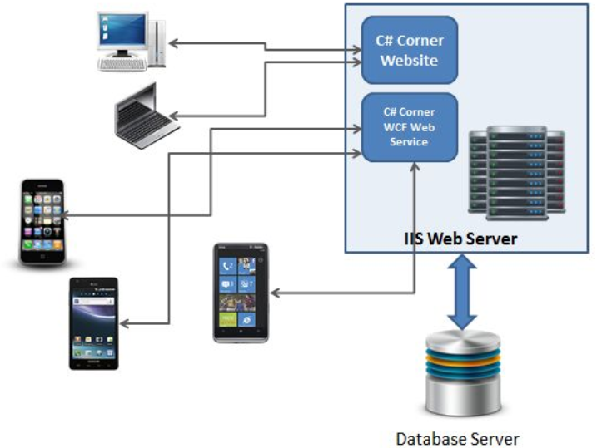

Slide 5
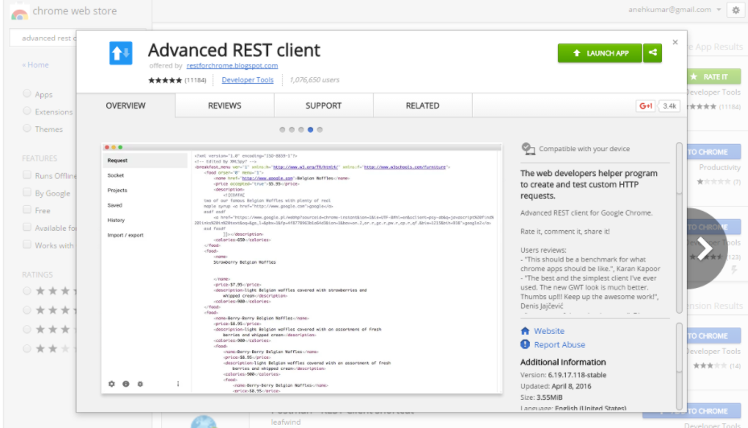
Building Rest Web Services Using PHP: Step 1 – download Advanced REST Client
Refs: https://trinitytuts.com/build-first-web-service-php/

Slide 6
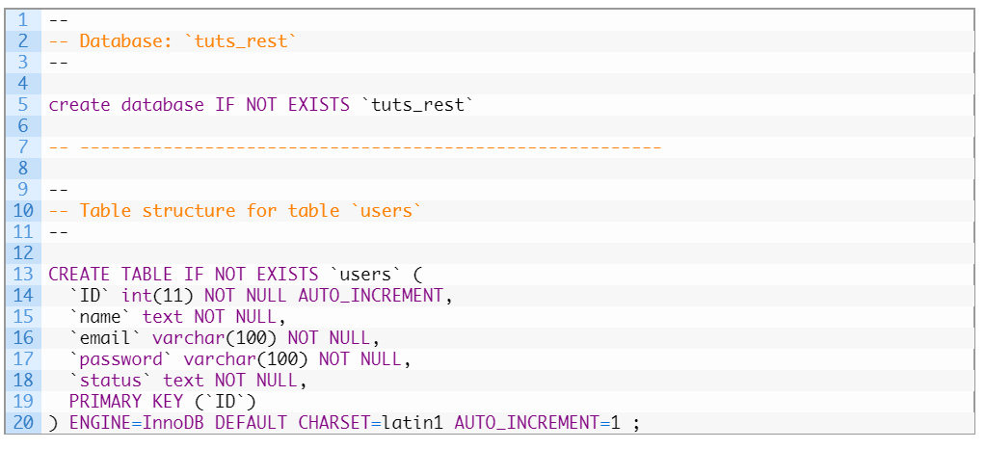
Building Rest Web Services Using PHP: Step 2: Create table in MySlq

Slide 7
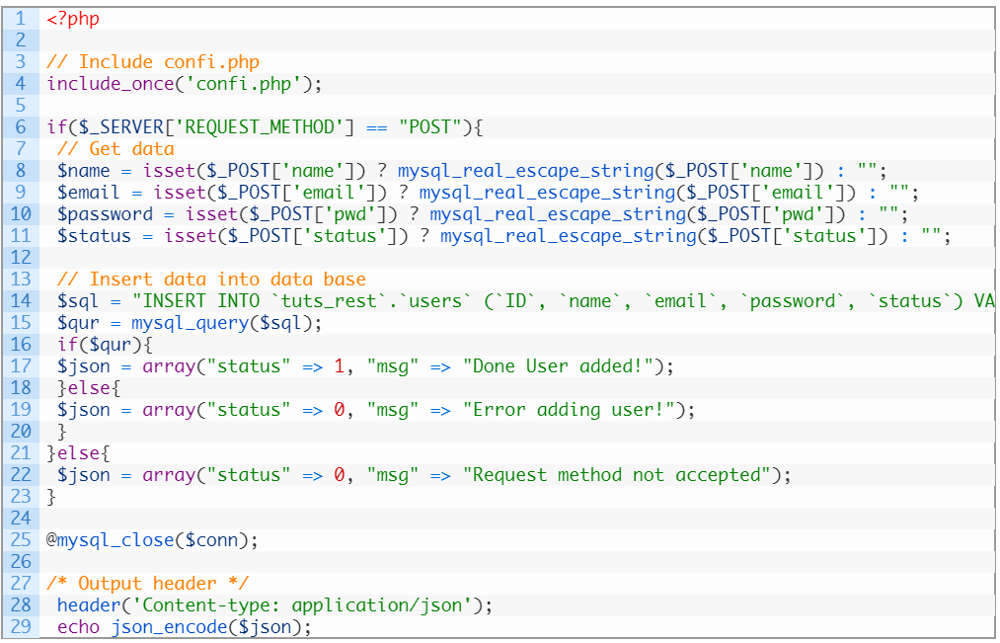
Building Rest Web Services Using PHP: Creating Sign Up Services Using Post

Slide 8
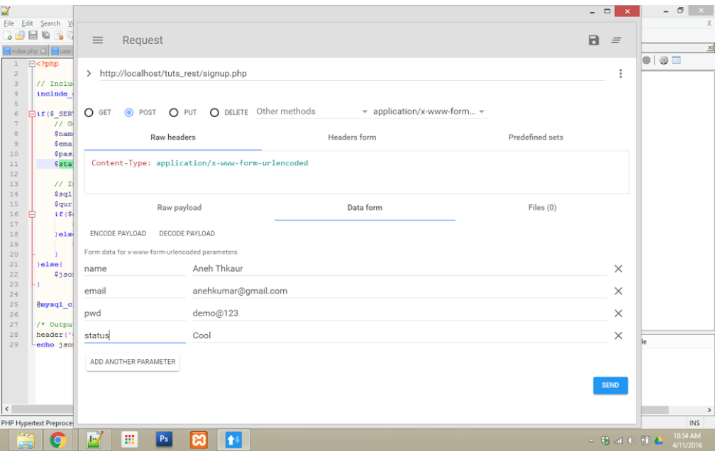
Testing your Service Using Advanced REST Client

Slide 9
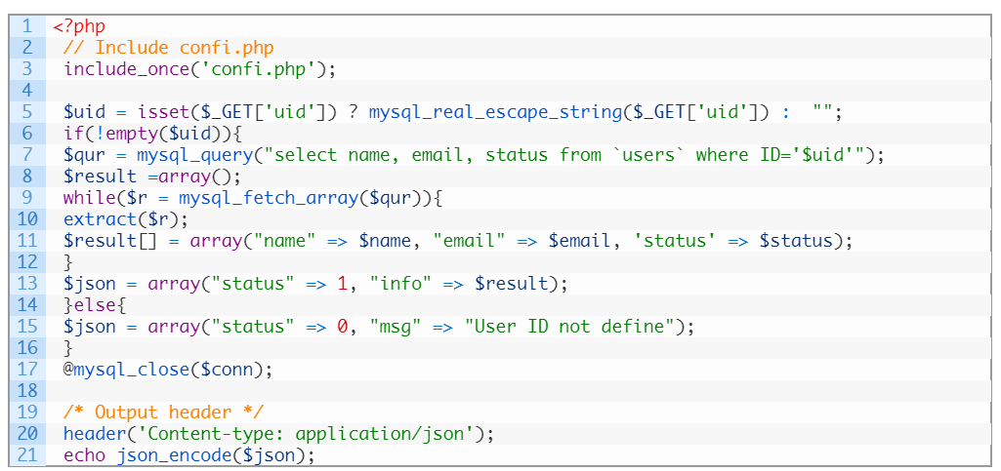
Building Rest Web Services Using PHP: Creating Rest Service Using Get

Slide 10
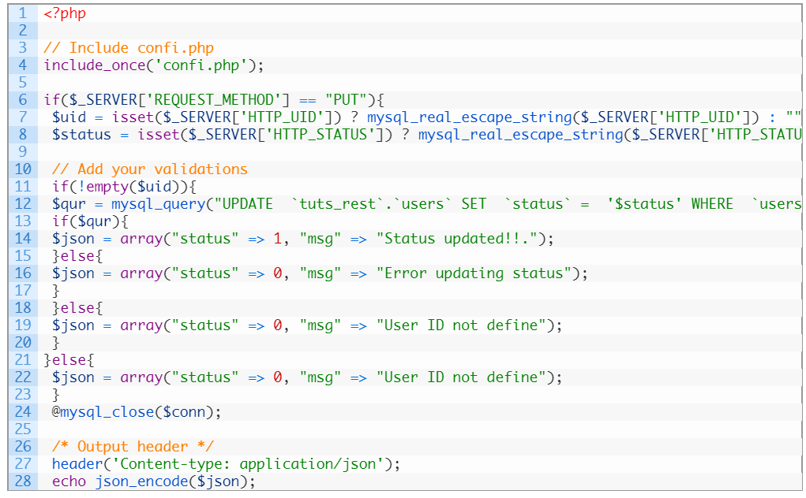
Building Rest Web Services Using PHP: Creating Rest Service Using PUT

Slide 11
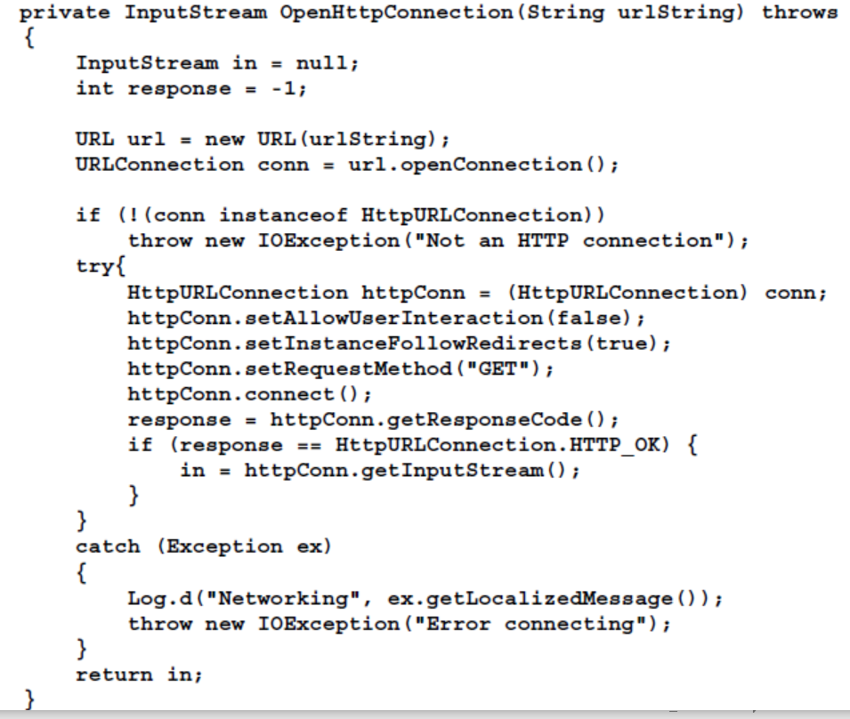
Consuming Web Services Using HTTP

Slide 12
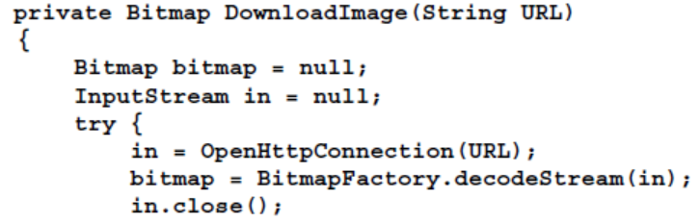
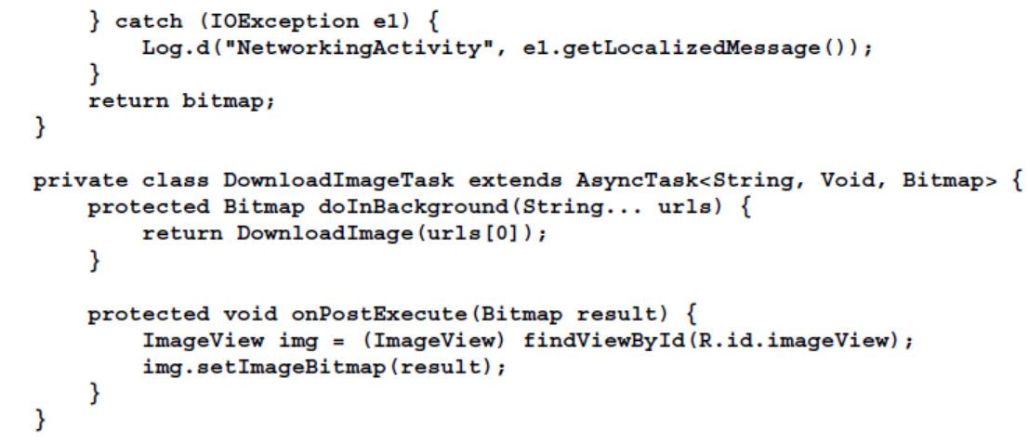
Downloading Binary File (Image)

Slide 13
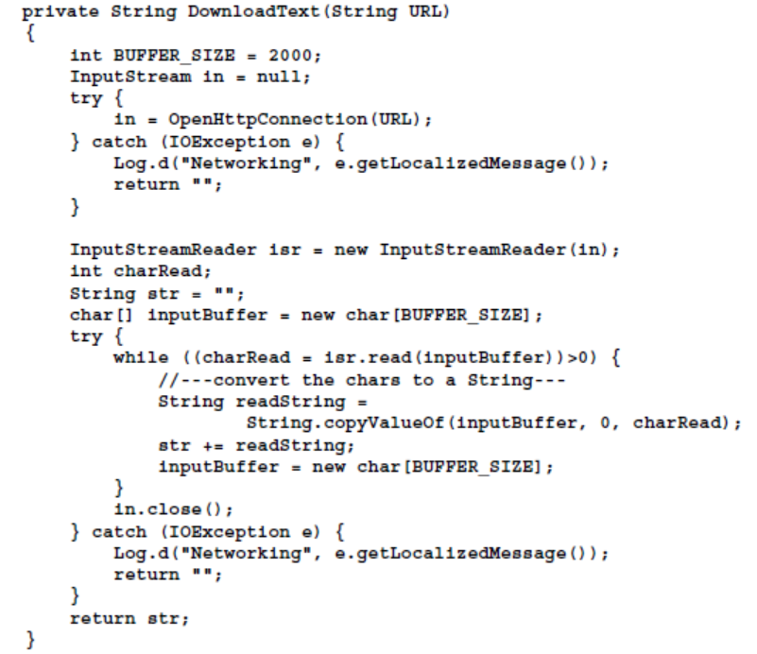
Downloading Text File

Slide 14
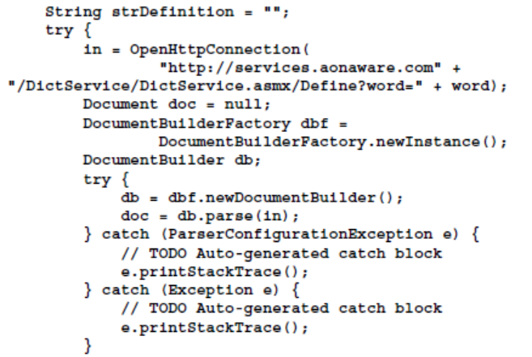
Consuming SOAP Web Service

Slide 15
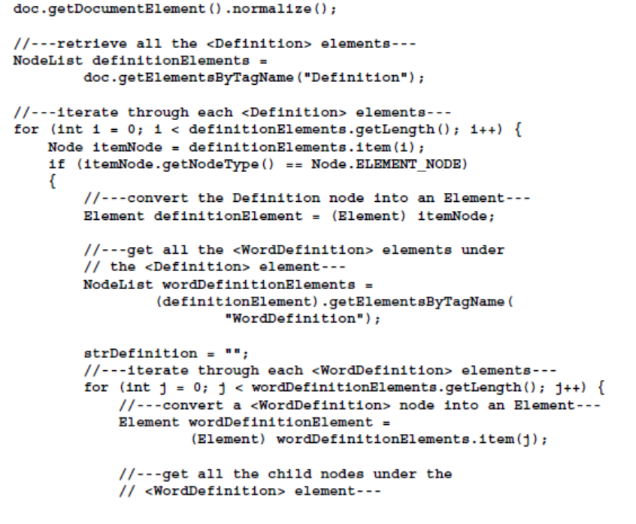
Consuming SOAP Web Service..2

Slide 16
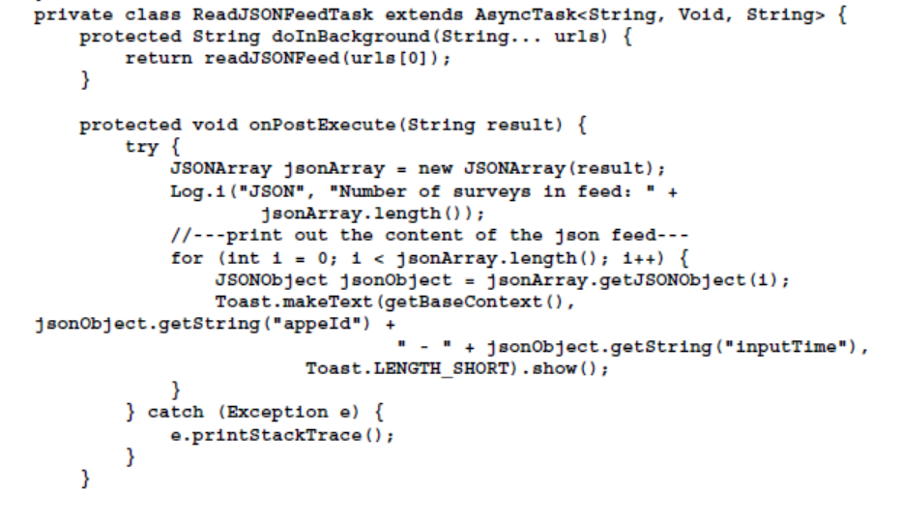
Consuming JSON Web Service

