Slide 1
Recycler Views & Card Views s
By Samer Zain – Ph.D. – Birzeit University – Computer Science Dept.

Slide 2
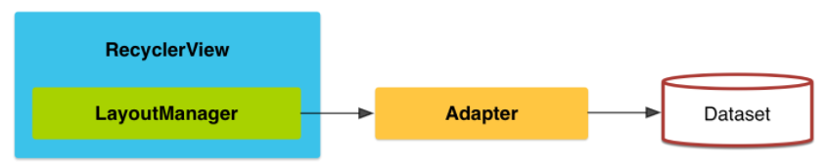
Introduction
The RecyclerView widget is a more advanced and flexible version of ListView.
This widget is a container for displaying large data sets that can be scrolled very efficiently by maintaining a limited number of views.
It is very effiecient and advanced view compared to ListView
However, Recycler Views needs lots of setup code.
Refs: developer.android.com

Slide 3
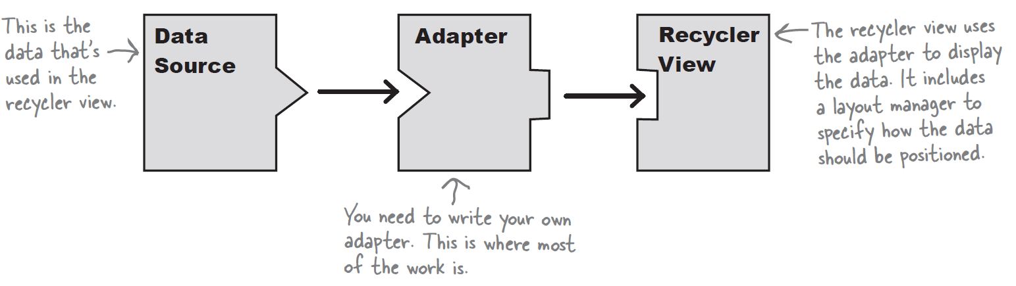
Recycler Views from 10,000 feet
A recycler view accesses its data using an adapter.
Unlike a list view, however, it doesn’t use any of the built-in Android adapters such as array adapters.
Instead, you have to write an adapter of your own that’s tailored to your data.
This includes specifying the type of data, creating views, and binding the data to the views.

Slide 4
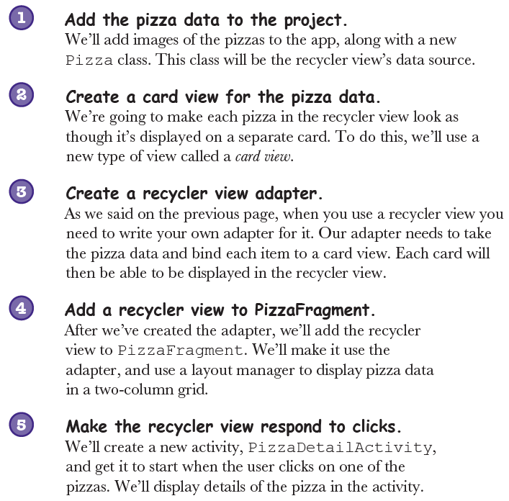
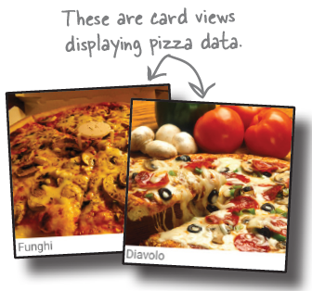
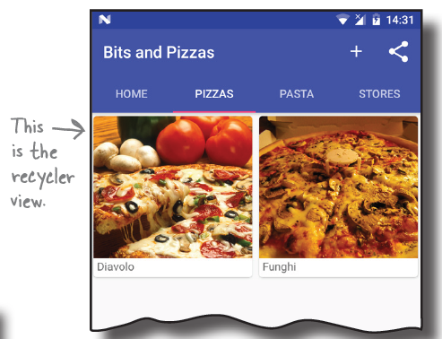
Example: Pizza App

Slide 5
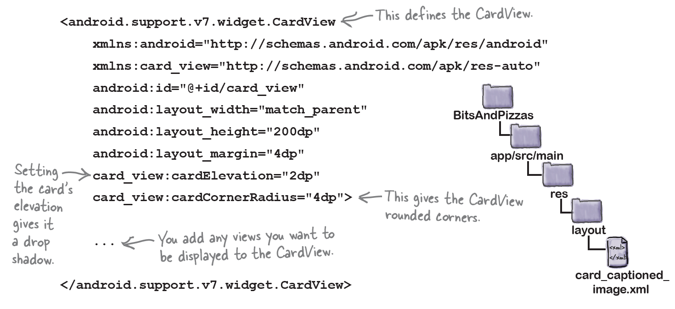
Adding card view

Slide 6
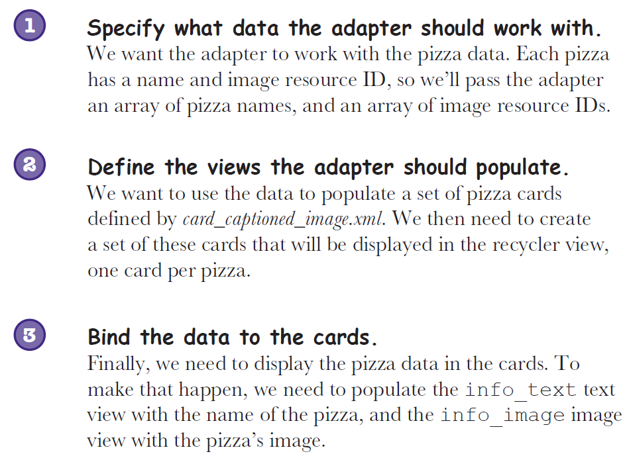
How the adapter will work?
The adapter has two main jobs:
A) Create each of the views that are visible within the recycler view
B) Bind each view to its corresponding data

Slide 7
