Slide 1
Mobile Apps
Introduction
Birzeit University, CS Dept, Mobile Software Development- Dr. Samer Zein

Slide 2

Overview
Mobile applications running on smartphone devices have become an indispensible part in people’s daily activities and modern life
For many people, smartphones have become an extension of themselves
Birzeit University, CS Dept., Mobile Software Development Course

Slide 3

Overview..cont.
Studies have shown that people become anxious if they misplace their device, lose connectivity, or run low on battery
Great advancements in HW:
Faster CPUs
Larger Memories
More Accurate Sensors
Birzeit University, CS Dept., Mobile Software Development Course

Slide 4
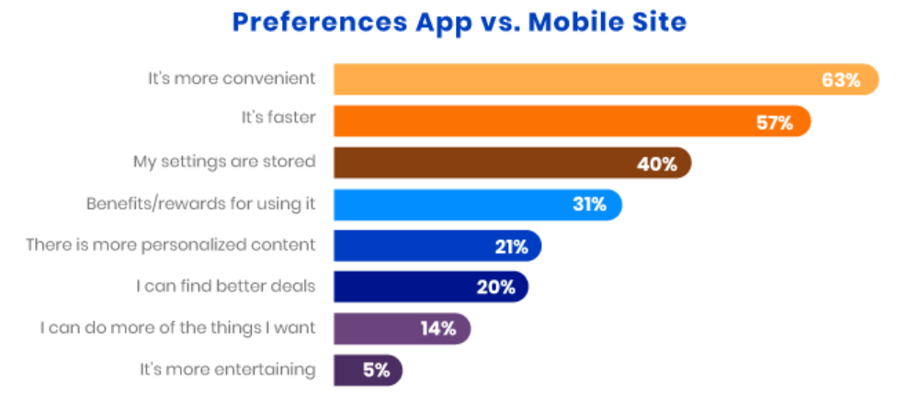
M-Sites vs Native Apps
Refs: buildfire.com
Birzeit University, CS Dept., Mobile Software Development Course

Slide 5
Overview
5.22 billion unique mobile users worldwide
218 billion apps downloaded in 2020
Estimates predict 258 billion downloads in 2022
Mobile applications, also known as apps, are software products developed to run on mobile devices, such as smartphones and tablets.
Smartphones technology as well as mobile apps are growing at steady pace, with no signs of slowing down in near future.
Source: TechCrunch
Birzeit University, CS Dept., Mobile Software Development Course

Slide 6
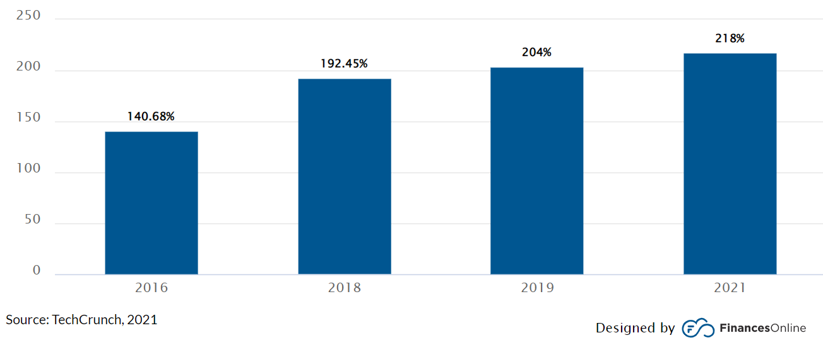
Global Mobile App Downloads 2016 - 2021
As of 2022:
Google Play has 3.5 million apps
Apple store has
2.2 millions apps
Source: Statista
Birzeit University, CS Dept., Mobile Software Development Course

Slide 7
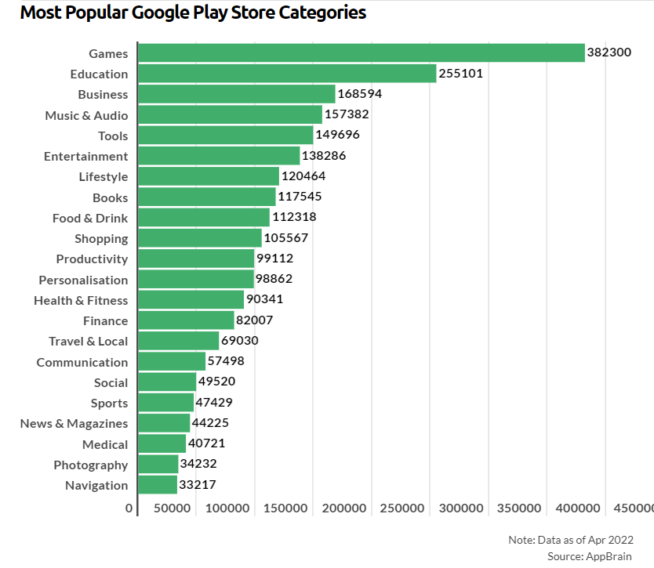
Popular apps
Birzeit University, CS Dept., Mobile Software Development Course

Slide 8
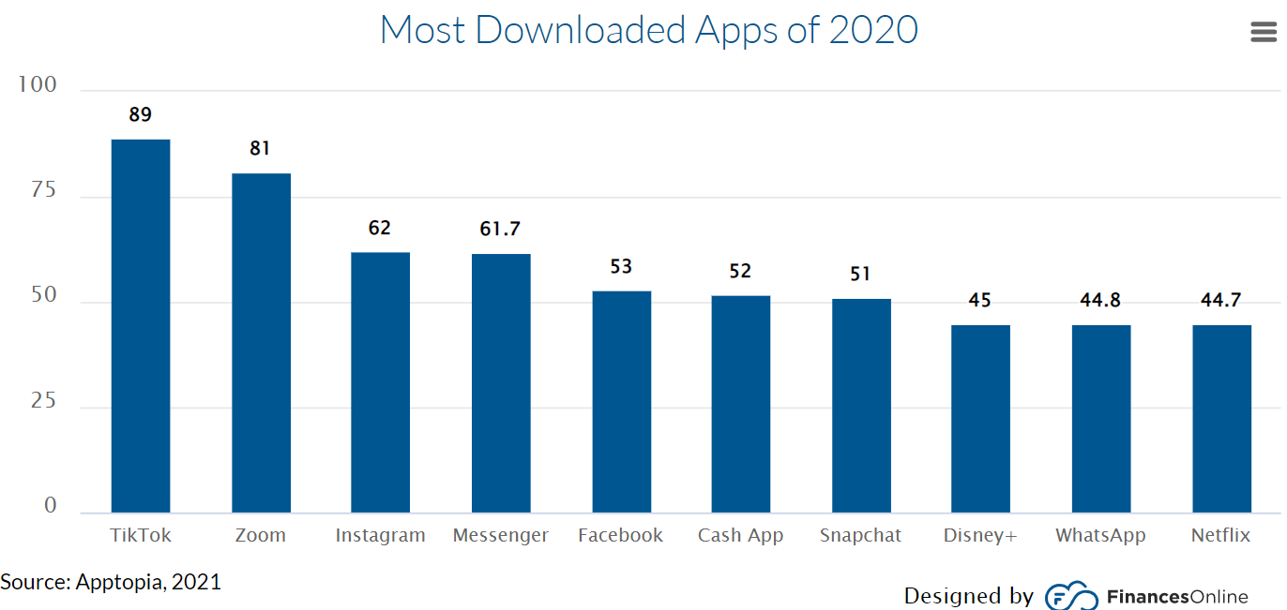
Paid vs Free Apps
Not surprisingly, the vast majority of global downloads are free. As a matter of fact, 98% of app revenue worldwide comes from free apps (Buildfire, 2021). Only a few are willing to pay for downloads.
Birzeit University, CS Dept., Mobile Software Development Course

Slide 9
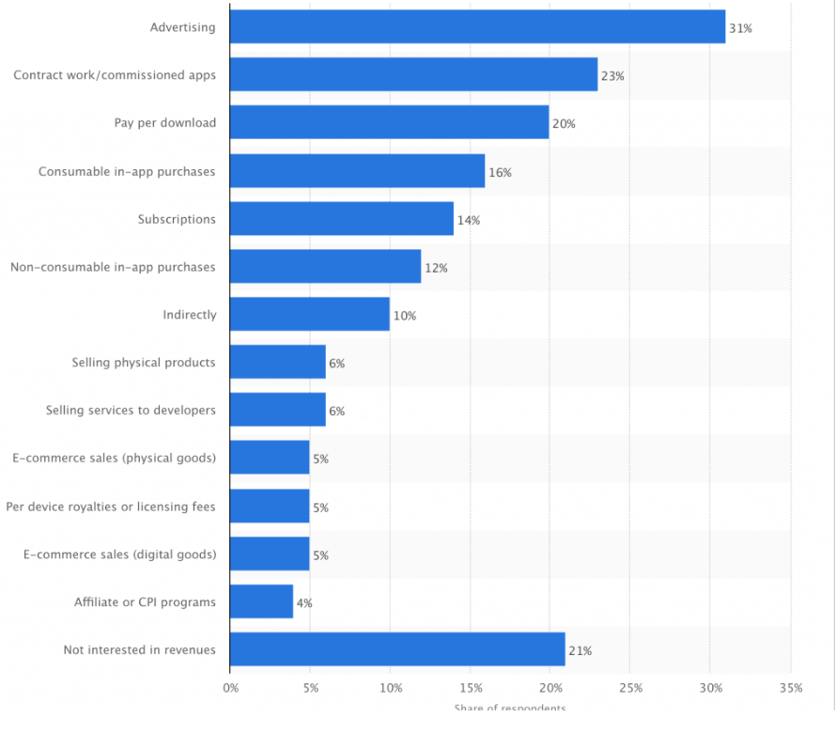
How do mobile apps make money?
Birzeit University, CS Dept., Mobile Software Development Course

Slide 10
Different than traditional web and desktop development?
A mobile application is more sophisticated and more complex than web applications because:
resource management,
data entry, sensors,
data storage,
and life cycle.
Furthermore, each operating system has its own set of development guidelines and a proprietary deployment model.
Birzeit University, CS Dept., Mobile Software Development Course

