Slide 1

Native app development with android
Part I

Slide 2
What is android?
Android is a mobile operating system that is based on a modified version of Linux.
It was originally developed by a startup of the same name, Android, Inc.
In 2005, as part of its strategy to enter the mobile space, Google purchased Android, Inc. and took over its development work, and also their team!
Google wanted Android OS to be free.
Thus it was released under Apache License.
Anyone can download Android OS.
Vendors do that, they also add their own extensions to differentiate their products from others.
In 2017, there was Two Billion active Android devices…!!!

Slide 3



Why android?
When iPhone first made a great success, many vendor saw Android as a great opportunity and solution.
This included Motorola and Sony Ericson, both been developing their own OS for many years.
And lets not forget HUAWEI, the Chinese dragon!
Only iPhone and SAMSUMG have more market share than HUAWEI..!!
The main advantage when adopting Android is that it offers a unified approach to development.
Developers need only to develop for Android.
And their apps will run on numerous Android devices

Slide 4
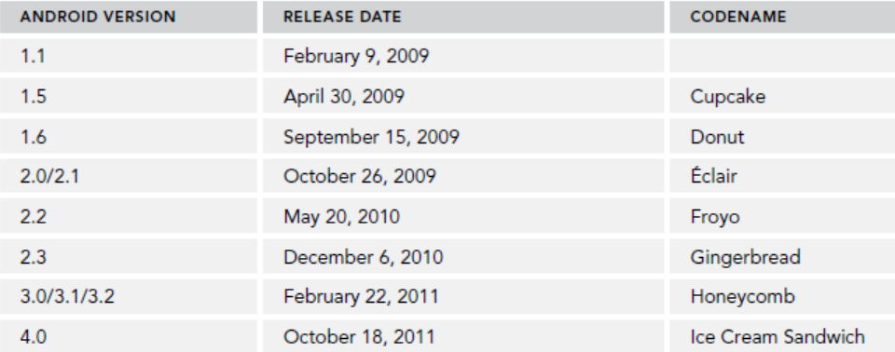
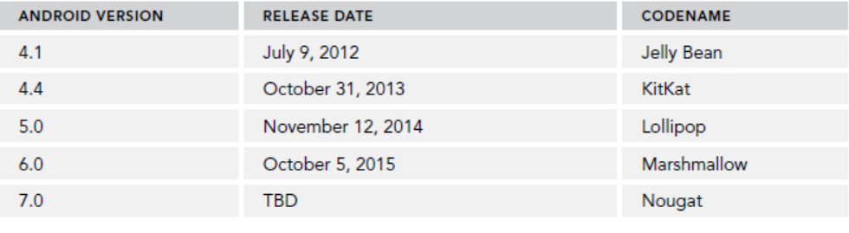
Android versions
One important thing to keep in mind as you are looking at Android versions is that each version has
its own features and APIs..!
8.0 | Oreo
9.0 | Pie
10 | Quince Tart
11 | Red Velvet Cake
12 | Snow Cone
13 | Tiramisu

Slide 5
Features of android
Android is free to be customized by vendors.
No fixed hardware or software configurations!
However, Android supports the following features:
Storage: such as SQLite
Connectivity: GSM/EDGE, IDEN, CDMA, EV-DO, UMTS, Bluetooth (includes A2DP and AVRCP), Wi-Fi, LTE, and WiMAX.
Messaging
All Media Support
Hardware Support: Accelerometer sensor, camera, digital compass, proximity sensor, and GPS.
Multi-Touch
Multi Tasking
Tethering

Slide 6
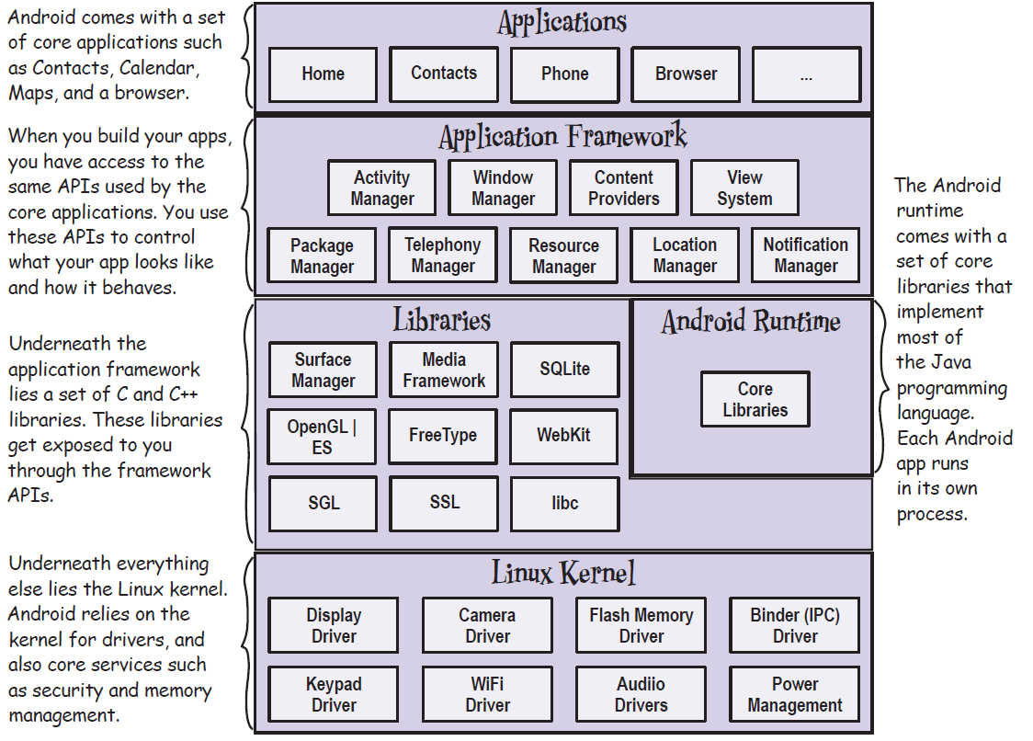
Android Platform Dissected

Slide 7
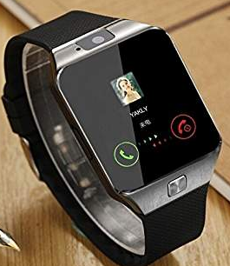

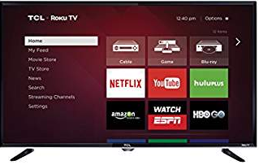
Android devices in the market!
Android devices come in all shapes and sizes including, but not limited to, the following types of devices:
Smartphones
Tablets
E-reader devices
Internet TVs
Automobiles
Smartwatches
Tablets

Slide 8

Android community
Stack Overflow → most likely your Android issue has already been solved there!
Google Android Training → developer.android.com
Android Discuss → monitored closely by Google Android Team

Slide 9
Obtaining the required tools for development
When developing for Android, you can use a Mac, a Windows PC, or a Linux machine.
All necessary tools are freely available!.
First download, Java JDK 8.
Then download and install Android Studio (IntelliJ IDEA)
Then through Android Studio, use SDK Manager Tool to download multiple versions of Android SDK.
Multiple SDK versions enable you to write Android app that targets several Android OS versions.
Finally you configure your Emulators

Slide 10
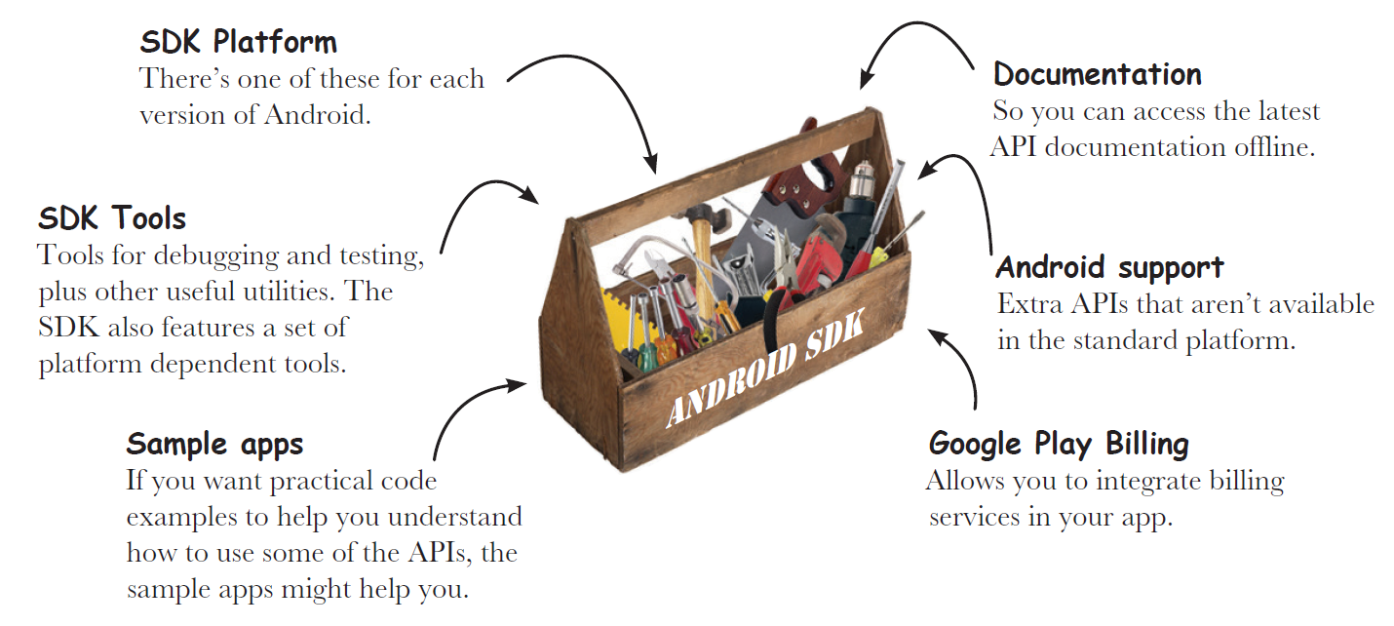

Slide 11
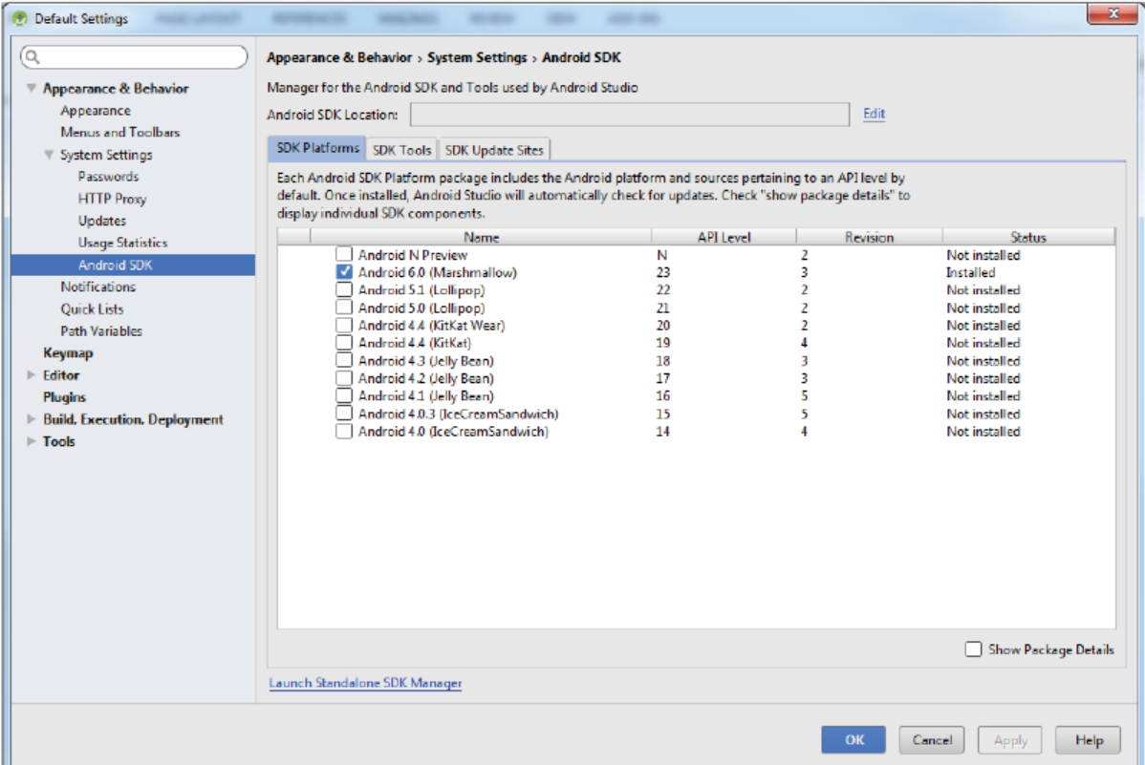

Slide 12
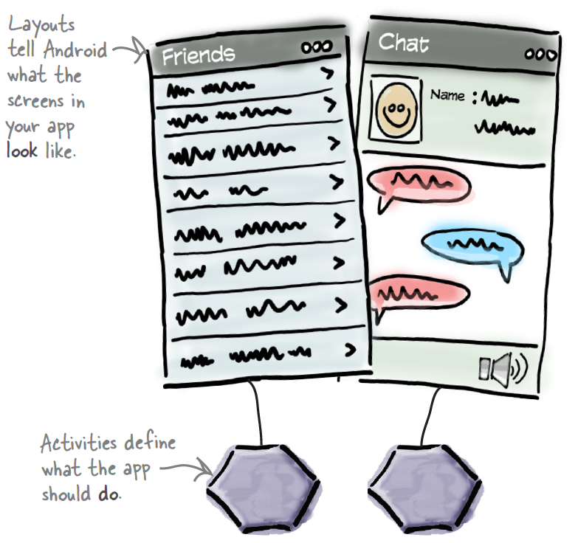
So what makes an Android App?
A typical Android app is comprised of one or more screens (Activities).
You define what each screen looks like using a layout to define its appearance.
Layouts are usually defined using XML, and can include GUI components such as buttons, text fields, and labels.
Java on the other hand defines what each activity should do.
For example, if some activity has a button, Java will respond to that button click.
Extra resources (images, data) can be added too.
Your App is just a bunch of files and directories!!

Slide 13
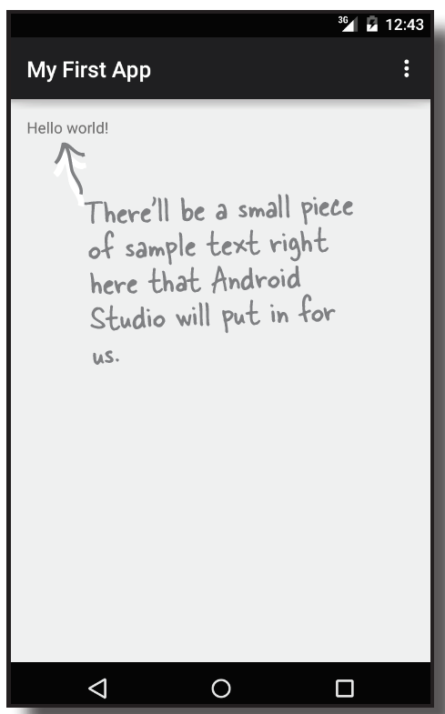
Example App I: Building a basic app Demo
Objectives:
1 – Android studio Test Drive
2 – Setup AVD
3 – Close Look at Activities and layouts
4 – introduce project structure

Slide 14
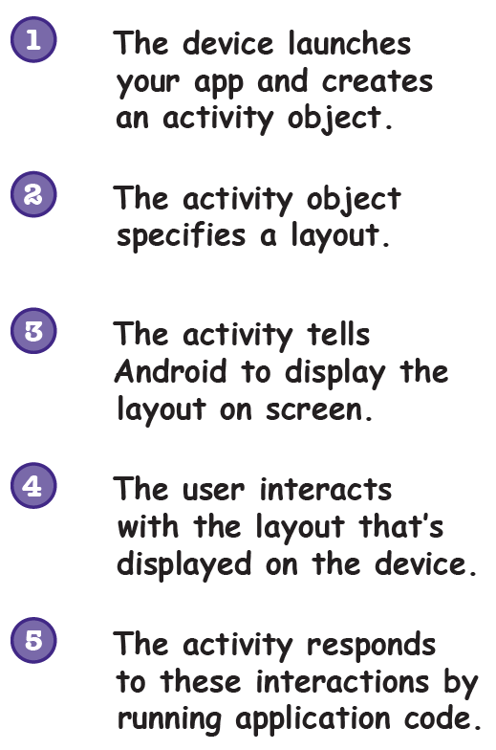
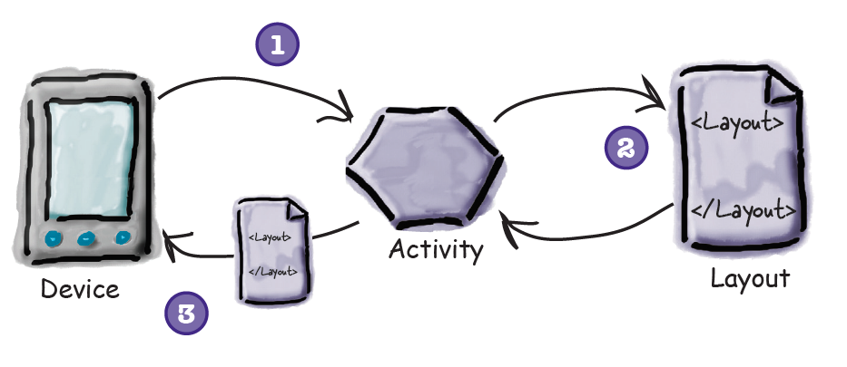
Activities and Layouts Intro

Slide 15
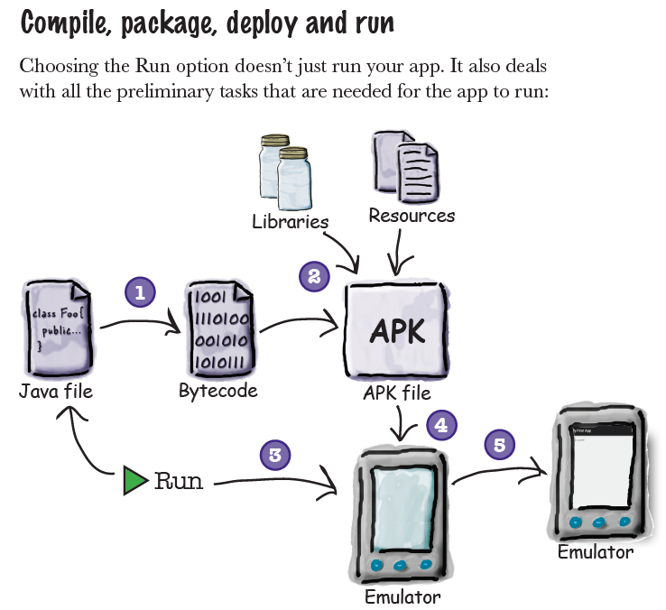

Slide 16
Specifying Minimum and Target API Levels
As we will see progressively, AndroidManifest.xml is the main configuration file for your project. It specifies details about your App.
Though AndroidManifest.xml, you need to specify which versions of Android it supports.
Specifically, the minSdkVersion and targetSdkVersion attributes for the <uses-sdk> element identify the lowest API level with which your app is compatible
and the highest API level against which you’ve designed and tested your app.

Slide 17
Specifying Minimum and Target API Levels..2
As new versions of Android are released, some style and behaviors may change.
To allow your app to take advantage of these changes and ensure that your app fits the style of each user's device,
you should set the targetSdkVersion value to match the latest Android version available

Slide 18
More on Activities
One of the Main building blocks of Android Apps
Android apps can have zero or more Activities.
Activity is like a GUI, but has to serve one action.
The purpose of Activity is to interact with users.
From the moment an activity appears on the screen to the moment it is hidden, it goes through a number of stages.
These stages are known as an activity’s life cycle.
Understanding the life cycle of an activity is vital to ensuring that your application works correctly.
Additionally, there are Fragments
Fragments can be seen as “miniature” activities that can be groups together.

Slide 19
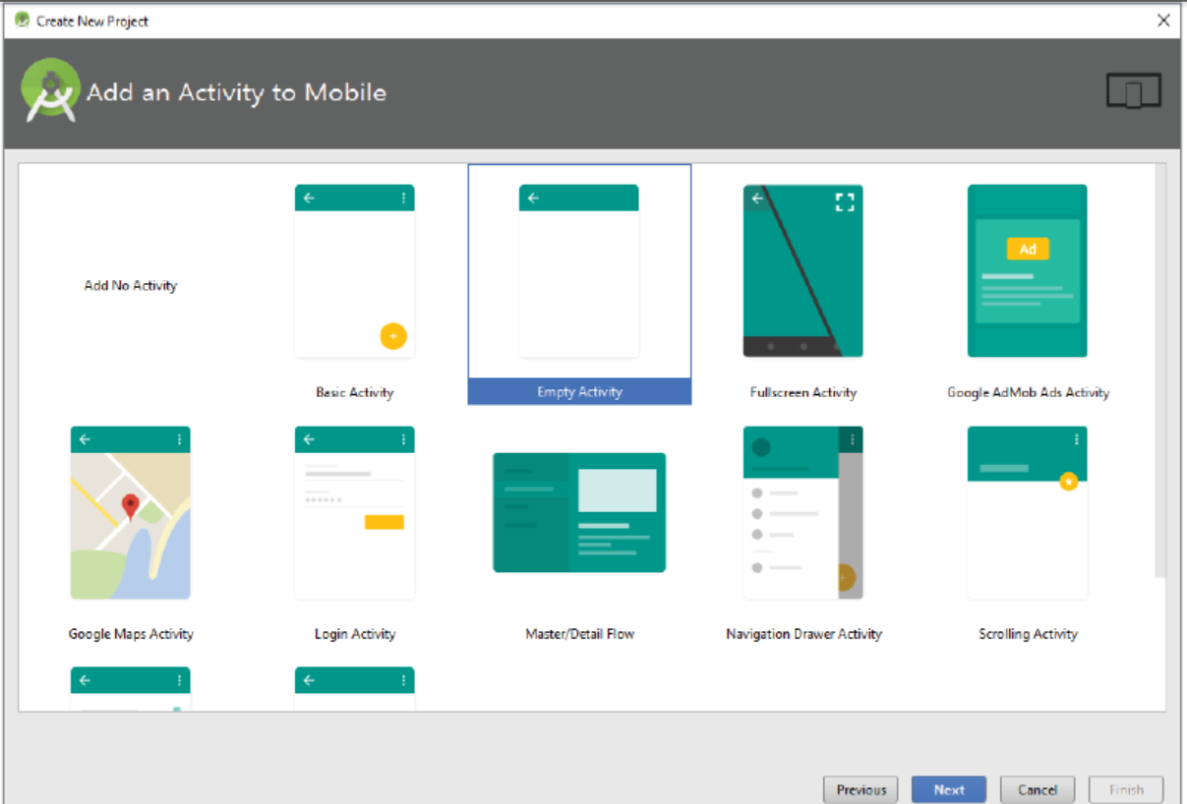

Slide 20
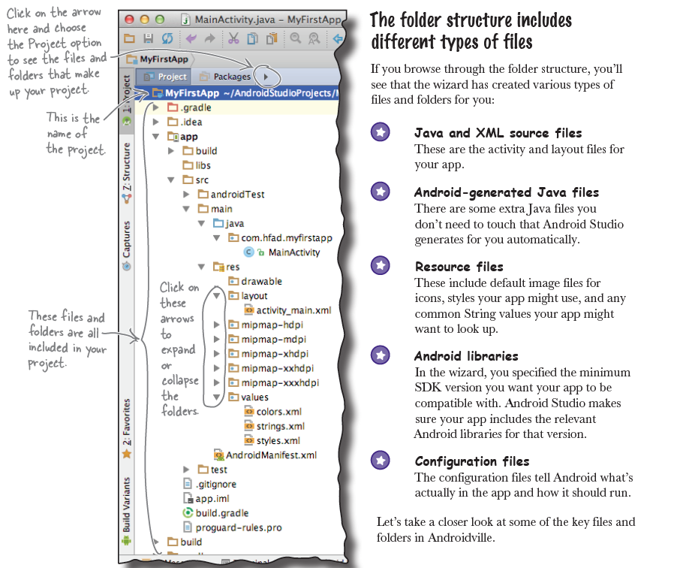

Slide 21
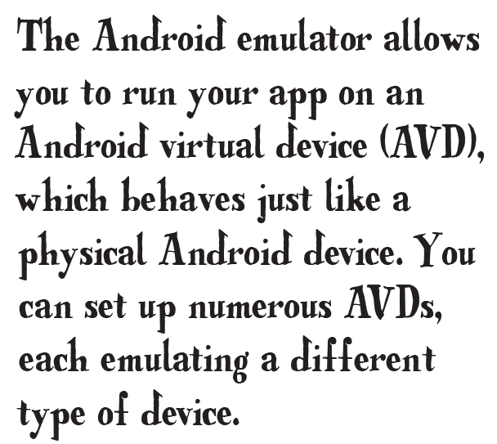
Android Virtual devices
Android AVDs allow you to test your App.
Each AVD has a hardware profile; a mapping to a system image; and emulated storage, such as a secure digital (SD) card.
One important thing to remember about emulators is that they are not perfect.
There are some applications that are games, or use sensors and GPS, are better tested on real device!
But it is so easy to deploy your APK on real device using USB connection!
You need to choose a system image for an API level that’s compatible with the app you’re building.
As an example, if you want your app to work on a minimum of API level 19, choose a system image for at least API level 19

Slide 22
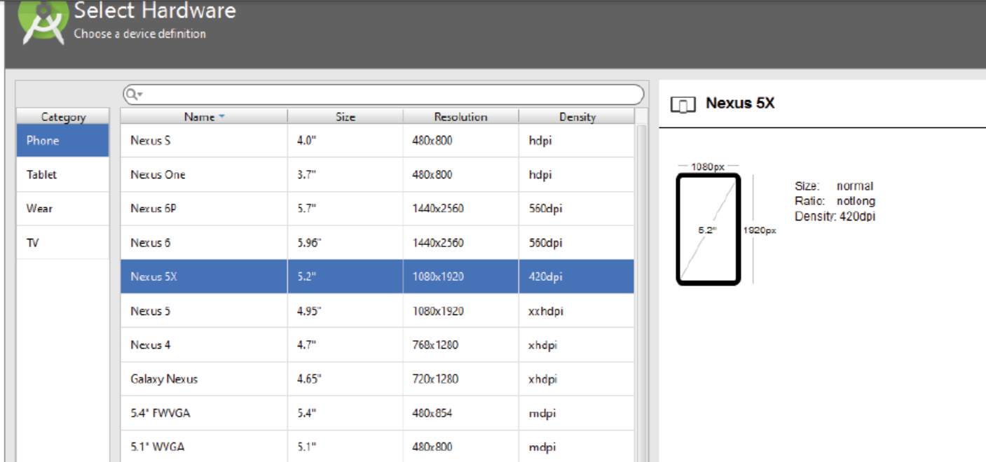

Slide 23
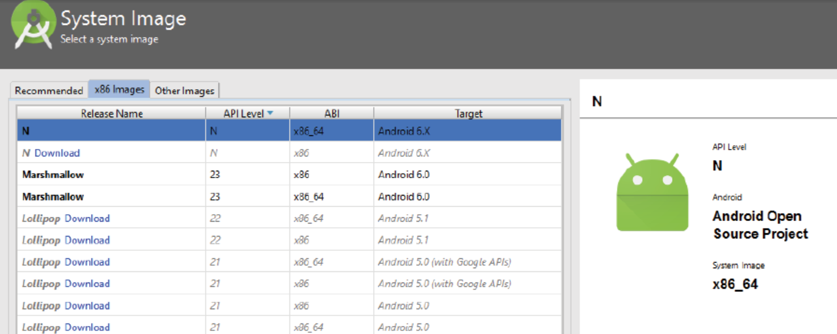

Slide 24
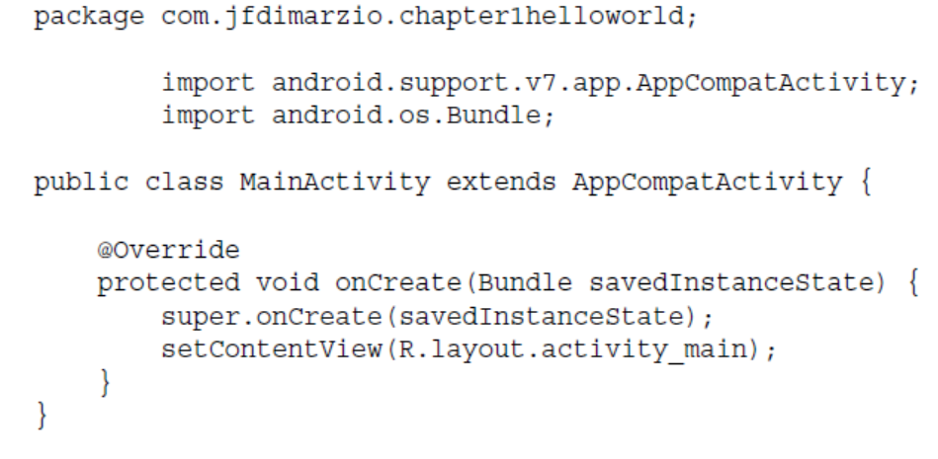
Activities: onCreate()
Your activity class loads its user interface (UI) component using the XML file defined in your res/layout folder.
Every activity you have in your application must be declared in your AndroidManifest.xml file.

Slide 25
Activities are different
Unlike programming paradigms in which apps are launched with a main() method,
the Android system initiates code in an Activity instance by invoking specific callback methods.
These callback methods correspond to specific stages of its lifecycle.

Slide 26
Activity Purpose
The Activity class serves as the entry point for an app’s interaction with the user, providing the window in which the app draws its UI.
This window typically fills the screen, but may be smaller than the screen and float on top of other windows.
You implement an activity as a subclass of the Activity class.
Generally, one activity implements one screen in an app.
For instance, one of an app’s activities may implement the Preferences screen, while another activity implements the Compose Email screen.

Slide 27
Activities are loosely coupled
Although activities work together to form a cohesive user experience in an app,
each activity is only loosely bound to the other activities;
there are usually minimal dependencies among the activities in an app.
In fact, activities often start up activities belonging to other apps.
For example, a browser app might launch the Share activity of a social-media app.

Slide 28
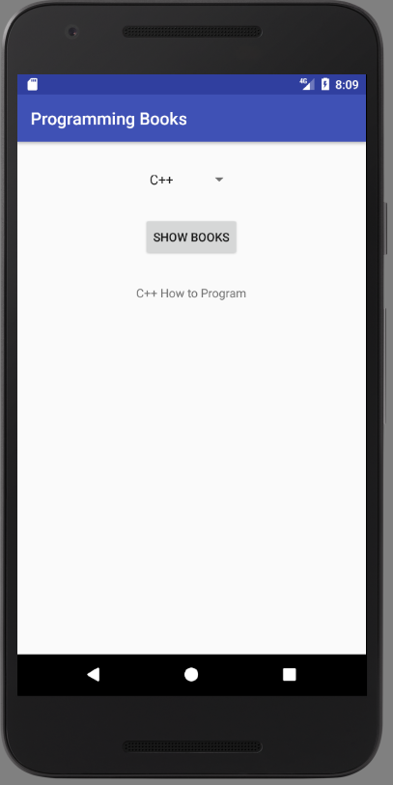
Example App 2: Interactive App
Objectives:
Get the App to do something in response to user action.
How to get Activity and Layout talk together.
Get deeper on how Android actually works.
Introduce LinearLayout
Introduce R, the hidden gem.
Introduce strings.xml
Introduce Mainifest.xml

