Slide 1
Android App Development
Part II

Slide 2
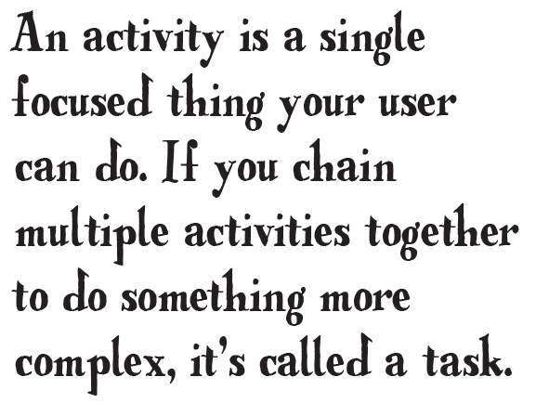
More than One Activity!
Till now we just looked at single-activity apps, which is fine for simple apps.
But when apps get more complicated, just having the one activity won’t work.
We need to understand how to build apps with multiple activities, and how you can get your activities talking to each other using intents.
We’ll also look at how you can use intents to go beyond the boundaries of your app and make activities in other apps on your device perform actions

Slide 3
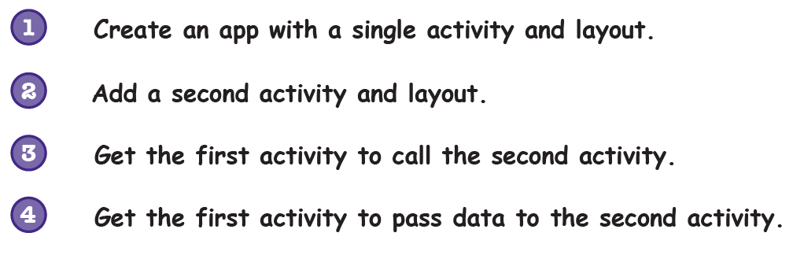
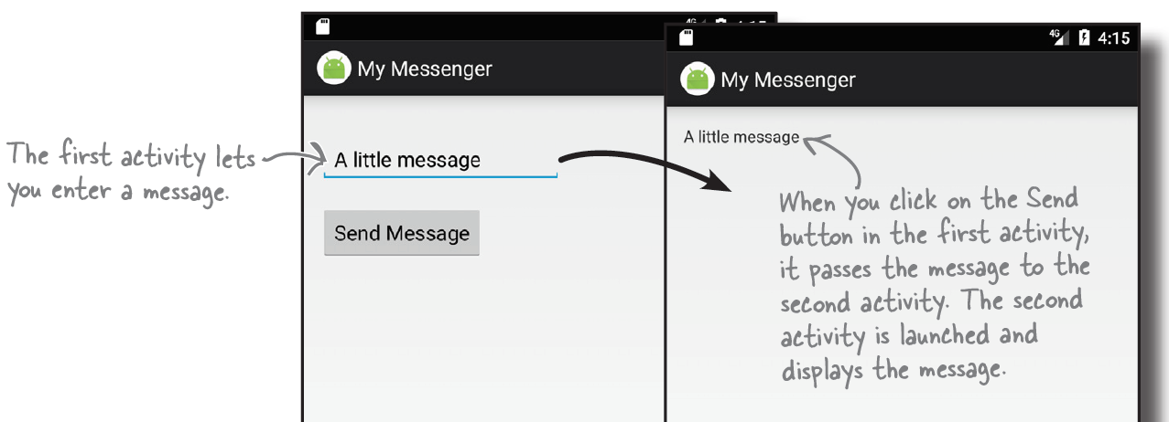
Example App3
Objectives
Introduce Intents
Send data using Intents
More about manifest.xml

Slide 4
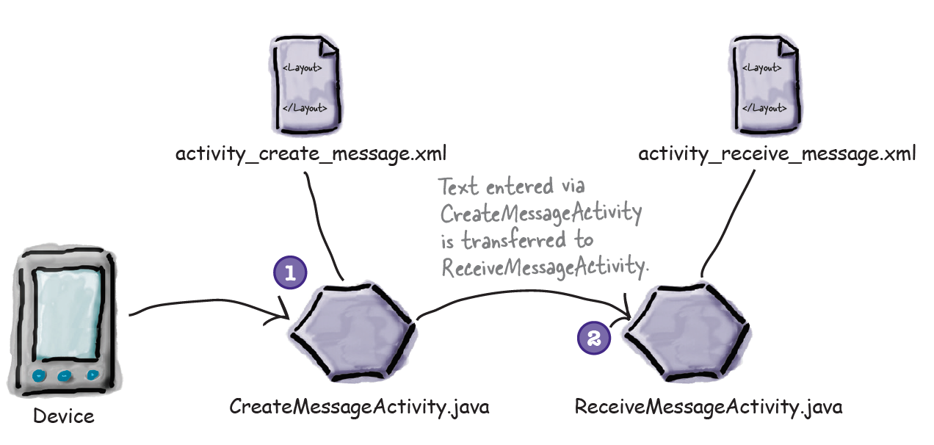
How the Two Activities will Work?

Slide 5
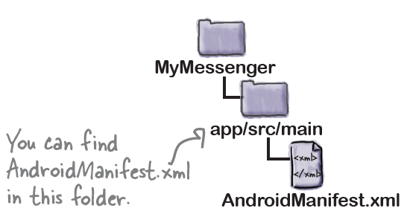
Android Manifest File
Every Android app must include a file called AndroidManifest.xml
The AndroidManifest.xml file contains essential information about your app, such as what activities it contains, required libraries, and other declarations.
Contains the settings of our app.

Slide 6
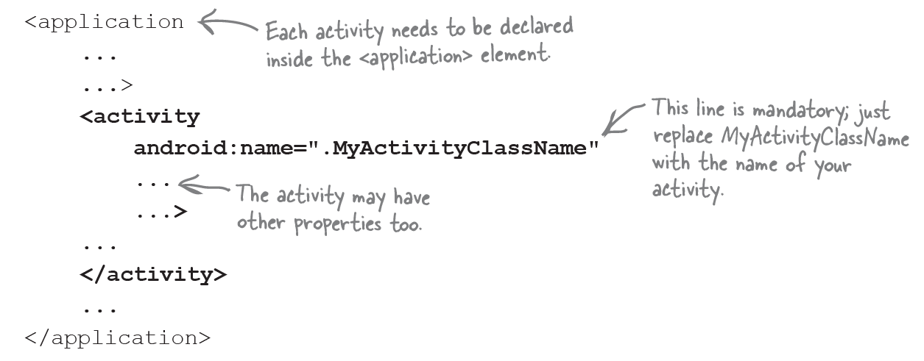
Android Manifest File..2
Every Activity has to be declared in the manifest file.
If an activity isn’t declared in the file, the system won’t know it exists.
The activity declaration may include other properties too, such as security permissions, and whether it can be used by activities in other apps.

Slide 7
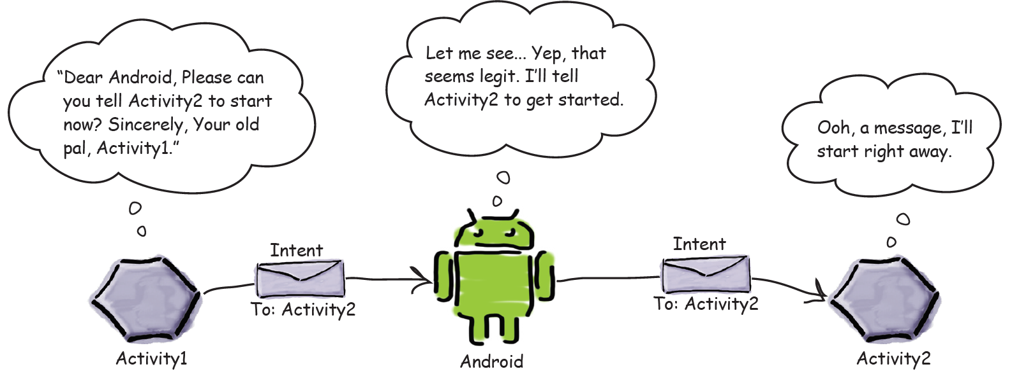
Intents
Intents are the messaging system in Android.
They are the glue the connects Android parts together.
Whenever you want an activity to start a second activity, you use an intent.
If one activity wants to start a second activity, it does it by sending an intent to Android. Android will then start the second activity and pass it the intent.

Slide 8
We can make our App start other Apps’ Activities!!
Now that we have an app that sends a message to another activity, we can change it so that it can send messages to other people.
We can do this by integrating with the message sending apps already on the device.
Depending on what apps the user has, we can get our app to send messages via Gmail, Google+, Facebook, Twitter..etc
you’re not just limited to using the activities within your app.

Slide 9
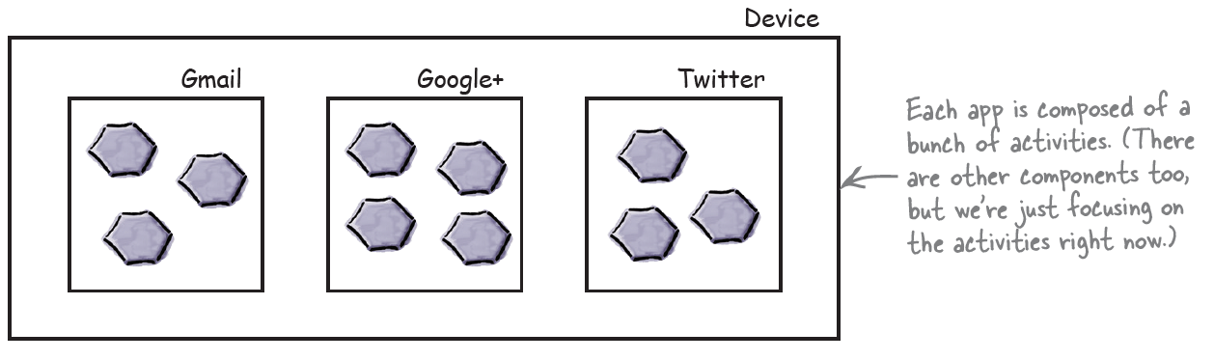
How Android Works?
As you’ve seen, all Android apps are composed of one or more activities, along with other components such as layouts.
Each activity is a single defined focused thing the user can do.
As an example, apps such as Gmail, Google+, Facebook, and Twitter all have activities that enable you to send messages, even though they may achieve this in different ways

Slide 10
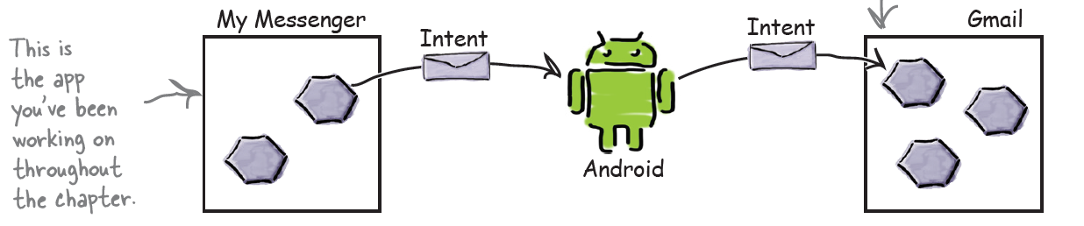
We can use Intents to start Activities in other apps!
We used intents to start activity in the same app.
But we can use the same principal to start activities in other apps.
For example, we can Gmail to send email, instead of writing a whole new activity to do so.
This means that you can build apps that perform powerful tasks by chaining together activities across the device

Slide 11
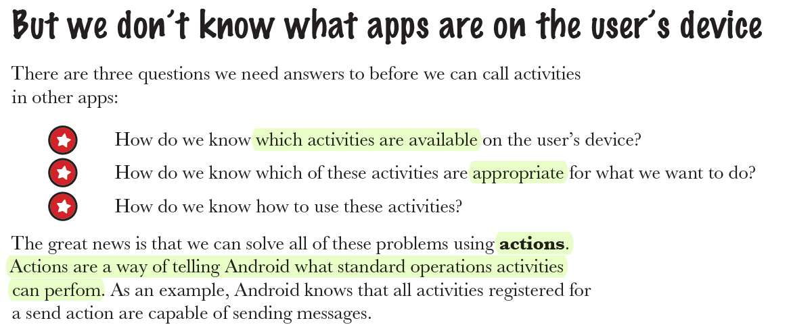

Slide 12
Create Implicit Intents
To start a certain activity, you use explicit intent, for example:
However, if you want to make some action, and you do not care which activity that does it, you can use an implicit intent:
Android provides you with a number of standard actions you can use.
As an example, you can use:
Intent.ACTION_DIAL to dial a number,
Intent.ACTION_WEB_SEARCH to perform a web search,
and Intent.ACTION_SEND to send a message.

Slide 13
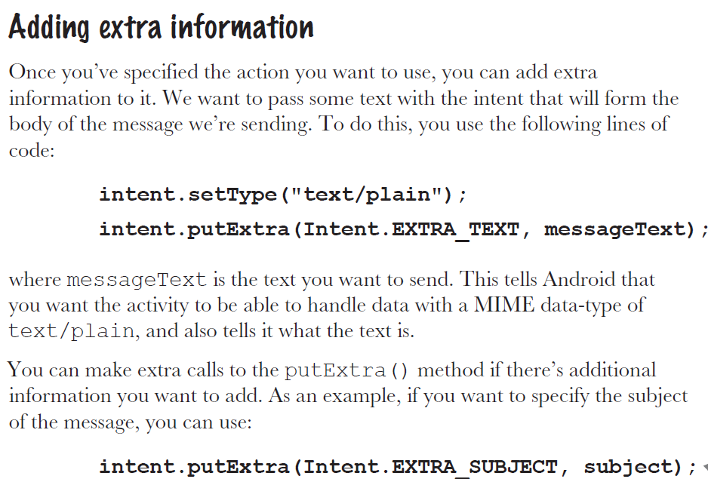
When you use implicit intents, Android needs to see which activities are capable for carrying out the action you specified. It does so by checking the intent filter for each activity in the manifest.xml

Slide 14
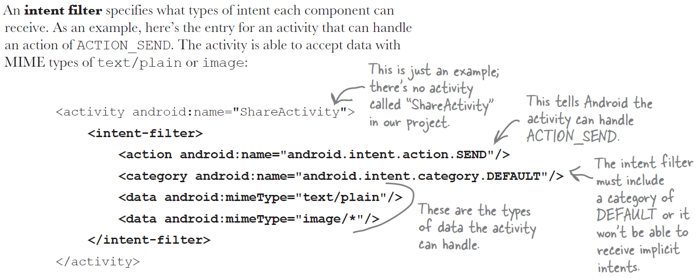
Intent Filter Example

Slide 15
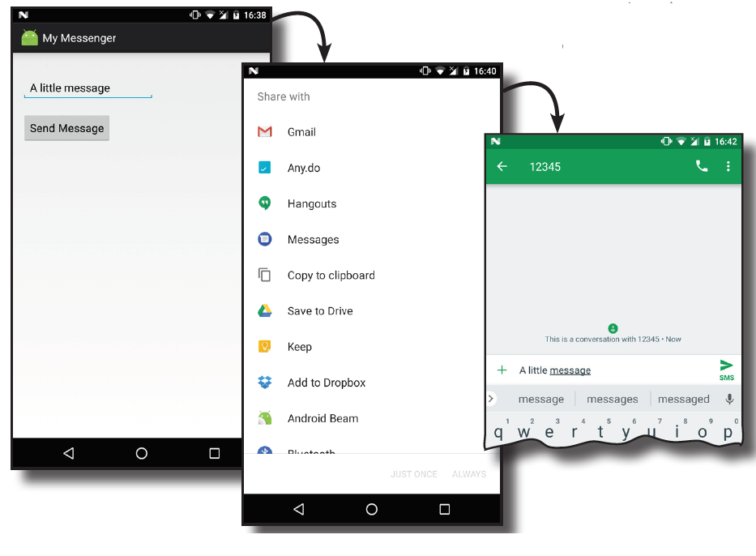
Example 4: Start Other Activities
Objectives:
Intents
Intent actions and types
Running app on real mobile device

Slide 16
Start an Activity and getting a result data
you might have an activity that prompts the user for username and password.
The information entered by the user in that activity needs to be passed back to the calling activity for further processing.
If you need to pass data back from an activity, you should instead use the
startActivityForResult() method
Another Example on this!

Slide 17
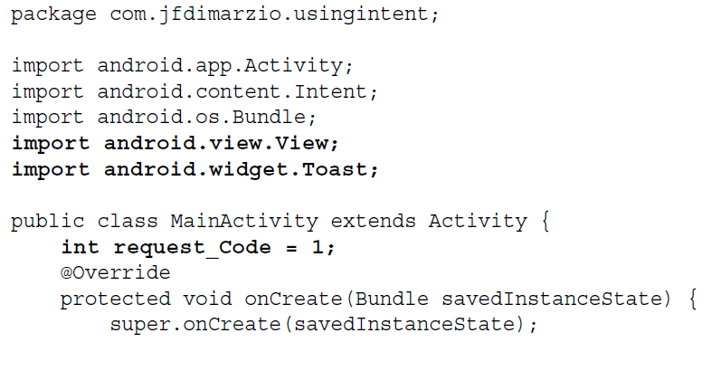
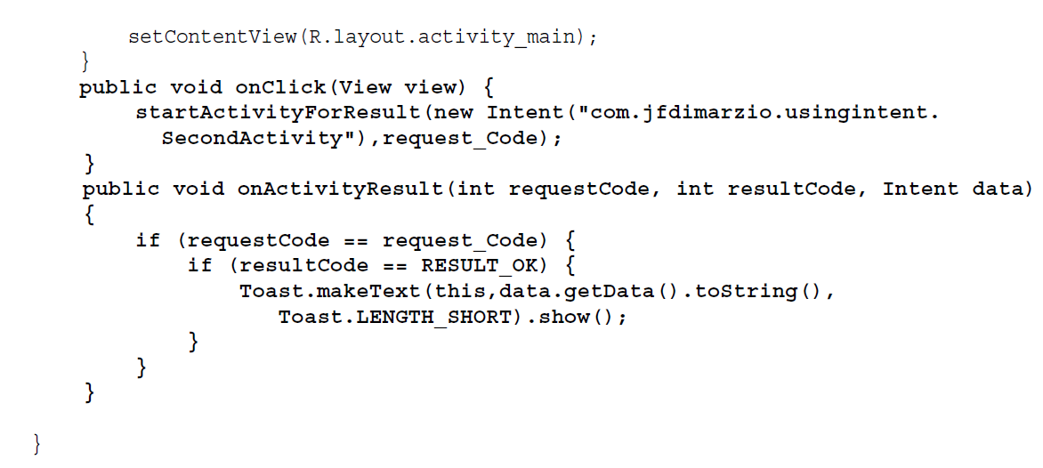
Returning data from Activity:

Slide 18
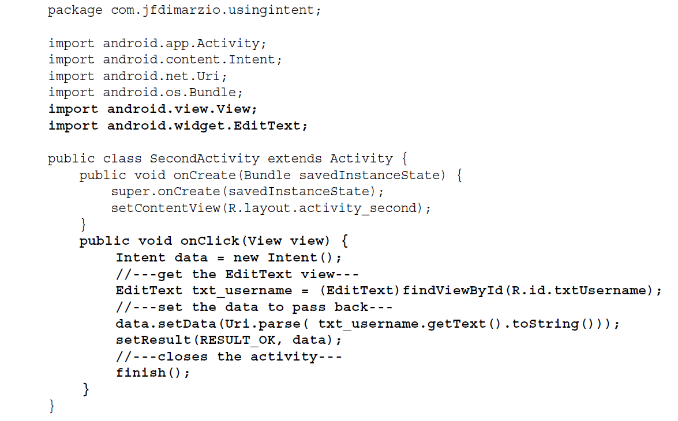
Returning data from Activity:….cont

