Slide 1
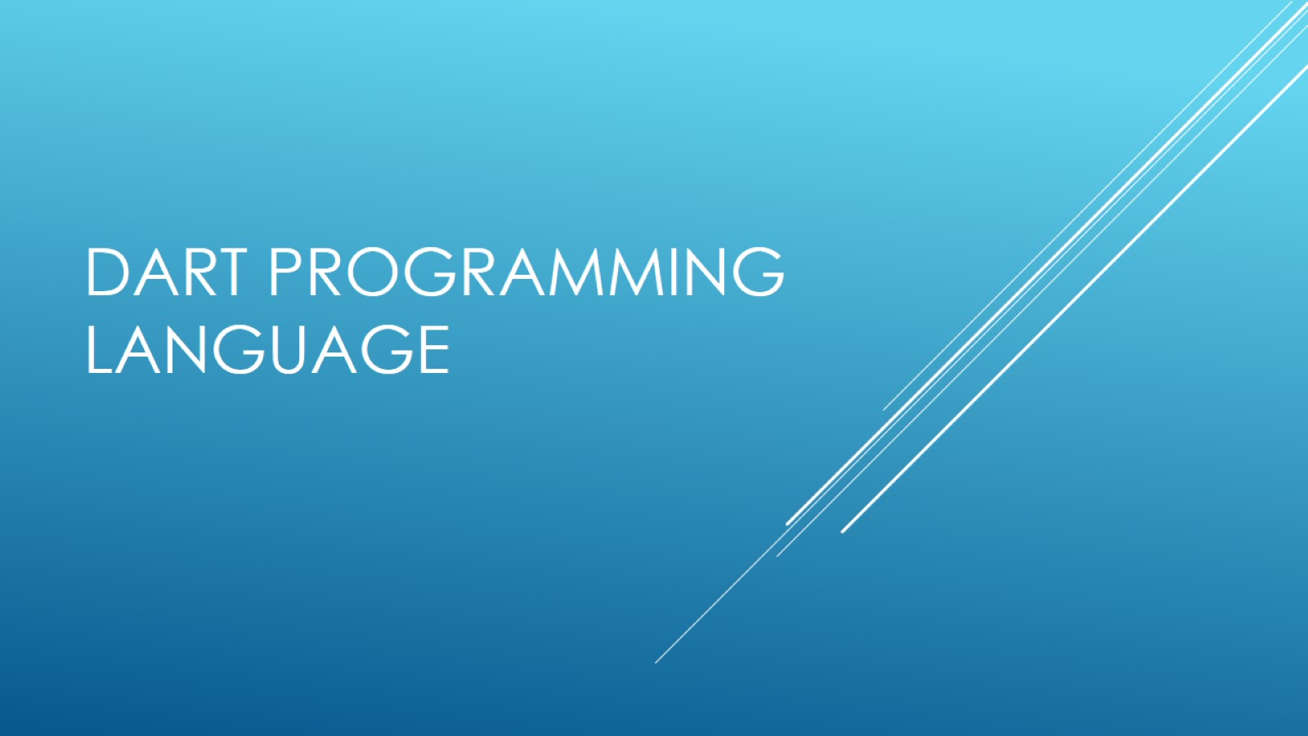
Dart programming Language

Slide 2


Slide 3
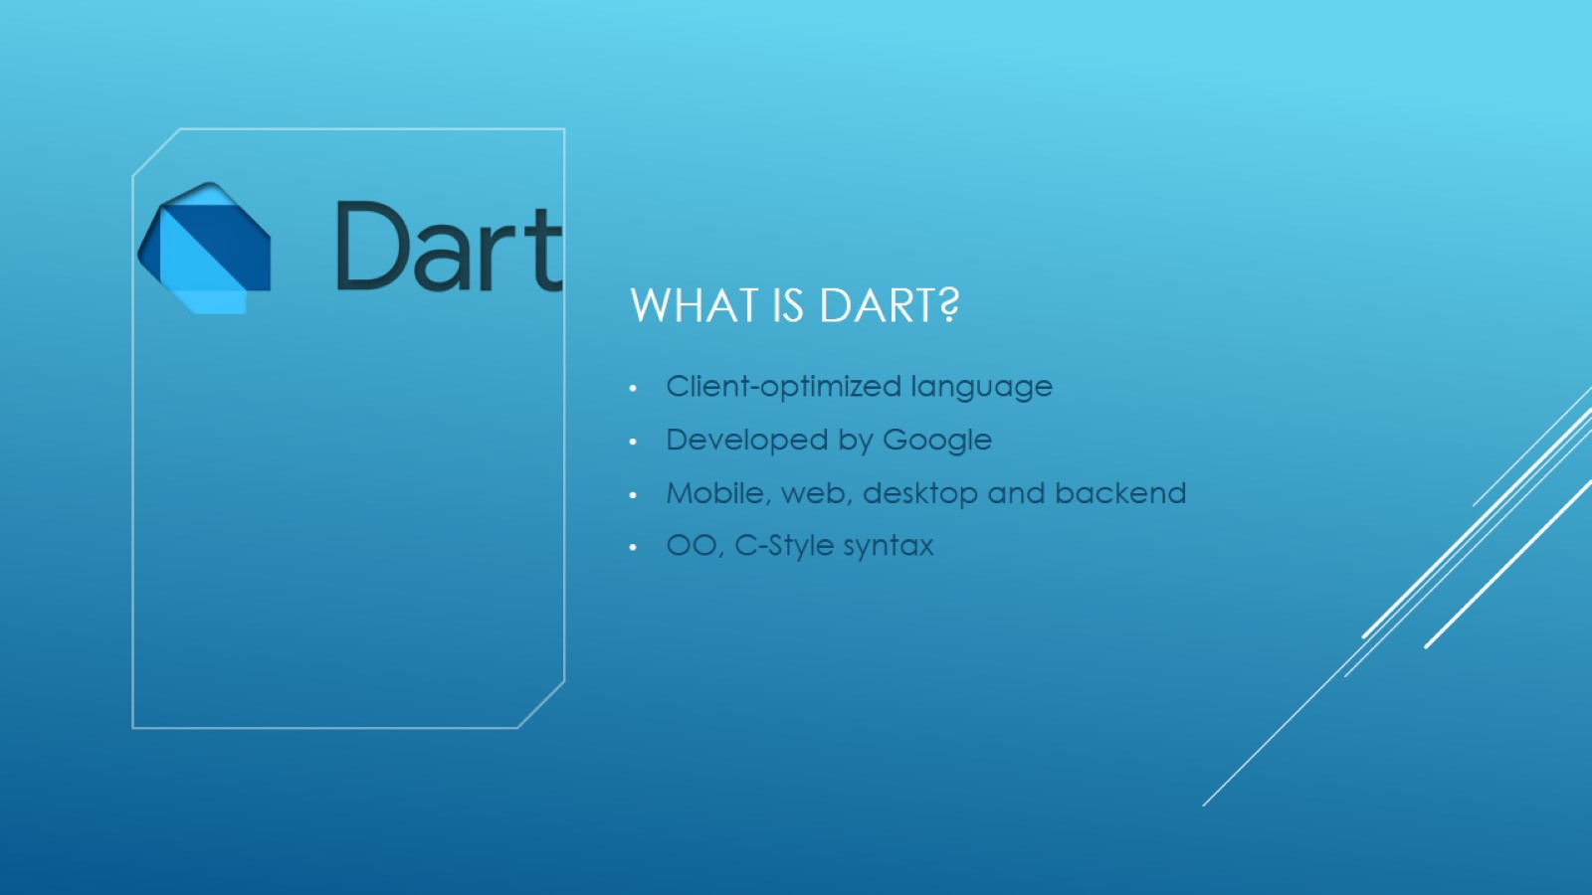
What is Dart?

Slide 4
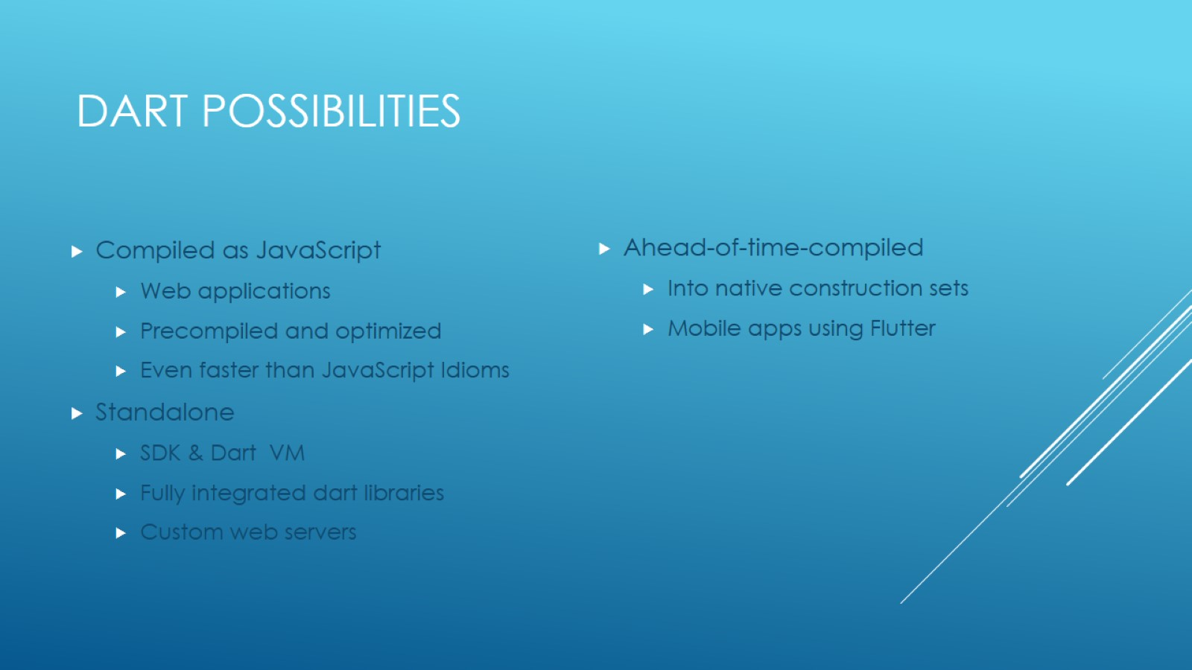
Dart possibilities

Slide 5
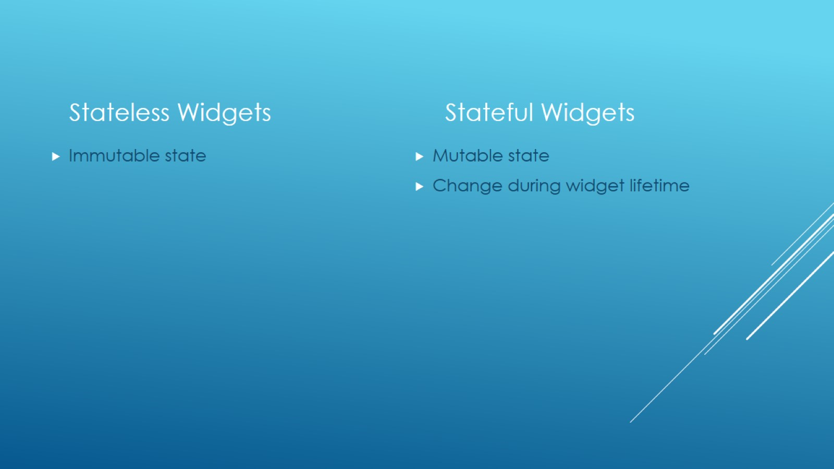

Slide 6
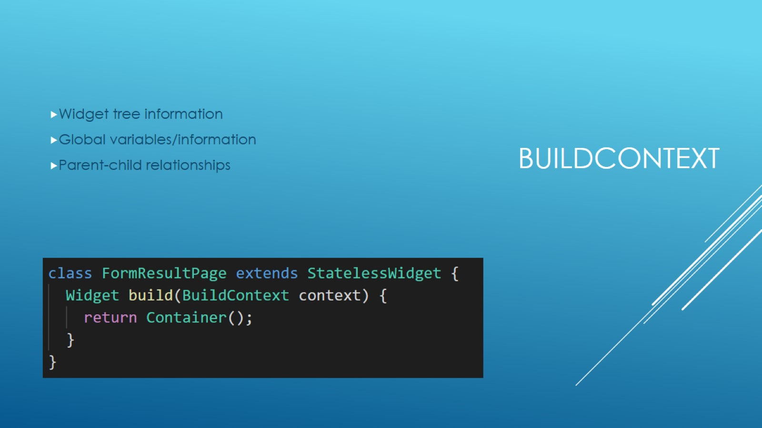
BuildContext

Slide 7
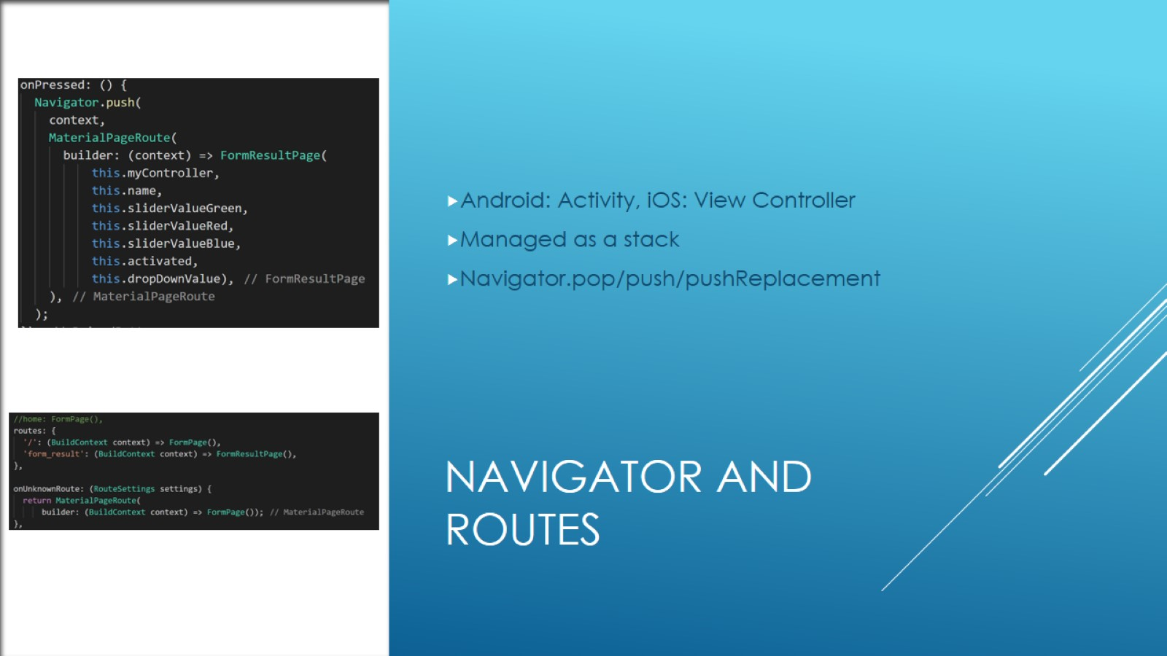
Navigator and Routes

Slide 8

Flutter, Tutorial and in-class Exercise

