Slide 1

It’s
Roc.

Slide 2

2015？
2015？
2015？

Slide 3

What Roc is doing…
Roc

Slide 4

Roc is learning a driver's license..

Slide 5

and is learning six courses …

Slide 6
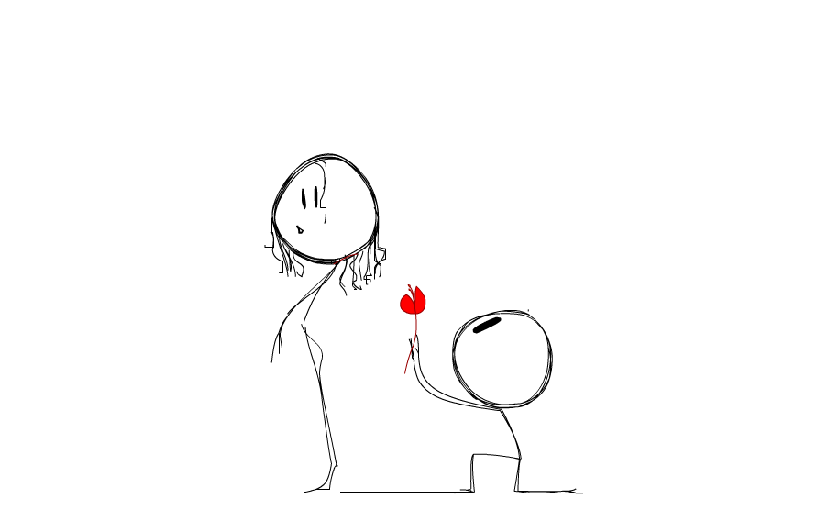
Roc is pursuing a girl…

Slide 7

Roc is great at making friends…

Slide 8
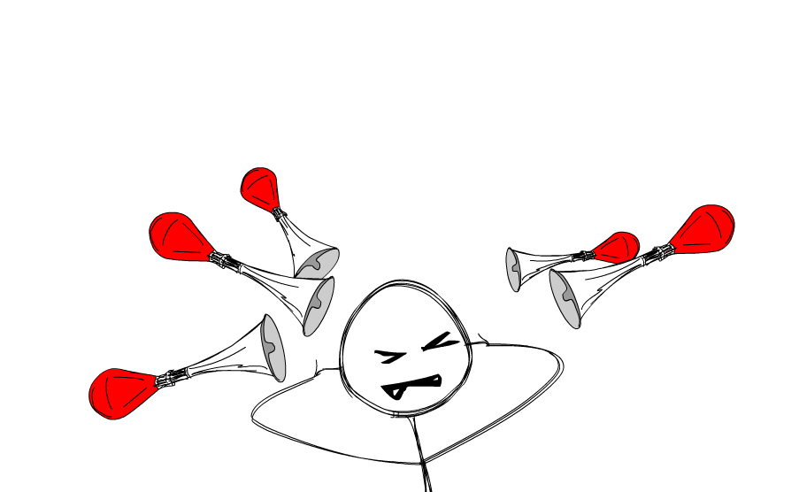
Roc is lousy at heavy work...

Slide 9
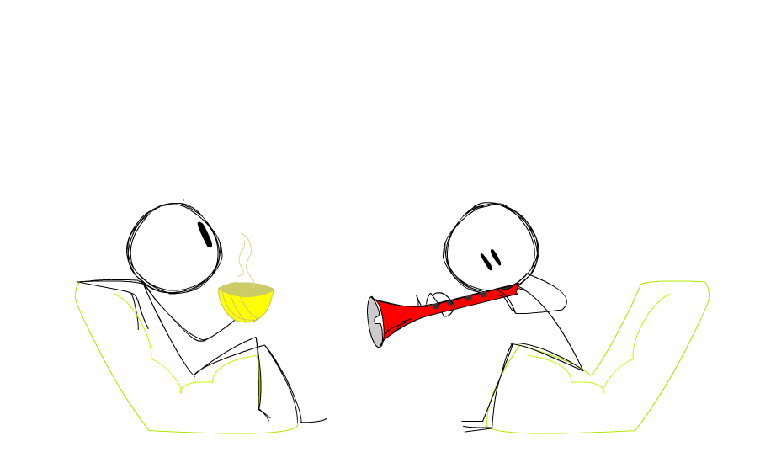
Roc needs a good conversation!

Slide 10

Wanna a date?
(约吗~)

Slide 11

.. chat with Roc

Slide 12
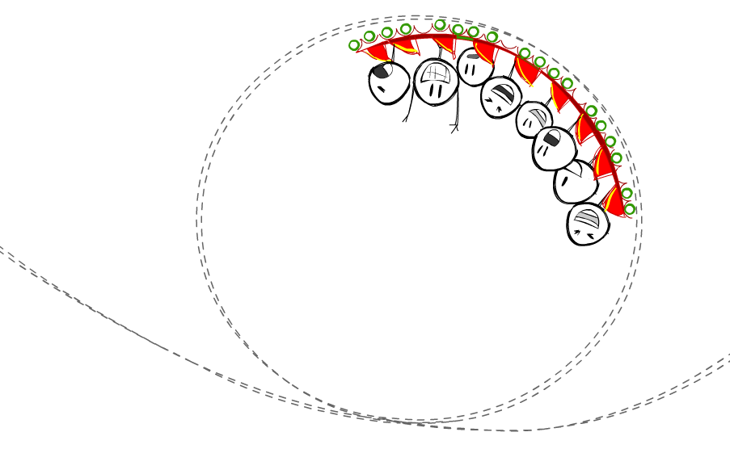
..or just hang out with Roc?

Slide 13
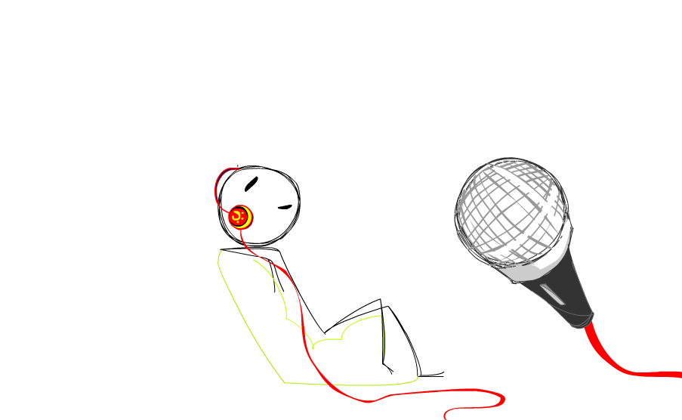
..or sing songs ~~~ to be happy！

Slide 14
All you need to do is..

Slide 15

TEL：
17888888888

