Slide 1


Dialysis of Patients
DOMAIN : HEALTHCARE
GROUP : 4

Slide 2

TEAM MEMBERS :
TANUJA TUKARAM TOPARE
THOTAPALLY SAIRAM REDDY
VAIBHAV PANDURANG GOSAVI
SARAN S
REPALLE RAM BRAHMAIAH
UPPULA VENKATA SAI TEJA
PRIYANKA DASH

Slide 3
AGENDA
INTRODUCTION
CONTENT
KPI’S
DASBOARD

Slide 4




INTRODUCTION
The "Dialysis of Patients" project within the healthcare domain focuses specifically on the realm of dialysis facilities and the outcomes of patients undergoing dialysis treatment. |  | The project aims to shed light on various aspects, ranging from facility characteristics and operational statistics to patient outcomes and financial considerations. |  | By analyzing key performance indicators (KPIs) derived from datasets, the project seeks to provide actionable insights that can influence decision-making, improve patient care, and contribute to the overall optimization of dialysis facilities. |  | Tools used for data analysis and visualization are;

Slide 5
Datasets Overview :
This dataset provides a detailed overview of dialysis facilities, encompassing critical information such as provider details, facility names, state-wise ratings, patient outcomes, and operational statistics.
Key dimensions include patient transfusions, hypercalcemia incidents, hospitalization rates, survival rates, and infection occurrences.
Facility characteristics such as profit or non-profit status, chain ownership, and the number of dialysis stations are also examined.
Dialysis-1 Dataset:
Dialysis-2 Dataset:
This supplementary dataset adds depth to the analysis by incorporating specific metrics related to individual dialysis centers.
Metrics include VATCatheter, VATFistula, NKt/VComprehensive, Hypercalcemia, NHSNBSI, and an overall Total Performance Score.
Additionally, the dataset includes payment reduction percentages for the year 2020, offering insights into the financial landscape of these facilities.

Slide 6




Tools Used :
EXCEL :-
Utilized for initial data exploration, cleaning, and basic analysis. Excel charts and pivot tables were created to visualize KPIs.
TABLEAU :-
Employed for creating interactive and visually appealing dashboards. Various charts, including bar charts, funnel charts, and maps, were utilized to present KPIs effectively.
Power BI:
Utilized for creating dynamic and interactive dashboards. Power BI allowed for seamless integration of multiple data sources and the creation of visually appealing reports.
SQL:
Executed for data manipulation, filtering, and aggregation to derive key metrics. SQL queries were essential for preparing datasets for visualization.

Slide 7

CONTENT
KPI II
Profit vs. Non-Profit Stats
KPI III
Chain Organizations with Total Performance Score as No Score
KPI IV
Dialysis Stations Stats
KPI V
# of Category Text - As Expected
KPI I
Number of Patients across Various Summaries
KPI VI
Average Payment Reduction Rate

Slide 8
KPI1 : Number of Patients across various summaries
Observations :
Analyzing the no. of patients across various summaries
Suggestions :
Ensure that the data in the specified columns (transfusionsummary, hypercalcemiasummary, etc.) is appropriately formatted and contains numeric values.
Conclusions:
The Kpi provides insights into the demand for dialysis services, helps in capacity planning, and assists healthcare providers in delivering personalized care based on patient characteristics

Slide 9
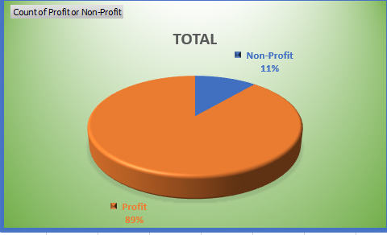
KPI2 : Profit Vs Non-Profit Stats
Observations :
This pie chart represents the distribution of dialysis stations based on Profit and Non-Profit stats.
A notable majority of the chart is shaded in orange (Profit), indicating that a significant proportion of the summation # Dialysis Stations in the dataset is associated with Profit facilities.
The blue portion (Non-Profit) is comparatively smaller, suggesting that Non-Profit facilities collectively contribute a smaller share to the summation of # dialysis stations.
Suggestions :
Ensure that the "ProfitorNonProfit" column has consistent and accurate values (e.g., "Profit" and "Non-Profit").
Validate the data in the "# Dialysis Stations" column to ensure it contains numeric
values and reflects the expected number of dialysis stations for each facility.
Conclusions:
The main conclusion that can be drawn from the above KPI is it basically represents the Profit Vs Non-Profit Stats of various organizations which is present in the data set.

Slide 10
KPI3 : Chain Organizations w.r.t. Total Performance Score as No Score
Observations :
According to the above given KPI the maximum value being 163755 which is represented by Davita while the minimum value being 12 represented by Physicians Choice Dialysis. And the total Sum being 424181
Suggestions :
Improving a Key Performance Indicator (KPI) involves a targeted approach which involves Data Accuracy and Consistency, Benchmarking and Comparative Analysis.
Conclusions:
The main conclusion that can be drawn from the above KPI is it basically represents the Total Performance Score as No Score with respect to Chain organizations which is present in the data set.

Slide 11
KPI4 : Dialysis Stations Stats
Observations :
According to the above given KPI the total no. dialysis stations 135055. Highest no. of stations are in the state CA and lowest are in state of AS.
Suggestions :
Improving a Key Performance Indicator (KPI) involves a targeted approach which involves Data Accuracy and Consistency,Technology Integration, and Process Optimization.
Conclusions:
The main conclusion that can be drawn from the above KPI gives pictorial representation of the Dialysis Station Stats.

Slide 12
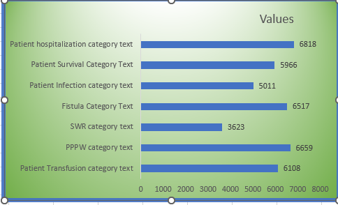
KPI5 : # of Category Text - As Expected
Observations :
The "Patient Infection" category has the highest count among all the categories.
"SWR" categories have relatively lower counts compared to others.
The total sum of number of Category text as excepted is 47416.
Suggestions :
Consider looking into the "Grand Total" to get an overall perspective on the distribution of the "As Expected" condition across all categories.
Conclusions:
The main conclusion that can be drawn from the above KPI is it basically represents the Number of Category Text As Excepted.
The "Grand Total" provides an overview of the total count of occurrences under the "As Expected" condition, giving a comprehensive view of the dataset.

Slide 13
KPI6 : Average Payment Reduction Rate
Observations :
According to the above given KPI the Average payment reduction rate is 0.81 which is being represented pictorially by the above Bar chart.
Suggestions :
Suggestions :
Improving a Key Performance Indicator (KPI) involves a targeted approach which involves Data Accuracy and Consistency,Technology Integration, and Process Optimization.
Conclusions:
The main conclusion that can be drawn from the above KPI is it basically represents the Average Payment Reduction Rate.

Slide 14

Sql Analysis

Slide 15
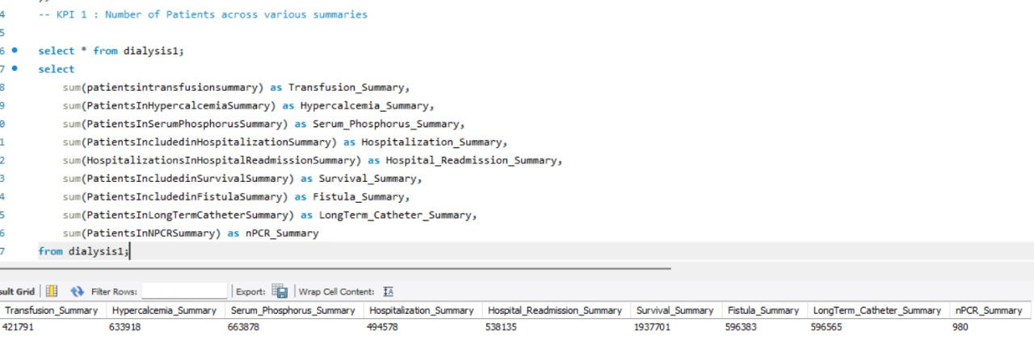
KPI - 1 Number of Patients across various summaries

Slide 16
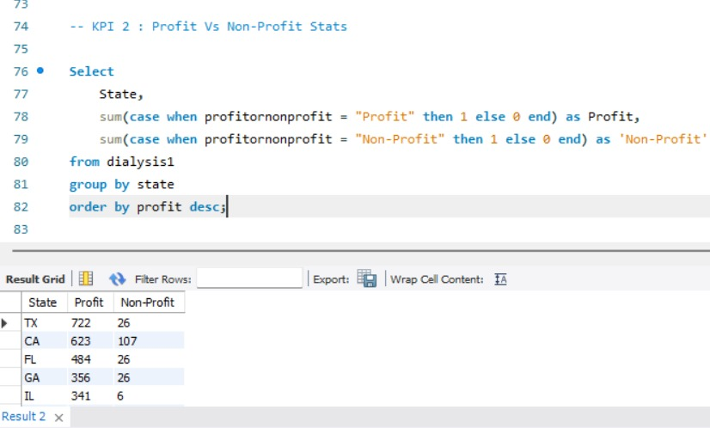
KPI - 2 Profit Vs Non-Profit Stats

Slide 17
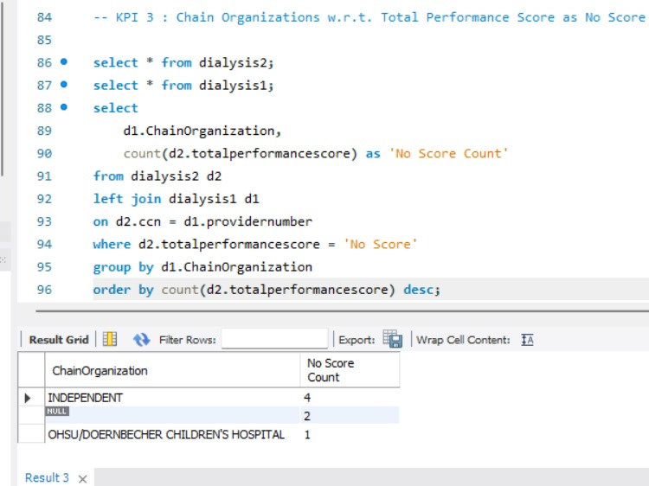
KPI - 3 Top 3 Chain Organizations in terms of number of dialysis stations

Slide 18
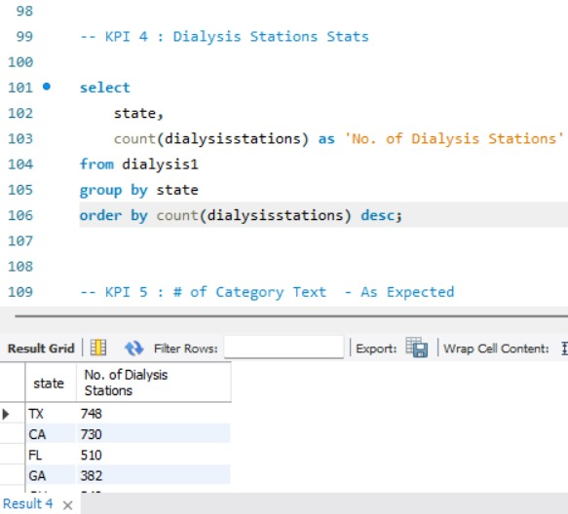
KPI - 4 Dialysis Stations Stats

Slide 19
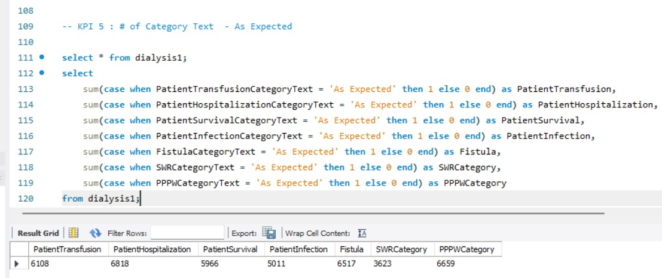
KPI - 5 # of Category Text - As Expected

Slide 20
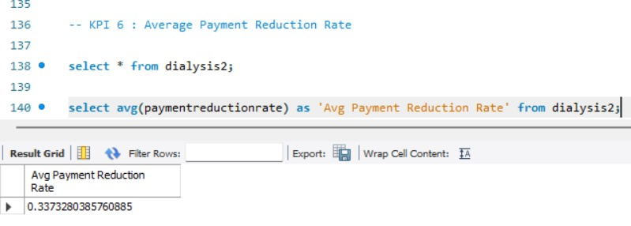
KPI - 6 Average Payment Reduction Rate for 2020

Slide 21
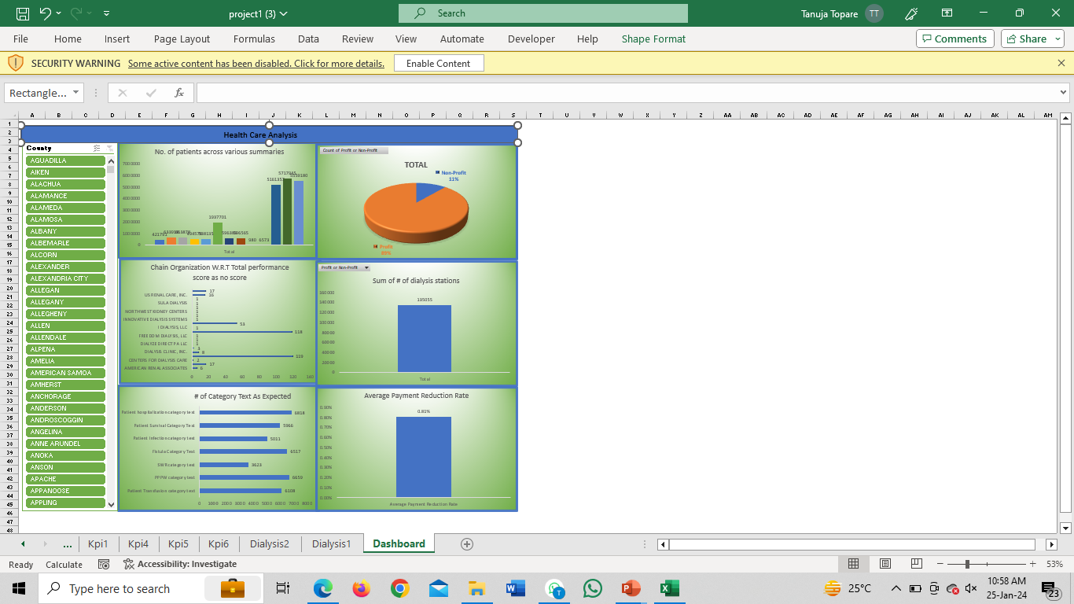
Overview
By using an excel dashboard dialysis healthcare analytics can be visually presented in user-friendly and interactive manner.
It facilitates effective data analysis, provides actionable insights,and empowers healthcare providers to make informed decisions to make informed decisions to optimize dialysis care delivery and improve patient outcomes.
EXCEL DASBOARD

Slide 22
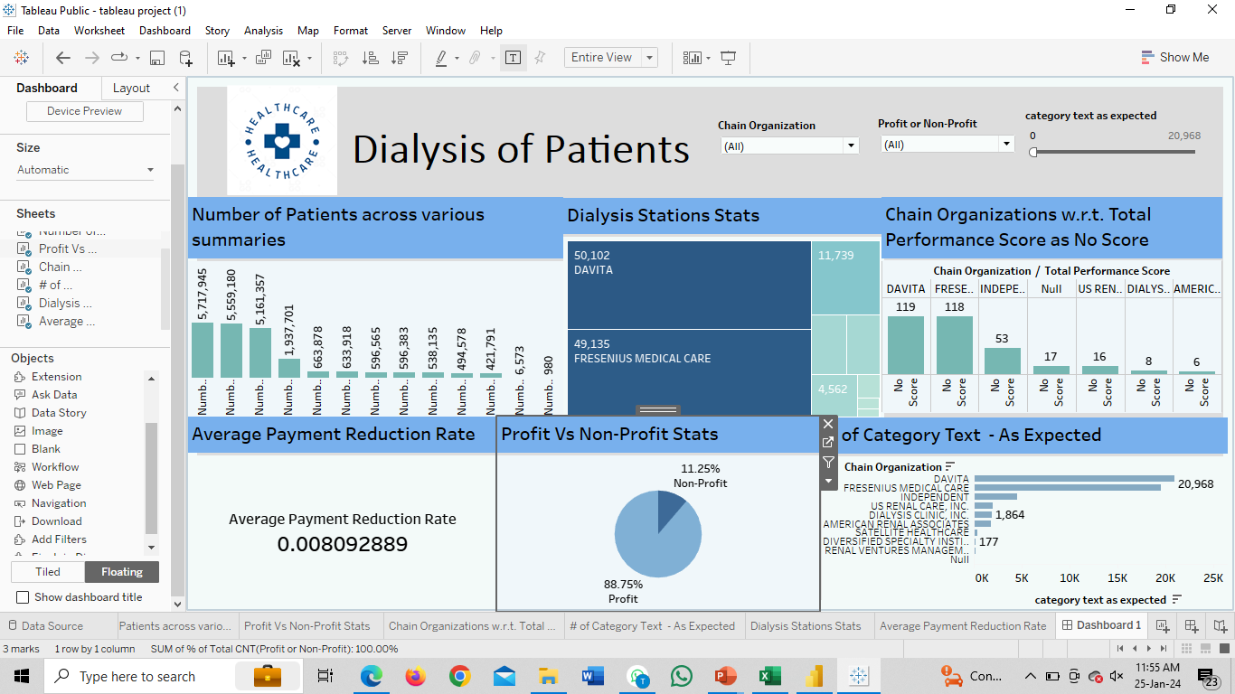
TABLEAU DASBOARD
OVERVIEW:
Overall, the dialysis healthcare analytics dashboard in tableau provides a comprehensive and intuitive platform for healthcare provides analyze and monitor key kpis in the dialysis care sector
It facilitates data-driven decision-making, optimization of care delivery, improvement of operational efficiency, and ultimately, better patient outcomes.

Slide 23
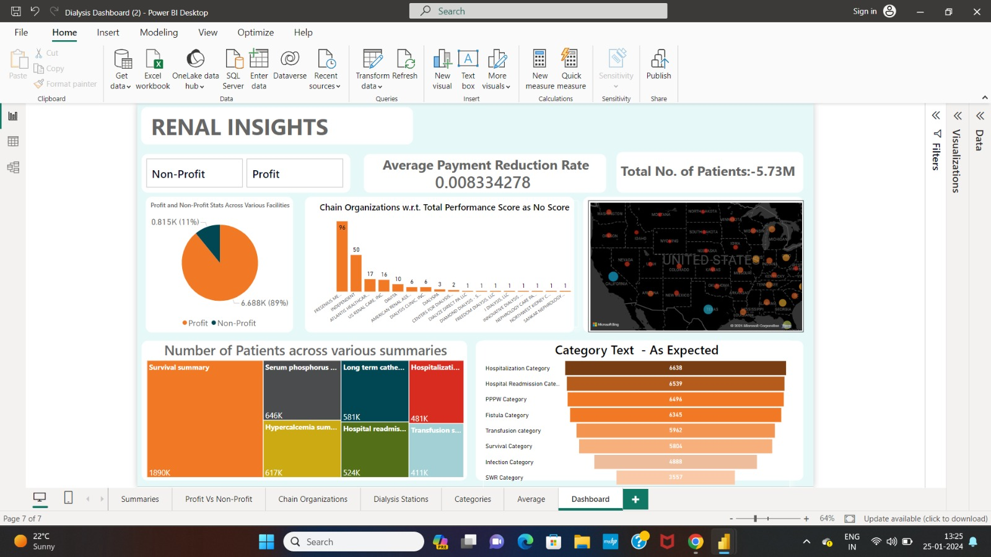
POWER BI DASBOARD
Overview
Overall, the dialysis healthcare analytics dashboard in powerbi provides healthcare providers with a comprehensive view of key metrics and trends in the dialysis care sector.
By leveraging the interactive capabilities of powerbi stakeholders can make data driven decisions, optimize care delivery, improve operational efficiency, and enhance patient outcomes.

Slide 24


THANK YOU

