Slide 1

Algorithms 2025

Slide 2
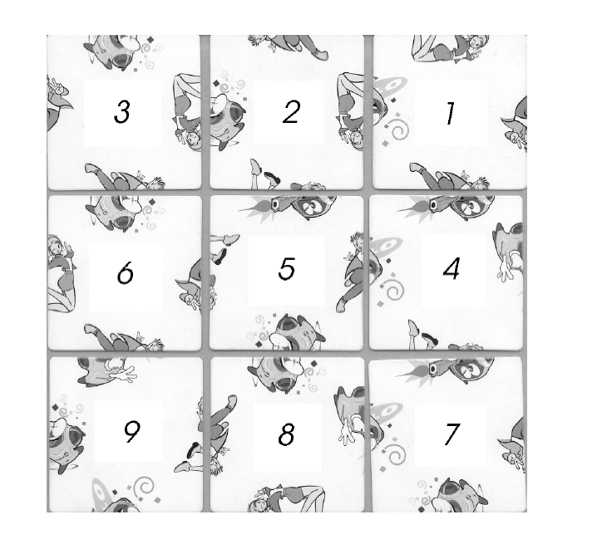
3x3 Puzzle #1

Slide 3

0
1
2
3
4
5
6
7
8

Slide 4
3x3 Puzzle #1

Slide 5
3x3 Puzzle #1

Slide 6
3x3 Puzzle #1

Slide 7
3x3 Puzzle #1

Slide 8
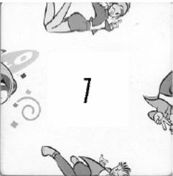
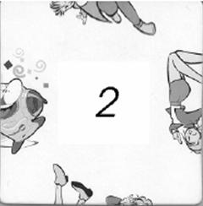
Example Match #1

Slide 9
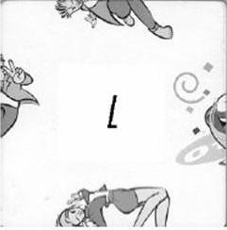
Example Match #2

Slide 10

0
1
2
3
4
5
6
7
8

Slide 11

3x3 Puzzle #3

Slide 12

3x3 Puzzle #4

Slide 13
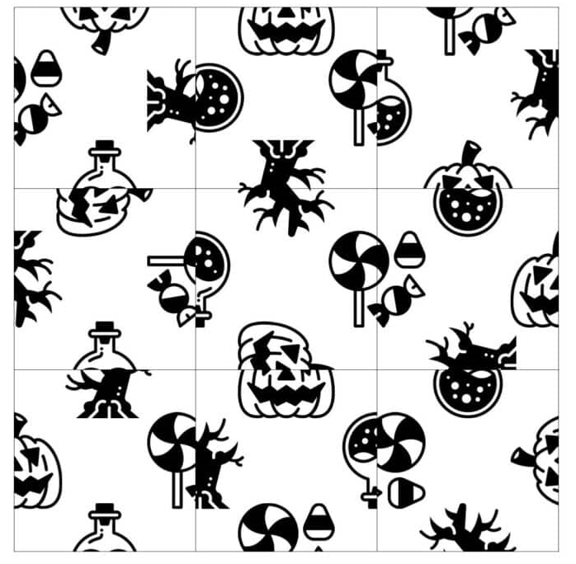


3x3 Puzzle #5

Slide 14
Homework #3
Solve these 5 puzzles through computer programming.
In computer programming, choose the input and output freely,
And present the final answer as a completed puzzle image suitable for inclusion in a report.
Hint: Backtracking!

Slide 15
Due Date
Submission date | Deduction rate
June 3 | 10%
June 4 | 20%
June 5 | 30%
June 6 | 40%
June 7 | 50%
June 8 | 60%
June 9 | 70%
June 10 | 100%
Soft deadline: June 2, 2025
Hard deadline: June 9, 2025
But, will be deducted 10% per one day from your original score

Slide 16
Notice (cont’d)
You should submit a compressed file (HW3_your-ID.zip) containing the following two files to the web-site (https://klas.kw.ac.kr).
HW3_your-ID.hwp/doc/pdf // report document
HW3_your-ID.cxx (or .java) // source code

Slide 17
Notice (cont’d)
Source code
It should be compiled in
C/C++ Language: Visual Studio 2010 or higher, or gcc/g++
Java Language: not restricted
You should note your environment in your report.
Your name and student ID should be noted at the top of your source files in the form of comment.
Report
Free format, but VERY IMPORTANT!
But, it must include several examples for testing your program and your own discussion.
It will be an important factor for getting a good score.
Mention your programming language together with compiler.

