Slide 1

Algorithms 2025

Slide 2
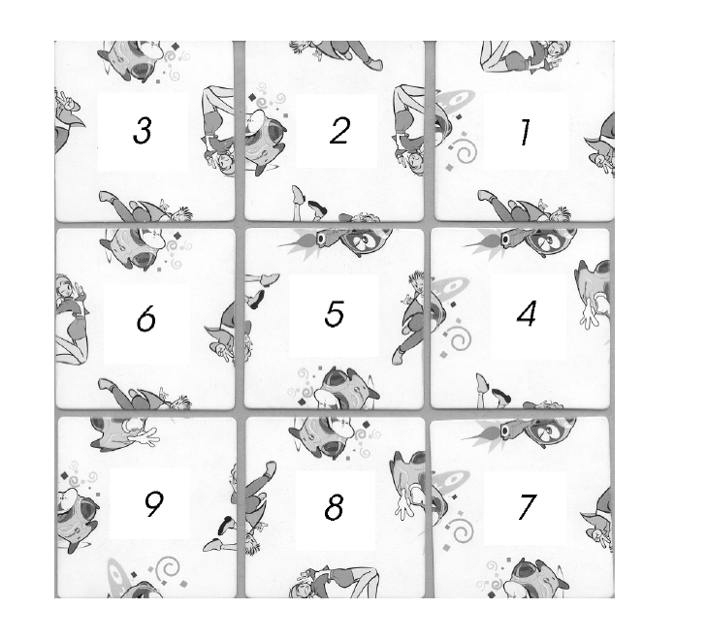
3x3 Puzzle #1

Slide 3
3x3 Puzzle #1

Slide 4
3x3 Puzzle #1

Slide 5
3x3 Puzzle #1

Slide 6
3x3 Puzzle #1

Slide 7
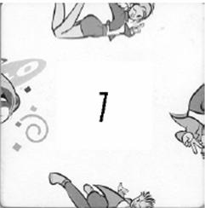
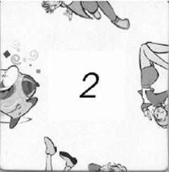
Example Match #1

Slide 8
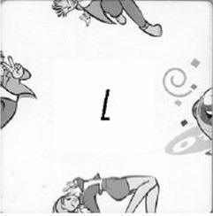
Example Match #2

Slide 9

3x3 Puzzle #2

Slide 10

3x3 Puzzle #3

Slide 11

3x3 Puzzle #4

Slide 12
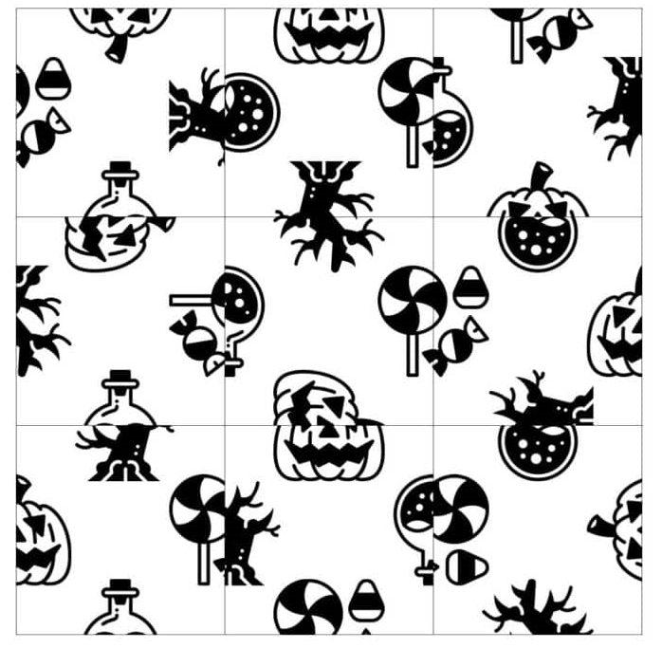
3x3 Puzzle #5

Slide 13
Homework #3
Solve these 5 puzzles through computer programming.
  In computer programming, choose the input and output freely,
  And present the final answer as a completed puzzle image suitable for inclusion in a report.
Hint: Backtracking!

Slide 14
Due Date
Soft deadline: June 2, 2025
Hard deadline: June 9, 2025
  But, will be deducted 10% per one day from your original score
Submission date | Deduction rate
June 3 | 10%
June 4 | 20%
June 5 | 30%
June 6 | 40%
June 7 | 50%
June 8 | 60%
June 9 | 70%
June 10 | 100%

Slide 15
Notice (cont’d)
You should submit a compressed file (HW3_your-ID.zip) containing the following two files to the web-site (https://klas.kw.ac.kr).
  HW3_your-ID.hwp/doc/pdf // report document
  HW3_your-ID.cxx (or .java) // source code

Slide 16
Notice (cont’d)
Source code
  It should be compiled in
    C/C++ Language: Visual Studio 2010 or higher, or gcc/g++
    Java Language: not restricted
    You should note your environment in your report.
  Your name and student ID should be noted at the top of your source files in the form of comment.
Report
  Free format, but VERY IMPORTANT!
  But, it must include several examples for testing your program and your own discussion.
  It will be an important factor for getting a good score.
  Mention your programming language together with compiler.

