Slide 1
0729 progress

Slide 2
Architecture with Autism, Savant Feature
How to Memorize
Like Hippocampus?
How to communication
Like Brain?
How to Overgrow Like Autism?

Slide 3
Prior research (Memorize, Comm)
CLS Theory
Dual Cognitive Architecture Incorporating Biases
and Multi-Memory Systems for Lifelong Learning

Slide 4
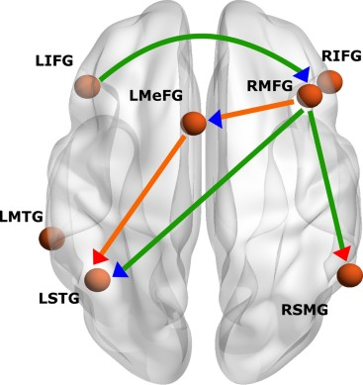
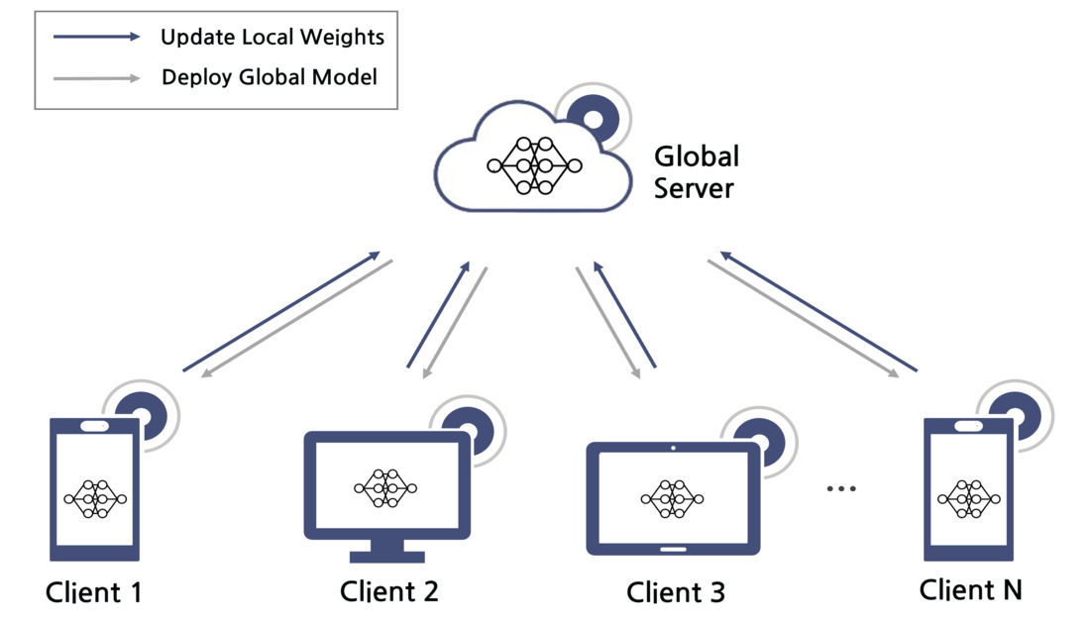
Architecture with Autism, Savant Feature
Model
Thus, structured and patterned codes serve as the core domain in which savant abilities most often emerge.

Slide 5
Prior research
Andrew Jaegle et al. 2021
Perceiver: General Perception with Iterative Attention
Model
Attention?
Code?

Slide 6
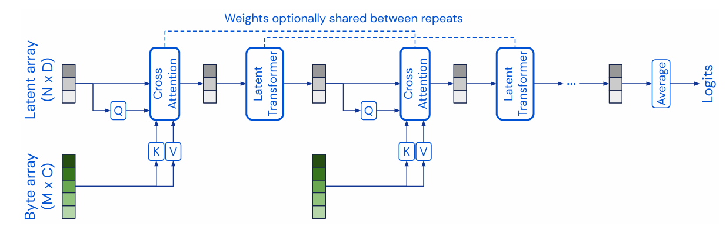
Prior research
Code?

Slide 7
Opinion
Prodigious memory
Music
Perfect pitch
Art
Drawing
Calendar
calculating
Mathematics
Prime number
Mechanical
spatial skills
1. The Default Setting of Autistic Perception is more Locally Oriented than that of Nonhautistics
Overfitting
6: Perceptual Expertise Underlies Savant Syndrome

Slide 8
Prior research (Overfit)
Machi Shimmei et al. 2023
Can’t Inflate Data? Let the Models Unite and Vote:
Data-agnostic Method to Avoid Overfit with Small Data
A situation with limited data
Overfit -> Over Memorize
Many Overfit Model -> Many analysis -> High Accuracy

Slide 9
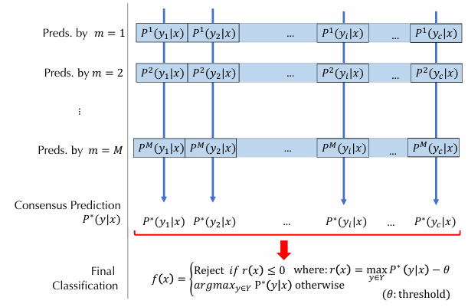
Prior research
Overfitted Model
Mean or Gaussian Mixture Model

Slide 10
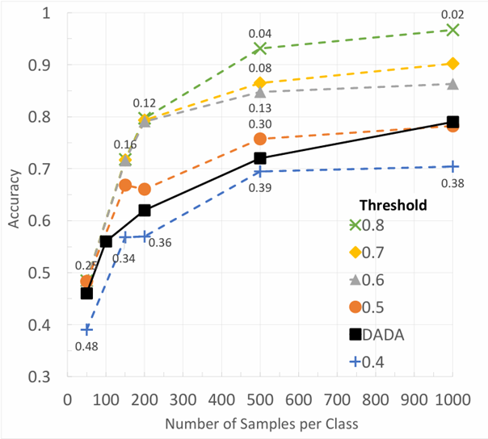
Prior research

Slide 11
Future considerations
Prodigious memory
Music
Perfect pitch
Art
Drawing
Calendar
calculating
Mathematics
Prime number
Mechanical
spatial skills
Savant
Human
Savant
Net
What kind of ability?

Slide 12
인간 인지구조 더 찾아보기
－＞ 모사 필요

