Slide 1
0722 progress

Slide 2
Intro
Darold A. Treffert 2009
The savant syndrome: an extraordinary condition. A synopsis: past, present, future

Slide 3
Definition?
Savant syndrome is a rare, but extraordinary, condition in which persons with serious mental disabilities, including autistic disorder, have some ‘island of genius’ which stands in marked, incongruous contrast to overall handicap

Slide 4
Symptoms
Prodigious memory
Music
Perfect pitch
Art
Drawing
Calendar
calculating
Mathematics
Prime number
Mechanical
spatial skills
The ability does not disappear

Slide 5
Who?
Autism
CNS injury
or disease
OR

Slide 6
Features
 | Autism | Non-Autism
Probability | 0.1 | 0.0014
 | Male | Female
Ratio | 6 | 1

Slide 7
Autism?
Autism is a severe neurobehavioral syndrome, arising largely
as an inherited disorder, which can arise from several diseases

Slide 8
Autism Feature
Laurent Mottron et al. 2006
Enhanced Perceptual Functioning in Autism: An Update, and Eight Principles of Autistic Perception

Slide 9
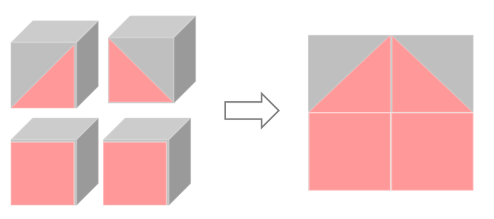
Autism Feature
1. The Default Setting of Autistic Perception is more Locally Oriented than that of Nonhautistics
2. Increased Gradient of Neural Complexity is Inversely Related to Level of
Performance in Low-Level Perceptual Tasks

Slide 10
Autism Feature
3. Early Atypical Behaviors have a Regulatory Function Toward Perceptual Input
4: Perceptual Primary and Associative Brain Regions are
Atypically Activated During Social and Non-Social Tasks
5: Higher-order Processing is Optional in Autism and Mandatory in Non-Autistics
6: Perceptual Expertise Underlies Savant Syndrome
7: High-Level Perceptual Abilities in Autism are a Function of Perceptual Expertise and Experience
8: Enhanced Perception Influences Neurodevelopment and Cognitive Development in Autism

Slide 11
Servant Feature
Laurent Mottron et al. 2009
Enhanced perception in savant syndrome: patterns, structure and creativity

Slide 12
Laurent Mottron
Servant Data
music
graphic code
numeration
Music
Perfect pitch
hyperlexia
Calendar
calculating
Mathematics
Prime number

Slide 13
Laurent Mottron
Human codes (e.g., letters, numbers, music) are characterized by
repetition, structure, and recognizable patterns. → In the paper, this is referred to as phenomenal redundancy.
Autistic perceptual mechanisms are highly sensitive to such
structured and recurring patterns. → They can rapidly detect, analyze, and internalize these patterns.
As a result, autistic individuals develop strong interests in these highly patterned codes. → This leads to intense focus or the emergence of specialized abilities,
especially in domains such as language, numbers, or music.
Thus, structured and patterned codes serve as the core domain in which savant abilities most often emerge.

Slide 14
Laurent Mottron
mapping
absolute pitch
pitch labels
keyboard locations
calendar
calculation
dates
days of the week
prime number
series of
numbers
factor composition
Pattern recognition is the process of learning mappings.

Slide 15
Causes of Autism
Marcel Adam Just et al. 2004
Cortical activation and synchronization during sentence comprehension
in high-functioning autism: evidence of underconnectivity

Slide 16
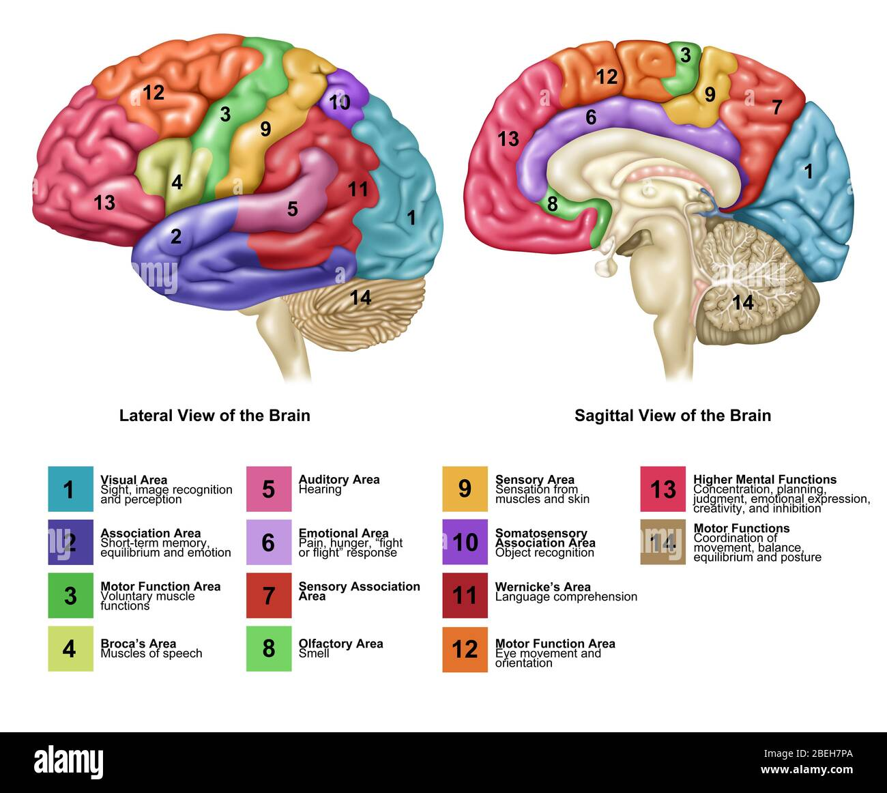
Thinking?

Slide 17
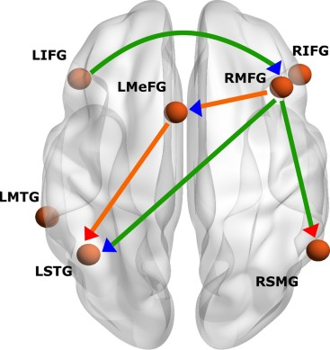
Marcel Adam
integrating(context) processes
word-processing ability

Slide 18
Task and Hypothesis
Task Example
The cook thanked the father. Who was thanked? cook – father
Autism
cognitive tasks
(sentence
comprehension task)
LESS
integrating processes
MORE
word-processing ability
cerebral cortex
synchronization
LESS
broka
MORE
wernike

Slide 19
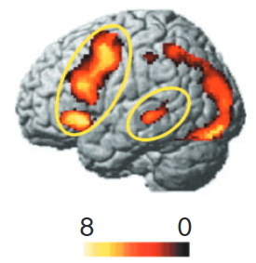
Research Methods
fMRI can detect
changes
in oxygenation.
Brain Activation
need
Oxygen
Comparision

Slide 20
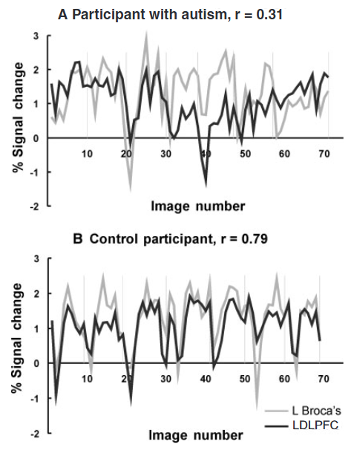
Research Methods
fMRI
signal

Slide 21
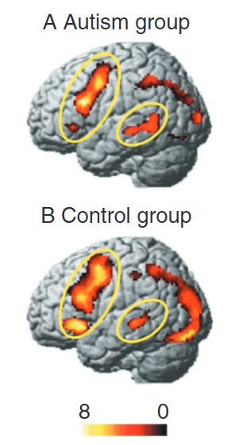
Result
occipito
parietal
LIFG
LSTG

Slide 22
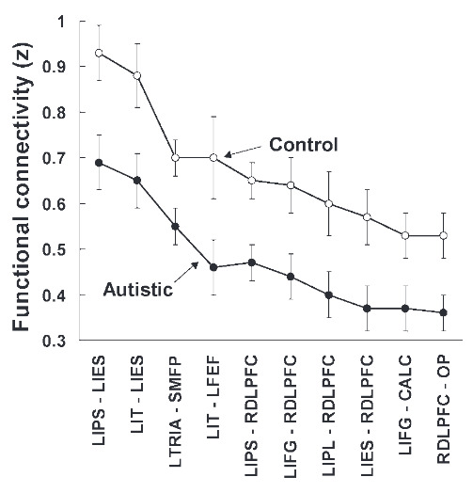
Result
Reduced functional connectivity

Slide 23
Result
Participants with autism allocate more cognitive resources to processing the meanings of individual words within a sentence.
LESS LIFG
They have difficulty integrating the meaning
of complex sentences
1. The Default Setting of Autistic Perception is more Locally Oriented than that of Nonhautistics
5: Higher-order Processing is Optional in Autism
and Mandatory in Non-Autistics

Slide 24
author's proposal
NORMAL OR OVERDEVELOPMENT
cortical centres
LESS
integrative processing at higher levels
underconnectivity theory

Slide 25
underconnectivity theory
Task need
high-level integrative processing
underfunctioning of integrative circuitry
Deficit in integration of information
cognitive deficit

Slide 26
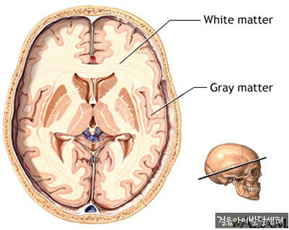
underconnectivity theory
role : long-distance connections
overgrowth in Autism
Decreased efficiency and accuracy of
inter-regional neural communication

Slide 27
underconnectivity theory
Microstructural abnormalities have been reported
Atypical early brain development
Minicolumnar overpacking or abnormal arrangement may limit information distribution and integration pathways
Children with autism exhibit abnormal brain growth patterns within the first two years of life.
Total brain volume increases rapidly (Courchesne, 2004), followed by a plateau or deceleration.
Interregional processing is negatively affected
This atypical trajectory may disrupt normal synaptic pruning and network alignment, ultimately impairing connectivity optimization.

Slide 28
Causes of Savant syndrome
Allan Snyder 2009
Explaining and inducing savant skills: privileged access to lower level, less-processed information

Slide 29
Allan Snyder
Savant abilities suddenly emerged
SAVANT SKILLS LATENT IN EVERYONE
Acquired emergence due to CNS injury or disease
INDUCING SAVANT SKILLS ARTIFICIALLY

Slide 30
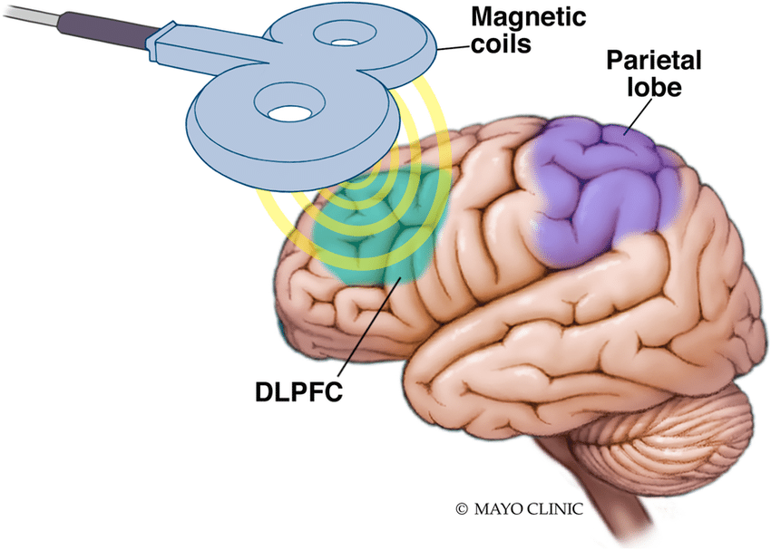
Allan Snyder
High Level Process
rTMS
Low Level Process

Slide 31
Allan Snyder
Induced drawing skills :
Subjects reported enhanced perception of environmental details after stimulation.
rTMS
Induced proofreading skills :
Induced numerosity :
Some autistic savants have the ability to accurately count large numbers of objects.
Stored with minimal subjective processing by the brain
(e.g., emotion, expectation, interpretation) of an objective event or action."

Slide 32
Allan Snyder
Savant abilities are latently present and can be induced
Savant abilities may arise from privileged access to raw, less-processed sensory information
normally inaccessible to conscious awareness due to top-down inhibition, despite being present in all brains.

Slide 33
Savant-Inspired Architecture
Renzo Massobrio 2021
Learning for Optimization with Virtual Savant

Slide 34
Virtual Savant - Inspiration
Human codes (e.g., letters, numbers, music) are characterized by
repetition, structure, and recognizable patterns. → In the paper, this is referred to as phenomenal redundancy.
Autistic perceptual mechanisms are highly sensitive to such
structured and recurring patterns. → They can rapidly detect, analyze, and internalize these patterns.
As a result, autistic individuals develop strong interests in these highly patterned codes. → This leads to intense focus or the emergence of specialized abilities,
especially in domains such as language, numbers, or music.
Thus, structured and patterned codes serve as the core domain in which savant abilities most often emerge.

Slide 35
Virtual Savant - Inspiration
mapping
absolute pitch
pitch labels
keyboard locations
calendar
calculation
dates
days of the week
prime number
series of
numbers
factor composition
Pattern recognition is the process of learning mappings.

Slide 36
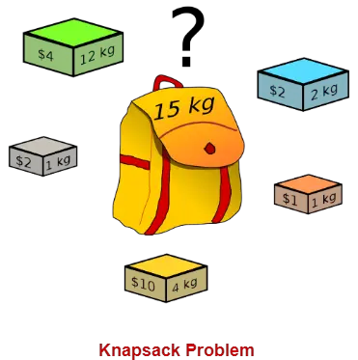
Problem
Combinatorial Optimization
12kg | 2kg | 1kg | 1kg | 4kg
4 | 2 | 1 | 2 | 10
0 | 1 | 1 | 1 | 1
Human codes (e.g., letters, numbers, music) are characterized by
repetition, structure, and recognizable patterns.

Slide 37
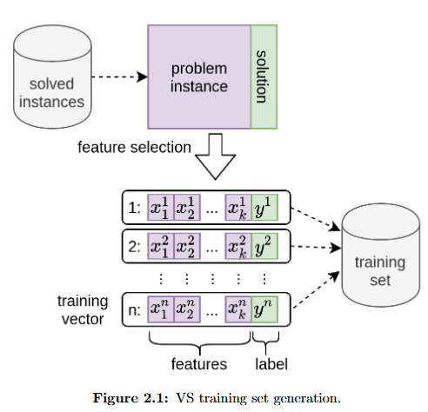
Virtual Savant
Item1 weight | Item1 profit | Bag Limit | Label(0,1)
Item2 weight | Item2 profit | Bag Limit | Label(0,1)
Pattern
Item3 weight | Item3 profit | Bag Limit | Label(0,1)

Slide 38
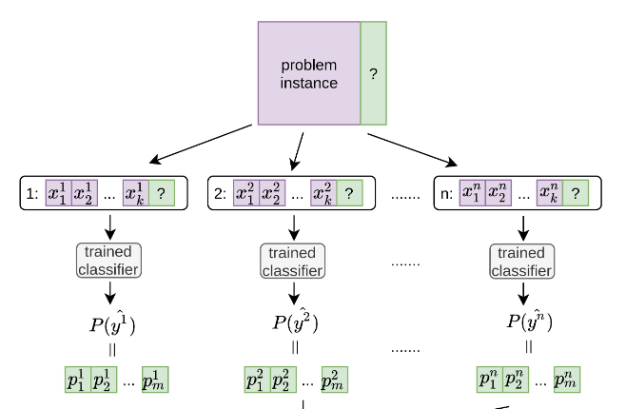
train and inference
Same Model

Slide 39
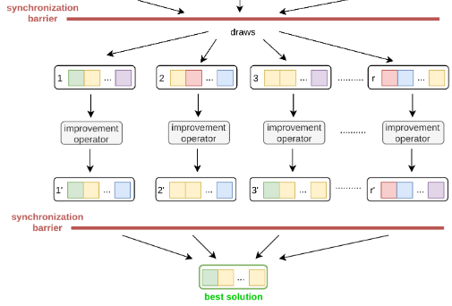
train and inference

Slide 40
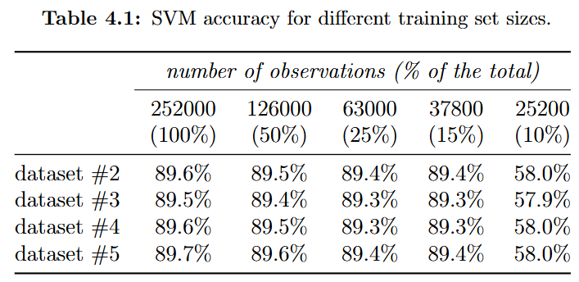
Accuracy
The solutions computed by the VS version implementing this greedy mechanism were within 1% from the optima in all studied instances.

Slide 41
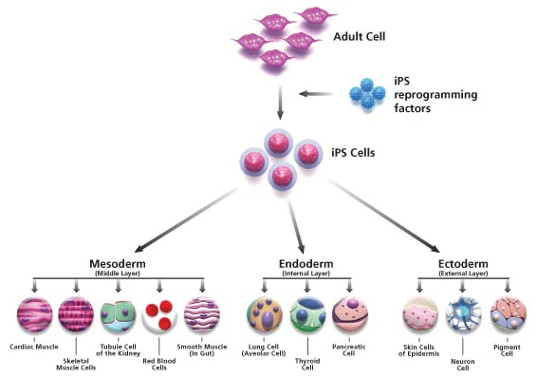
Related Studies
Jinjing Song et al.
Dysregulation of neuron differentiation
in an autistic savant with exceptional memory (2019)

Slide 42
Jinjing Song
Autism Savant
iPSc
neuron
analysis
normal

Slide 43
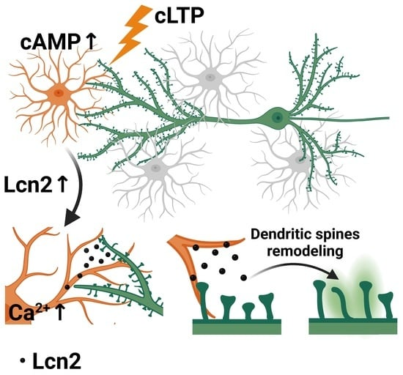
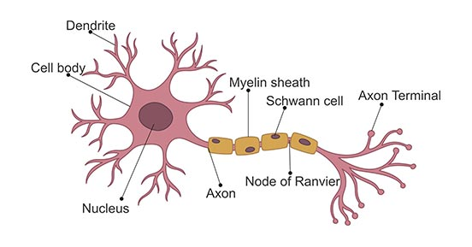
Jinjing Song

Slide 44
Jinjing Song
Autism Savant Cell
hypertrophic neural somas
enlarged dendritic spines
reduced spine density
LESS synaptic inhibition
No functional interpretation is provided
increased firing probability

Slide 45
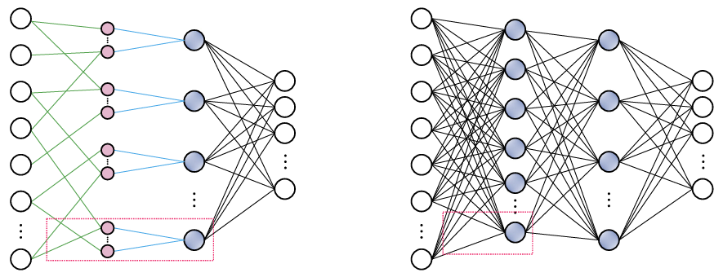
Architecture with Autism, Savant Feature
Spyridon Chavlis et al.
Dendrites endow artificial neural networks with accurate, robust and parameter efficient learning (2024)
Autism Savant Cell
hypertrophic neural somas
enlarged dendritic spines
reduced spine density

Slide 46
Architecture with Autism, Savant Feature
How to Memorize
Like Hippocampus?
How to communication
Like Brain?
How to Overgrow Like Autism?

Slide 47
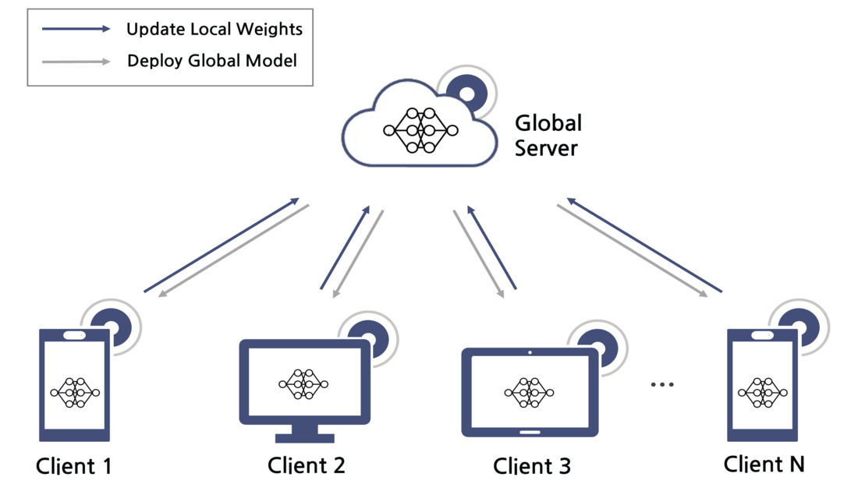
Architecture with Autism, Savant Feature
Model
Thus, structured and patterned codes serve as the core domain in which savant abilities most often emerge.

