Slide 1
0722 progress

Slide 2
인용 용 텍스트 들
Marcel Adam Just et al. 2004
Cortical activation and synchronization during sentence comprehension
in high-functioning autism: evidence of underconnectivity
[]
Laurent Mottron et al. 2009
Enhanced perception in savant syndrome: patterns, structure and creativity
[]
Renzo Massobrio 2021
Learning for Optimization with Virtual Savant
[]
Allan Snyder 2009
Explaining and inducing savant skills: privileged access to lower level, less-processed information
[]
Darold A. Treffert 2009
The savant syndrome: an extraordinary condition. A synopsis: past, present, future
[]
Kielan Yarrow et al. 2009
Inside the brain of an elite athlete: the neural processes that support high achievement in sport
[]
Laurent Mottron et al. 2006
Enhanced Perceptual Functioning in Autism: An Update, and Eight Principles of Autistic Perception
[]
J. L. R. Rubenstein et al. 2003
Model of autism: increased ratio of excitation/inhibition
in key neural systems
[]

Slide 3
Definition?
Savant syndrome is a rare, but extraordinary, condition in which persons with serious mental disabilities, including autistic disorder, have some ‘island of genius’ which stands in marked, incongruous contrast to overall handicap [1]
Darold A. Treffert 2009
The savant syndrome: an extraordinary condition. A synopsis: past, present, future
[1] : p1

Slide 4
Symptoms
Prodigious memory
Music
Perfect pitch
Art
Drawing
Calendar
calculating
Mathematics
Prime number
Mechanical
spatial skills
[1]
The ability does not disappear
[2]
Darold A. Treffert 2009
The savant syndrome: an extraordinary condition. A synopsis: past, present, future
[1] : p3 / [2]: p4

Slide 5
Who?
Autism
CNS injury
or disease
OR
[1]
Darold A. Treffert 2009
The savant syndrome: an extraordinary condition. A synopsis: past, present, future
[1] : p2

Slide 6
Features
 | Autism | Non-Autism
Probability | 0.1 | 0.0014
[1]
 | Male | Female
Ratio | 6 | 1
Darold A. Treffert 2009
The savant syndrome: an extraordinary condition. A synopsis: past, present, future
[1] : p2

Slide 7
Autism?
Autism is a severe neurobehavioral syndrome, arising largely
as an inherited disorder, which can arise from several diseases
[1]
J. L. R. Rubenstein et al. 2003
Model of autism: increased ratio of excitation/inhibition
in key neural systems
[1] : p1

Slide 8
Autism Feature
Enhanced Perceptual Functioning in Autism:
An Update, and Eight Principles of Autistic Perception

Slide 9
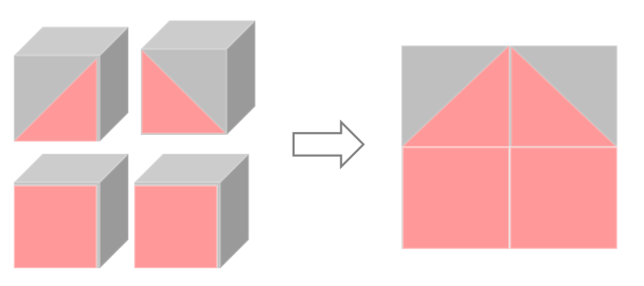
Autism Feature
1. The Default Setting of Autistic Perception is more Locally Oriented than that of Nonhautistics

Slide 10
Autism Feature
2. Increased Gradient of Neural Complexity is Inversely Related to Level of
Performance in Low-Level Perceptual Tasks
3. Early Atypical Behaviors have a Regulatory Function Toward Perceptual Input
4: Perceptual Primary and Associative Brain Regions are
Atypically Activated During Social and Non-Social Tasks
5: Higher-order Processing is Optional in Autism and Mandatory in Non-Autistics
6: Perceptual Expertise Underlies Savant Syndrome
7: High-Level Perceptual Abilities in Autism are a Function of Perceptual Expertise and Experience
8: Enhanced Perception Influences Neurodevelopment and Cognitive Development in Autism

Slide 11
Causes of Autism
Marcel Adam Just et al. 2004
Cortical activation and synchronization during sentence comprehension
in high-functioning autism: evidence of underconnectivity
[]
J. L. R. Rubenstein et al. 2003
Model of autism: increased ratio of excitation/inhibition
in key neural systems
[]

Slide 12
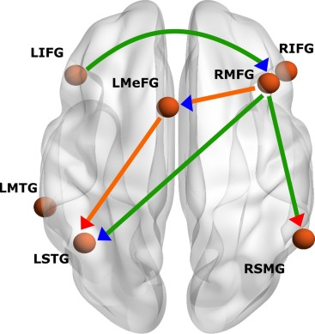
Marcel Adam
integrating(context) processes
word-processing ability

Slide 13
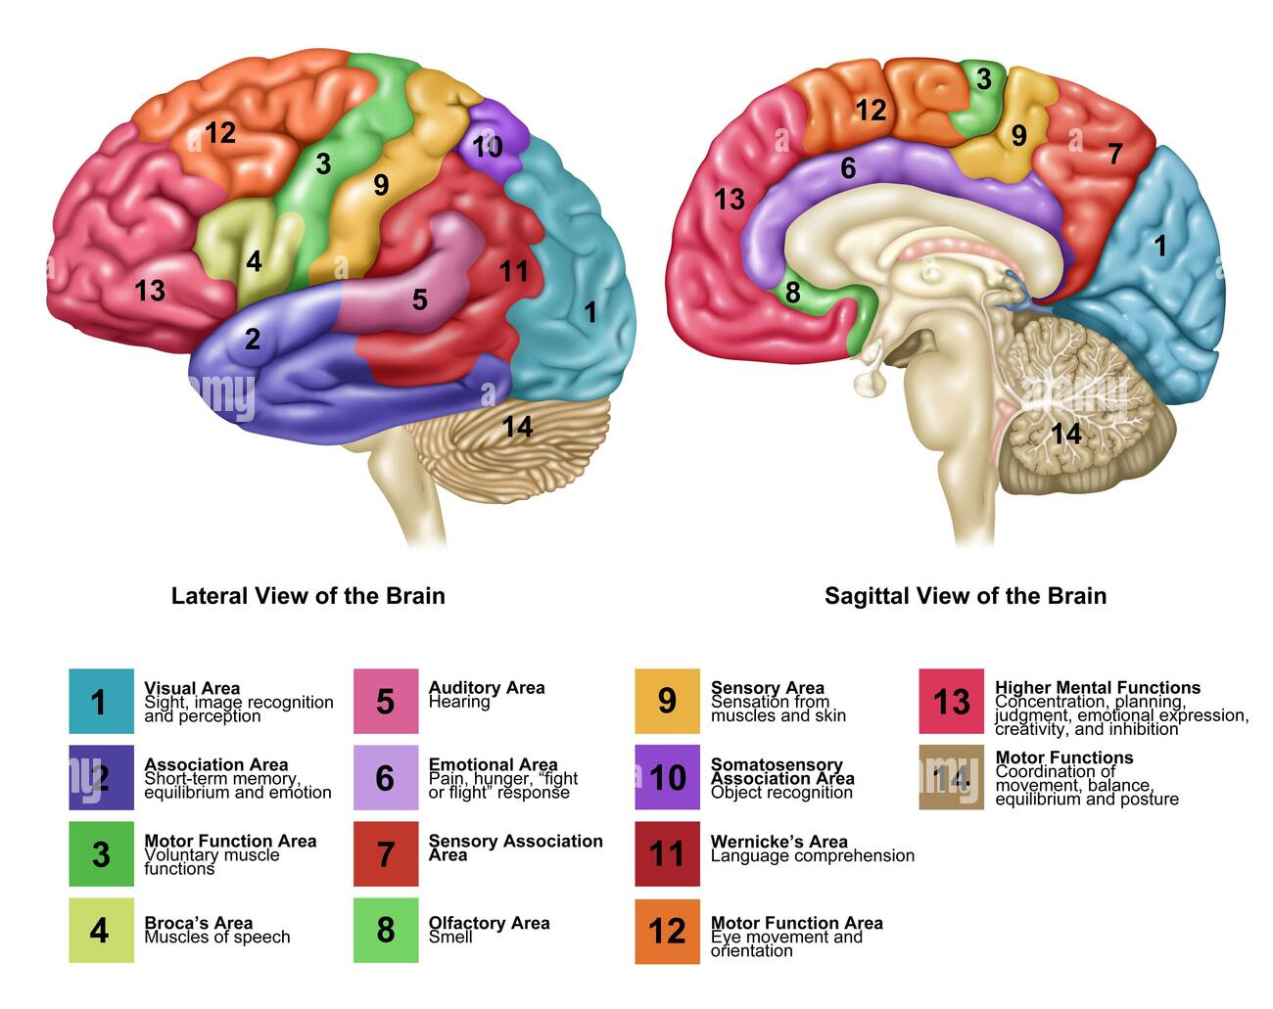
Thinking?

Slide 14
Task and Hypothesis
Task Example
The cook thanked the father. Who was thanked? cook – father
Autism
cognitive tasks
(sentence
comprehension task)
LESS
integrating processes
LESS
word-processing ability
cerebral cortex
synchronization
LESS
broka
LESS
wernike

Slide 15
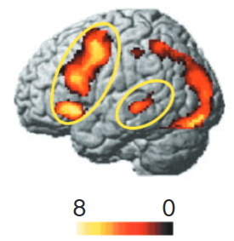
Research Methods
fMRI can detect
changes
in oxygenation.
Brain Activation
need
Oxygen
Comparision

Slide 16
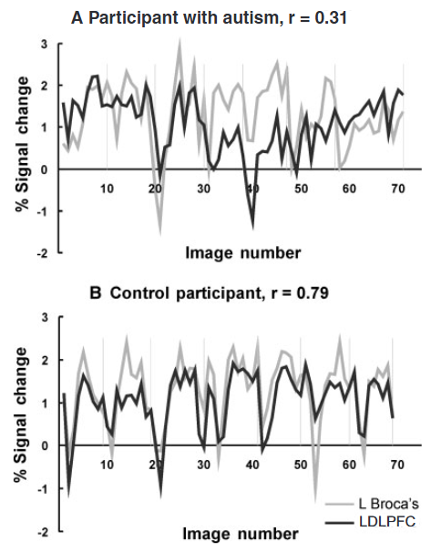
Research Methods
fMRI
signal

Slide 17
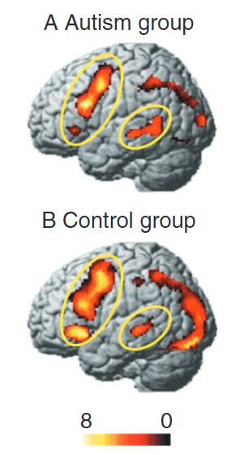
Result
occipito
parietal
LIFG
LSTG

Slide 18
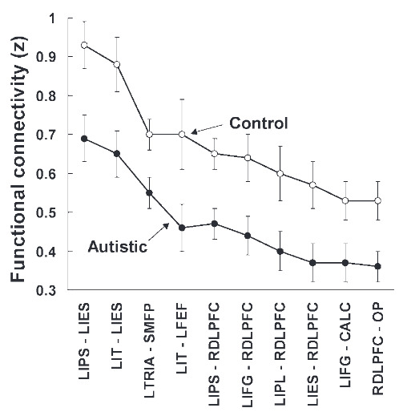
Result
Reduced functional connectivity

Slide 19
Result
Participants with autism allocate more cognitive resources to processing the meanings of individual words within a sentence.
LESS LIFG
They have difficulty integrating the meaning
of complex sentences
1. The Default Setting of Autistic Perception is more Locally Oriented than that of Nonhautistics
5: Higher-order Processing is Optional in Autism
and Mandatory in Non-Autistics

Slide 20
author's proposal
NORMAL OR OVERDEVELOPMENT
cortical centres
LESS
integrative processing at higher levels
underconnectivity theory

Slide 21
underconnectivity theory
Task need
high-level integrative processing
underfunctioning of integrative circuitry
Deficit in integration of information
cognitive deficit

Slide 22
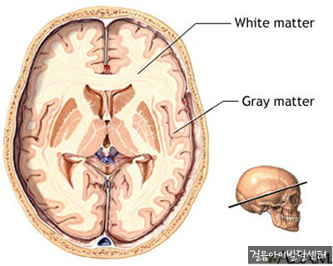
underconnectivity theory
role : long-distance connections
overgrowth in Autism
Decreased efficiency and accuracy of
inter-regional neural communication

Slide 23
underconnectivity theory
Microstructural abnormalities have been reported
Atypical early brain development
Minicolumnar overpacking or abnormal arrangement may limit information distribution and integration pathways
Children with autism exhibit abnormal brain growth patterns within the first two years of life.
Total brain volume increases rapidly (Courchesne, 2004), followed by a plateau or deceleration.
Interregional processing is negatively affected
This atypical trajectory may disrupt normal synaptic pruning and network alignment, ultimately impairing connectivity optimization.

Slide 24
J. L. R. Rubenstein

Slide 25
Causes of Savant syndrome
Laurent Mottron et al. 2009
Enhanced perception in savant syndrome: patterns, structure and creativity
[]
Allan Snyder 2009
Explaining and inducing savant skills: privileged access to lower level, less-processed information
[]

Slide 26
Laurent Mottron

Slide 27
Laurent Mottron

Slide 28
Laurent Mottron

Slide 29
Laurent Mottron

Slide 30
Laurent Mottron

Slide 31
Laurent Mottron

Slide 32
Laurent Mottron

Slide 33
Laurent Mottron

Slide 34
Why Does It Occur?

Slide 35
Savant-Inspired Architecture

Slide 36
Virtual Savant

Slide 37
Related Studies

