Slide 1
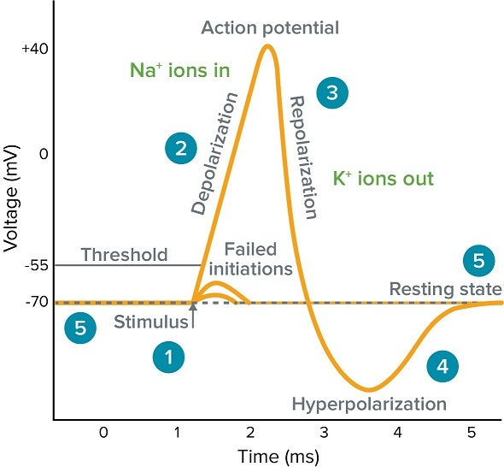
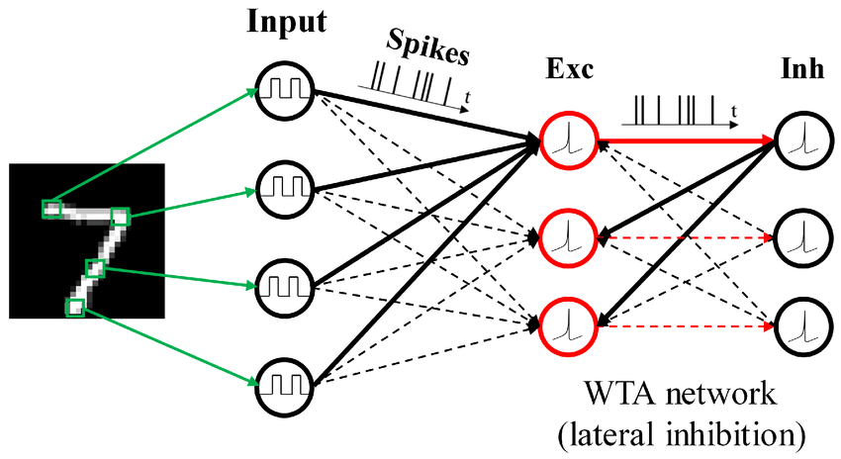
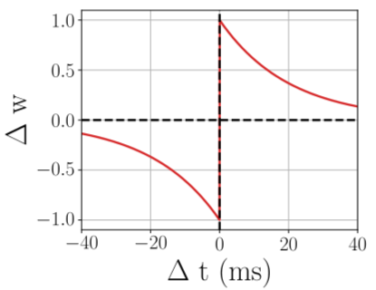
2020203090 한용옥
Method
Weight-space MDP formulation
On-policy PPO with clipped objective
Gaussian Actor–Critic (shared synaptic policy)
Main Loop per Img
snn simulate
collect spike event
observation action / critic
update weight
observation reward
ppo update using 3,5
ENV
Reward
How are synapses
in our brain updated?
AGENT
action
(continous)
state
Perpose
To verify whether synaptic update policies that can solve a given task
well can in fact be learned, by using global rewards generated
from local information and synaptic policies.
To compare how such learned synaptic policies differ from traditional
STDP rules in terms of their update patterns and functional properties.
STDP

Slide 2
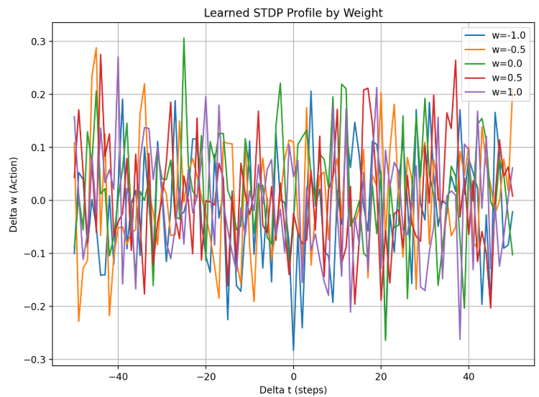
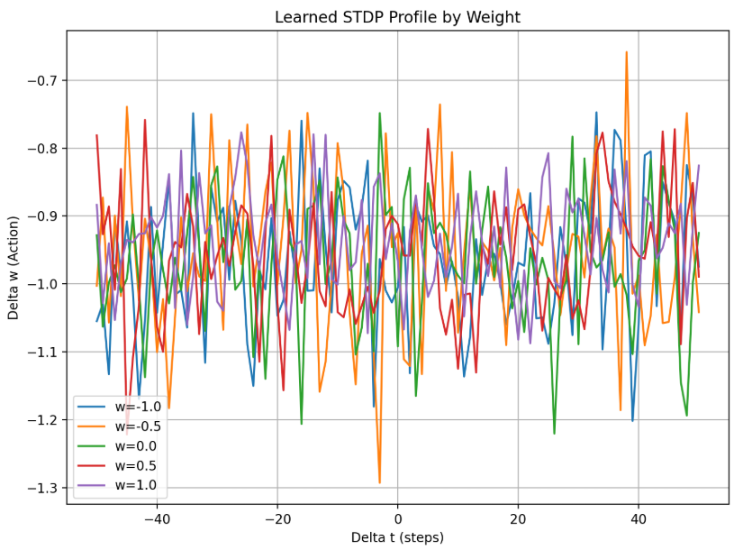
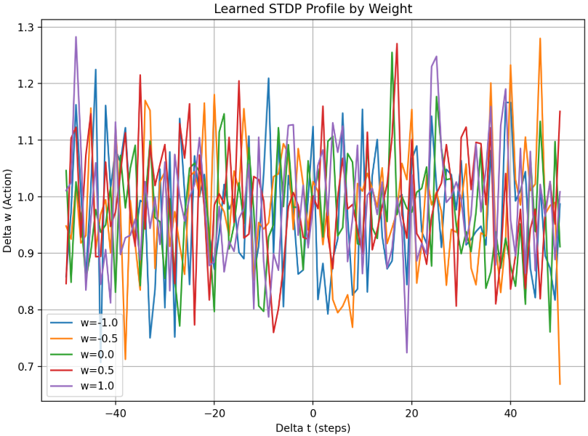
Result
It failed to learn meaningful behaviors across all scenarios and effectively collapsed into a noise-like policy.
Test Accu : 0.098
Test Accu : 0.098
Test Accu : 0.098
Limitation
Because the global reward was only defined at the episode/batch level, it was very hard to tell which synaptic events actually contributed to performance, leading to a severe credit assignment problem.
Since all selected events were given the same return, the policy gradient estimates had very high variance and the learning signal was effectively close to noise.
The on-policy PPO setup (no replay) made sample efficiency low, and within the limited number of episodes the policy could not converge to a meaningful solution.
SNN simulation and PPO updates were computationally expensive, so GPU memory and compute limits prevented sufficiently long training runs and forced us to cap the number of events per image, repeatedly discarding potentially important events.
The hyperparameter space (reward weights, PPO settings, simulation length, etc.) is large and sensitive, but resource and time constraints prevented adequate tuning.
As a result, across multiple scenarios the learned policies failed to acquire meaningful behaviors and effectively collapsed into noise-like policies.

