Slide 1
pFedMoE: Data-Level Personalization with Mixture of Experts for Model-Heterogeneous Personalized Federated Learning

Slide 2
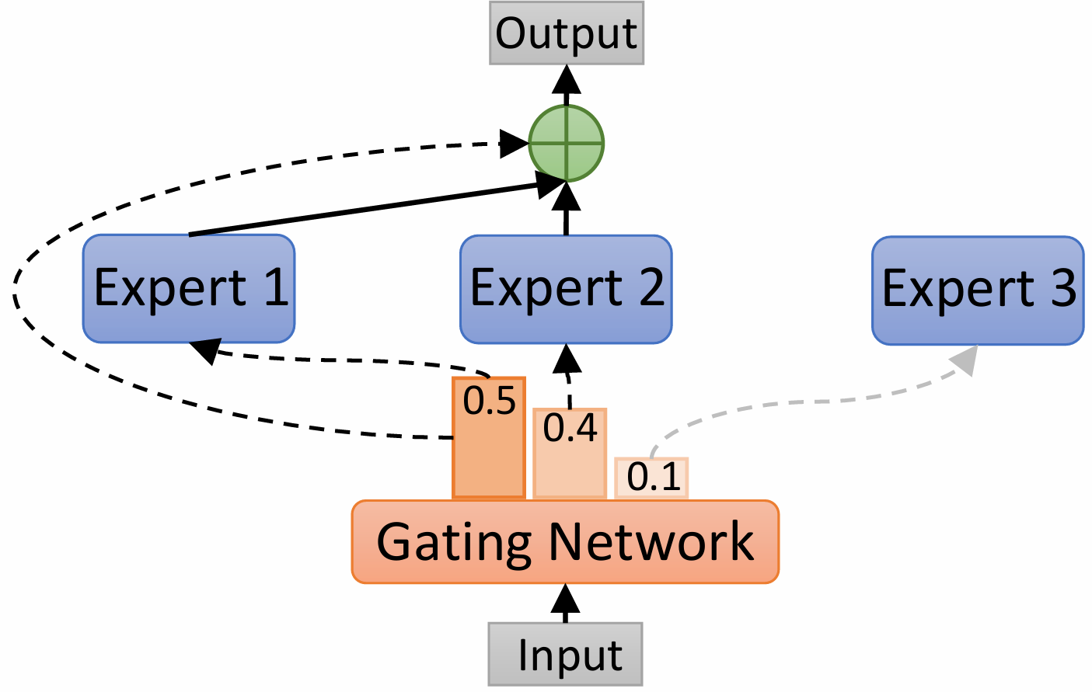
MoE?

Slide 3
FL?

Slide 4
Challenges in FL
-> heterogeneity!

Slide 5
Related Work
-> Model-Heterogeneous Personalized FL

Slide 6
Challenges in MHPFL

Slide 7
The Problem the Author Aimed to Solve

Slide 8
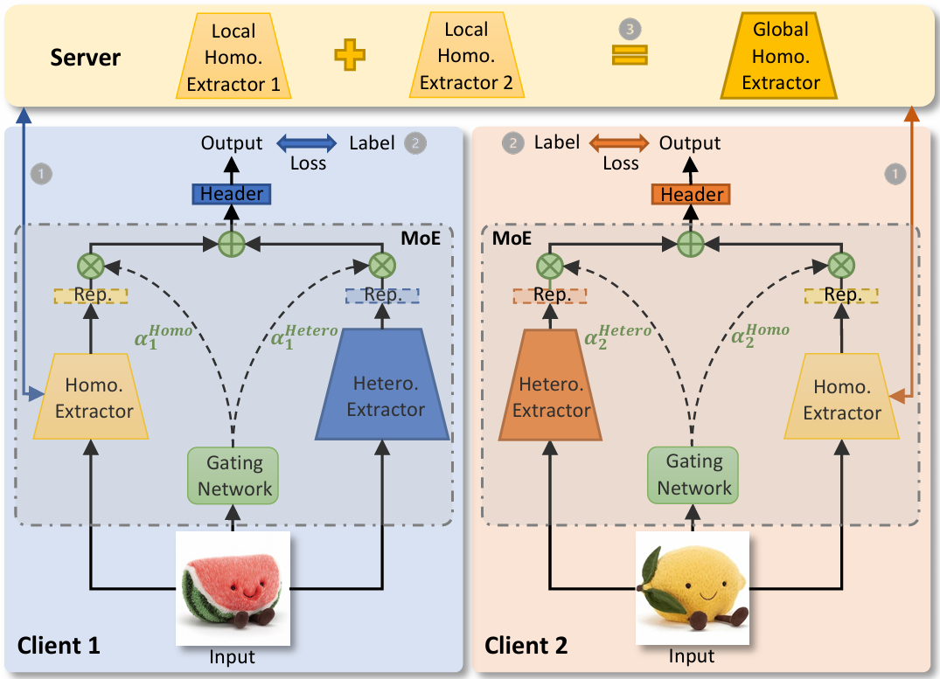
pFedMoE

Slide 9
pFedMoE

Slide 10

Gating

Slide 11
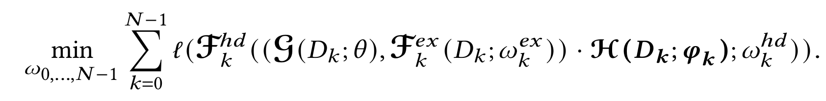
pFedMoE
homo
extracter
local header
hetero
extracter
gating

Slide 12
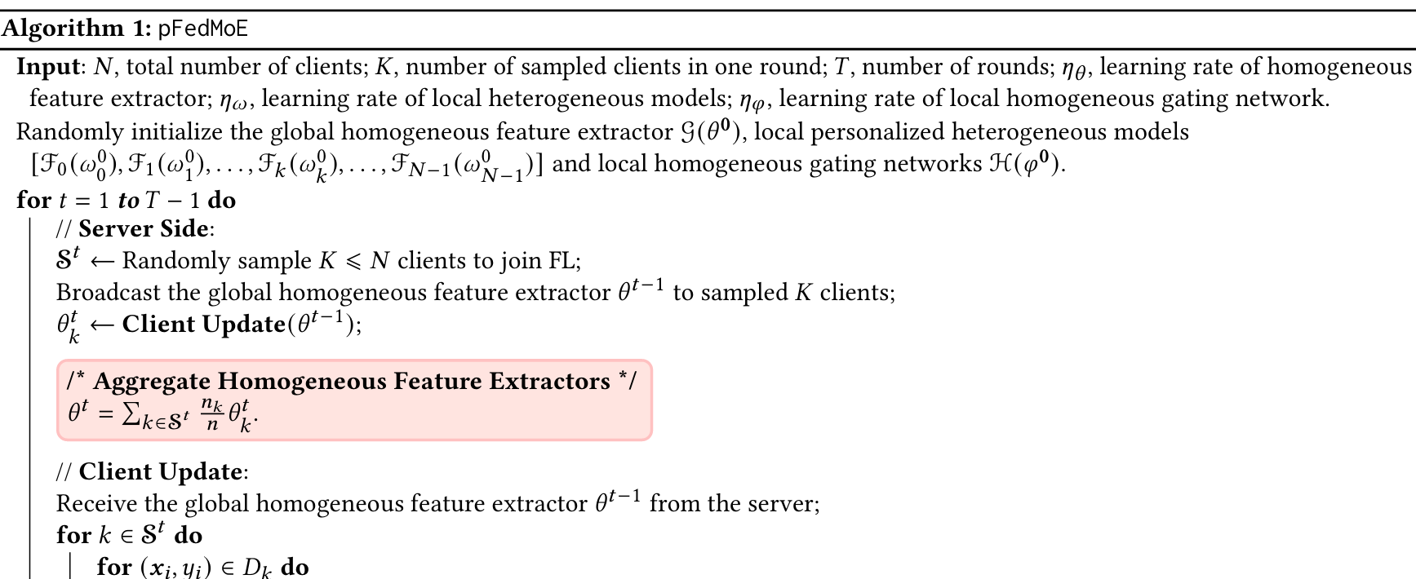
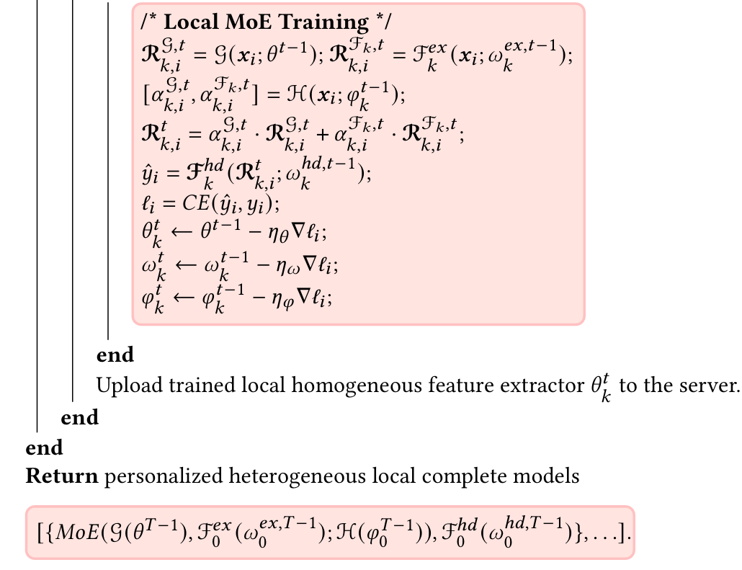

Slide 13
Analysis

Slide 14
Experiment Setup

Slide 15
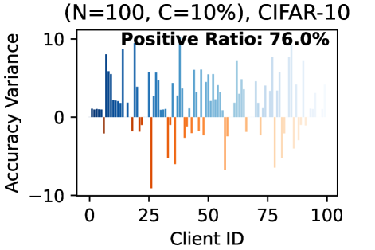
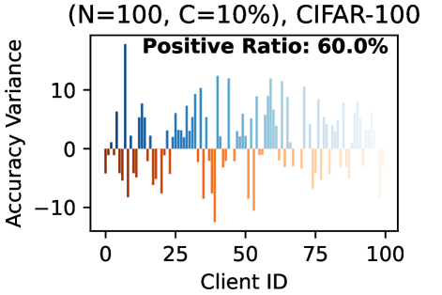
Result

Slide 16
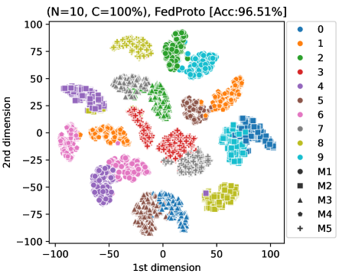
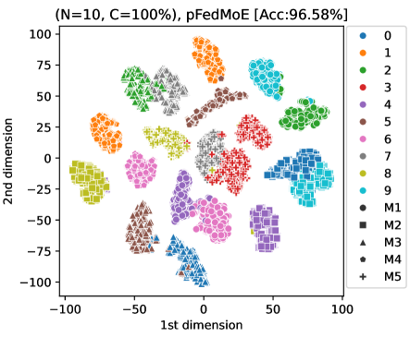
Result

Slide 17
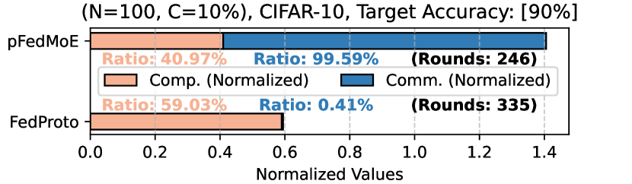
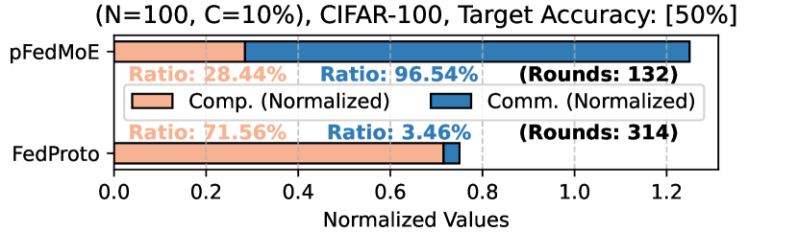
Result

Slide 18
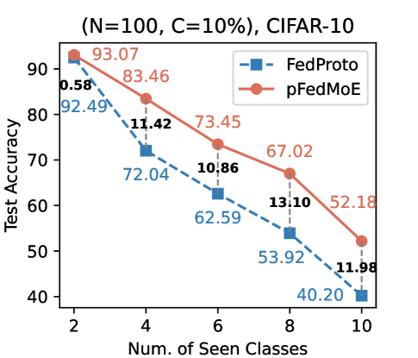
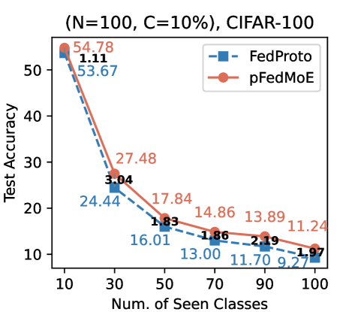
Result

Slide 19
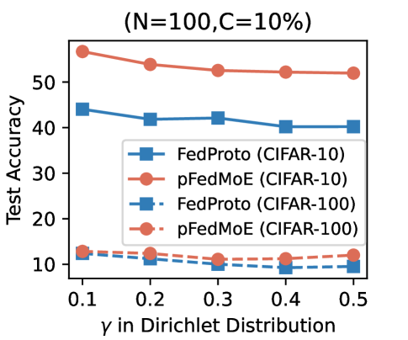
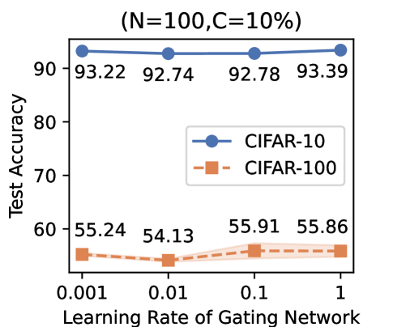
Result

Slide 20
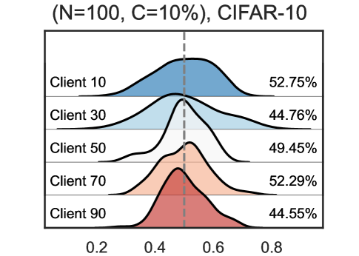
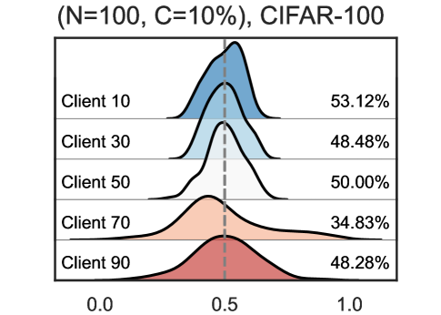
Result

Slide 21
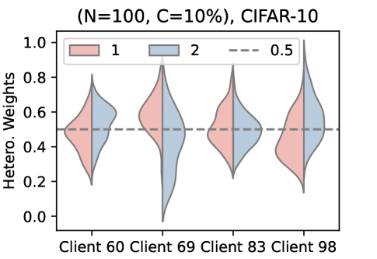
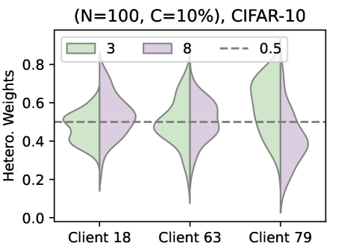
Result

Slide 22
Conclusions

