Slide 1
pFedMoE: Data-Level Personalization with Mixture of Experts for Model-Heterogeneous Personalized Federated Learning

Slide 2
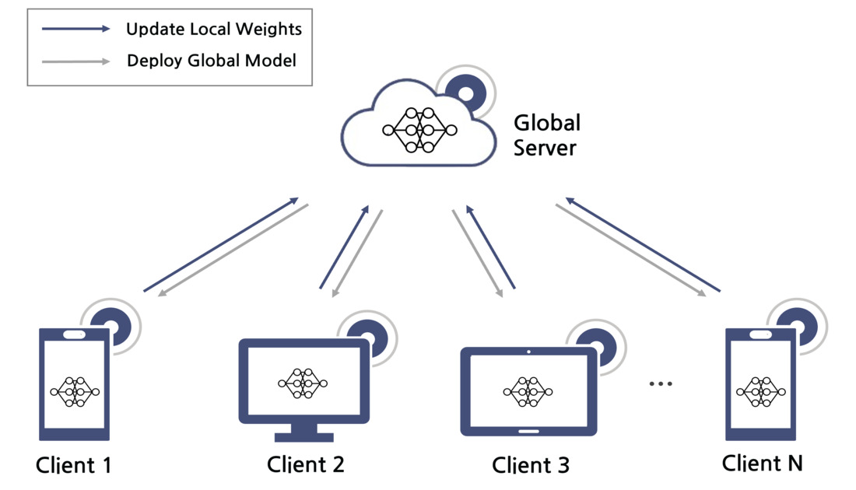
FL

Slide 3
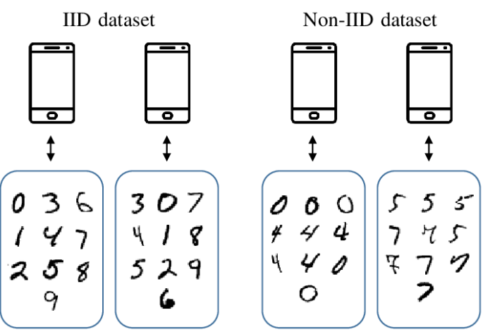
Weaknesses of FL
data or statistical heterogeneity
system heterogeneity
model heterogeneity

Slide 4
Weaknesses of FL
data or statistical heterogeneity
system heterogeneity
model heterogeneity

Slide 5
Model-Heterogeneous Personalized FL
Knowledge distillation
Model mixture
Mutual learning
FD
FedProto
LG-FedAvg
FML
FedKD
FedAPEN

Slide 6
Weaknesses of MHPFL
Knowledge distillation
Model mixture
Mutual learning
Need
Public data
Need
Public data

Slide 7
Target Problems
1. Lack of Complete Model Heterogeneity Support
1. Lack of Complete Model Heterogeneity Support
2. Lack of Data-Level Personalization
3. High Computational and Communication Costs

Slide 8
The Problem the Author Aimed to Solve

Slide 9
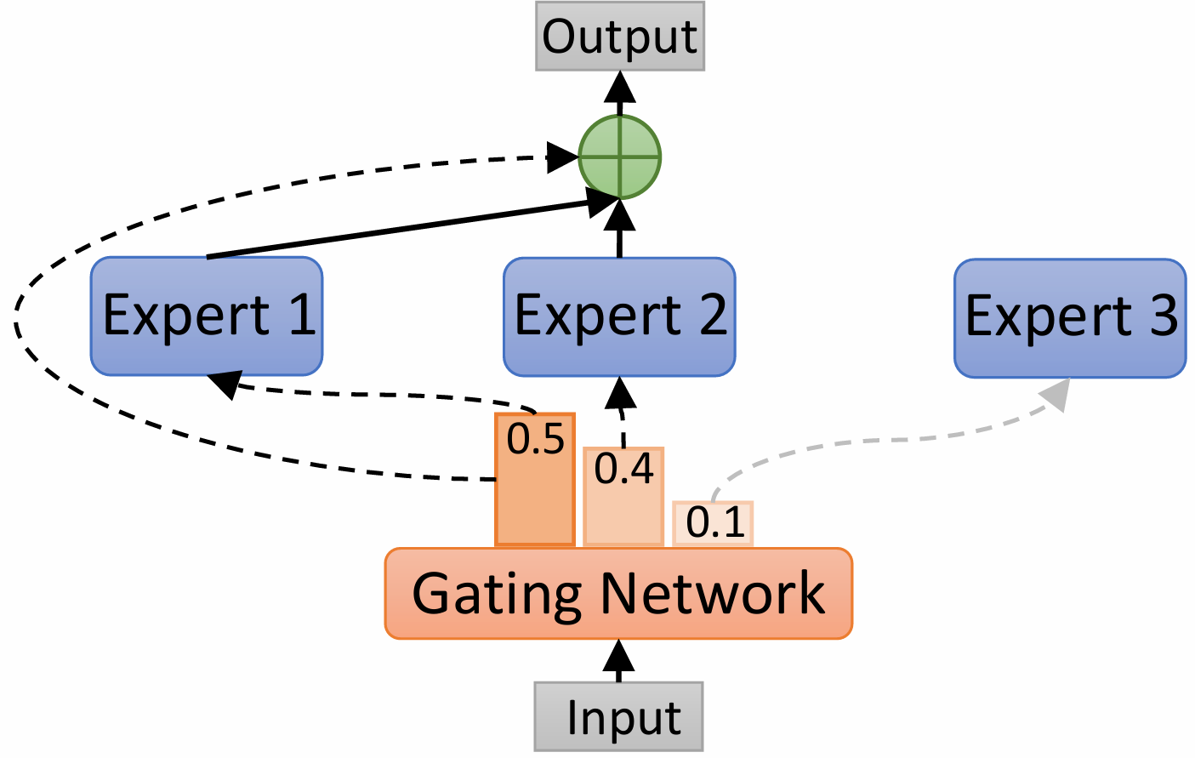
MoE

Slide 10
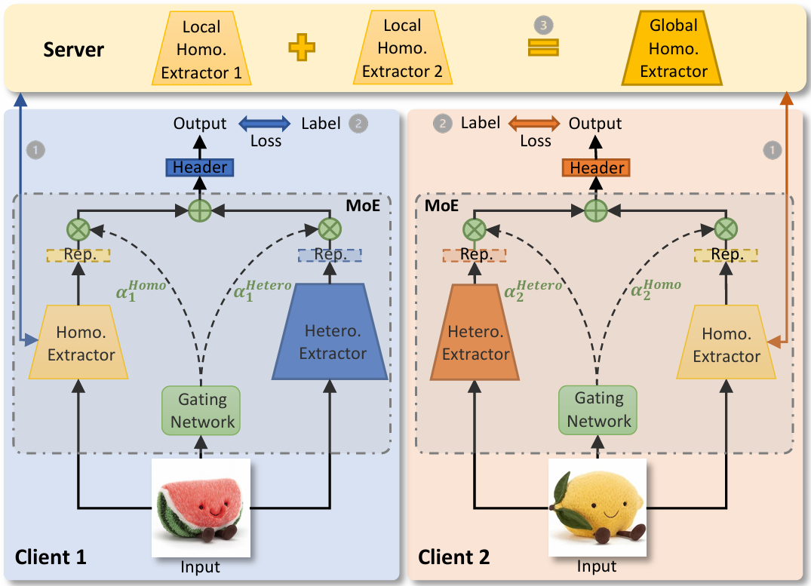
pFedMoE

Slide 11
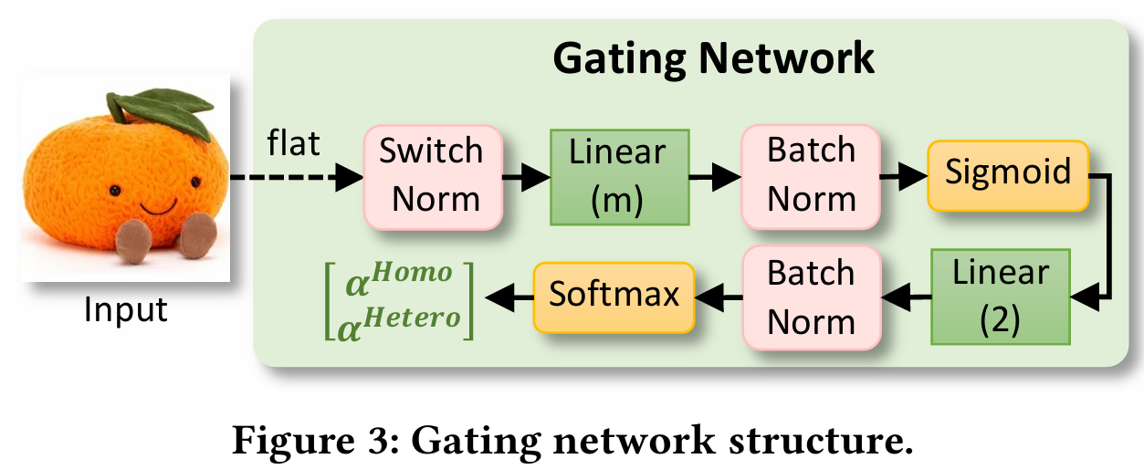
pFedMoE

Slide 12






inference
local header
local header
gating
network
hetero
extracter

Slide 13
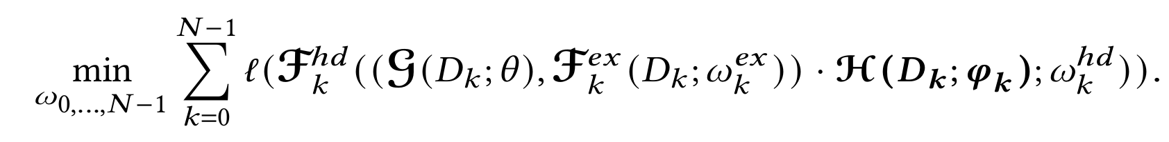
training
homo
extracter
local header
hetero
extracter
gating
network

Slide 14


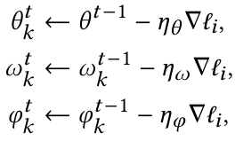
training
local
server
FedAvg
cross entropy
SGD

Slide 15
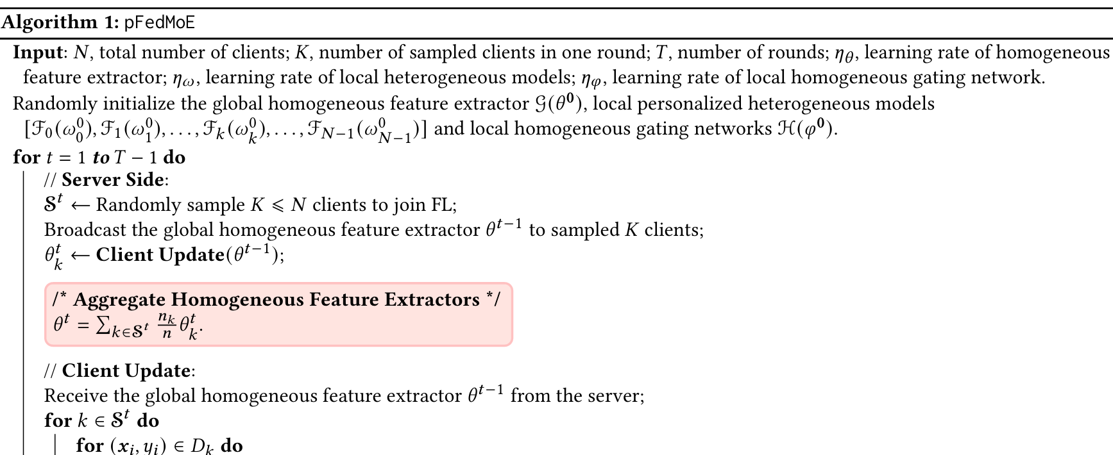
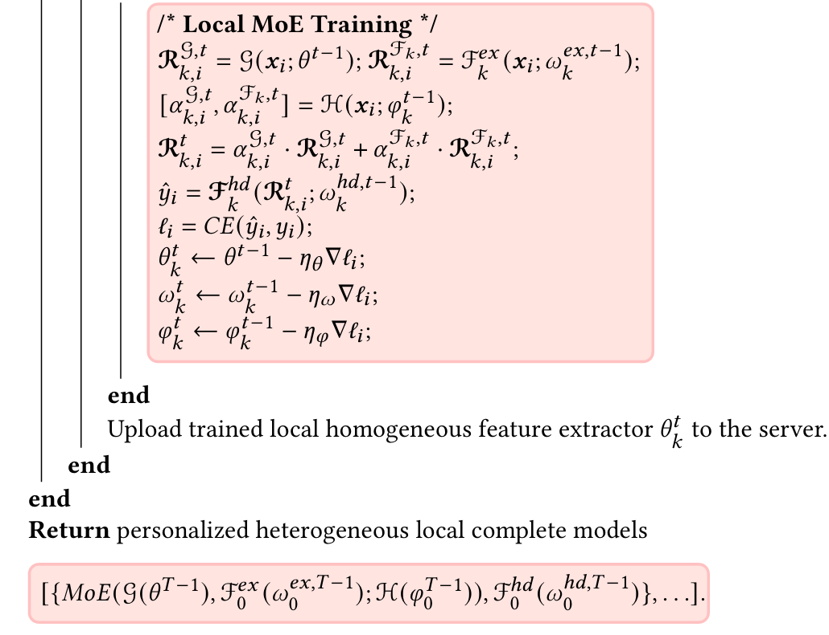

Slide 16
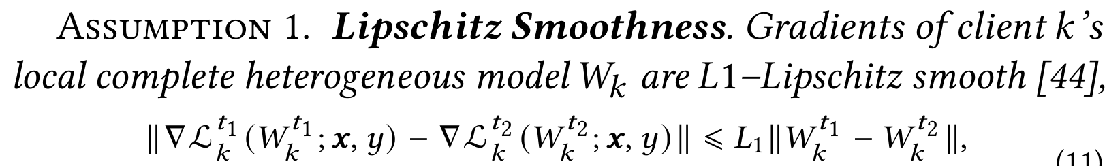
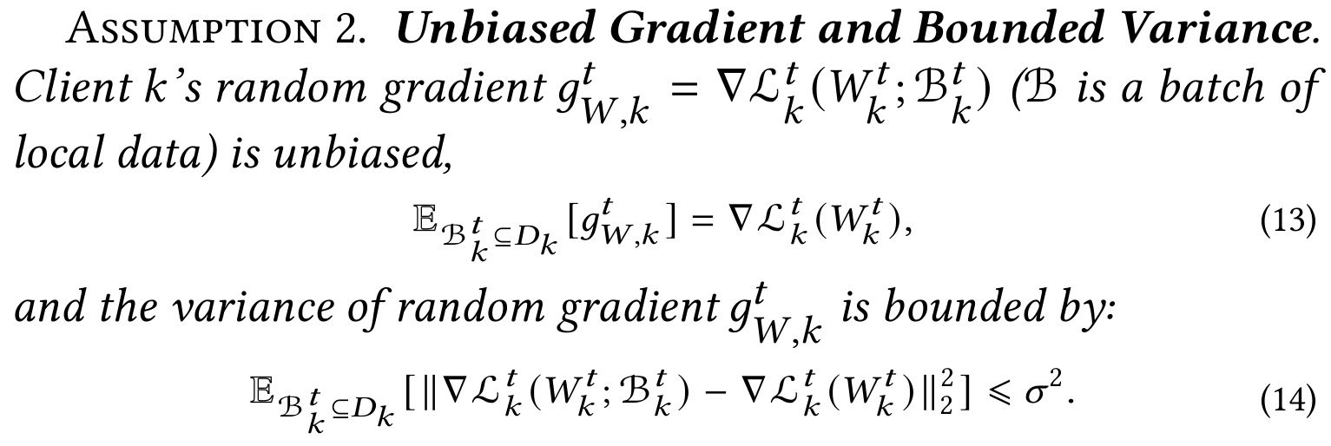
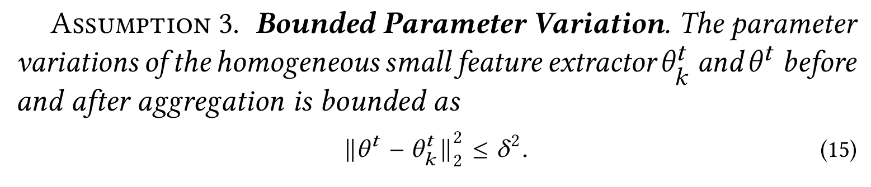
Analysis

Slide 17
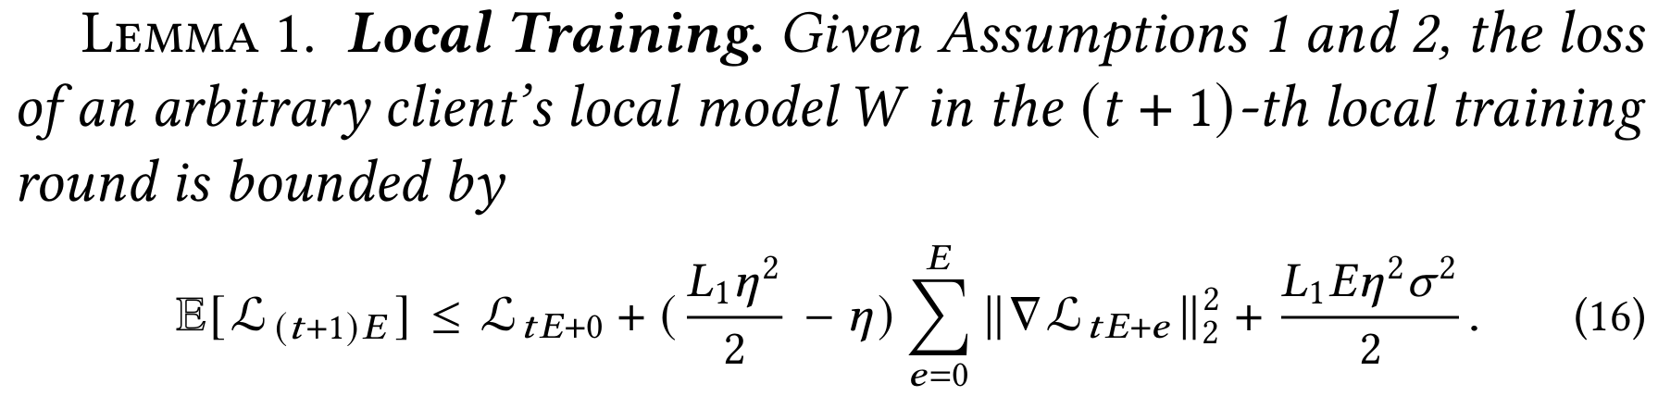
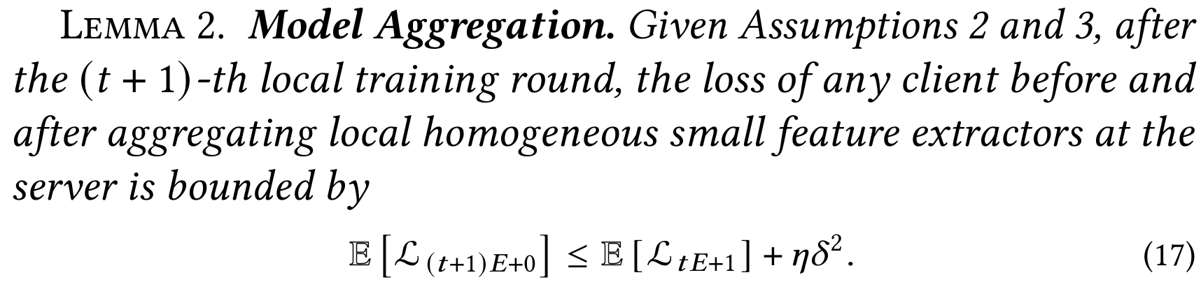
Analysis

Slide 18
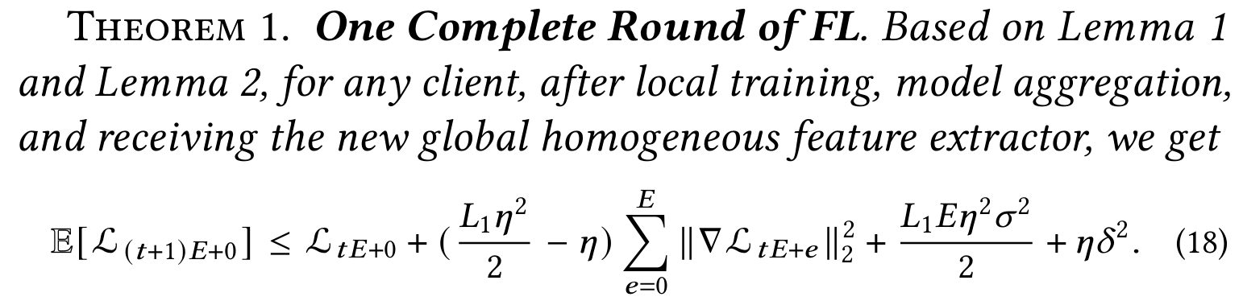
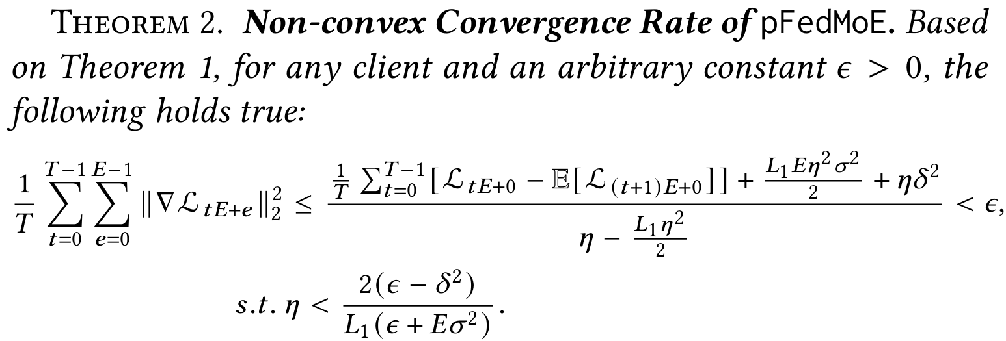

Analysis

Slide 19
Experiment Setup
task
implement
image classification
pytorch
4 X 3090
dataset
non-iid
CIFAR-10
CIFAR-100
2/10
10/100
Dirichlet distribution
comparison model
Grid search
standalone
pFedMoE
MHPFL
{100, 500}
T
{1, 10}
local epoch
{64, 128, 256, 512}
batch size
{0.001, 0.01, 0.1, 1}
learning rate
pFedMoE : 𝜂𝜃 = 𝜂w

Slide 20
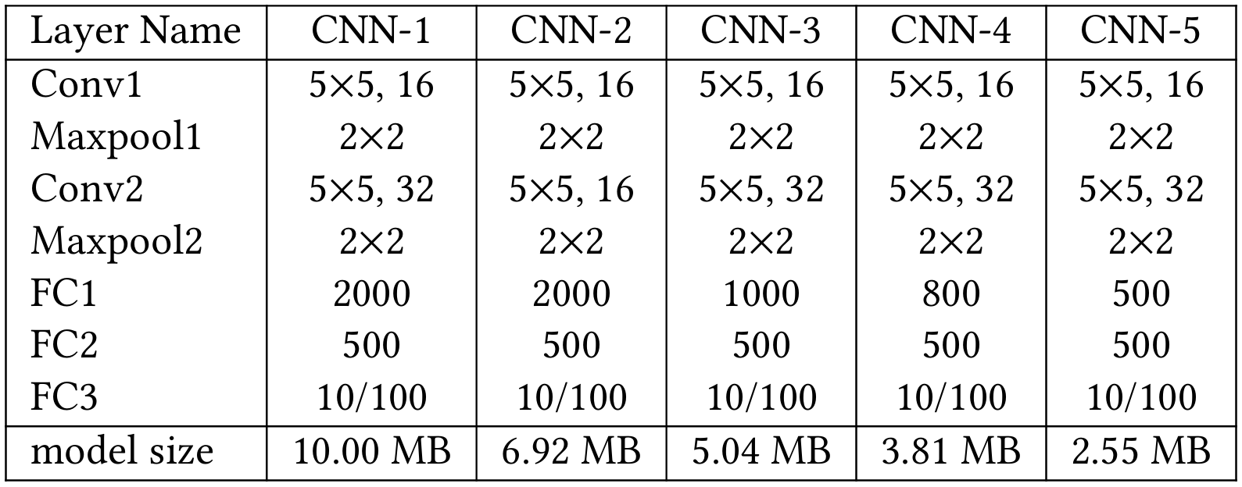
Experiment Setup
model-homogeneous
hetero extracter
model-heterogeneous
hetero extracter
model-heterogeneous
homo extracter

Slide 21
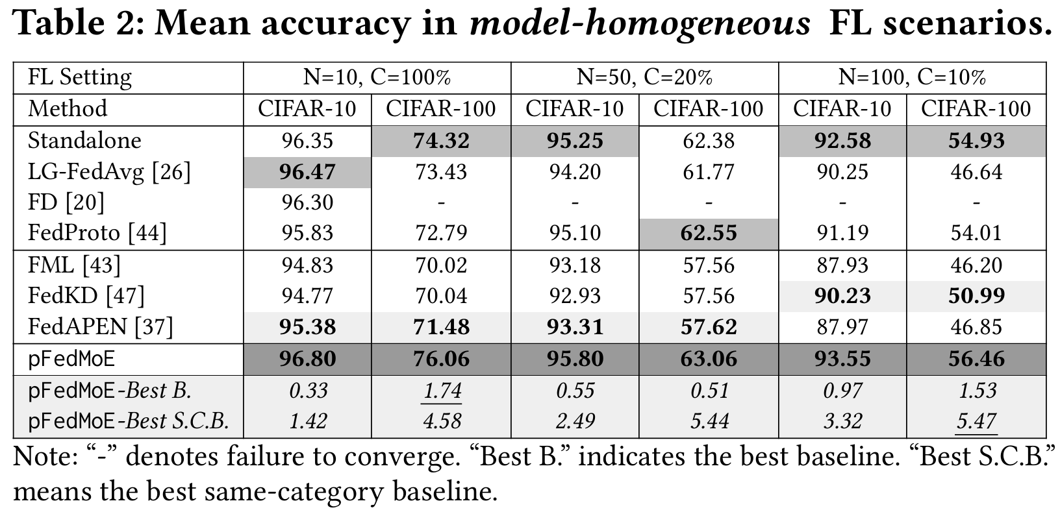
Result

Slide 22
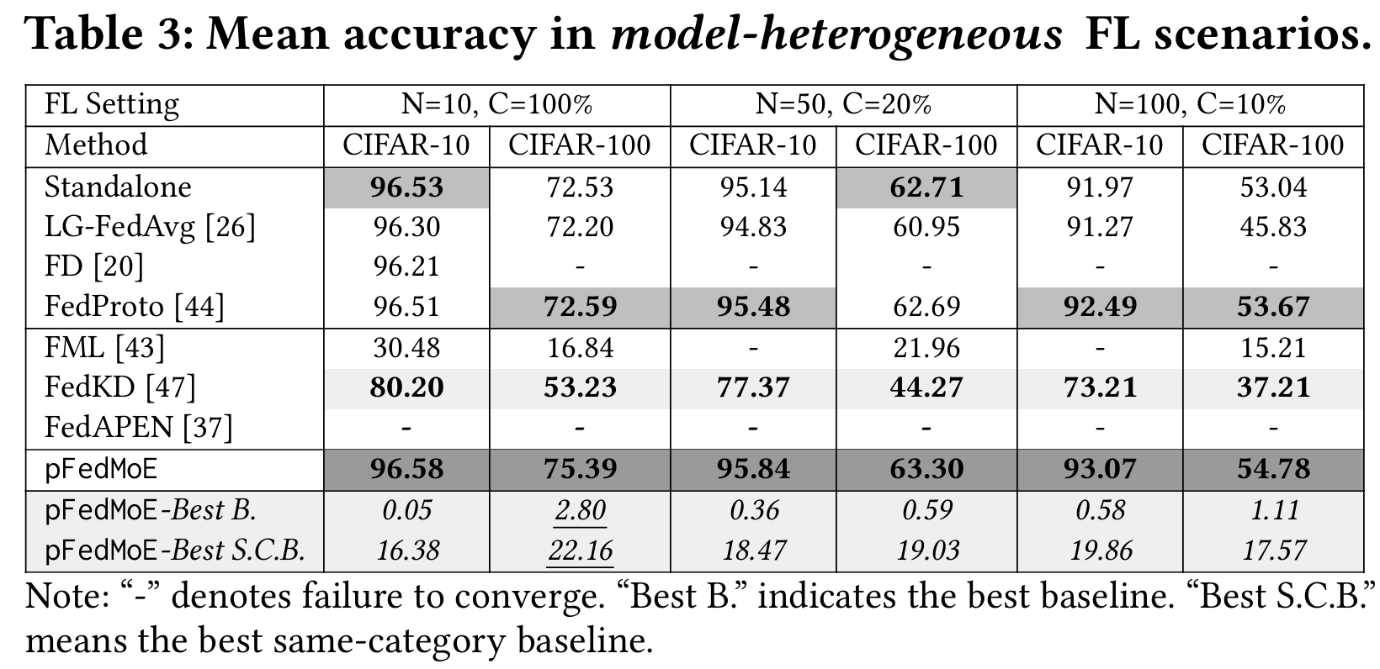
Result

Slide 23
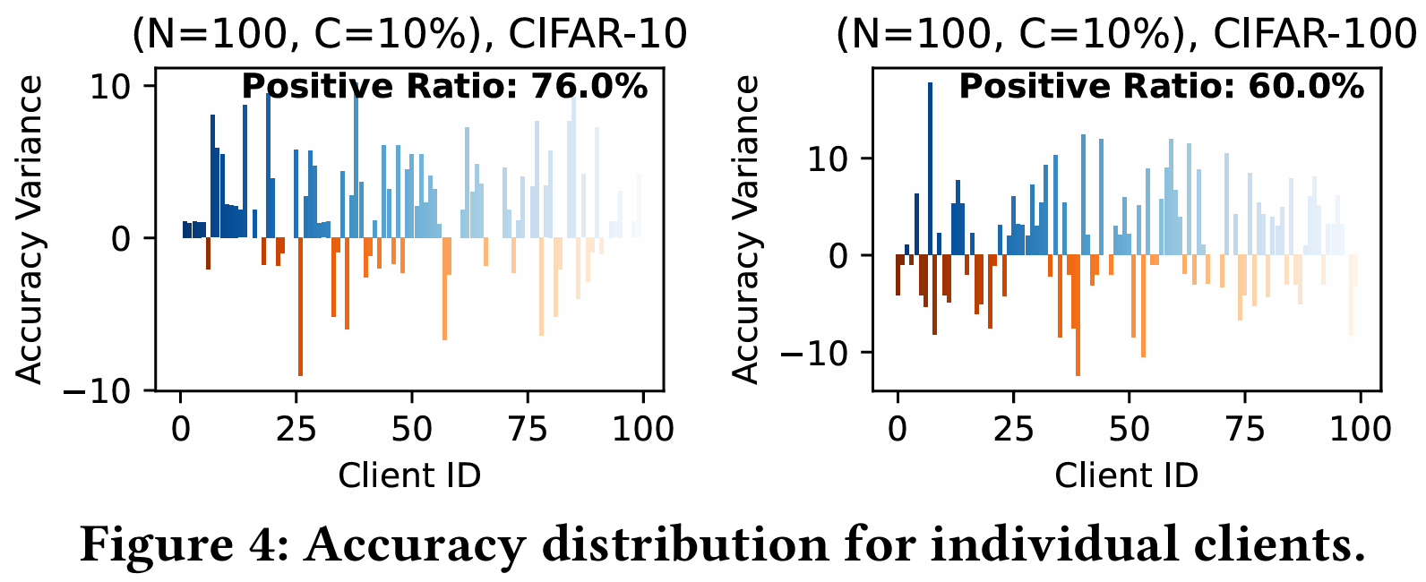
Result

Slide 24
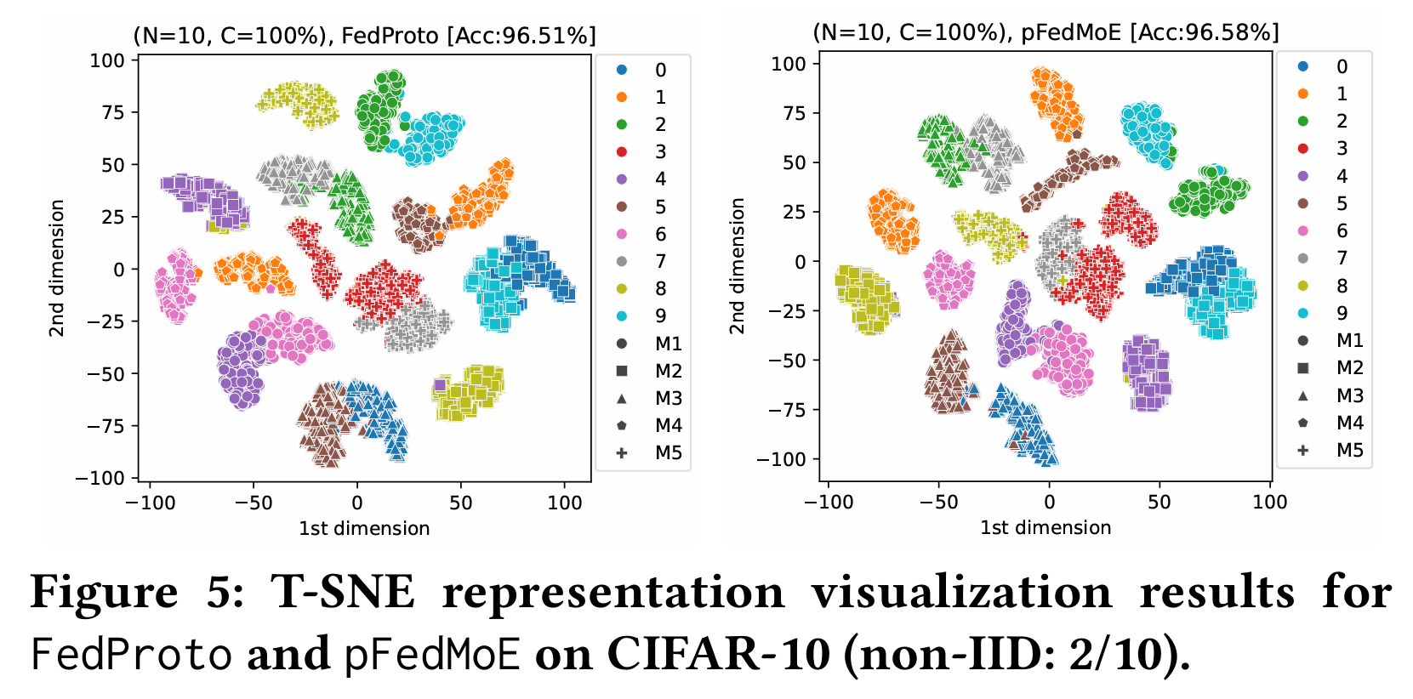
Result

Slide 25
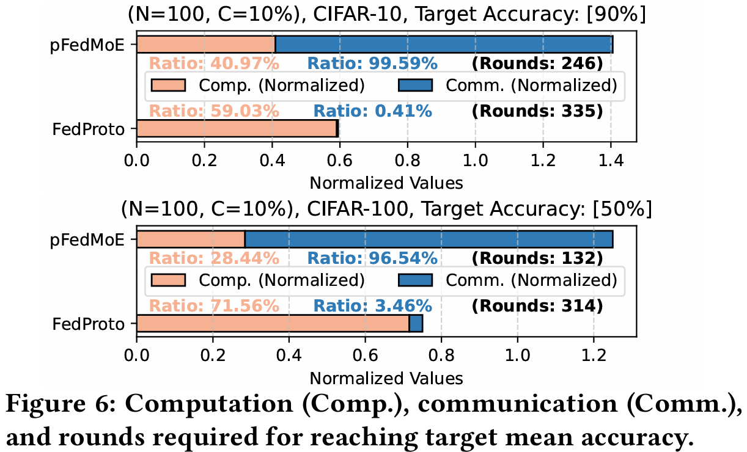
Result

Slide 26
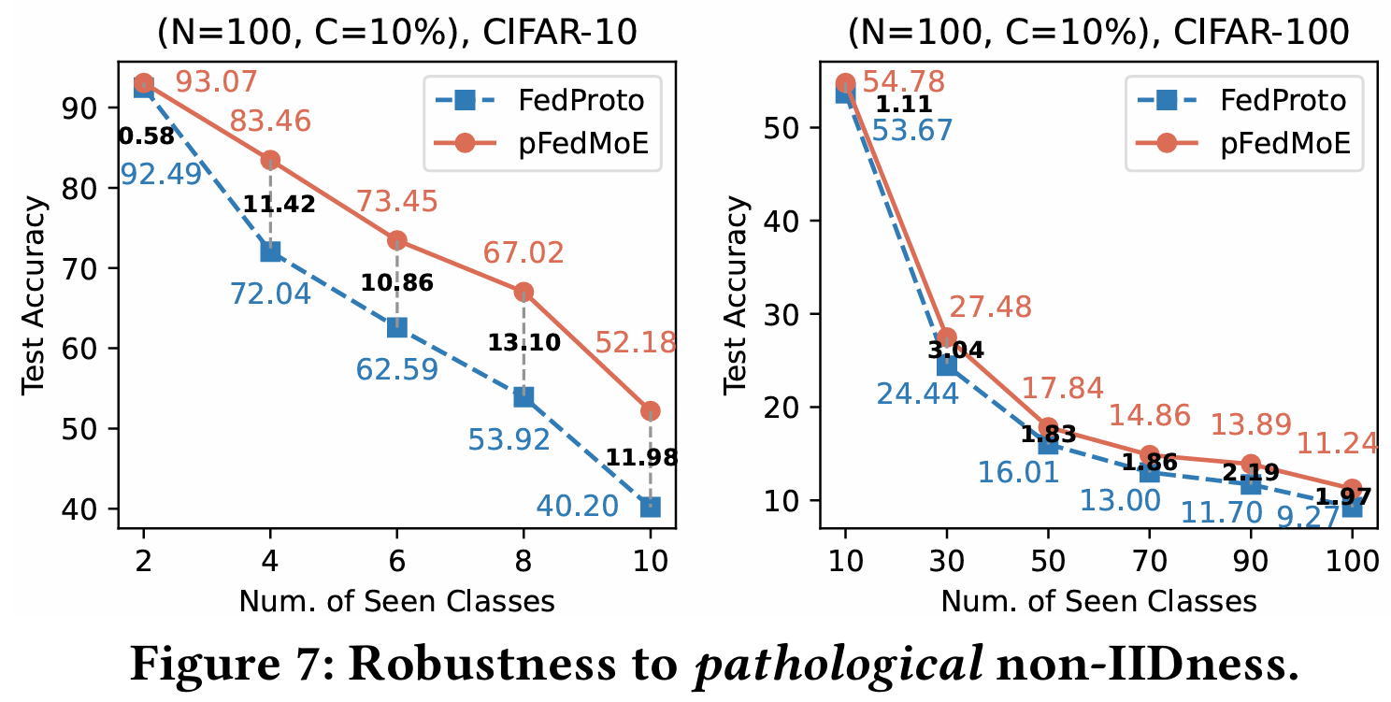
Result

Slide 27
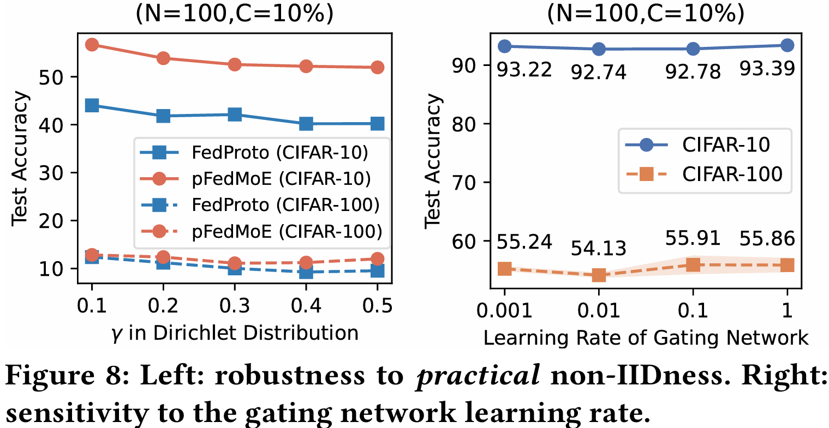
Result

Slide 28
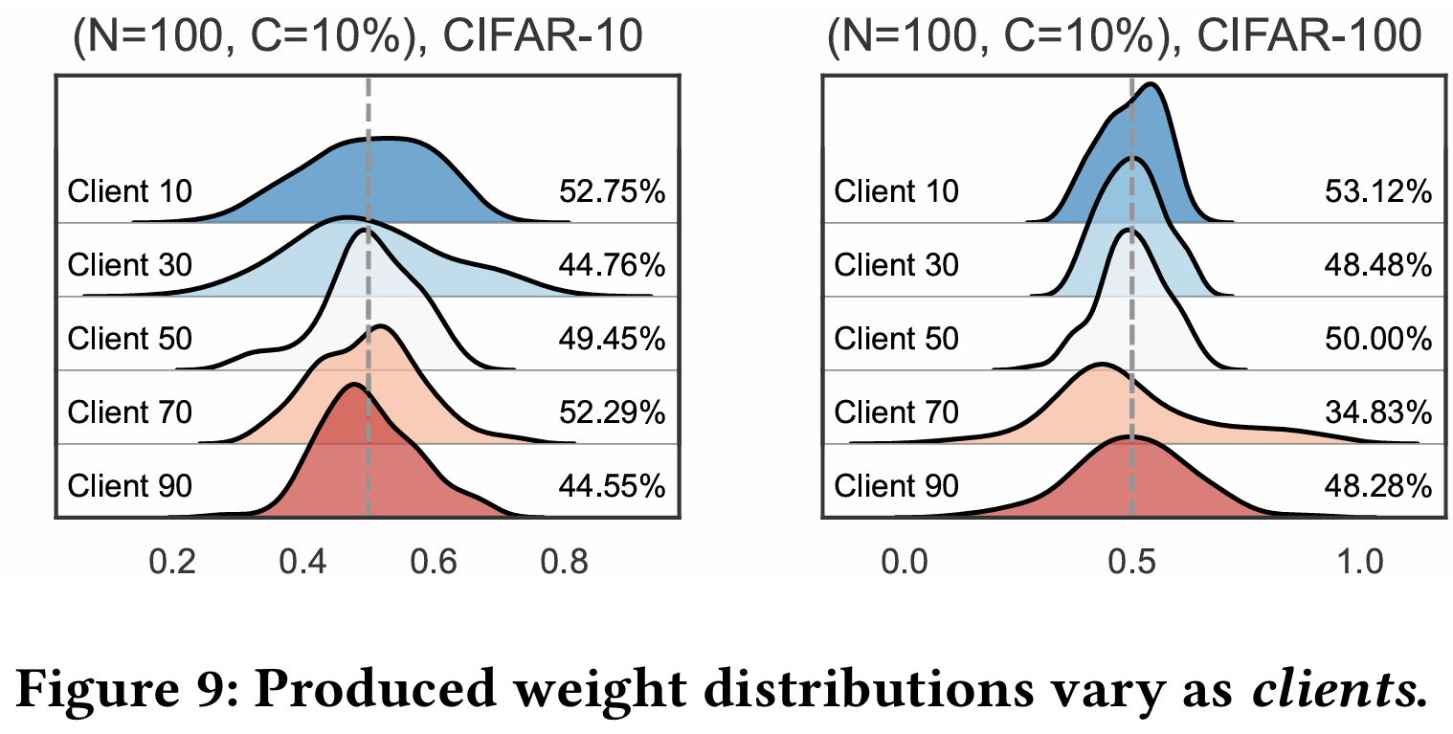
Result

Slide 29
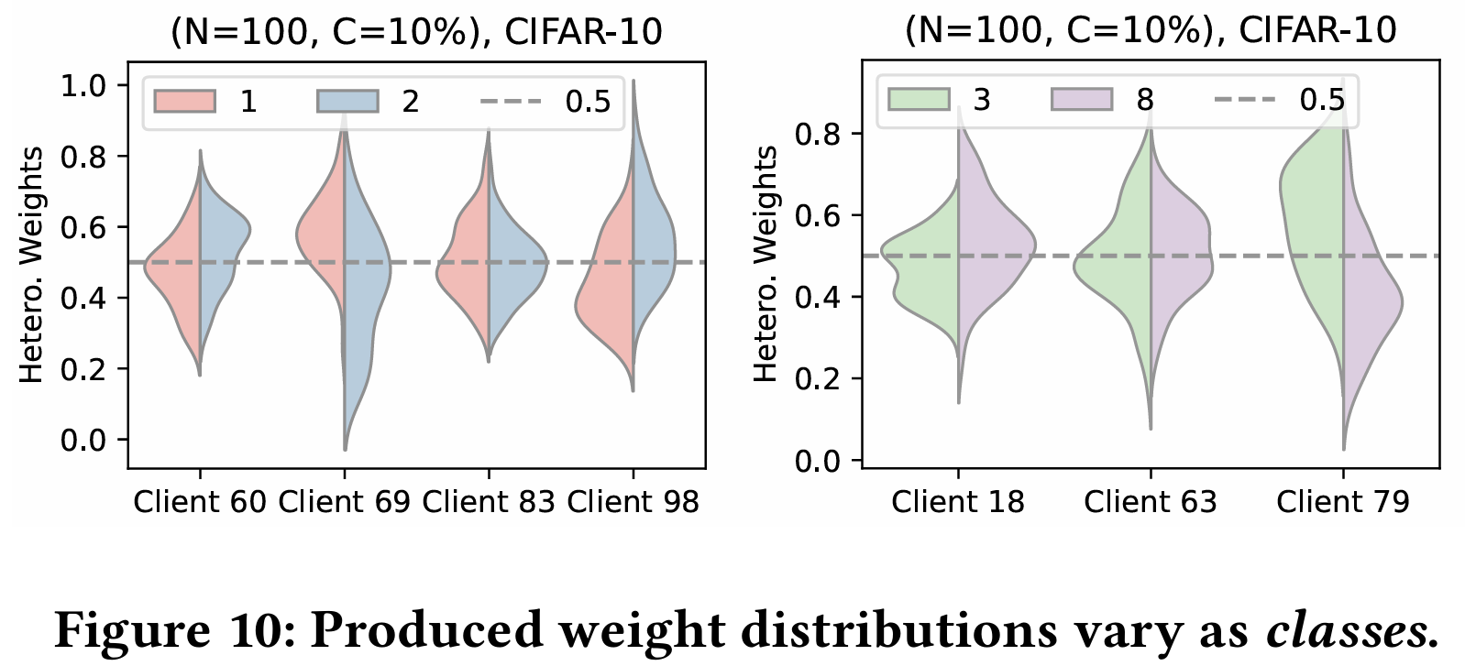
Result

Slide 30
Conclusions

