Slide 1
pFedMoE: Data-Level Personalization with Mixture of Experts for Model-Heterogeneous Personalized Federated Learning

Slide 2
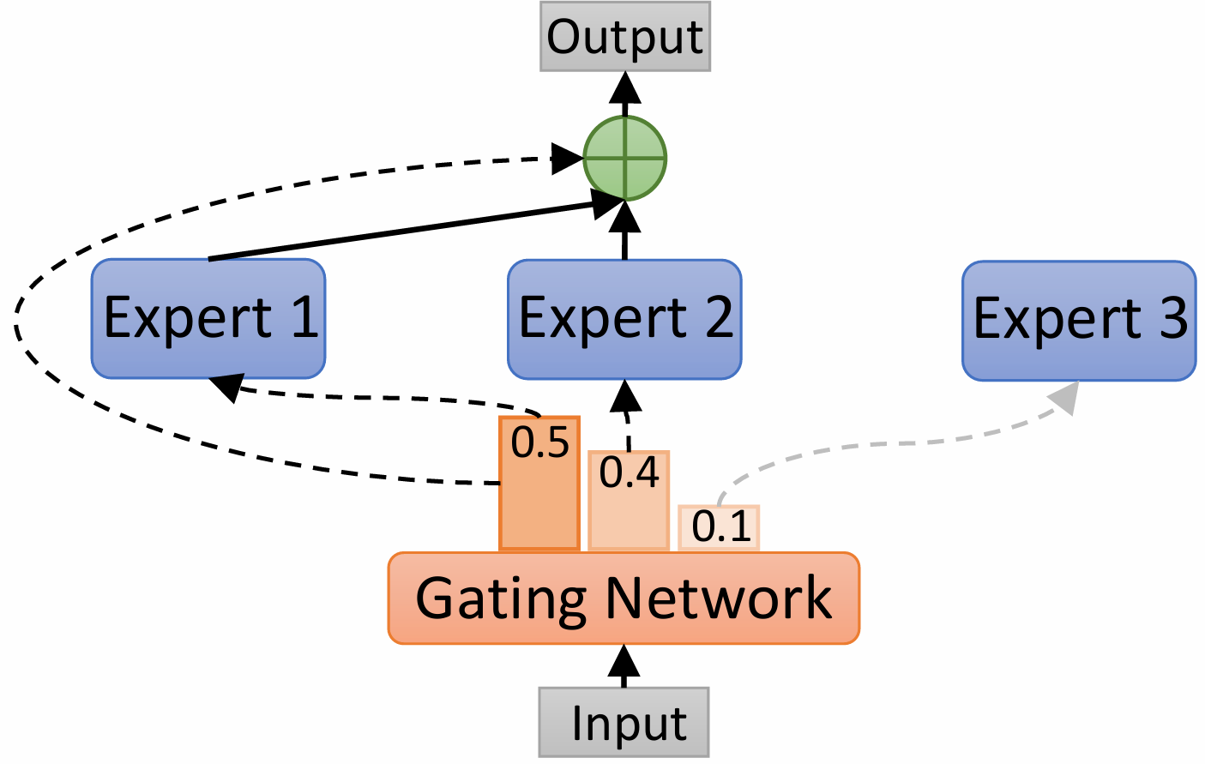
MoE?

Slide 3
FL?

Slide 4
Challenges in FL
-> heterogeneity!

Slide 5
Related Work
-> Model-Heterogeneous Personalized FL

Slide 6
Challenges in MHPFL

Slide 7
The Problem the Author Aimed to Solve

Slide 8
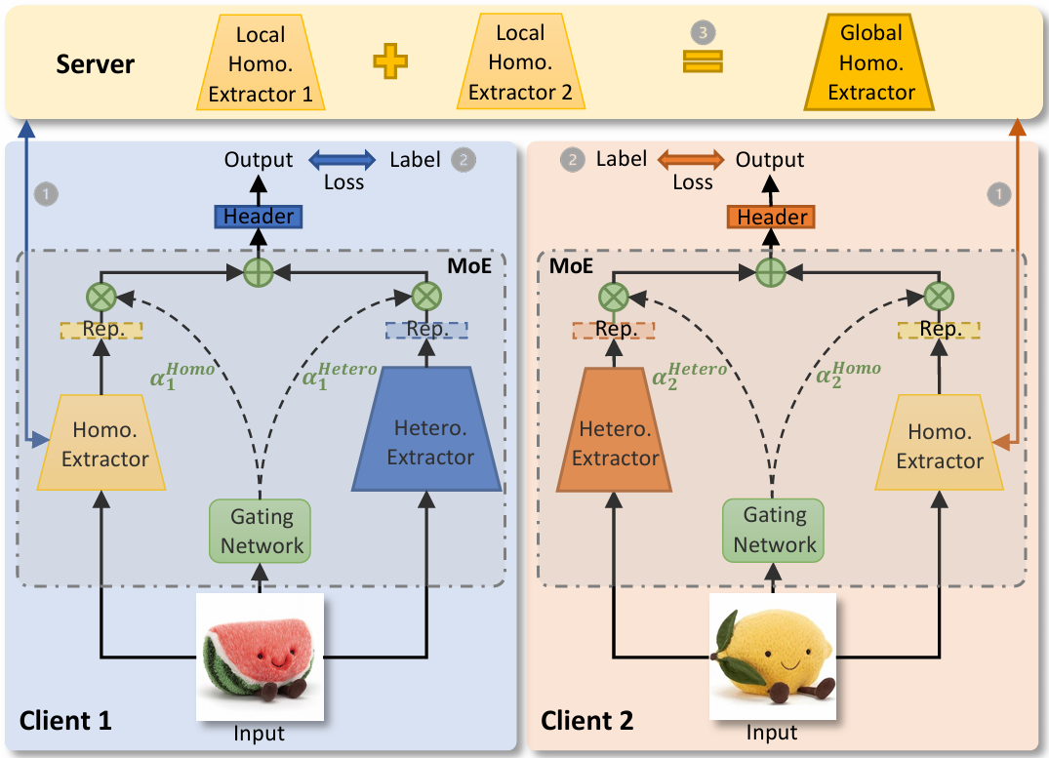
pFedMoE

Slide 9
Analysis

Slide 10
Experiment Setup

Slide 11
Result

Slide 12
Conclusions

